Slide 1
Compressive Sensing
Li-Fang Cheng
April 28th, 2014

Slide 2
Compressive Sensing at a Glance
Compressive sensing (CS), also know as compressed sensing, compressive sampling, has opened a new era of signal processing
… and more!
Wired, 2010:
“Compressed sensing, or CS, the paradigm-busting field in mathematics that’s reshaping the way people work with large data sets. Only six years old, CS has already inspired more than a thousand papers and pulled in millions of dollars in federal grants.
In 2006, Candes’ work on the topic was rewarded with the $500,000 Waterman Prize, the highest honor bestowed by the National Science Foundation. It’s not hard to see why. Imagine MRI machines that take seconds to produce images that used to take up to an hour, military software that is vastly better at intercepting an adversary’s communications, and sensors that can analyze distant interstellar radio waves. Suddenly, data becomes easier to gather, manipulate, and interpret. ”

Slide 3
Outline
Theory
  Compressive Sensing
  Informative Sensing
Applications
  Image Denoising
  Face Recognition
  Background Subtraction & Tracking
  Media Recovery
  Others…

Slide 4
Part I:
Compressive Sensing (CS) Theory

Slide 5
Compressive Sensing (in one slide)
If a signal is in a basis / dictionary
, then it is possible to fully recover by a measurement
taken by , under some conditions; i.e.
are basis vectors of orthonormal
Vector has only nonzero elements,
Measurement matrix satisfies Restricted Isometry Proporty (RIP)

Slide 6
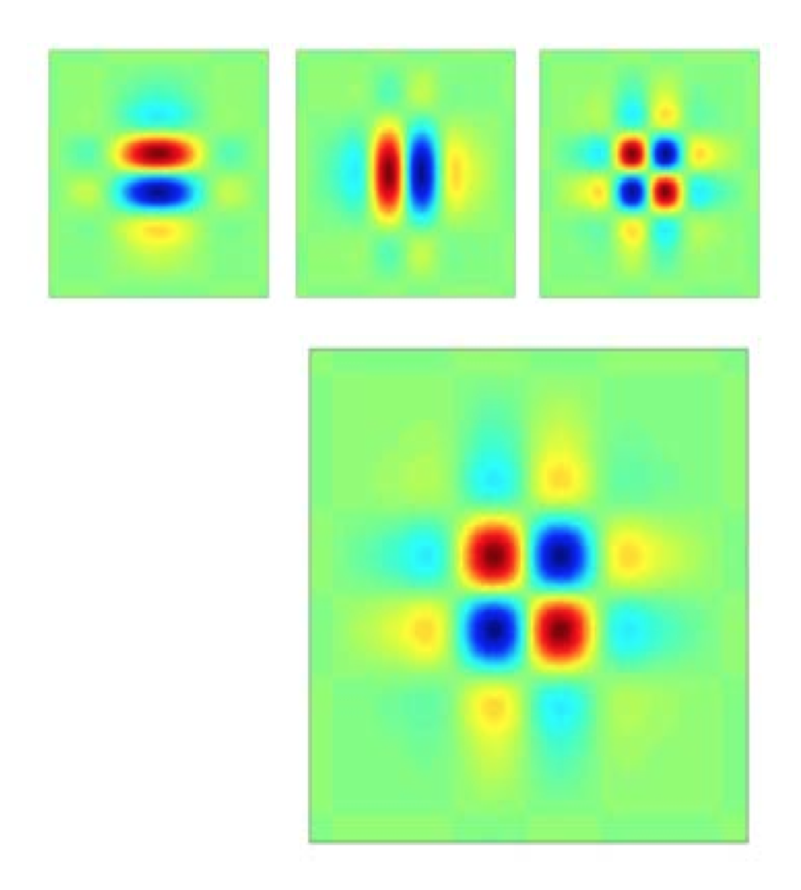
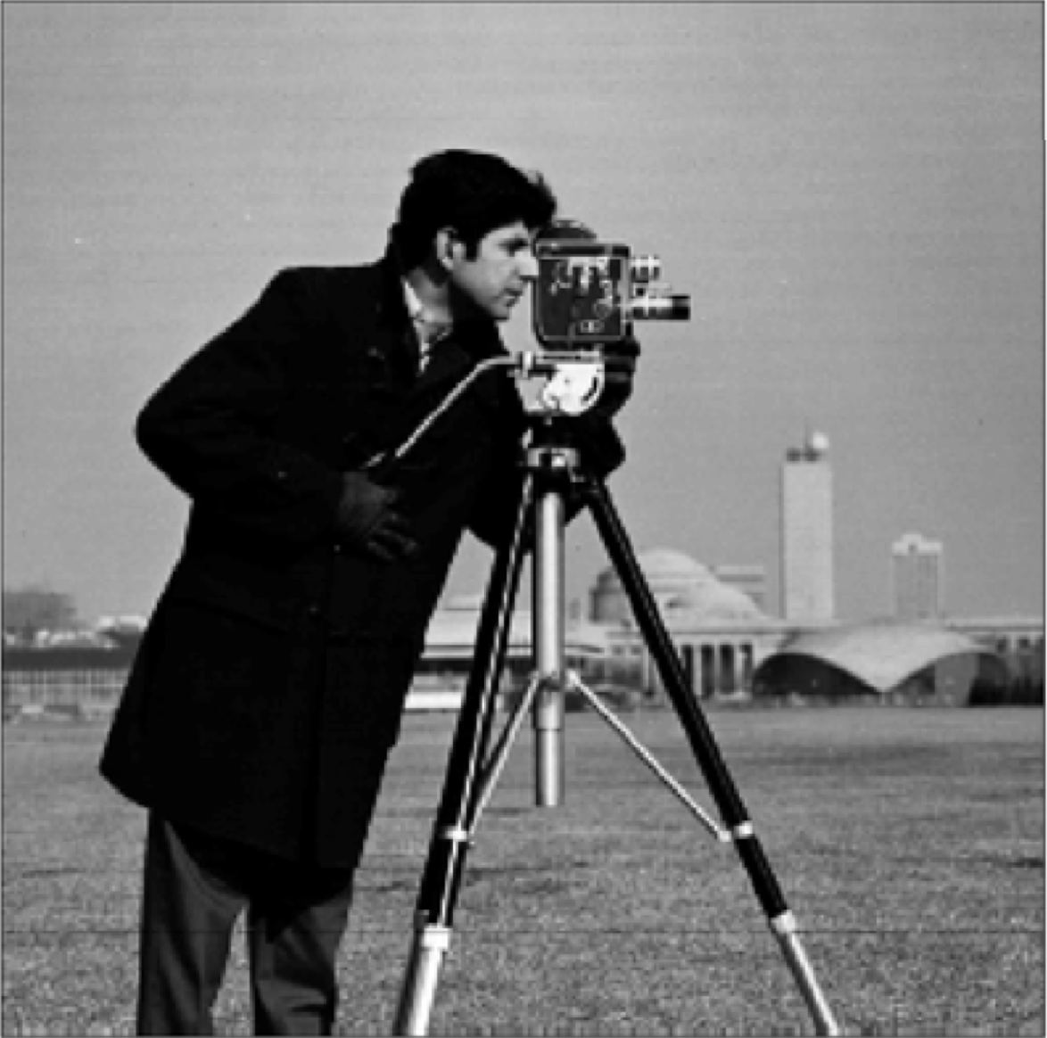
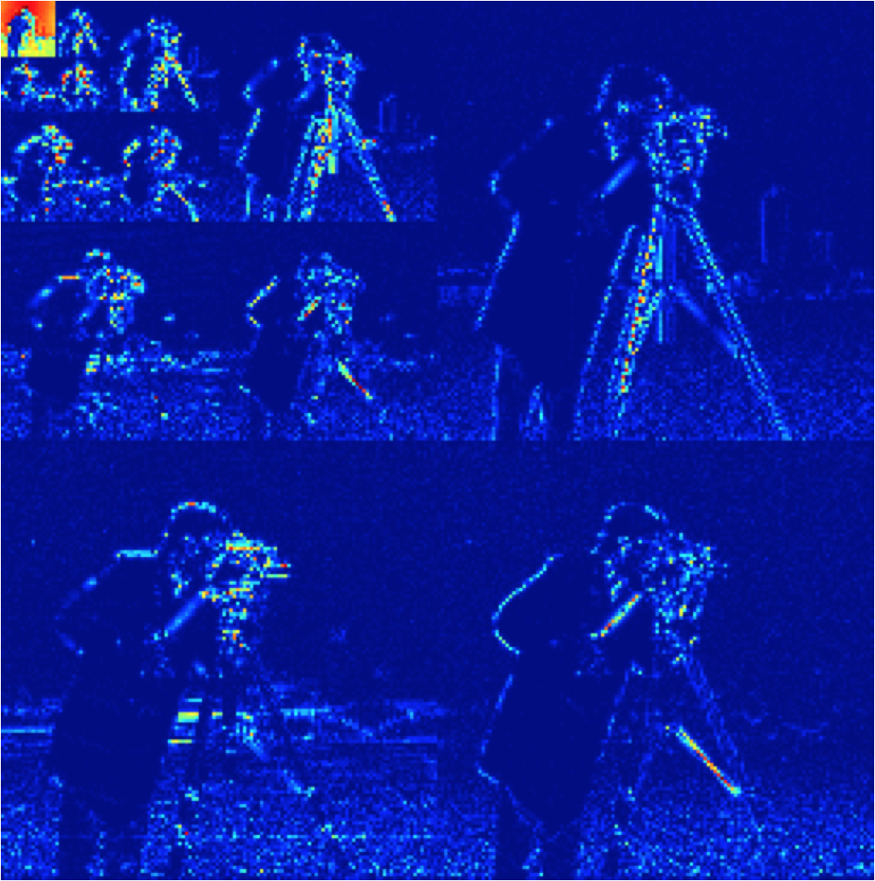
Compressive Sensing (step by step)
Image
Orthonormal Basis
ex. Gabor, Wavelets, …
Sparse Representation

Slide 7


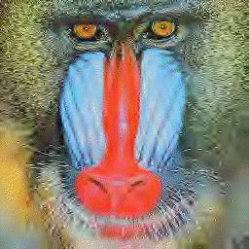
Compressive Sensing (step by step)
Conventional coding methods compress / reconstruct the signals through discarding sufficiently small coefficients
Original (24 bit/pixel)
JPEG2000 (2 bit/pixel)
JPEG2000 (0.5 bit/pixel)

Slide 8
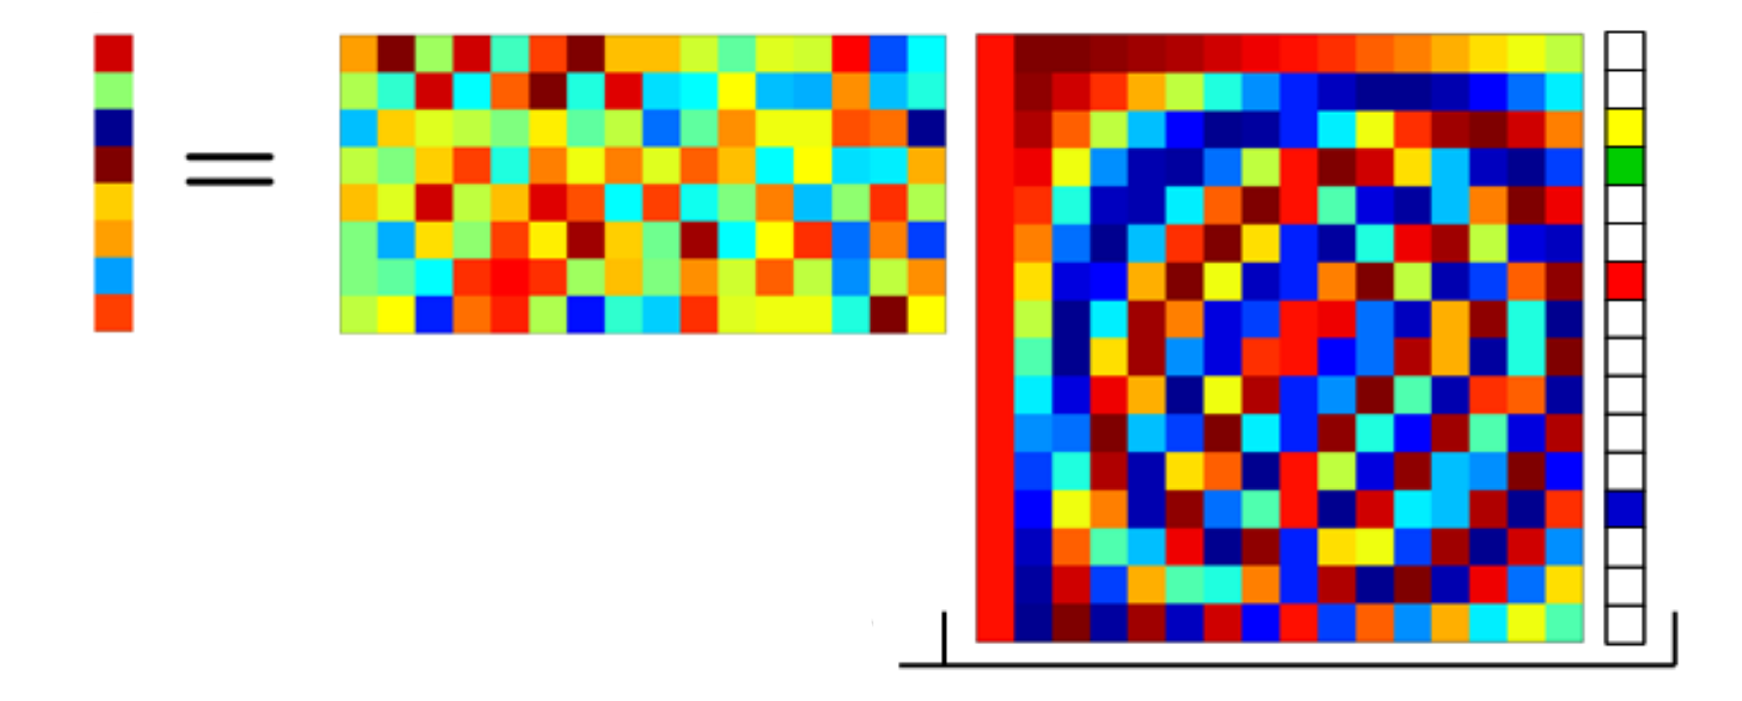
Compressive Sensing (step by step)
Compressed sensing theorems state that, for signals that are sparse in some domains, they can be fully reconstruct using only few designed measurements
  Sensing = Compressing!
  # of required measurements depends on sparsity

Slide 9
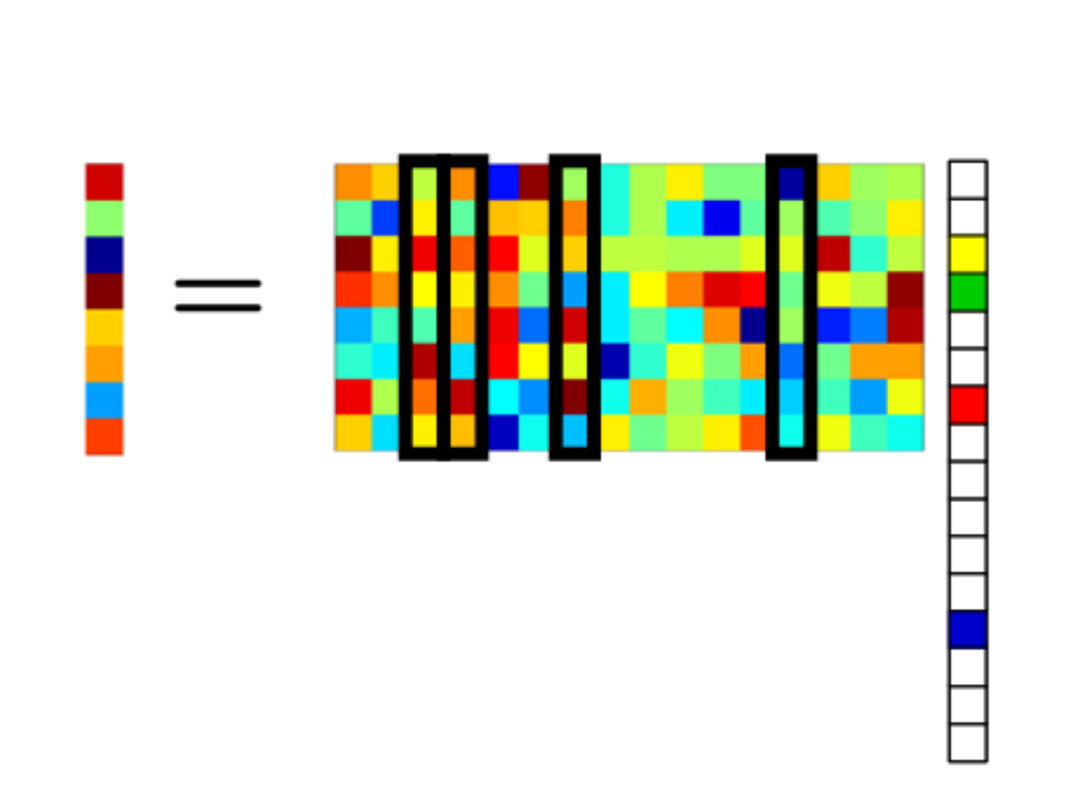
Compressive Sensing (step by step)
In order to recover the sparse signal, the measurements should be taken from a measurement matrix whose product with the basis satisfies Restricted Isometry Proporty (RIP)
CS Reconstruct Matrix

Slide 10
Restricted Isometry Property (RIP)
A matrix is said to satisfy the RIP of order with isometry constant , which is not too close to one, such that
for vector , or
In plain English!
  approximately preserves the Euclidean length for signals
  All subsets of columns taken from are in fact nearly orthogonal

Slide 11
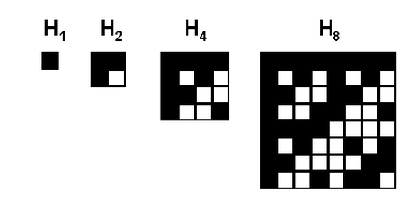
The Measurement Matrix
Key problem: how to design the measurement matrix such that satisfies RIP of order ?
  In practice, there is no computationally feasible way to check RIP property for a given matrix
Solution: pick random matrices, which are usually incoherent with any fixed basis
Examples
  Random Gaussian
  Random Bernoulli
  Hadamard matrix
1 1
1 -1
H H
H -H

Slide 12
CS Recovery
Reconstruction / Decoding Problem
  , this is an ill-posed problem in general
Given: measurements,
and sensing matrix
Assumption:
Sparsifying Basis
Target:
Sparse Representation

Slide 13
CS Recovery Algorithms
Signal reconstruction algorithm aims to find signal’s sparse coefficient vector
  L2 norm (energy) minimization:
  ⇒ pseudo inverse is closed form, but does not find sparse solution
  L0 norm minimization:
  ⇒ can recover signal exactly with high probability using only
  measurements, but solving it is NP-complete
  (need exhaustive search all positions nonzero coefficients)

Slide 14
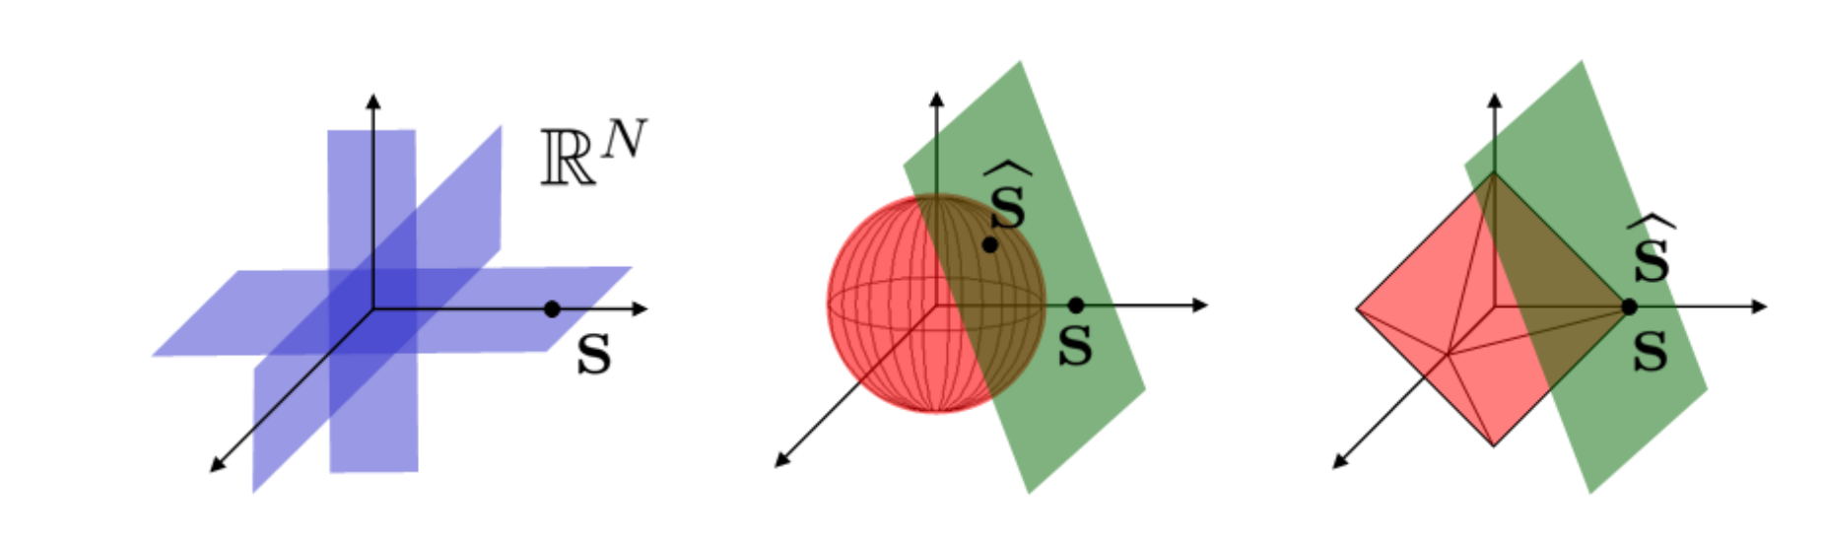
CS Recovery Algorithms
Signal reconstruction algorithm aims to find signal’s sparse coefficient vector
  L1 norm minimization:
  ⇒ can exactly recover K-sparse signals with high probability using only
  measurements (mild oversampling)

Slide 15
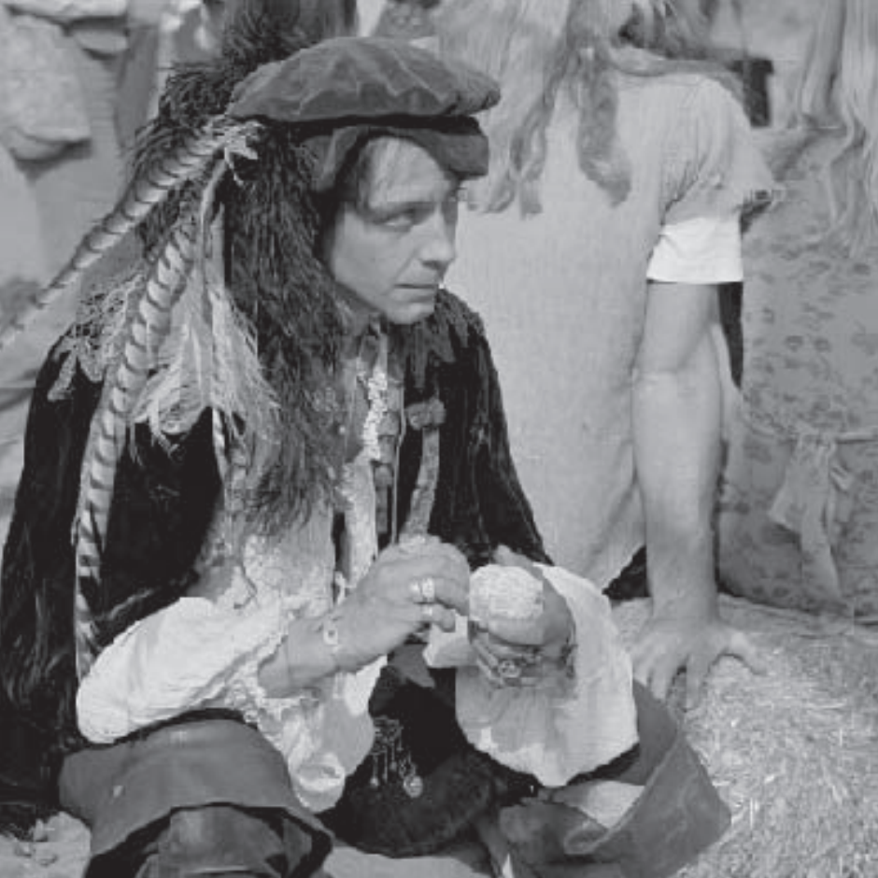
CS for Image Reconstruction
An one megapixel image, with only 25K nonzero wavelet coefficients

Slide 16

CS for Image Reconstruction
An one megapixel image, with only 25K nonzero wavelet coefficients
L1-reconstruction using 96K random measurements

Slide 17
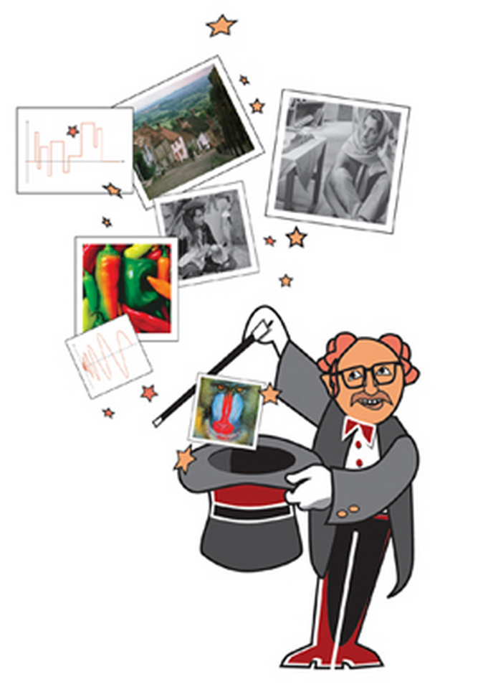
L1 Recovery Algorithms
L1-mininization, a.k.a Basis Pursuit (BP)
  Solvable in polynomial time by linear programming (LP)
  Methods supported by L1-magic: Primal-dual algorithm (LP)
  , log-barrier algorithm (SOCP), Newton iterations
Min-L1 with equality constraints
Min-L1 with quadratic constraints

Slide 18
L1 Recovery Algorithms
If the underlying signal is a 2D image, an alternative recovery model is that the gradient is sparse, i.e. solving by
total variation (TV) minimization
Second-Order Cone Problem (SOCP)

Slide 19
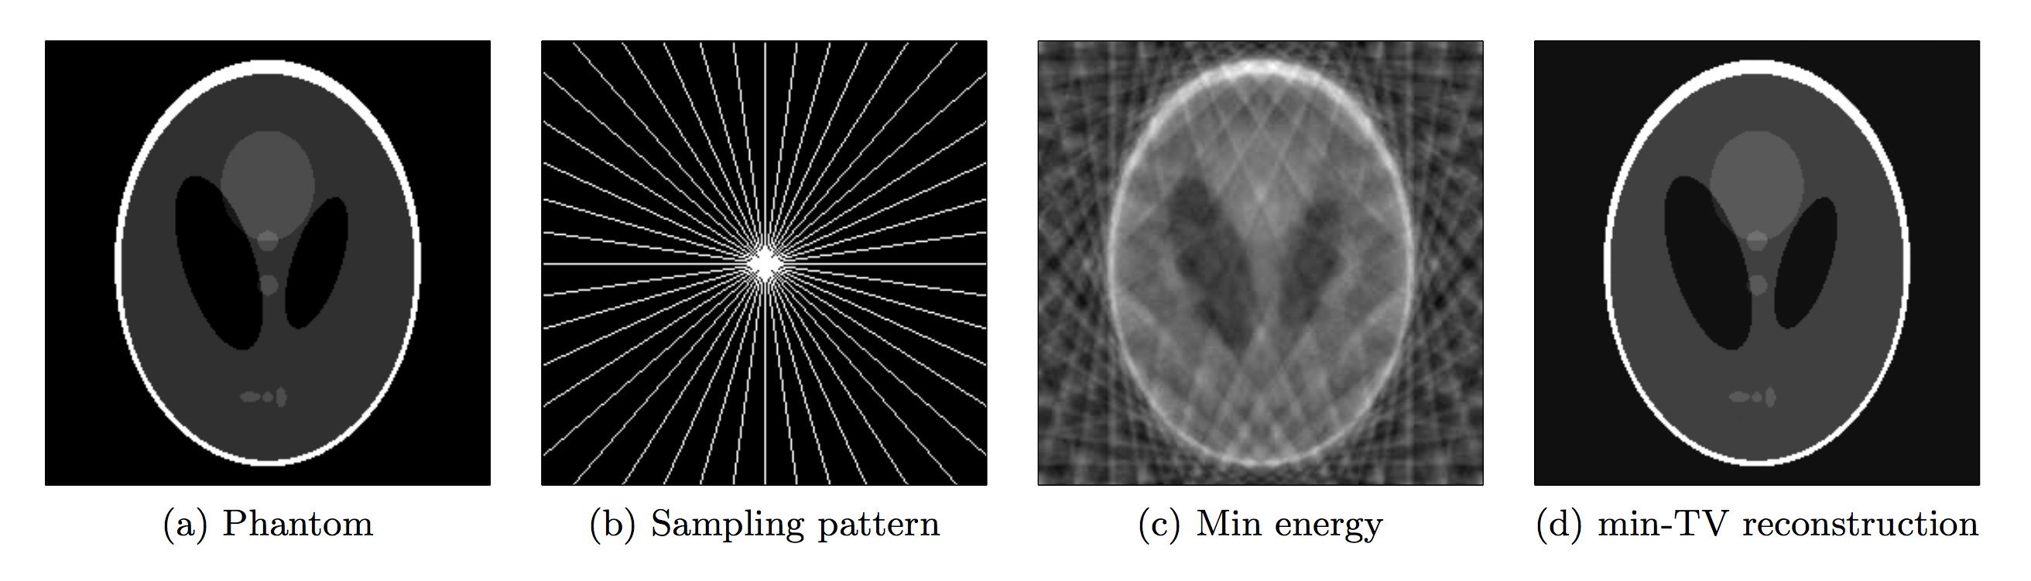
Phantom Recovery using L1-magic
Notes:
189 for equality constraint
156 for quadratic constraint

Slide 20
L1 Recovery Algorithms
Matching Pursuit (MP): OMP, StOMP, CoSaMP,…
  Iterative greedy algorithms for basis
  Faster, usually in time , and easier to implement
  Many variations

Slide 21
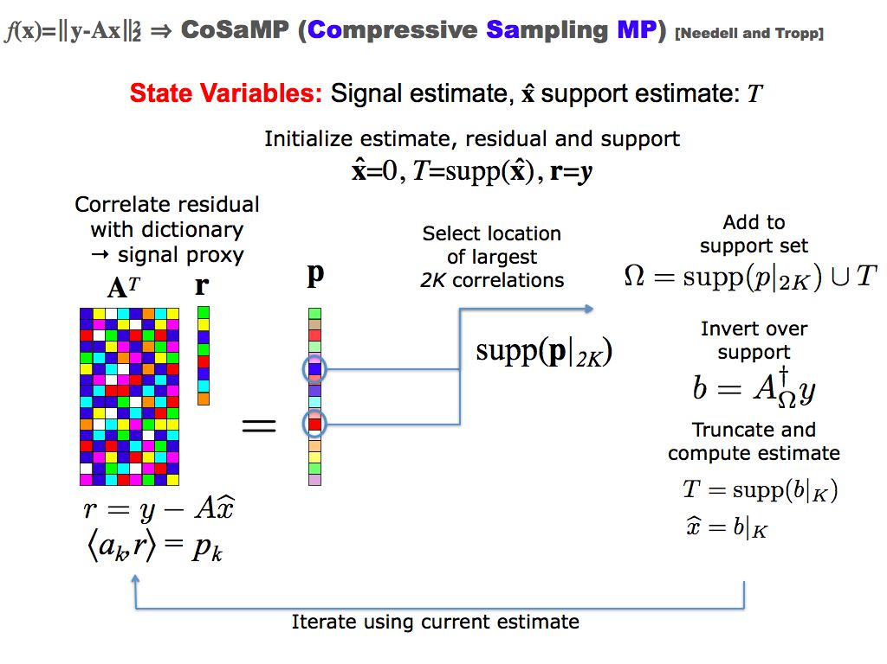

Slide 22
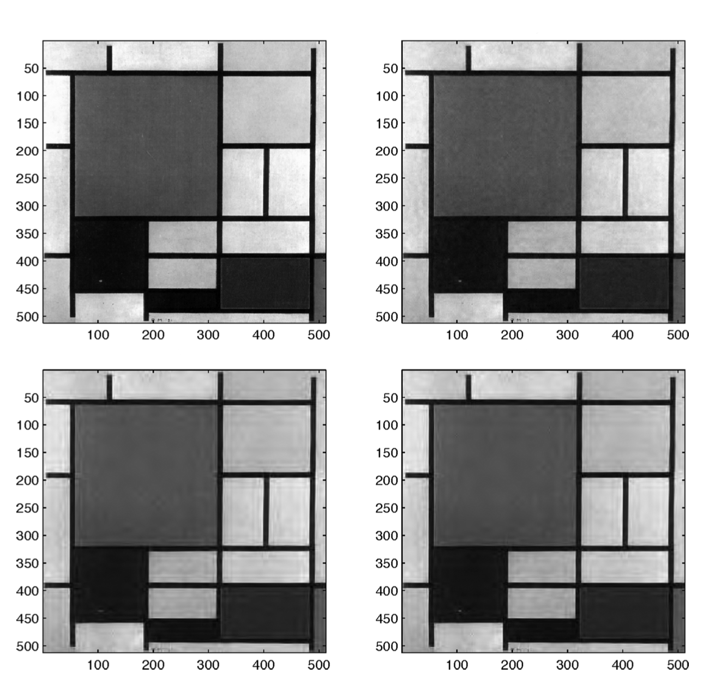
Comparison of Recovery Algorithms
Original Image
(512 x 512)
Basis Pursuit
(30 hours)
StOMP
(lower quality, 16 s)
StOMP
(higher quality, 64 s)
Notes:
Diff(X2) norm ratio

Slide 23
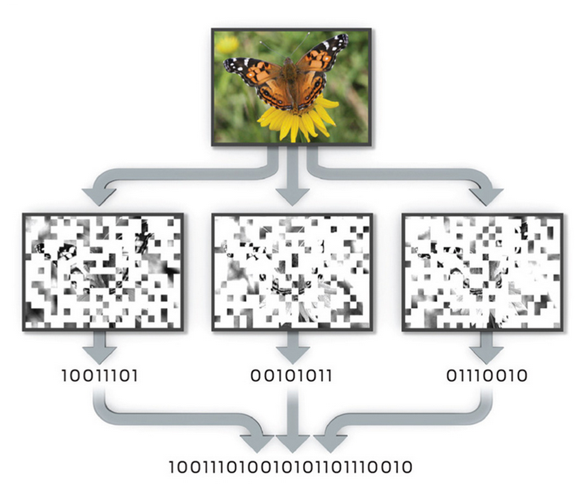
Idea for Cost-Effective Camera

Slide 24
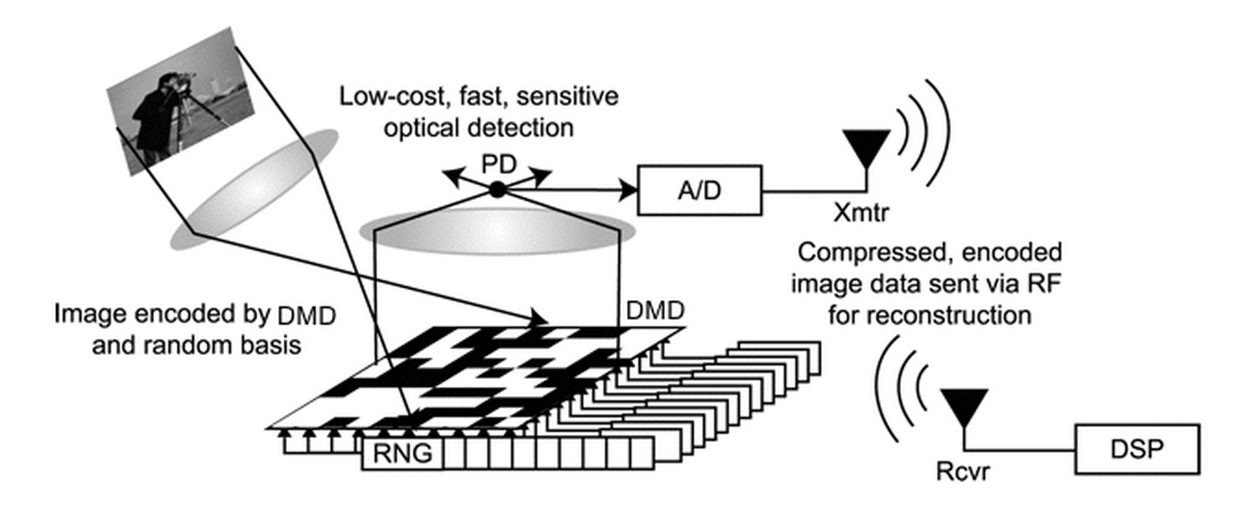
CS Single-Pixel Camera (SPC)
This new camera can obtain an image or video with a single detection element while measuring the scene fewer times than the number of pixels / voxels

Slide 25
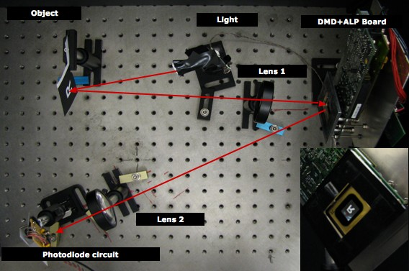
SPC Setting

Slide 26
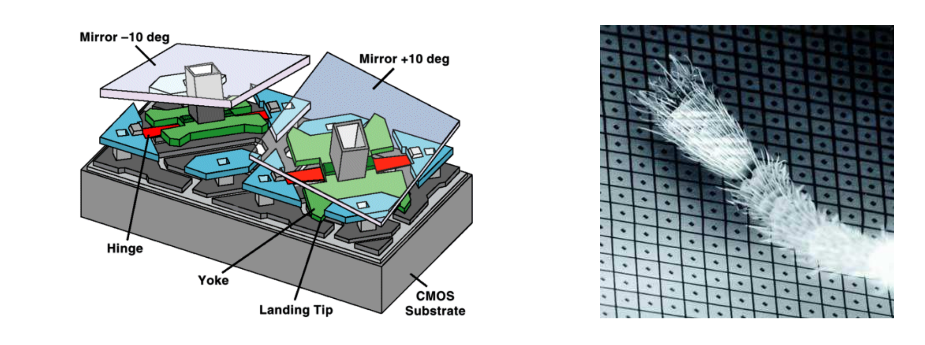
Architecture of DMD
Digital Micromirror Device (DMD) by Texas Instruments

Slide 27
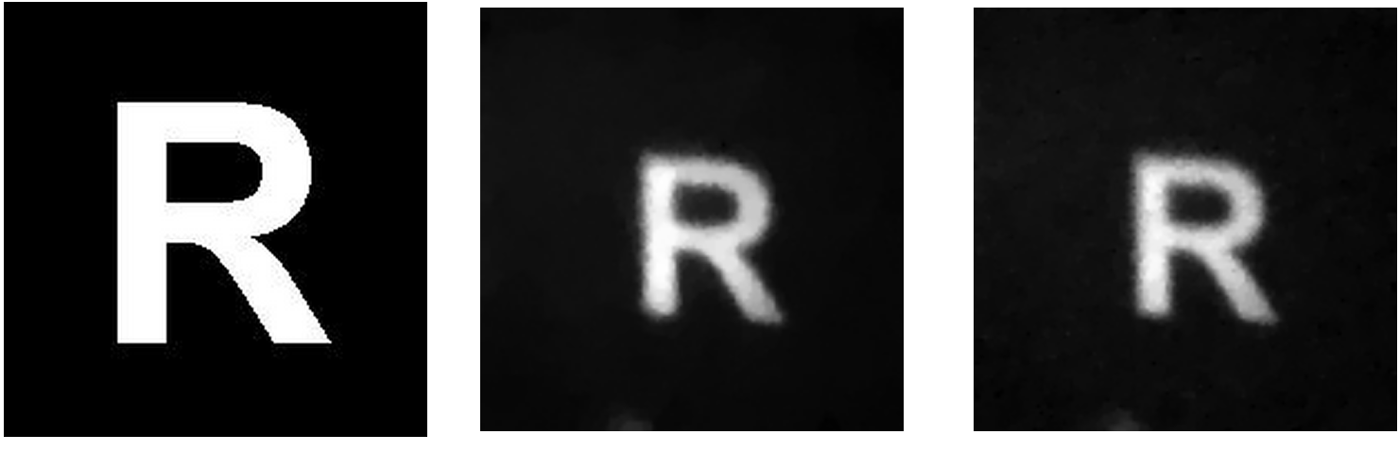
Image Acquisition Results
Original
(16384 pixels)
1600 measurements
(10%)
3300 measurements
(20%)

Slide 28
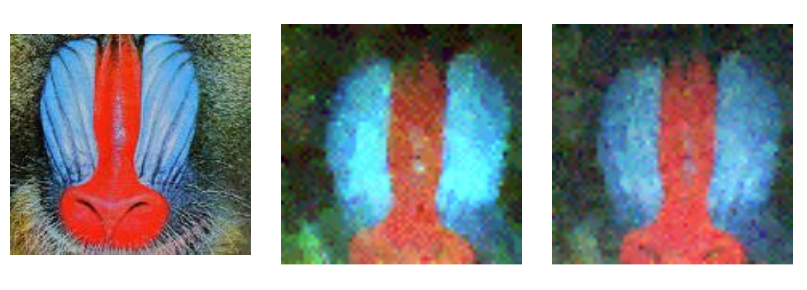
Image Acquisition Results
Original
(4096 pixels)
800 measurements
(20%)
1600 measurements
(40%)

Slide 29
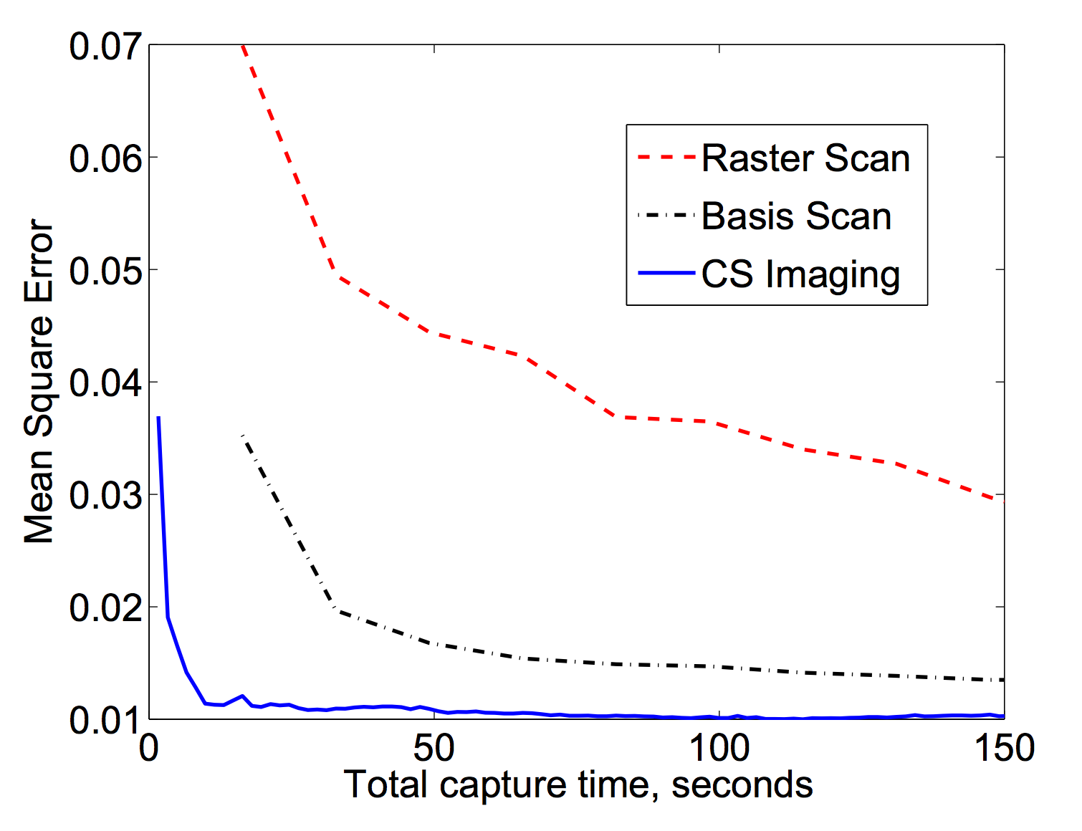
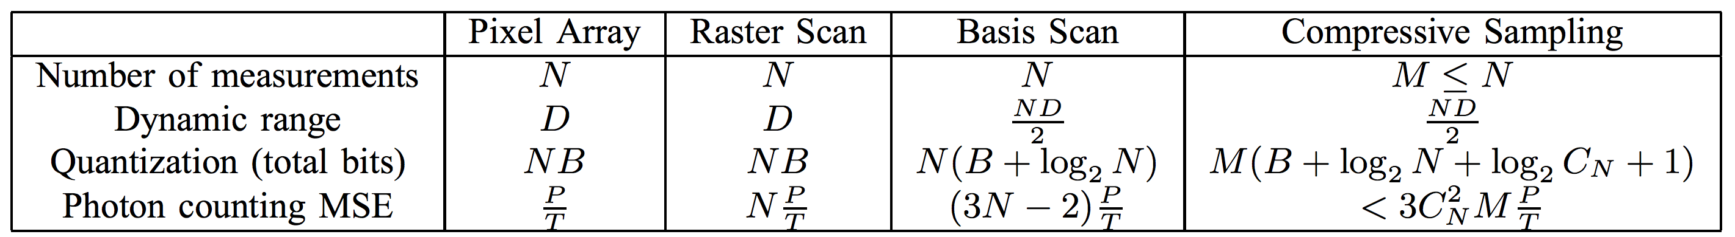
Performance
Comparisons with other scanning methodologies

Slide 30
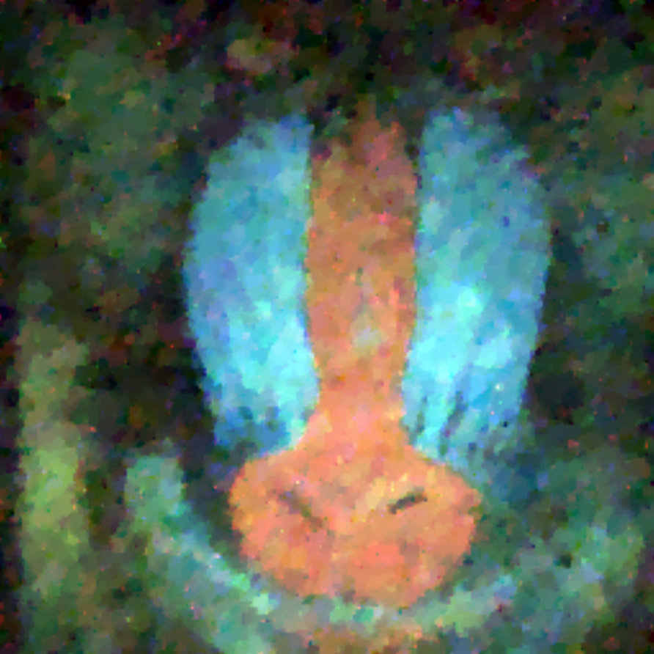
What’s Next
CS theorem provides guidelines for perfect reconstruction, which seems not to be the case here. Why?
10% random measurements,
perfect reconstruction
10% random measurements,
low quality reconstruction

Slide 31
Part II:
Informative Sensing
Hyun Sung Chang, Yair Weiss, William T. Freeman, 2009

Slide 32
Example for Perfect Reconstruction
Descriptions from L1-magic
This 1 megapixel image has a perfectly sparse wavelet expansion
It is a superposition of 25,000 Daubechies-8 wavelets
In real world, signals and images are not perfectly sparse, and there is always some degree of uncertainty in the measurements

Slide 33
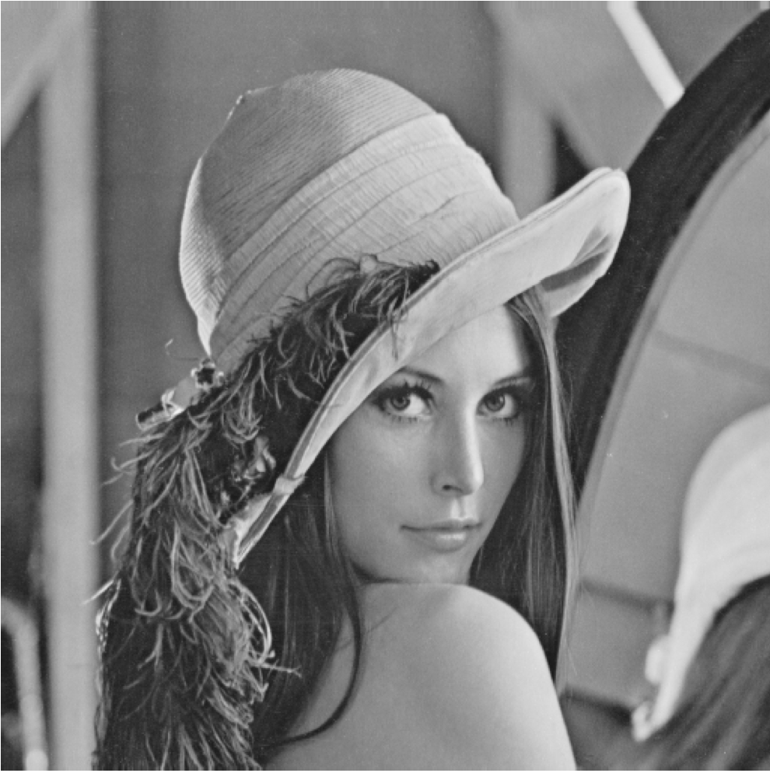
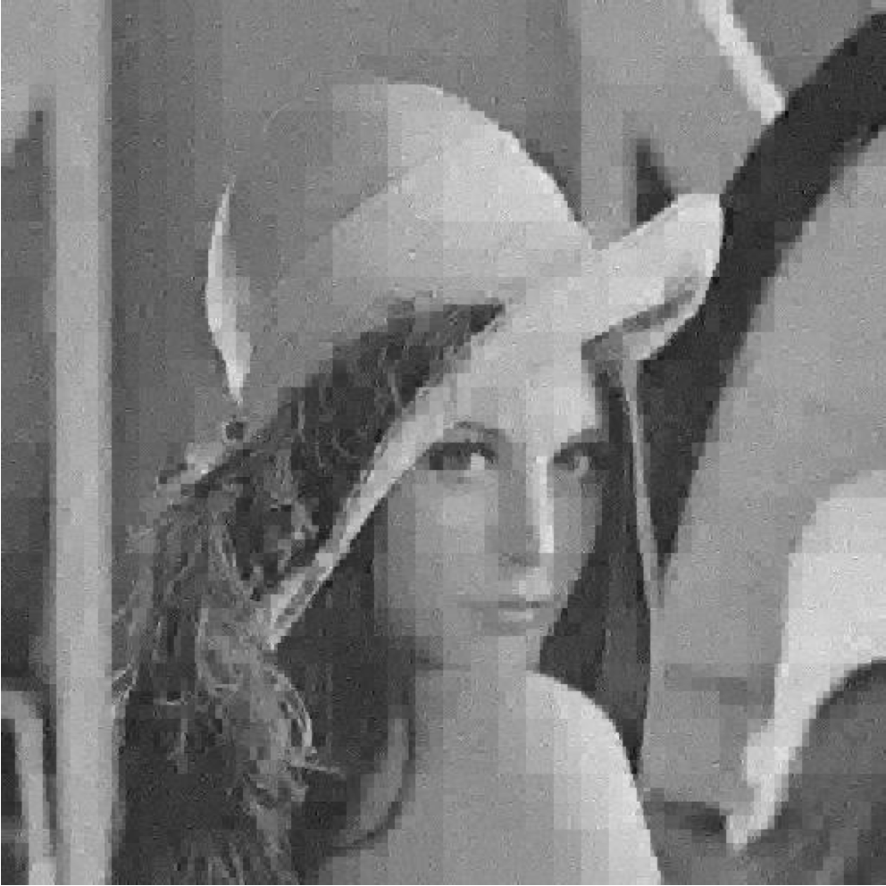
CS and Natural Images
Original Image
CS: 15% random measurements
PSNR = 25.25 dB

Slide 34

CS and Natural Images
Original Image
CS: 25% random measurements
PSNR = 28.02 dB

Slide 35

CS and Natural Images
Original Image
11% subsampling +
linear interpolation
PSNR = 30.03 dB

Slide 36

CS and Natural Images
Original Image
25% subsampling +
linear interpolation
PSNR = 33.52 dB

Slide 37
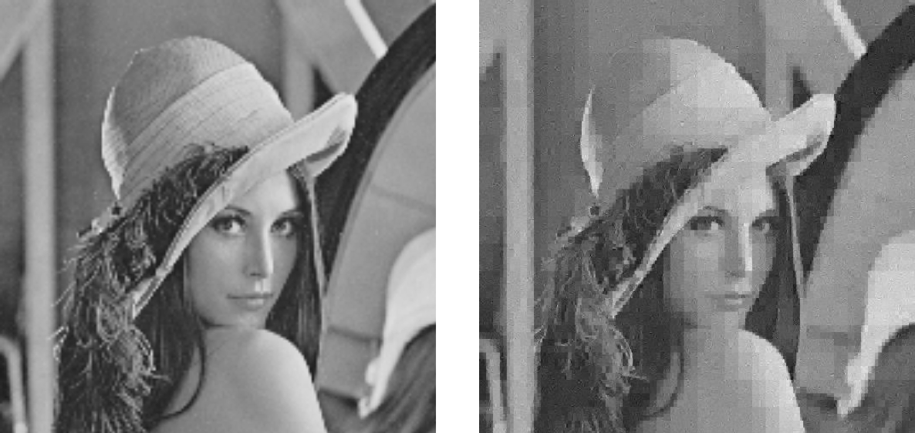
CS and Natural Images
CS theory holds for ideal sparse signals, not natural images
Subsampling + Interp
Compressive Sensing

Slide 38
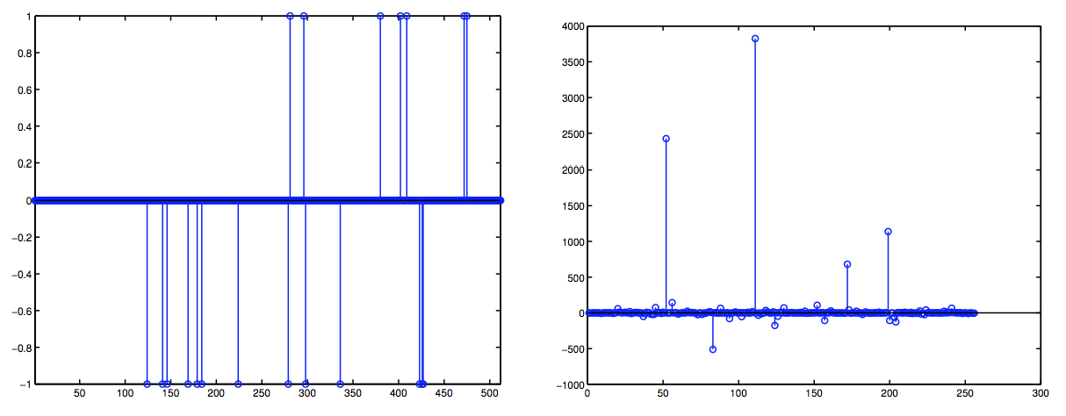
CS and Natural Images
CS theory holds for ideal sparse signals, not natural images
Ideal Sparse Signals
Wavelets of natural image

Slide 39
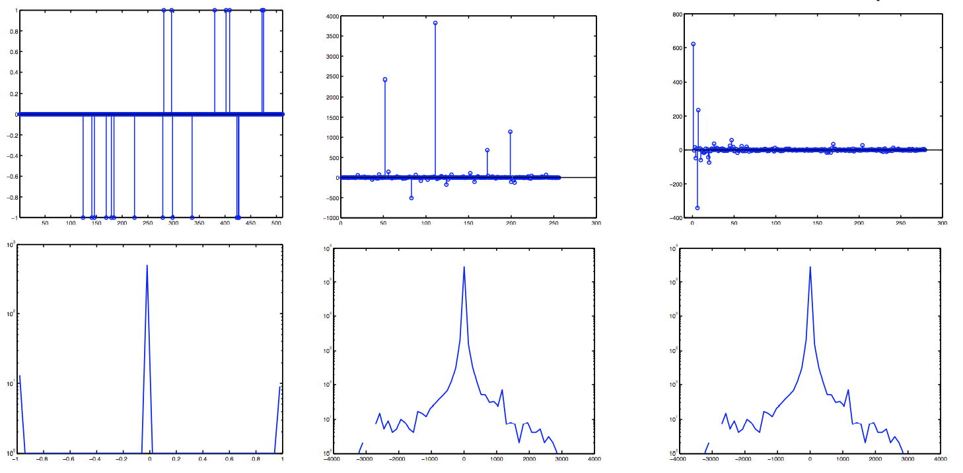
Natural Image Statistics
Ideal Sparse Signal
Image Wavelets
Image Wavelets (sorted)
Wavelet distribution is sparse (statistically)
Decreasing variance when sorted by spatial frequency

Slide 40
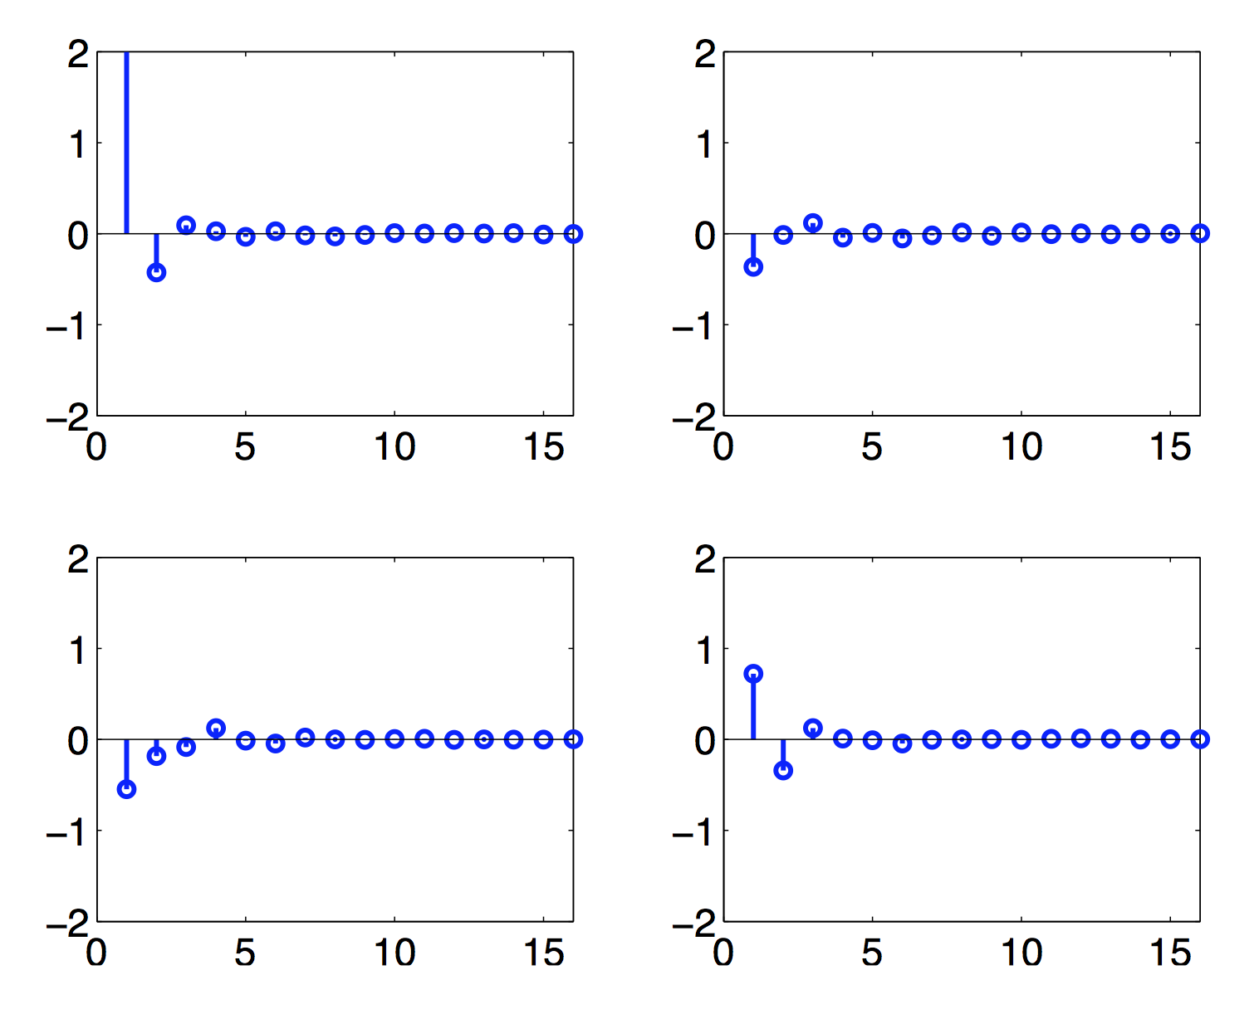
Two Conceptual Examples
Gaussian with decreasing variance
Principal Component Analysis (PCA) gives best projections

Slide 41
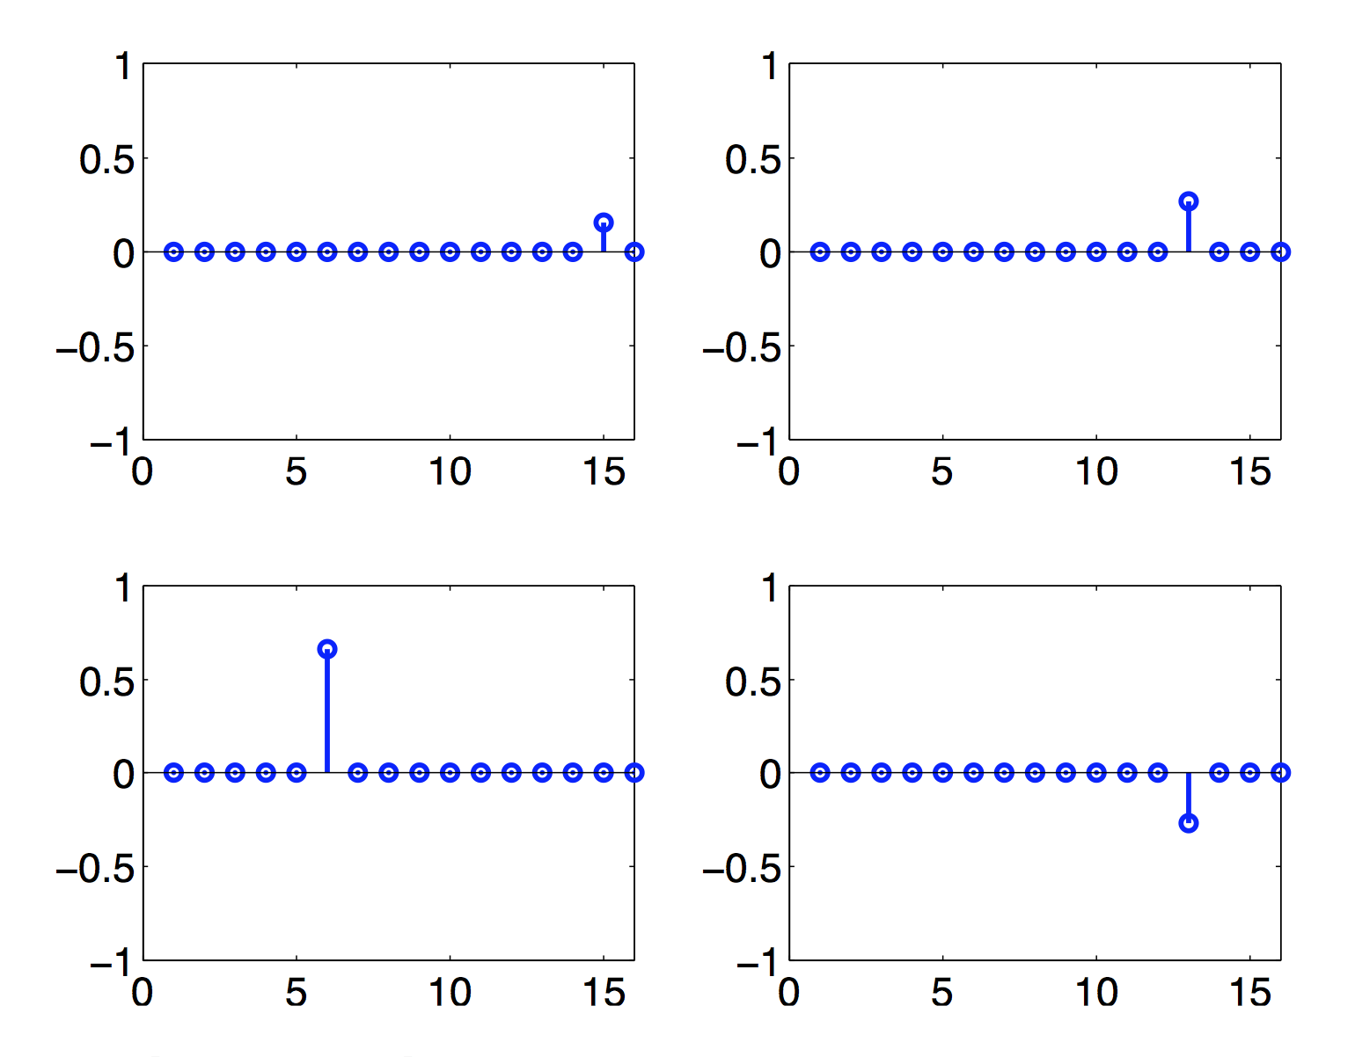
Two Conceptual Examples
Sparse with decreasing variance
Random projections are the best
(give perfect reconstruction!)

Slide 42
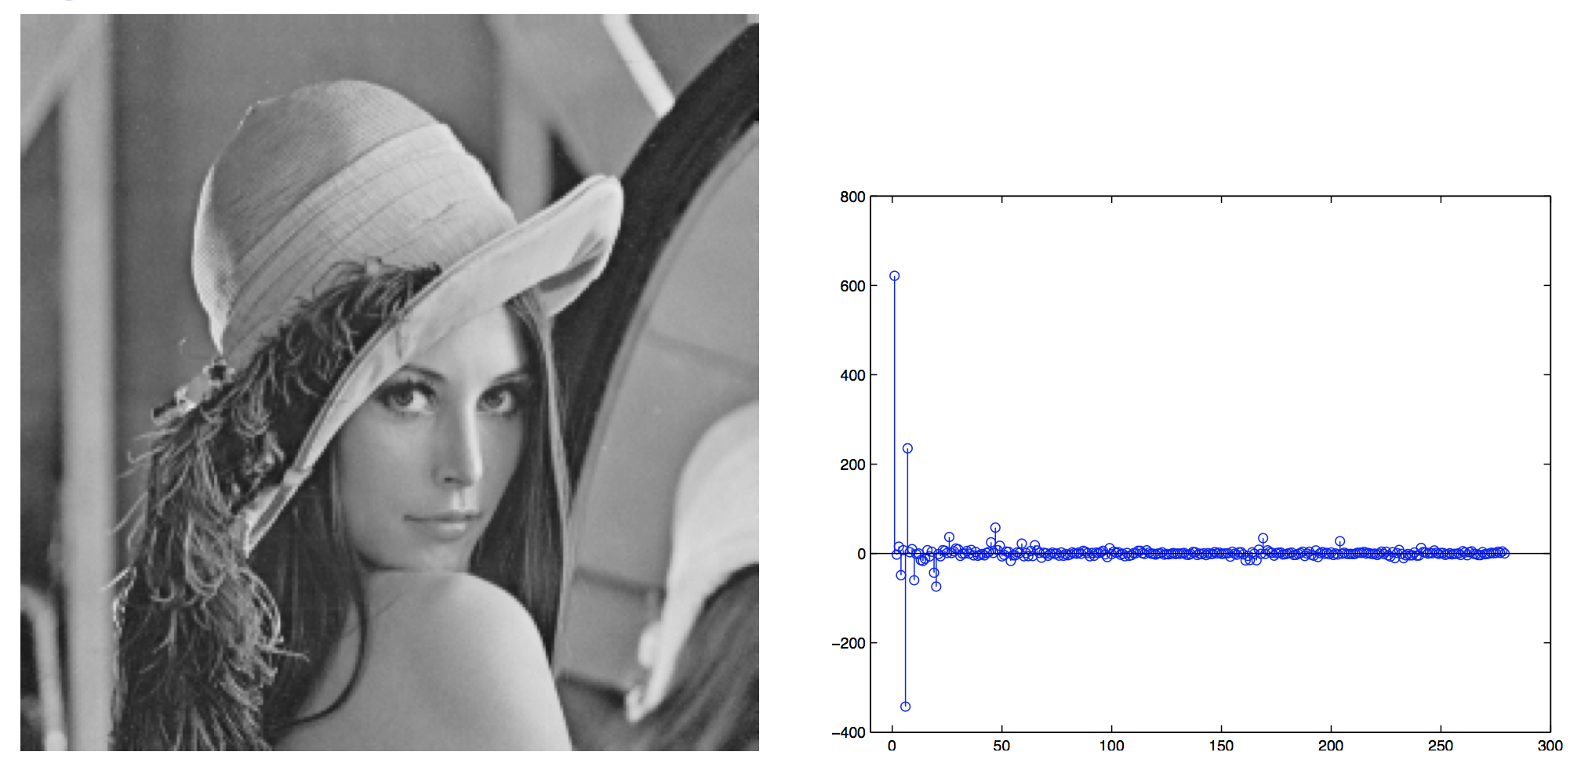
General Case
For general distributions, neither PCA nor random projections are optimal
The higher the sparsity, the higher the non-Gaussianity
We can use entropy (negentropy in this work) to characterize this property and find a better projection

Slide 43
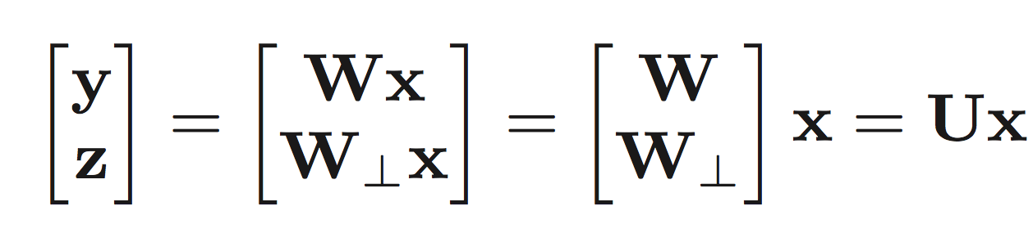
Informative Sensing
Optimize sensing matrix to get maximum information
  Given: known distribution over signals and a limited number of measurements
  Find: best measurements for that distribution
  Method: reduce the “uncertainty”, or conditional entropy of unmeasured terms
Conditional Entropy
Notes:
Minimize conditional entropy is equivalent to minimize the sum of the entropy

Slide 44
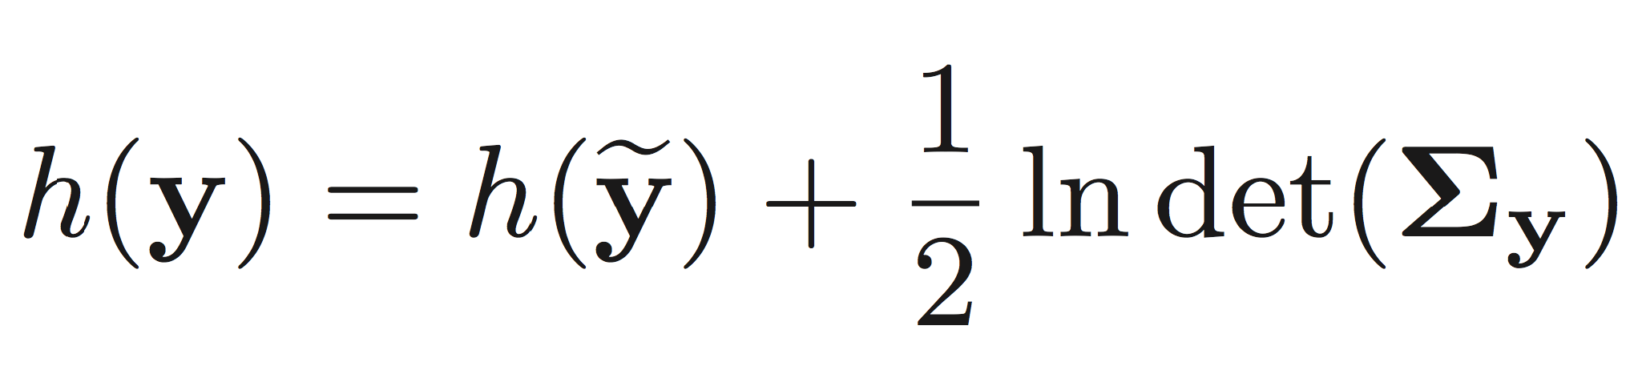
Informative Sensing
Optimize sensing matrix to get maximum information
  Given: known distribution over signals and a limited number of measurements
  Find: best measurements for that distribution
  Method: reduce the “uncertainty”, or conditional entropy of unmeasured terms
Notes:
Minimize conditional entropy is equivalent to minimize the sum of the entropy

Slide 45
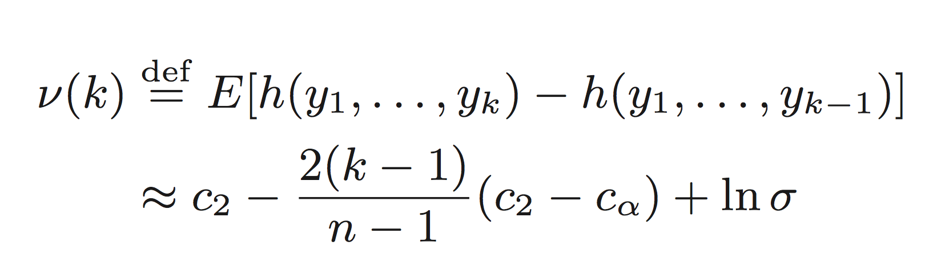
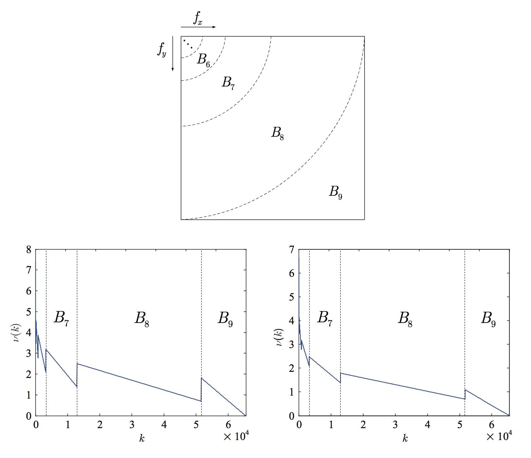
Bandwise (BW) Random Projection
Use the profiling of net capacity to determine how many samples to take from each band
  This distribution is related to the sparsity (non-Gaussianity) of the image

Slide 46
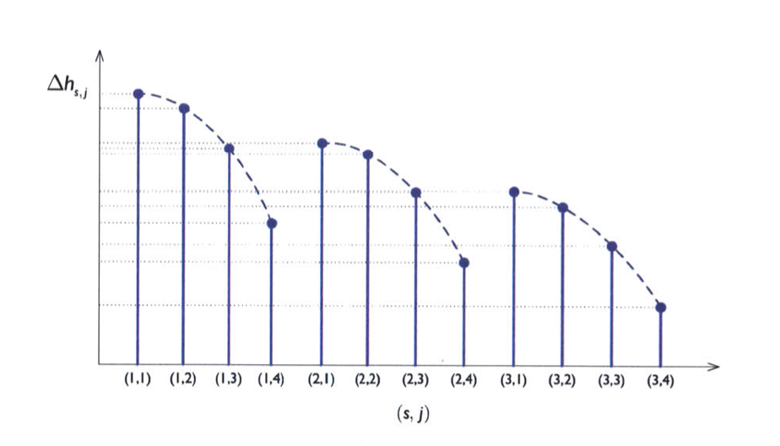
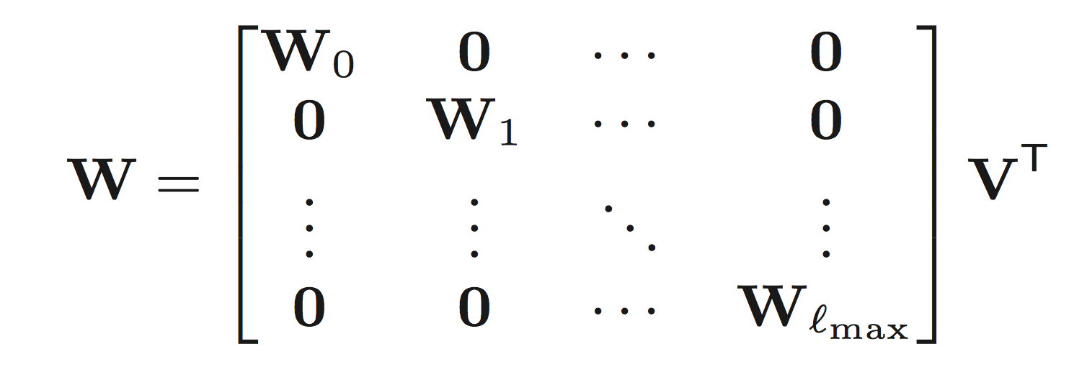
Bandwise (BW) Random Projection
(1) Estimate and sort the net capacity in a decreasing order
(2) Take random projections sequentially according to the total budget of number of projections

Slide 47
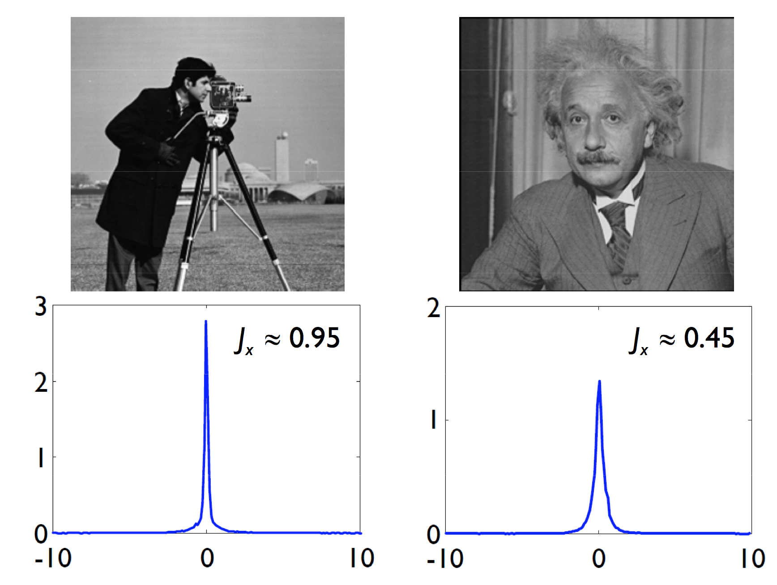
Experimental Results
Comparison of Two Examples

Slide 48
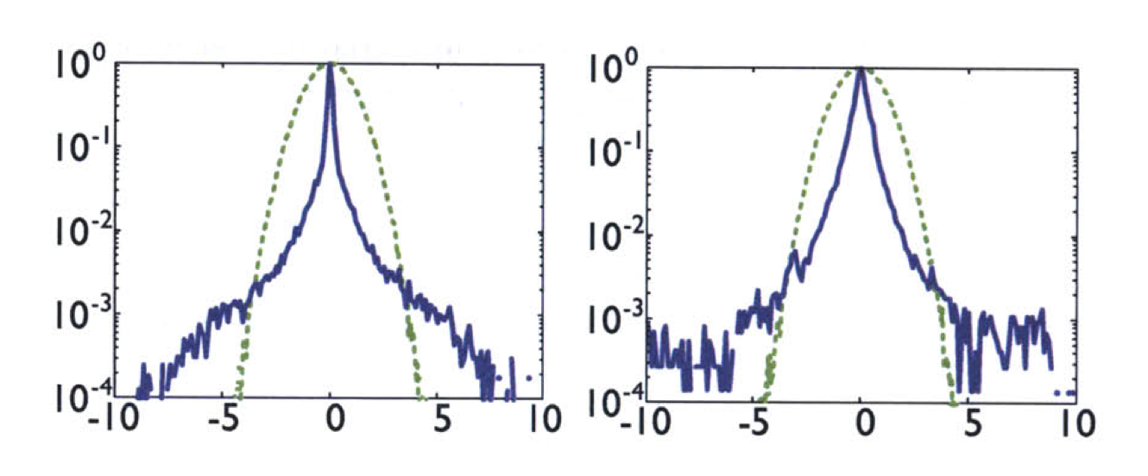
Experimental Results
Comparison of Two Examples
Density of Wavelet Coefficients

Slide 49
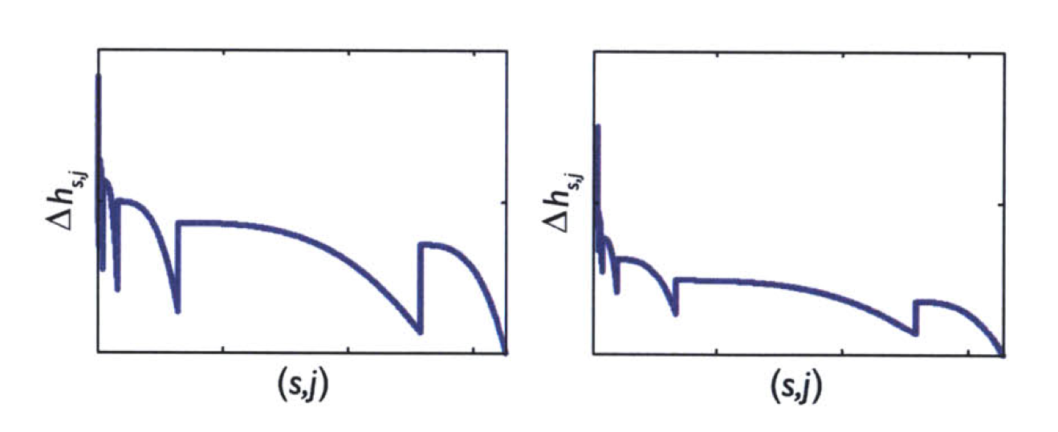
Experimental Results
Comparison of Two Examples
Net Capacity

Slide 50
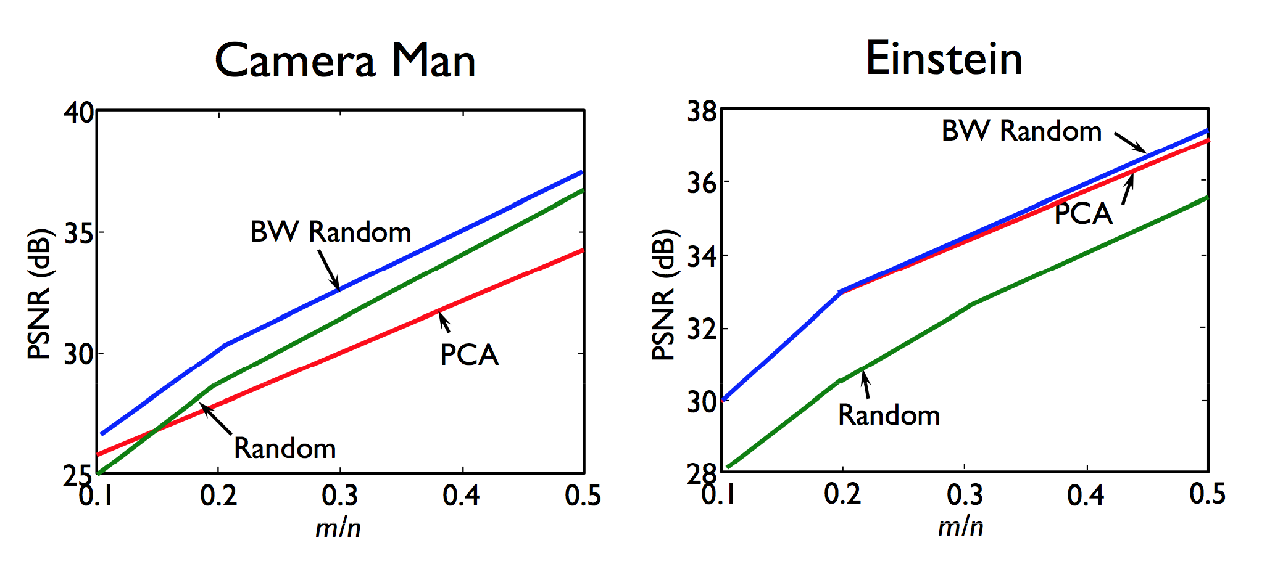
Experimental Results

Slide 51
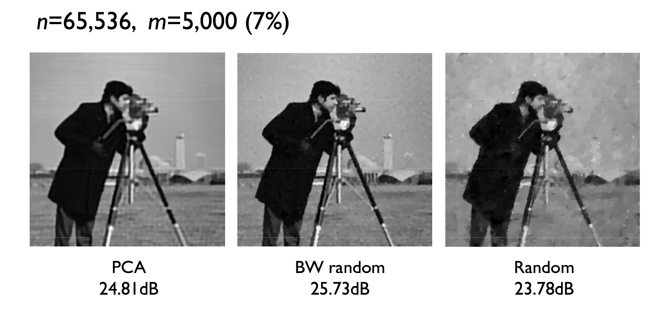
Experimental Results

Slide 52
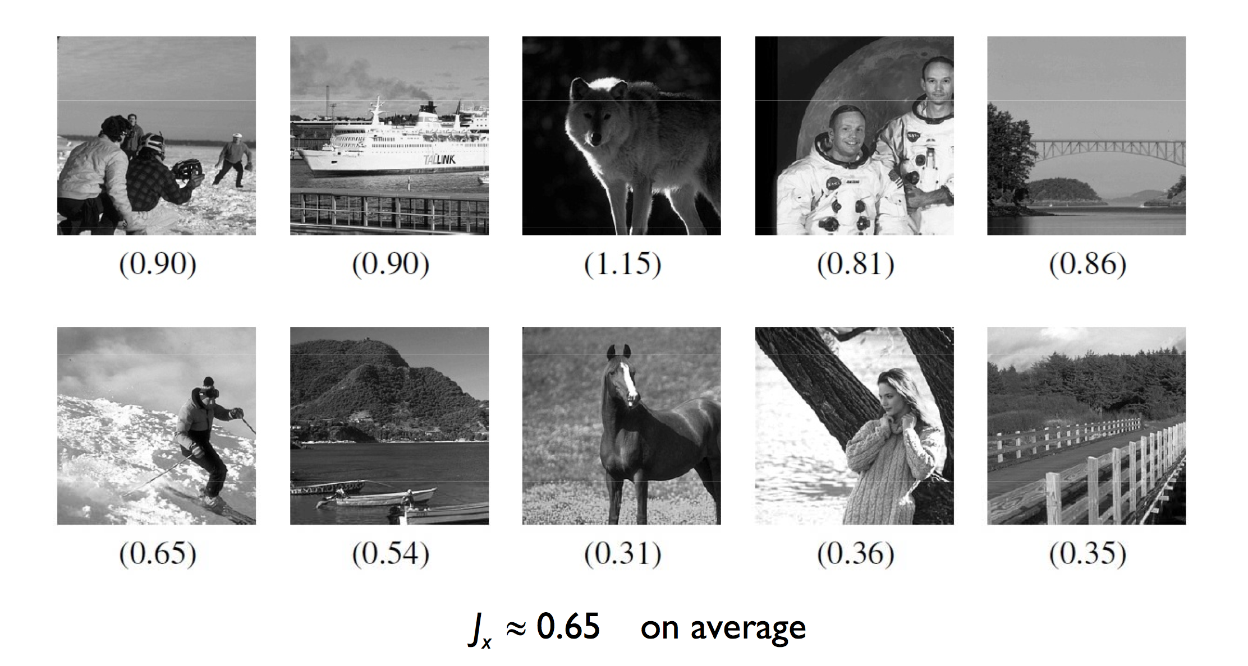
General Results
More images from Berkeley dataset

Slide 53

Informative Sensing and Natural Images
25% PCA measurements
(low frequencies, w/ TV min.)
CS: 25% random measurements
PSNR = 35.96 dB
PSNR = 28.02 dB

Slide 54
Summary for the CS / IS Theory
CS theorems hold for ideal sparse signals, but not natural images
Informative sensing aims to design optimal measurement matrix given knowledge of signal statistics
For natural images, optimal measurements depend on sparsity
  For most cases, measuring low frequencies is optimal
  For highly sparse cases, random projections are optimal
Even with optimal projections, the compression gains are modest

Slide 55
Part III:
CS Applications in Vision & Graphics

Slide 56
Beyond Image Reconstruction…
CS have been adopted to work on many problems in computer vision or computer graphics
A more useful framework inspired by CS is sparse representation and low-rank approaches
Some applications
  Image Denoising [M. Elad CVPR’06]
  Face Recognition [J. Wright PAMI’09, A. Wagner PAMI’12]
  Background subtraction [V. Cevher ECCV’08]
  Tracking [H. Li CVPR’11, K. Zhang ECCV’12]
  Media Recovery [J. Gu ECCV’08, PAMI’13]
  …

Slide 57
CS-inspired Frameworks
Target for Reconstruction
  General images or Specific Objects?
Sparsity Verification
  Explore a basis to decompose the target into a sparse signal
  Instead of generic basis like DCT or Wavelet, overcomplete dictionaries are useful in practice
Requirement for Computational Resources
  L1-minimization is generally time-consuming!

Slide 58
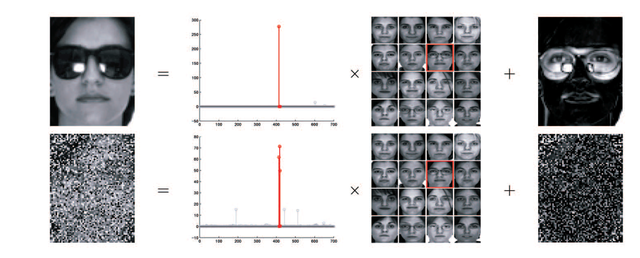
CS-inspired Face Recognition
Performance at a glance
  CS theory implies that precise choice of feature space is not so critical as before; random features also work!
  Robustness to Occlusion: Source-and-Error Separation

Slide 59
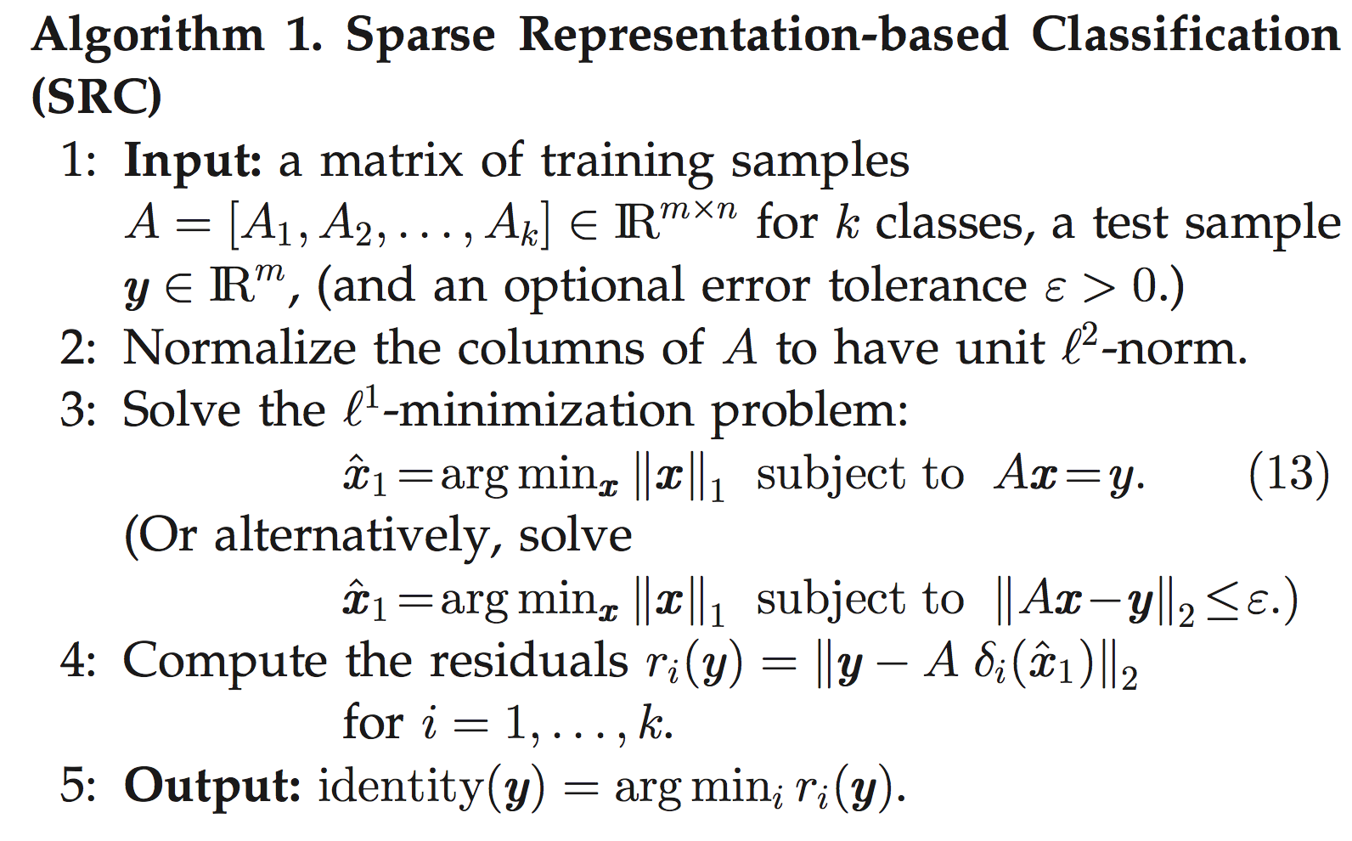
Algorithm

Slide 60
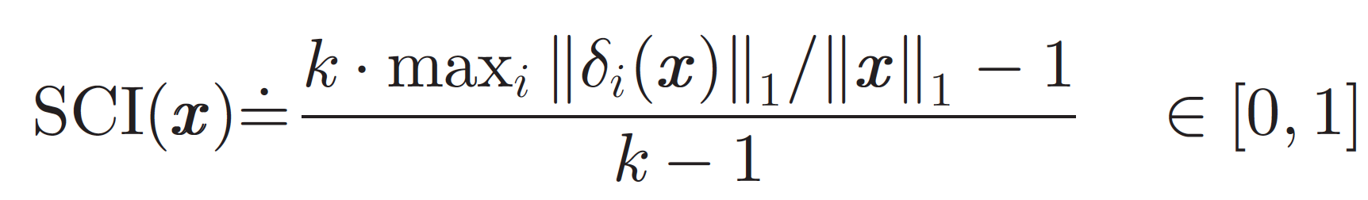
Robust Classification – SCI
Sparsity Concentration Index (SCI)
  SCI = 1, using only images from a single object, valid test image
  SCI = 0, the sparse coefficients are spread evenly over all classes, invalid test image
  Thresholding on SCI for validation
Projected Sparse Coefficients

Slide 61
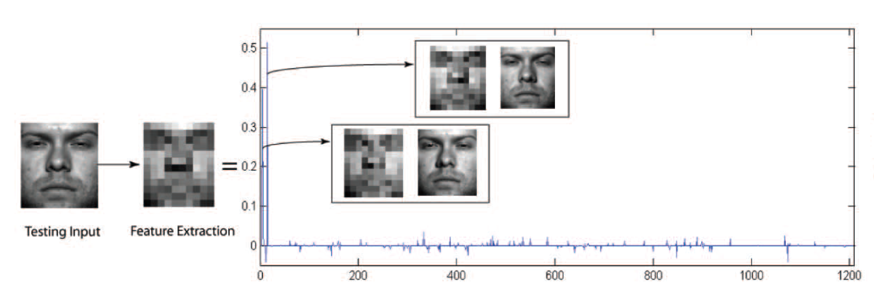
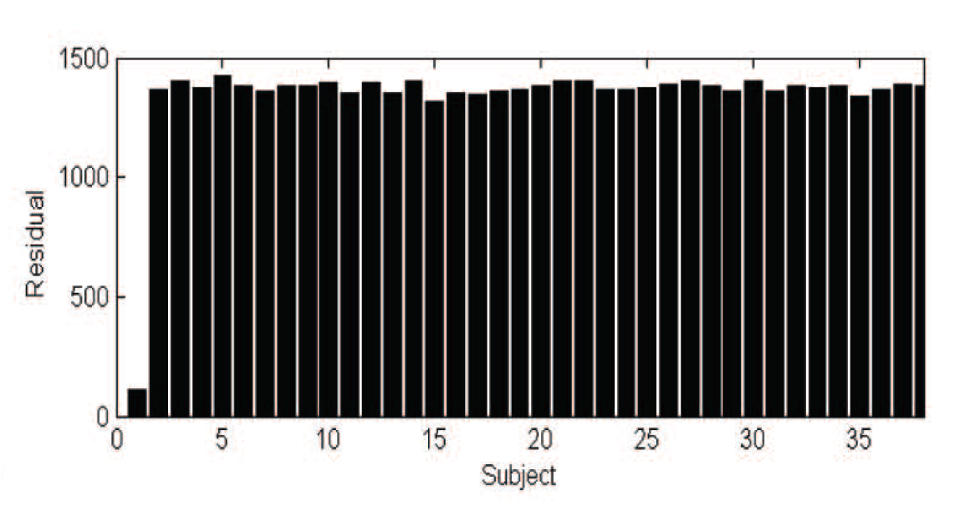
Sparse Representation Classification (SRC)
L1-minimization
Notes:
1:8,6

Slide 62
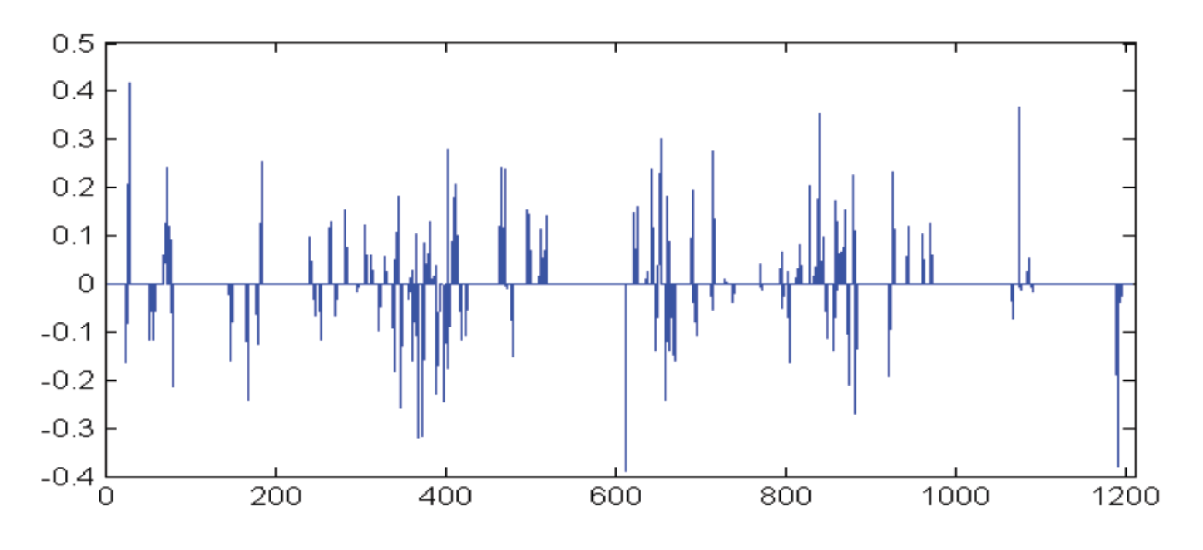
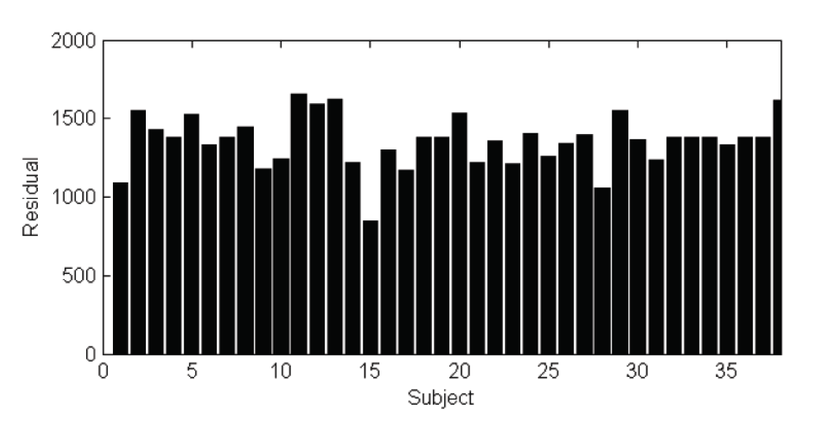
Sparse Representation Classification (SRC)
L2-minimization
Notes:
1:1.3

Slide 63
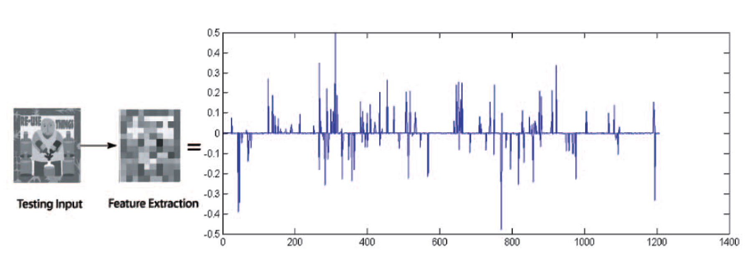

SCI Validation
Invalid Test Image
Notes:
1:1.2

Slide 64


Robust Classification under Occlusion
Main Concept: occlusions are sparse in some domains

Slide 65



Robust Classification under Occlusion
Modifications for the Optimization Problem
  If the proportion of occlusion is not too large, it is still possible to reconstruct the original sparse representation
  Ideally, we want (verified by experiments)
Sparse Basis for Noise
Sparsity of
Original Face
Sparsity of Noise
or Occlusion
Original Dimension

Slide 66
Datasets
Extended Yale B Database
  2,414 frontal-face images of 38 individuals
  192x168 normalized face images
  Captured under various laboratory-controlled lighting conditions
AR Database
  Over 4,000 frontal images for 126 individuals
  Include more facial variations, including illumination change, expressions, and facial disguises
  Select 50 male and female subjects with 14 variations
  Normalize image size to 165x120

Slide 67

Feature Extraction
Random
Projection
Eigenface
Laplacianface
Downsample

Slide 68

Extended Yale B Database
Notes:
*The dimension of fisherface is limited to the number of class k, so for Yale is 30, for AR is 30, 54
Yale feature dim: 30 (1/32), 56 (1/24), 120 (1/16), 504 (1/8)

Slide 69

AR Database
Notes:
*The dimension of fisherface is limited to the number of class k, so for Yale is 30, for AR is 30, 54
AR feature dim: 30 (1/24), 54 (1/18), 130 (1/12), 540 (1/6)

Slide 70

Recognition with Partial Face Features
Notes:
Overdetermined: > # of training samples = 1207

Slide 71

Results under Random Corruption

Slide 72

Results under Contiguous Occlusion

Slide 73


Partition Scheme

Slide 74
Summary & Comment
The CS-inspired SRC framework provides a relatively robust recognition framework
  Feature Extraction: choices of feature still matter
  Robustness to Occlusion: use local (partitioned scheme) to improve global SRC
Limitations
  The algorithm is robust to small variations (in pose or displacement), but high-quality detection, cropping and normalization are still desired
  Illumination and deformable problems have to be solved by additional modeling [PAMI’13]

Slide 75


What’s Participating Media
Participating Media: Real-world phenomena that can only be described by volume densities rather than boundary surface
  Examples are like smoke, clouds, or dynamic liquid
Conventional ways for recovering the volume densities of participating media include
  Laser sheet + high-speed camera + scanning
  Static laser rays + interpolation
How to improve efficiency in acquisition is critical!

Slide 76


Property of Participating Media
The volume densities of participating media usually have high sparsity (> 0.95) over time
J. Gu et al, ECCV’08, PAMI’13

Slide 77


Compressive Structured Light
Settings and Image Formation Model
Notes:
補 \lo (x,y) 和 L(x,y)

Slide 78

Compressive Structured Light
Scan
(one stripe turned on)
Laser-lines interpolation
Compressive Structured Light
The utilization of light is more efficient
The measurement process is highly efficient in both acquisition time and illumination power
Spatial Coding
Temporal Coding
J. Gu et al, ECCV’08, PAMI’13
Notes:
Scan (one stripe turned on)
Laser-lines interpolation

Slide 79



Slide 80

Simulation Results
J. Gu et al, ECCV’08, PAMI’13

Slide 81

J. Gu et al, ECCV’08, PAMI’13

Slide 82

Experimental Results – Static Volumes
Artifacts
  Multiple Scattering
  Attenuation
J. Gu et al, ECCV’08, PAMI’13

Slide 83


Dynamic Volumes – Milk Drop
Specification: 128 x128 x 128 volume at 15 fps
J. Gu et al, ECCV’08, PAMI’13

Slide 84

Dynamic Volumes – Milk Drop
J. Gu et al, ECCV’08, PAMI’13

Slide 85

Dynamic Volumes – Milk Drop
J. Gu et al, ECCV’08, PAMI’13

Slide 86
Summary
The property of high sparsity of participating media is exploited through compressive structured light method
  High efficiency in acquisition time and illumination power
  Attenuation correction further improves the results
Limitations
  Multiple scattering: may be alleviated through adopting more complicated light codes
  Temporal coding is more robust to noise and defocus
  Spatial coding is preferred due to high temporal resolution, but requires accurate calibrations

Slide 87
Conclusion
Compressive sensing (CS) provides strong theorems for perfect reconstruction of sparse signals
  For reconstruction of natural images, informative sensing is better
In practice, CS-inspired sparse representation may provide better solutions in many cases
  However, cannot and will not solve all vision / graphics problems!
When is possible to apply CS?
  It is possible to find a sparse representation of your data
  The system has asymmetrical computation resources in sensing and reconstruction

Slide 88
Reference
[1] “Compressed sensing,” IEEE Transactions on Information Theory, 2006
[2] “Compressive Sensing for Background Subtraction,” ECCV, 2008
[3] “Informative Sensing of Natural Images,” ICIP 2009
[4] “Compressive Structured Light for Recovering Inhomogeneous Participating Media,” IEEE Transactions On Pattern Analysis And Machine Intelligence (PAMI), 2013å
[5] “Robust Face Recognition via Sparse Representation,” IEEE Transactions On Pattern Analysis And Machine Intelligence (PAMI), 2009
[6] “A Compressive Sensing Approach for Expression-Invariant Face Recognition,” CVPR, 2009
[7] “Real-time Visual Tracking Using Compressive Sensing,” CVPR, 2011
[8] “Real-Time Compressive Tracking,” ECCV, 2012
[9] “CoSaMP: Iterative signal recovery from incomplete and inaccurate samples,” Applied and Computational Harmonic Analysis, 2009

