Slide 1
Autoencoders
David Dohan

Slide 2
Unsupervised Deep Learning
So far: supervised models
Multilayer perceptrons (MLP)
Convolutional NN (CNN)
Up next: unsupervised models
Autoencoders (AE)
Deep Boltzmann Machines (DBM)

Slide 3
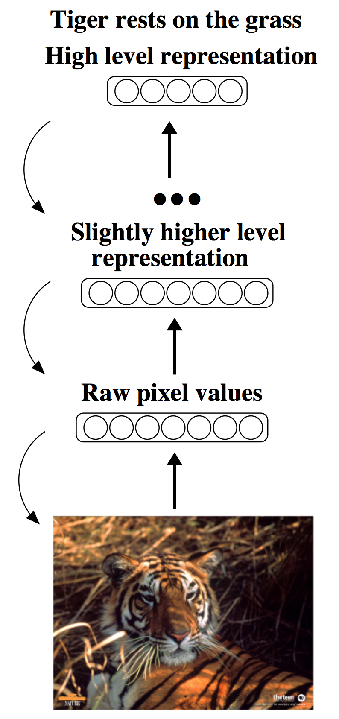
The Goal
Build high-level representations from large unlabeled datasets
Feature learning
Dimensionality reduction
A good representation may be:
Compressed
Sparse
Robust
Notes:
Feature learning - use with other classifiers

Slide 4
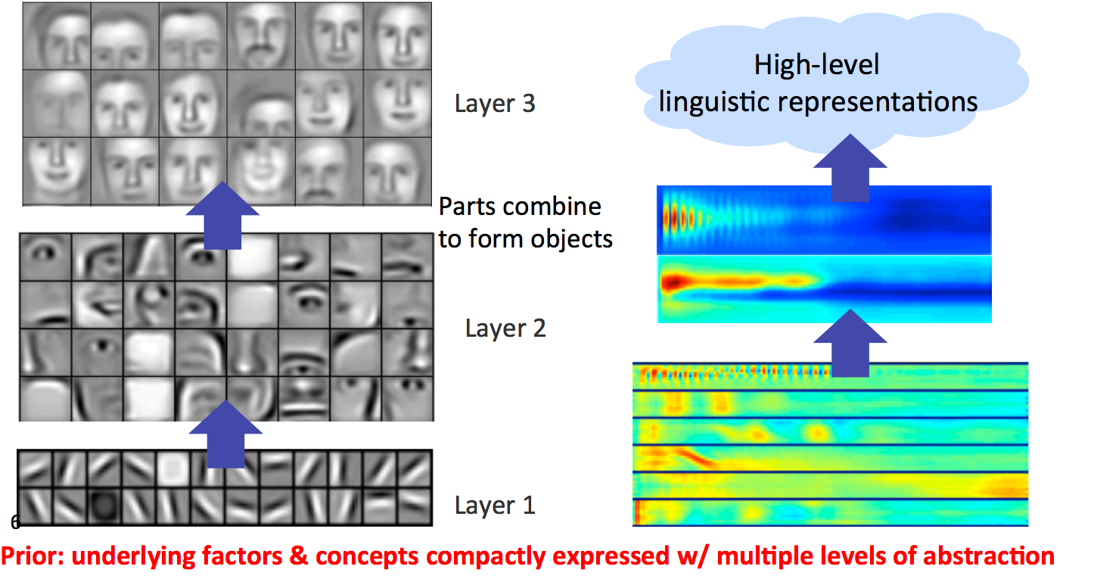
Hierarchical Representation

Slide 5
The Goal
Uncover implicit structure in unlabeled data
Use labelled data to finetune the learned representation
Better initialization for traditional backpropagation
Semi-supervised learning
Notes:
Feature learning - use with other classifiers

Slide 6
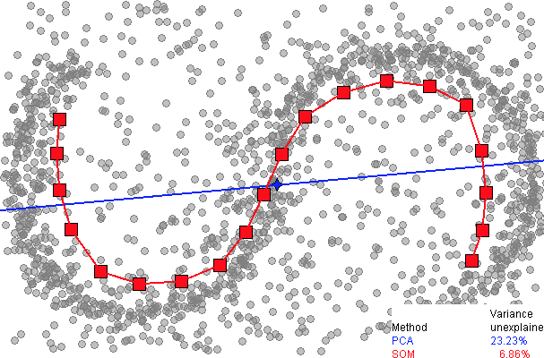
Manifold Hypothesis
Realistic data clusters along a manifold
Natural images v. static
Discovering a manifold, assigning coordinate system to it

Slide 7
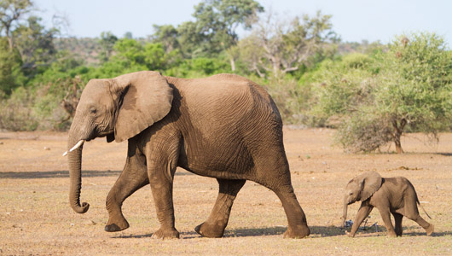
Manifold Hypothesis
Realistic data clusters along a manifold
Natural images v. static
Discovering a manifold, assigning coordinate system to it

Slide 8
Principal Component Analysis
Reduce dimensions by keeping directions of most variance
Direction of first principal component i.e. direction of greatest variance

Slide 9
Principal Component Analysis
Given N x d data matrix X, want to project using largest m components
Zero mean columns of X
Calculate SVD of X = UΣV
Take W to be first m columns of V
Project data by Y = XW
Output Y is N x m matrix

Slide 10
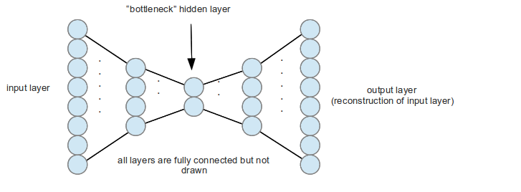
Autoencoder Structure
Input, hidden, output layers
Learning encoder to and decoder from feature space
Information bottleneck
Notes:
Explain specgram

Slide 11
Shallow Autoencoder
AE with 2 hidden layers
Try to make the output be the same as the input in a network with a central bottleneck.
The activities of the hidden units in the bottleneck form an efficient code.
Similar to PCA if layers are linear
output vector
code
input vector
Notes:
If the hidden and output layers are linear, it will learn hidden units that are a linear function of the data and minimize the squared reconstruction error.
This is exactly what PCA does.
The M hidden units will span the same space as the first M components found by PCA
Their weight vectors may not be orthogonal.
They will tend to have equal variances.

Slide 12
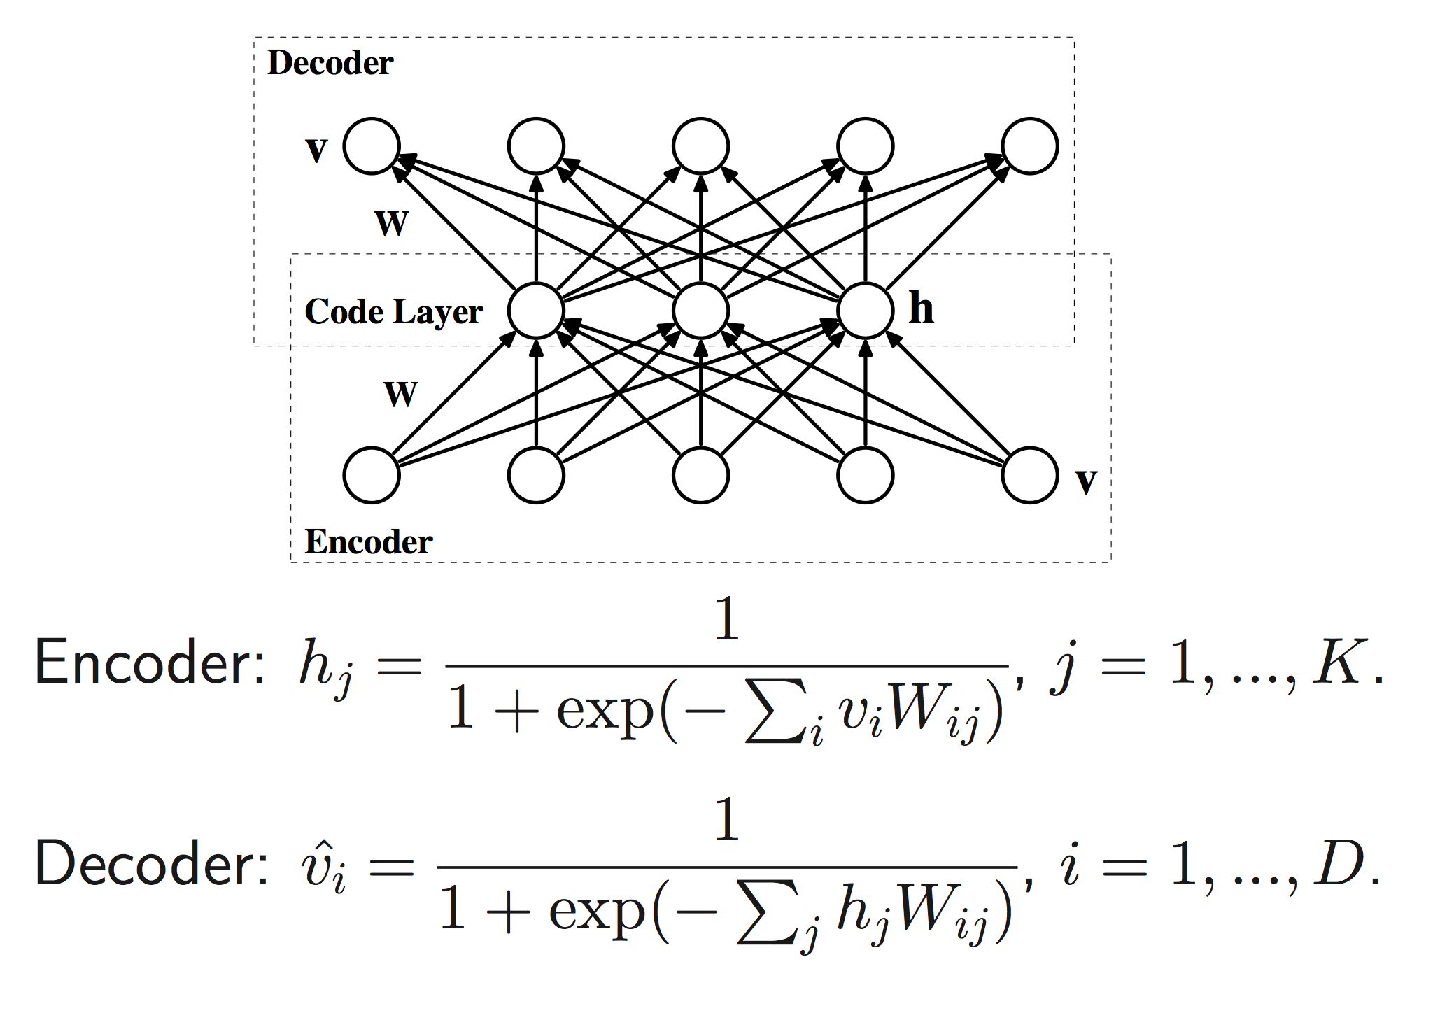
Shallow Autoencoder
Notes:
If the hidden and output layers are linear, it will learn hidden units that are a linear function of the data and minimize the squared reconstruction error.
This is exactly what PCA does.
The M hidden units will span the same space as the first M components found by PCA
Their weight vectors may not be orthogonal.
They will tend to have equal variances.

Slide 13
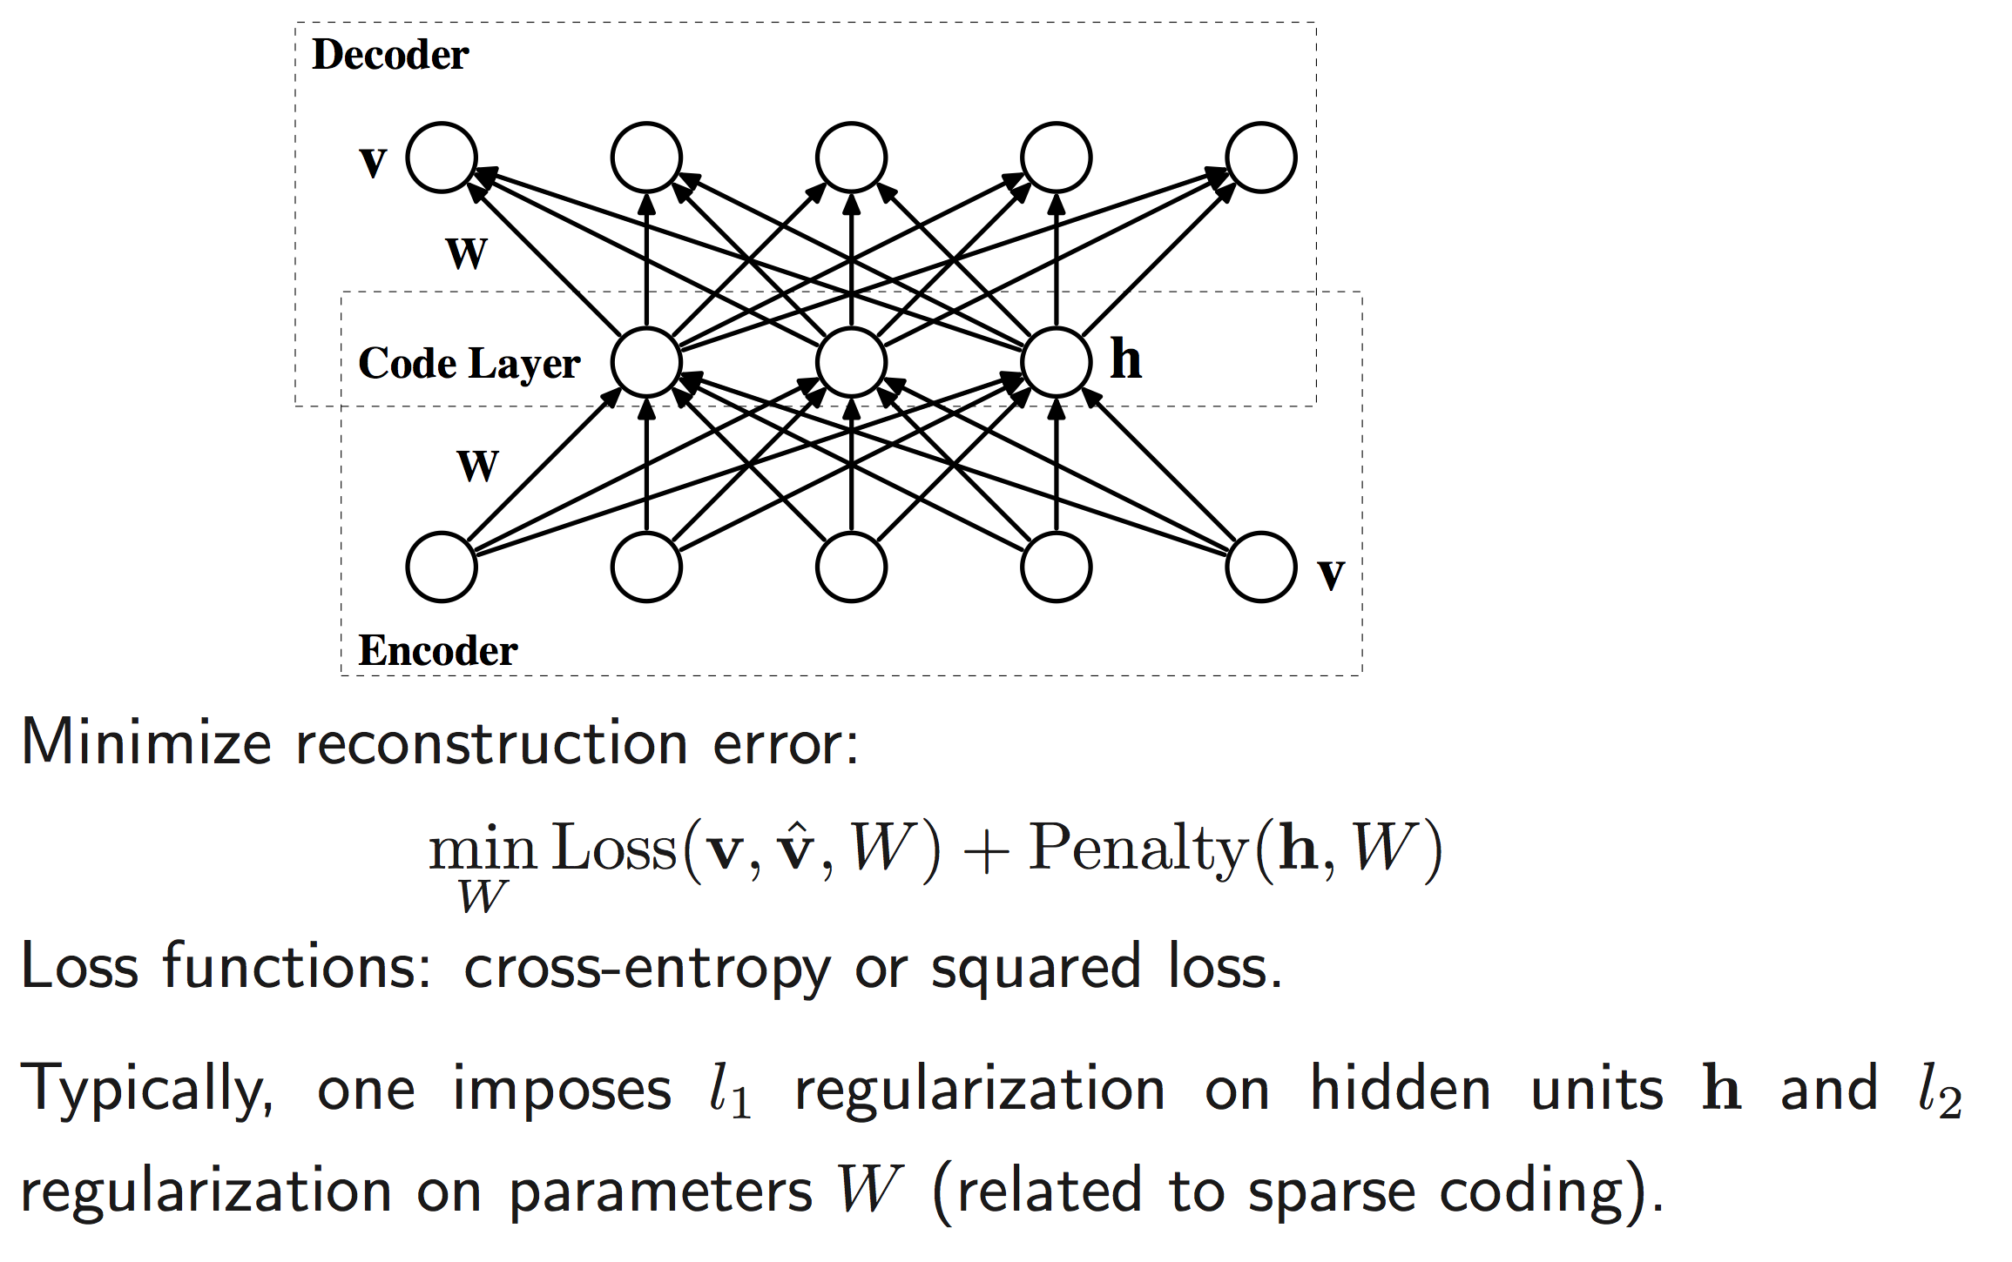
Shallow Autoencoder
Notes:
If the hidden and output layers are linear, it will learn hidden units that are a linear function of the data and minimize the squared reconstruction error.
This is exactly what PCA does.
The M hidden units will span the same space as the first M components found by PCA
Their weight vectors may not be orthogonal.
They will tend to have equal variances.

Slide 14
Deep Autoencoder
Non-linear layers allow an AE to represent data on a non-linear manifold
Can initialize MLP by replacing decoding layers with a softmax classifier
output vector
Decoding weights
code
Encoding weights
input vector
Notes:
LESS TEXT

Slide 15
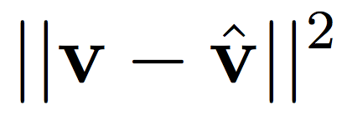
Training Autoencoders
Backpropagation
Trained to approximate the identity function
Minimize reconstruction error
Objectives:
Mean Squared Error:
Cross Entropy:

Slide 16
Reconstruction Example
Data
30-D AE
30-D PCA

Slide 17
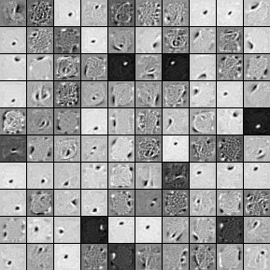
Learned Filters
Each image represents a neuron
Color represents connection strength to that pixel
Trained on MNIST dataset

Slide 18
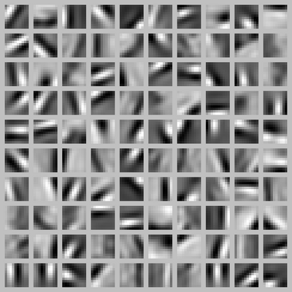
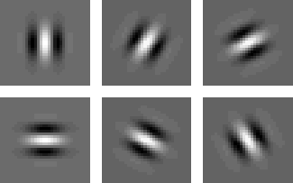
Learned Filters
Trained on natural image patches
Get Gabor-filter like receptive fields

Slide 19
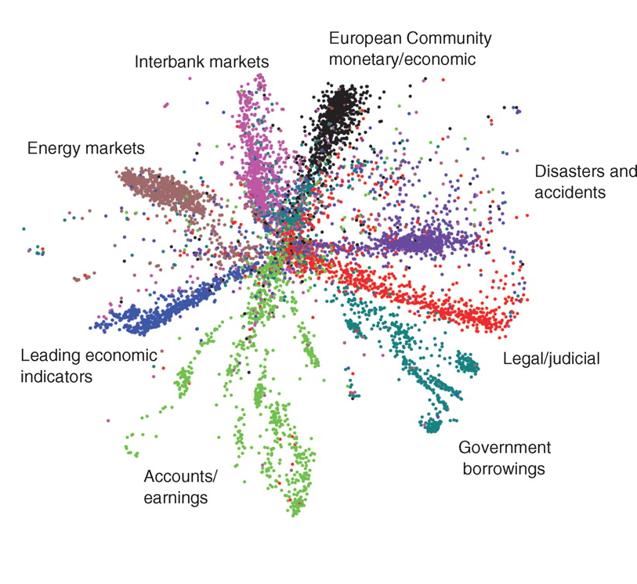
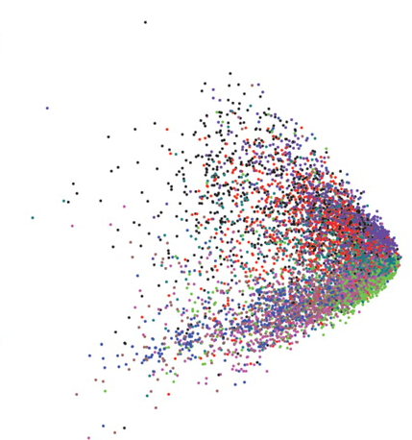

Slide 20
Deep Autoencoder
Face “vanishing gradient” problem
Solution: Greedy layer-wise pretraining
First approach used RBMs (Up next!)
Can initialize with several shallow AE
100
W₄
100
50
50
W₄
W₃
W₃
50
10
10
W₁
W₂
W₂
100
50
50
W₁
100

Slide 21
Denoising Autoencoder
Want to prevent AE from learning identity function
Corrupt input during training
Still train to reconstruct input
Forces learning correlations in data
Leads to higher quality features
Capable of learning overcomplete codes
Notes:
Add context for where each image is in the network
Perhaps multiple noisy versions of the image

Slide 22
Denoising Autoencoder
Web Demo
Notes:
Add context for where each image is in the network
Perhaps multiple noisy versions of the image

Slide 23
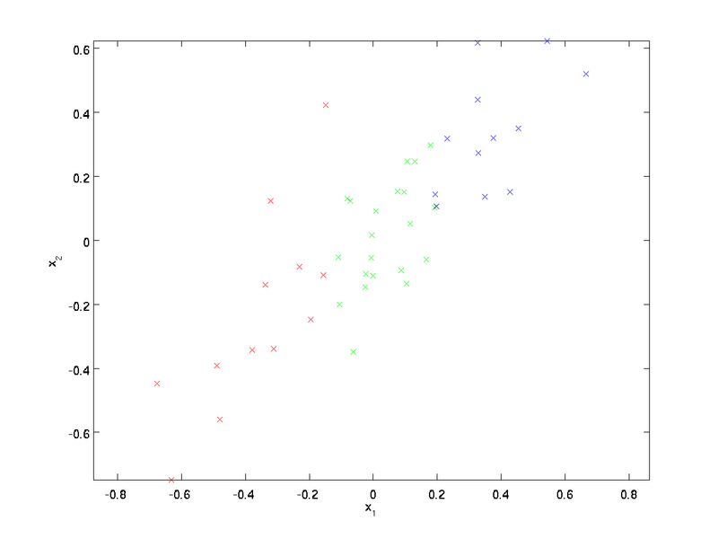
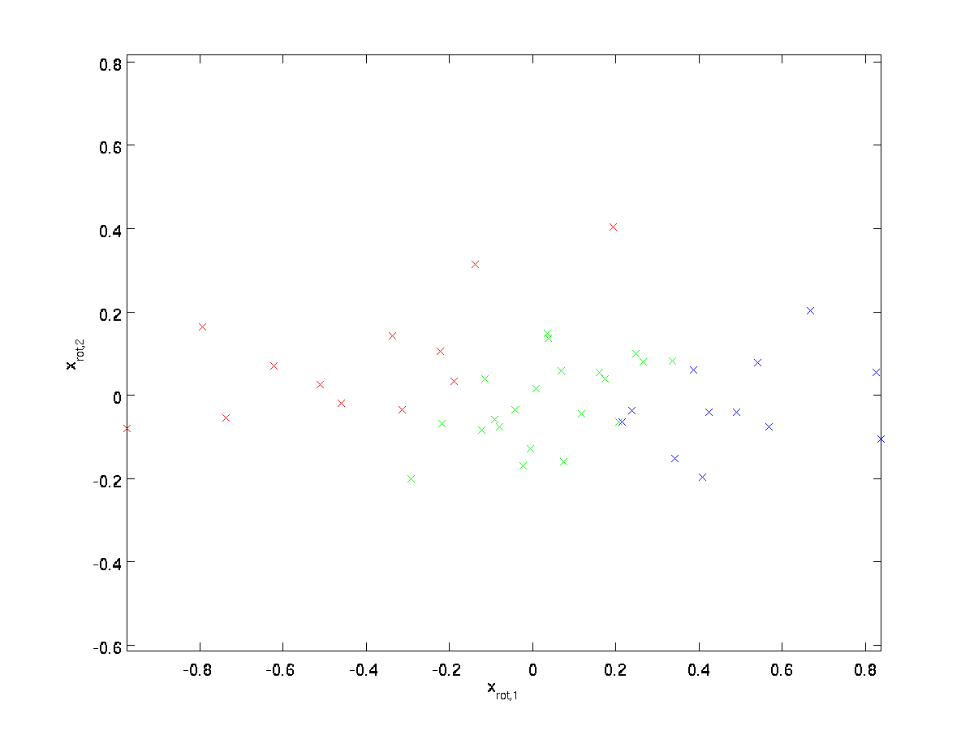
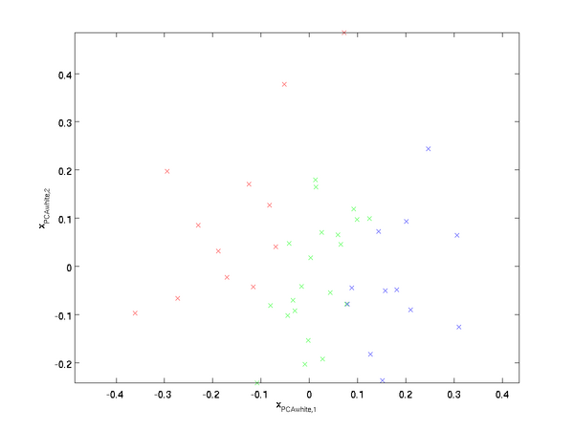
Whitening
AE work best for data with all features equal variance
PCA whitening
Rotate data to principal axes
Take top K eigenvectors
Rescale each feature to have unit variance
Implementation Details

Slide 24
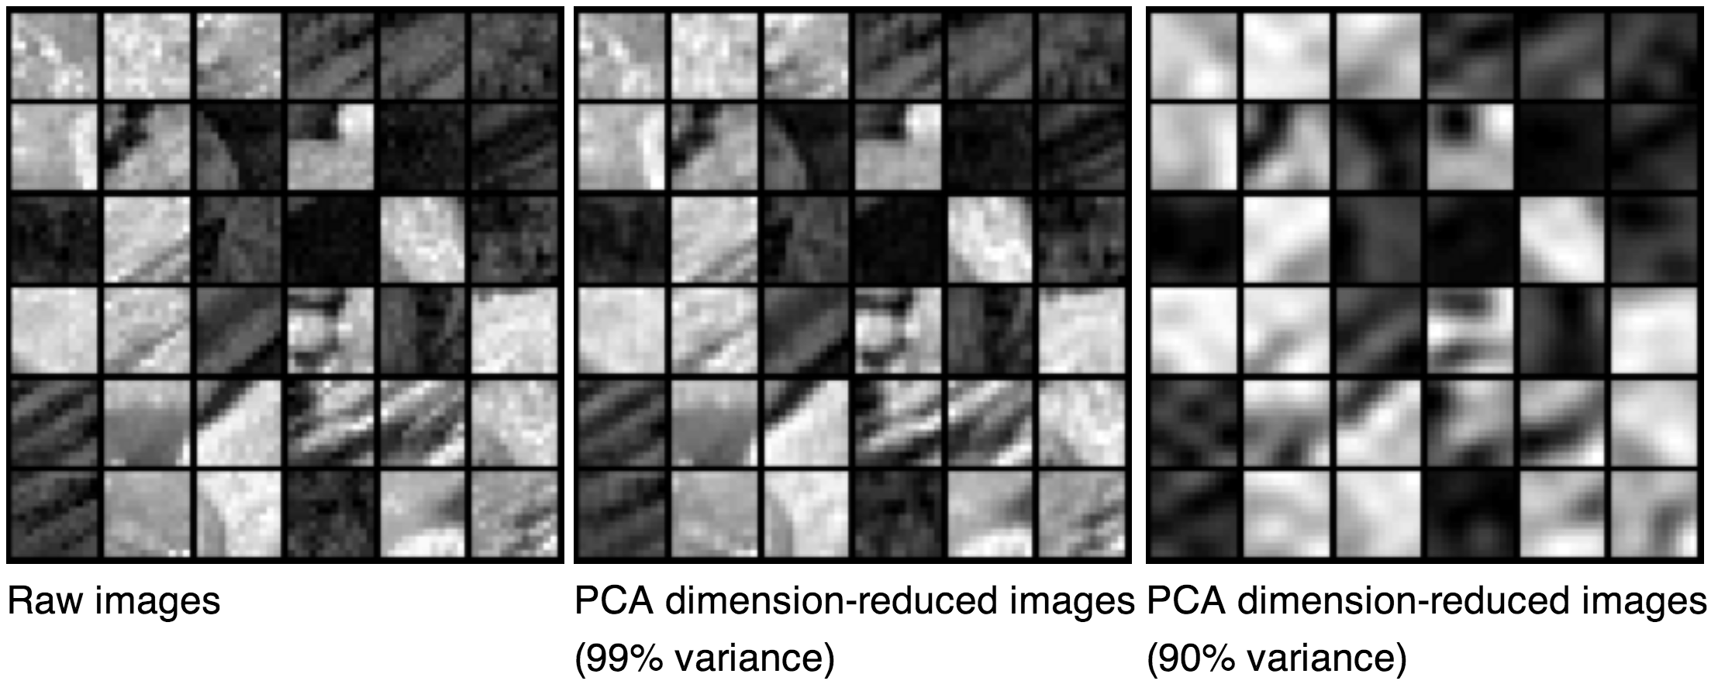
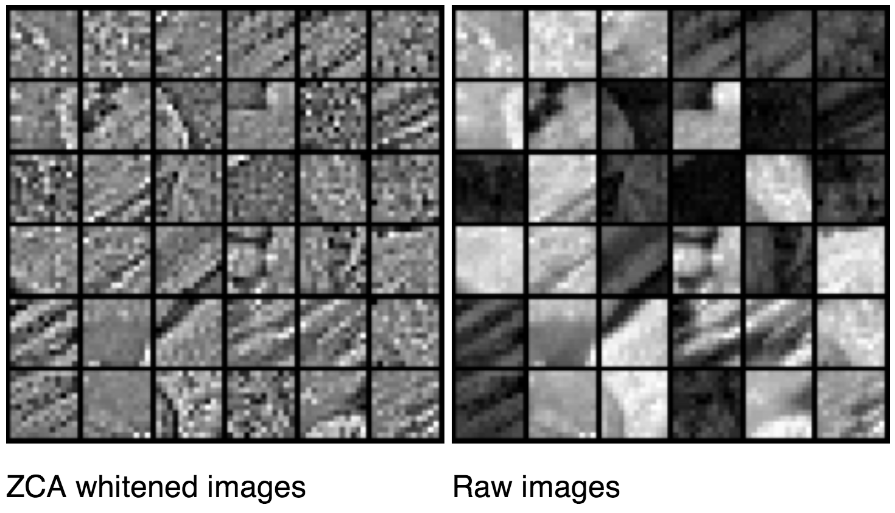

Slide 25
Additional Resources
Unsupervised Feature Learning and Deep Learning Tutorial
http://ufldl.stanford.edu/wiki/
deeplearning.net
deeplearning.net/tutorial/
Thorough introduction to main topics in deep learning

Slide 26
Deep Boltzmann Machines
David Dohan

Slide 27
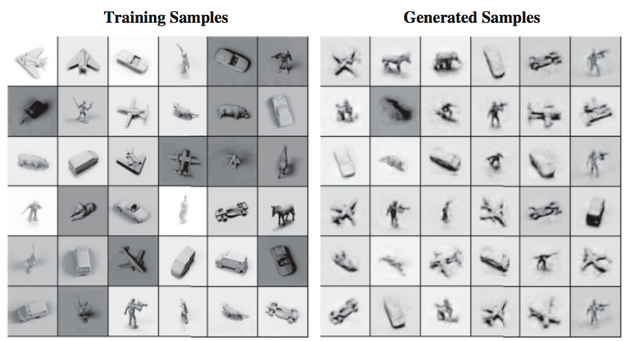
Generative Models
Discriminative models learn p(y | x)
Probability of a label given some input
Generative models instead model p(x)
Sample model to generate new values

Slide 28
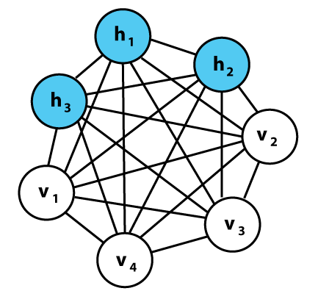
Boltzmann Machines (BM)
Visible and hidden layers
Stochastic binary units
Fully connected
Undirected
Difficult to train

Slide 29
Energy of a Joint Configuration
Visible-Hidden
connections
Visible-Visible
connections
Hidden-Hidden
connections
Visible Bias
Hidden Bias
v_{i}, h_{i} are binary states
Notice that the energy of any connection is local
Only depends on connection strength and state of endpoints

Slide 30
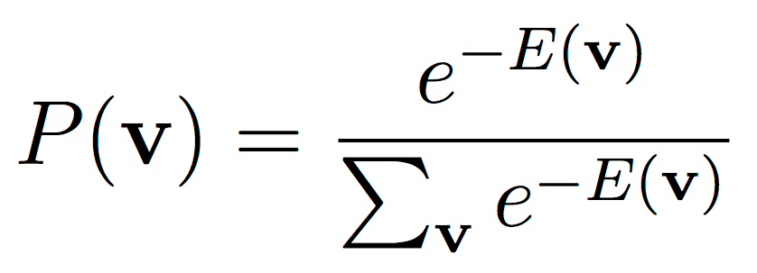
Energy Based Models
Assign an energy to possible configurations
For no connections, map to probability with:
v is a vector representing a configuration
Denominator is normalizing constant Z
Intractable in real systems
Requires summing over 2^{n} states
Low energy → high probability
Notes:
Explain specgram

Slide 31
Energy Based Models
Use hidden units to model more abstract relationships between visible units
With hidden units and connections:
θ is model parameters (e.g. connection weight)
v, h vectors representing a layer configuration
Similar form to Boltzmann distribution, therefore Boltzmann machines
Notes:
Explain specgram

Slide 32
Energy Based Models
This is equivalent to defining the probability of a configuration to be the probability of finding the network in that configuration after many stochastic updates
Notes:
Explain specgram

Slide 33
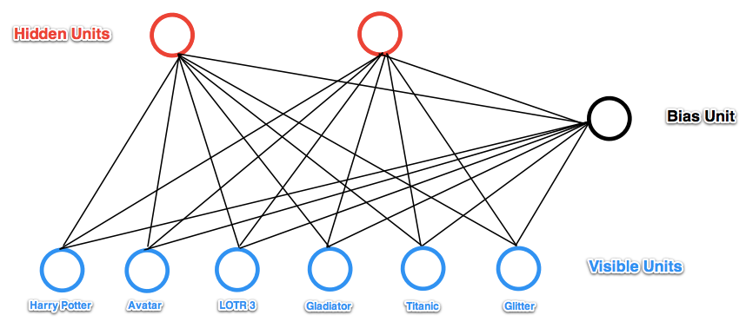
Hidden Variables
Latent factors/explanations for data
Example: movie prediction
+1
Notes:
Explain specgram

Slide 34
Restricted BM (RBM)
Remove visible-visible and hidden-hidden connections
Hidden units conditionally independent given visible units (and vice-versa)
Makes training tractable
+1
Notes:
Add +1 in bias unit (not random variable)

Slide 35
Energy of an RBM
For n visible and m hidden units
W is n x m weight matrix
θ denotes parameters W, b, c
b, v length n row vectors
c, h length m row vectors
Equation represents:
(vis↔hid) + visible bias + hidden bias
Notes:
Replace theta w/ W/b/c

Slide 36
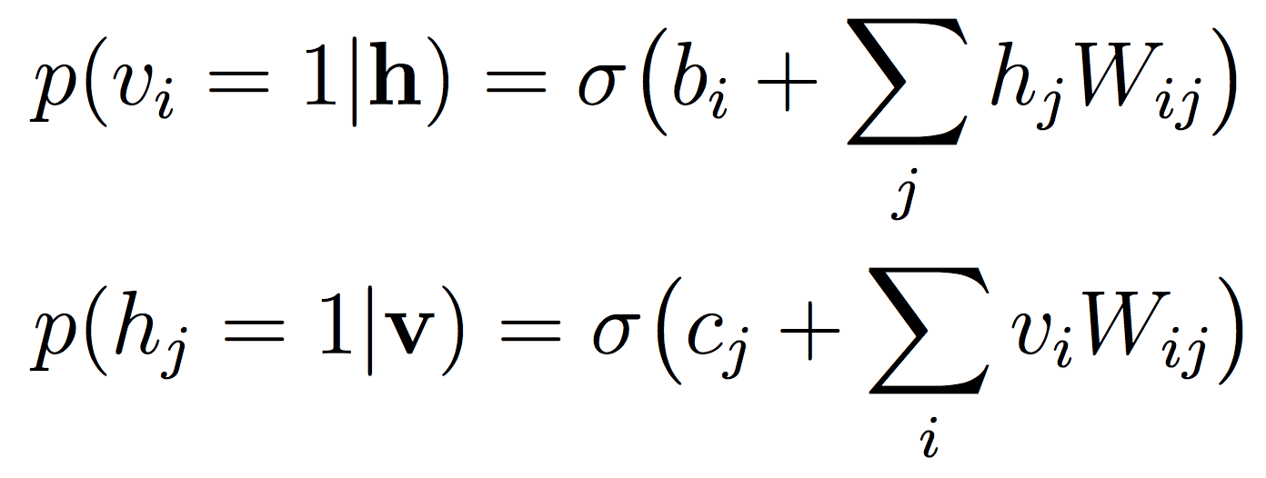
Inference in RBMs
Conditional distribution of visible and hidden units given by
Each layer distribution completely determined given other layer
Given v, is exact
Notes:
V is data (explain)
Different $v$ - make clear which parts actually need the data
Why is <h>_data w.r.t. data if we are using model parameters
Start by explaining simplest (visible → hidden → weights)
(Split into different slides)

Slide 37
RBM Training
Maximizing likelihood of training examples v using SGD
First term is exact
Calculate for every example
Second term must be approximated
Notes:
V is data (explain)
Different $v$ - make clear which parts actually need the data
Why is <h>_data w.r.t. data if we are using model parameters
Start by explaining simplest (visible → hidden → weights)
(Split into different slides)

Slide 38
RBM Training
Consider the gradient of a single example v
First term is exactly
Approximate second term by taking many samples from model and averaging across them
Notes:
V is data (explain)
Different $v$ - make clear which parts actually need the data
Why is <h>_data w.r.t. data if we are using model parameters
Start by explaining simplest (visible → hidden → weights)
(Split into different slides)

Slide 39
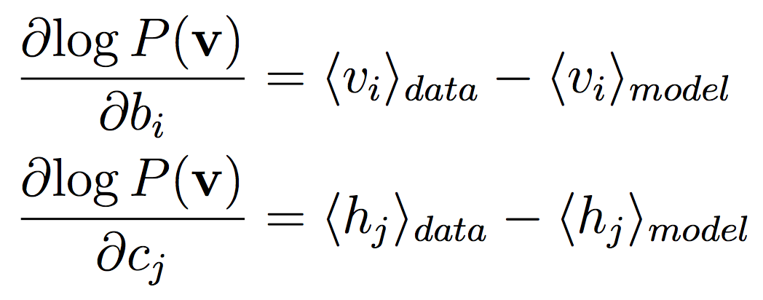
RBM Training
Bias terms are even simpler
Treat as a unit that is always on
Notes:
V is data (explain)
Different $v$ - make clear which parts actually need the data
Why is <h>_data w.r.t. data if we are using model parameters
Start by explaining simplest (visible → hidden → weights)
(Split into different slides)

Slide 40
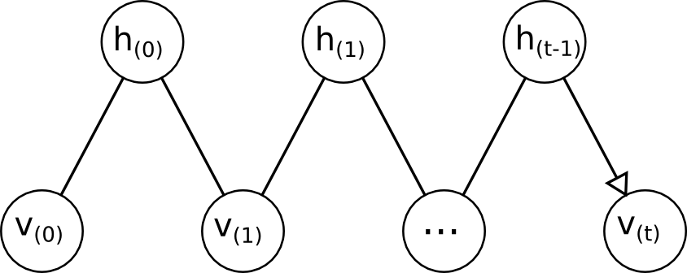
Sampling in an RBM
Approximate model expectation by drawing many samples and averaging
Stochastically update each unit based on input
Initialize randomly

Slide 41
Sampling in an RBM
Update each layer in parallel
Alternate layers
Known as a markov chain or fantasy particle

Slide 42
Contrastive Divergence (CD)
Reaching convergence while sampling may take hundreds of steps
K step contrastive divergence (CD-k)
Use only k sampling steps to approximate the expectations
Initialize chains to training example
Much less computationally expensive
Found to work well in practice
Notes:
Trained to make reconstruction similar to data (for CD learning). Like and AE but strongly regularized by using binary units in hidden layer.

Slide 43
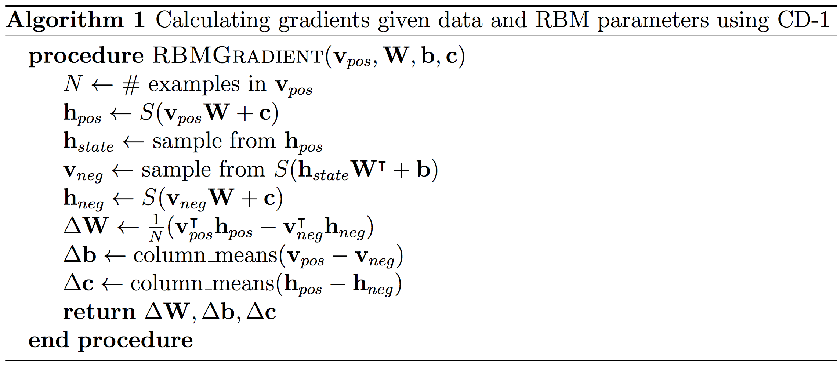
RBM Pseudocode
Notice that h_{pos} is real valued while v_{neg} is binary
Notes:
Explain specgram

Slide 44
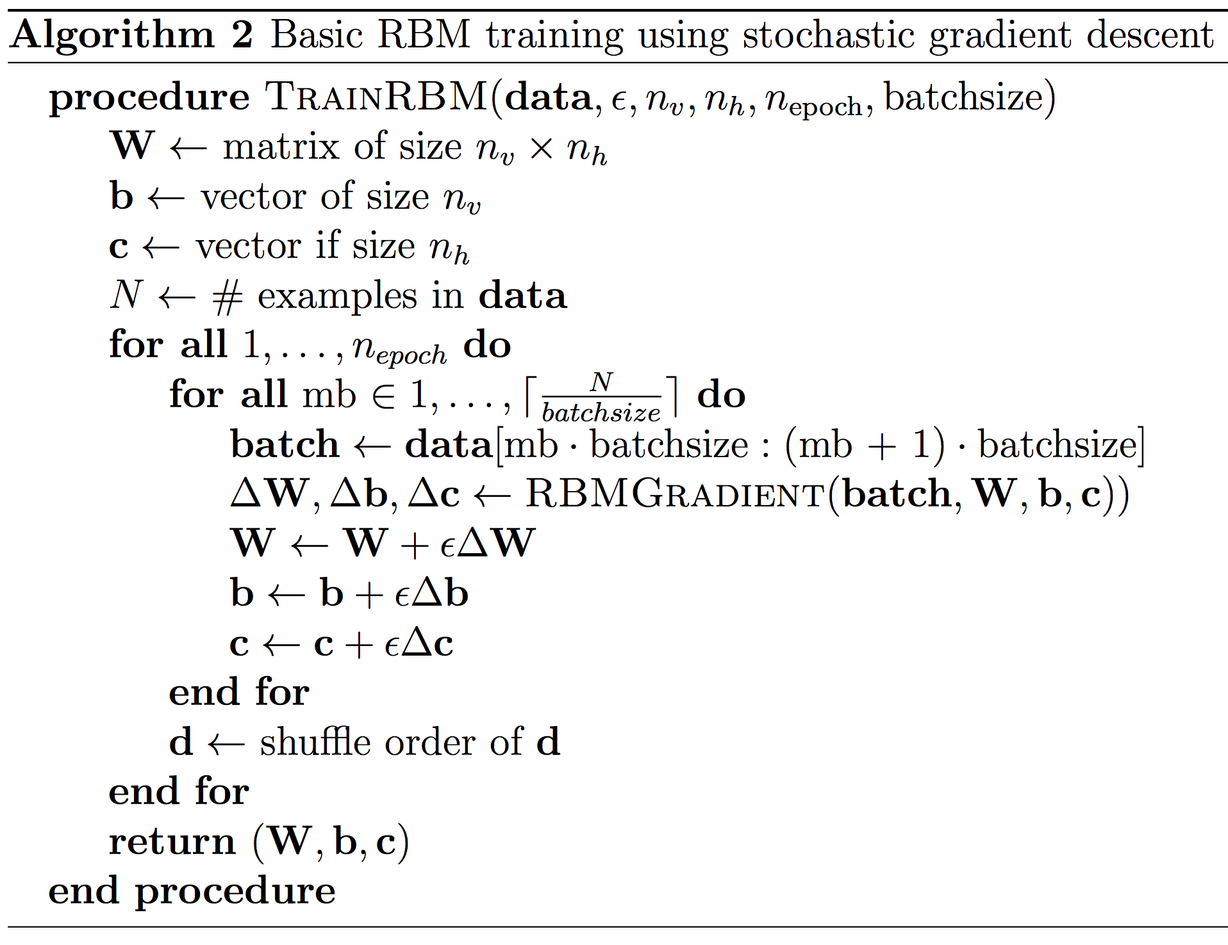
RBM Pseudocode
Notes:
Explain specgram

Slide 45
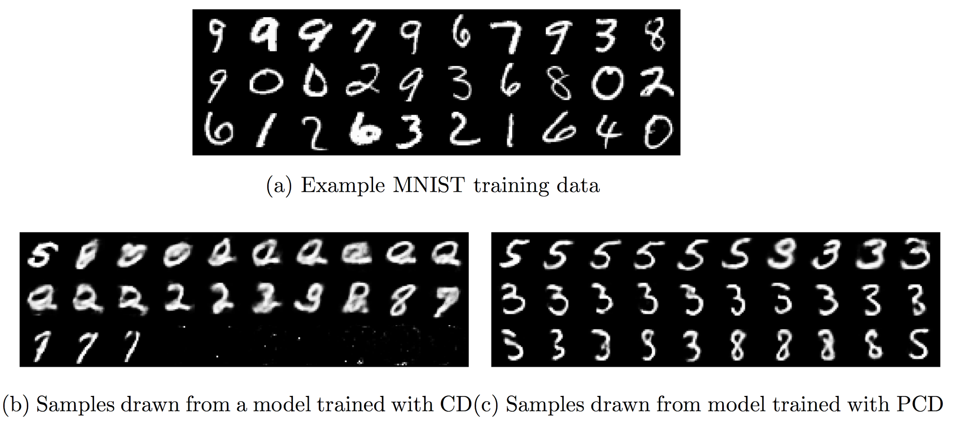
Persistent CD (PCD)
Markov chains persist between updates
Allows chains to explore energy landscape
Much better generative models in practice
Notes:
Explain specgram

Slide 46
Persistent CD (PCD)
In CD, # chains = batch size
Initialized to data in the batch
Any # of chains in PCD
Initialized once, allowed to run
More chains lead to more accurate expectation
Notes:
Explain specgram

Slide 47
KL Divergence
Measure of difference between probability distributions
CD learning minimizes KL divergence between data and model distributions
NOT the log likelihood
Notes:
Explain specgram

Slide 48
Deep Belief Networks (DBNs)
Limitations on what a single layer model can efficiently represent
Want to learn multi-layer models
Create a stack of easy to train RBMs
Notes:
Explain specgram

Slide 49
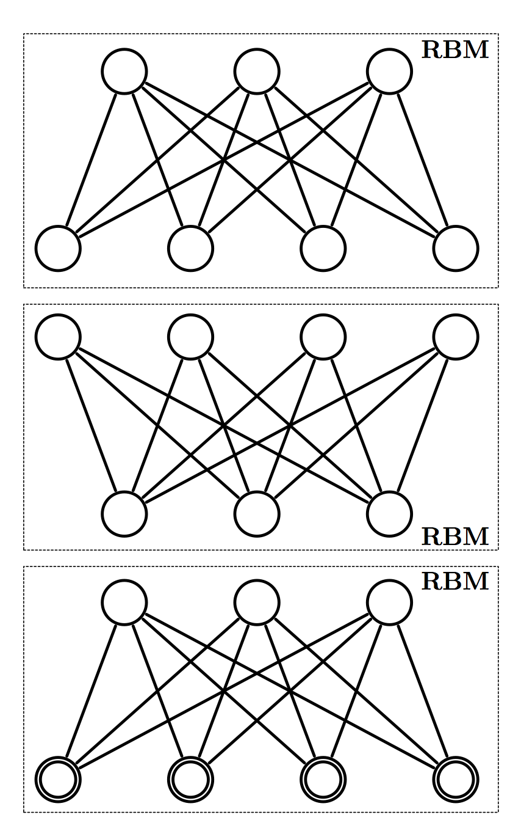
Greedy Layer-wise Pretraining
Greedy layer-by-layer learning:
Learn and freeze W¹
Sample h¹ ~ P(h | v, W¹)
treat h¹ as if it were data
Learn and freeze W²
…
Repeat
Notes:
Explain specgram

Slide 50
Greedy Layer-wise Pretraining
Each extra layer improves lower bound on log probability of data
Additional layers capture higher-order correlations between unit activities in the layer below
Notes:
Explain specgram

Slide 51
Deep Belief Networks (DBNs)
Top two layers from an RBM
Other connections directed
Can generate a sample by sampling back and forth in top two layers before propagating down to visible layers
Notes:
Explain specgram

Slide 52
Greedy Layer-wise Pretraining
Web Demo
Notes:
Explain specgram

Slide 53
Deep Boltzmann Machines
All connections undirected
Bottom-up and top-down input to each layer
Use layer-wise pretraining followed by joint training of all layers
Notes:
Explain specgram

Slide 54
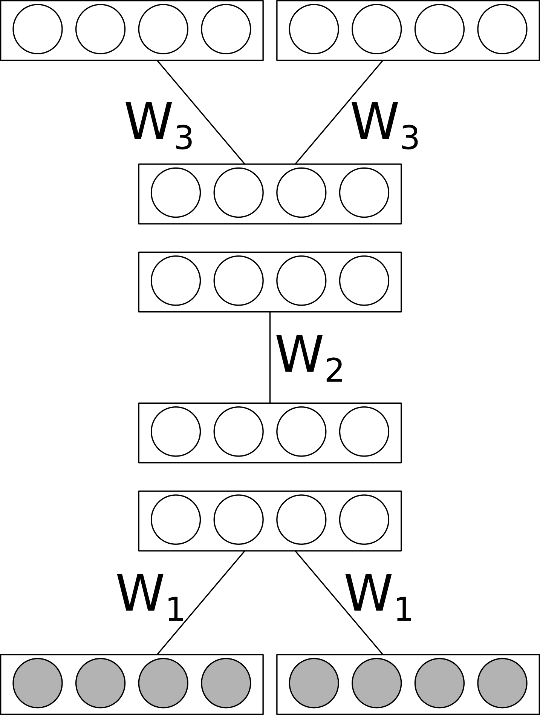
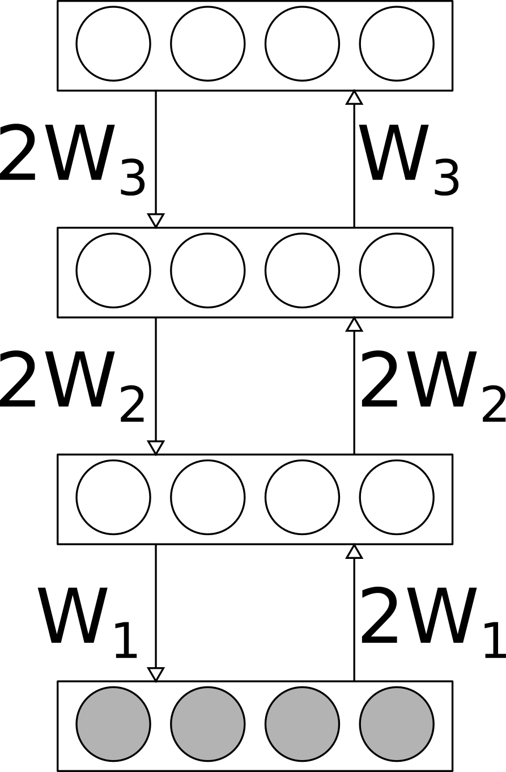
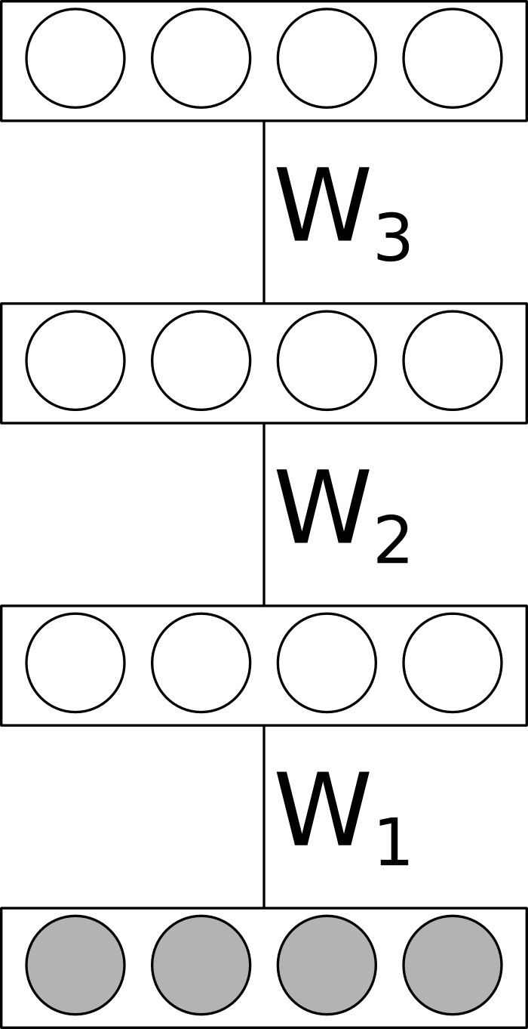
Pretraining DBMs
Layerwise pretraining
Must account for input doubling for each layer
Notes:
Must use CD learning with asymmetric weights

Slide 55
Joint Training of DBMs
Pretraining initializes parameters to favorable settings for joint training
Update equations take same basic form:
Model statistic remains intractable
Approximate with PCD
Data statistic, which was exact in the RBM, must also be approximated
Notes:
Explain specgram

Slide 56
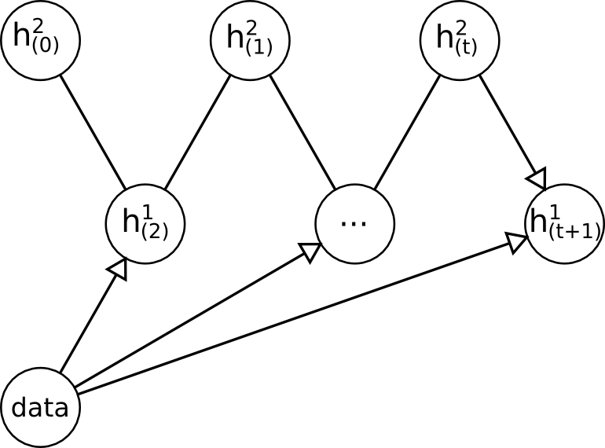
Data Dependent Statistic
No longer exact in DBM
Approximate with mean-field variational inference
Clamp data, sample back and forth in hidden layers
Use expectation instead of binary
state
Notes:
Explain specgram

Slide 57
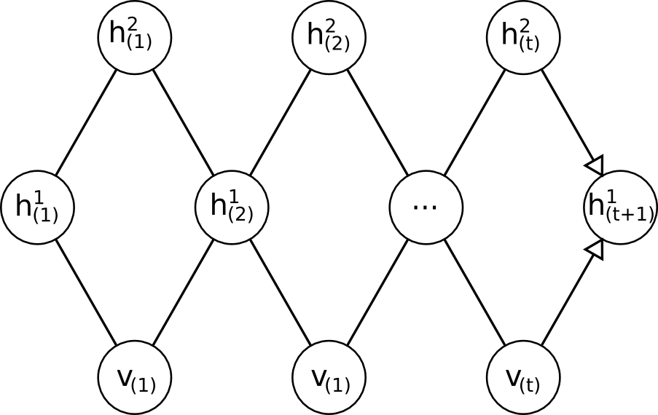
Model Dependent Statistic
Approximate with gibbs sampling as in an RBM
Always use PCD
Alternate sampling even/odd layers
Notes:
Explain specgram

Slide 58
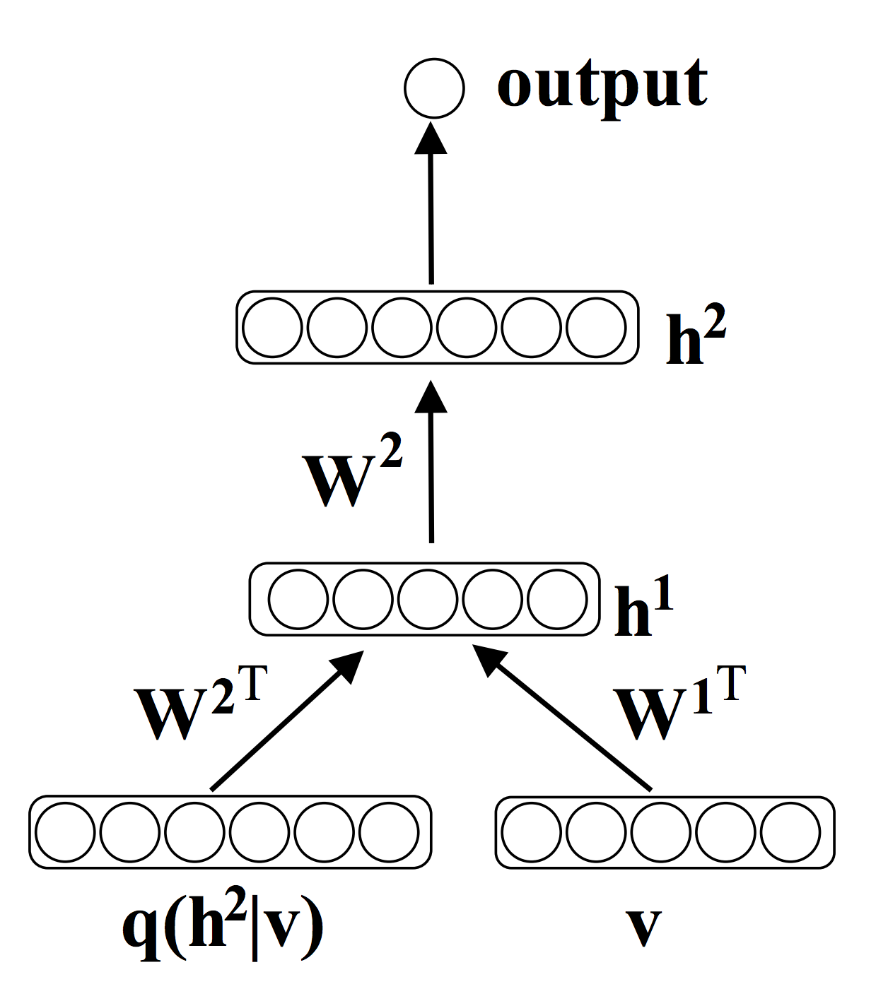
Finetuning for Classification
Can use to initialize MLP for classification
Ideal with lots of unsupervised and little supervised data
Notes:
Explain specgram

Slide 59
Semi-supervised Learning
Makes use of unlabelled data together with some labelled data
Initialize by training a generative model of the data
Slightly adjust for discriminative tasks using the labelled data
Most of the parameters come from generative model
Notes:
Explain specgram

Slide 60
Sparsity
Hidden units that are rarely active may be easier to interpret or better for discriminative tasks
Add a “sparsity penalty” to the objective
Target sparsity: want each unit on in a fraction p of the training data
Actual sparsity
Used to adjust bias and weights for each hidden unit

Slide 61
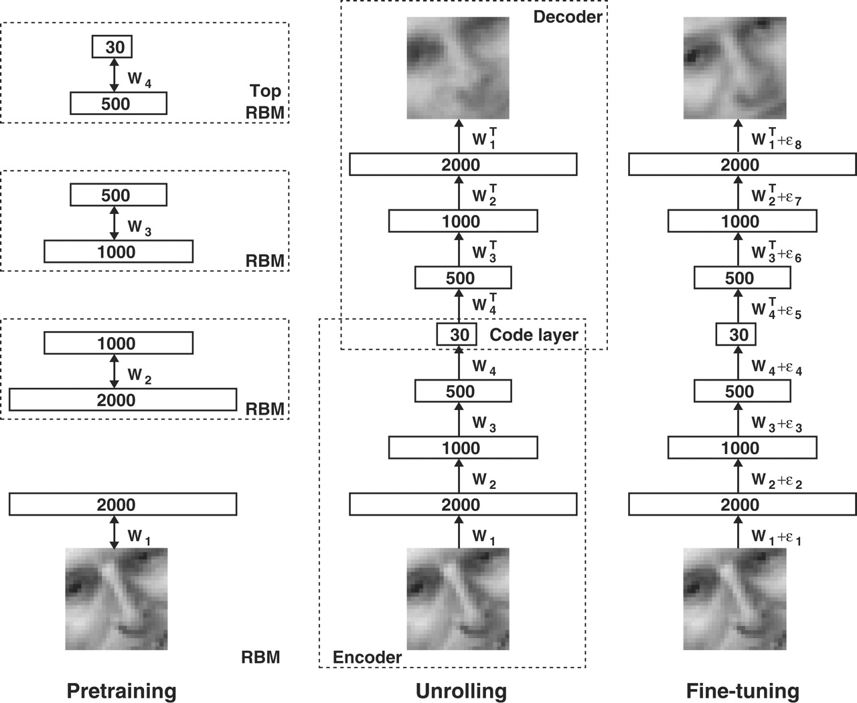
Initializing Autoencoders

Slide 62
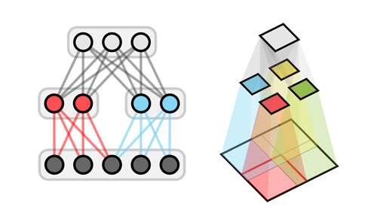
Example: ShapeBM
Weight sharing and sparse connections
Each layer models a different part of the data
Notes:
Explain specgram

Slide 63
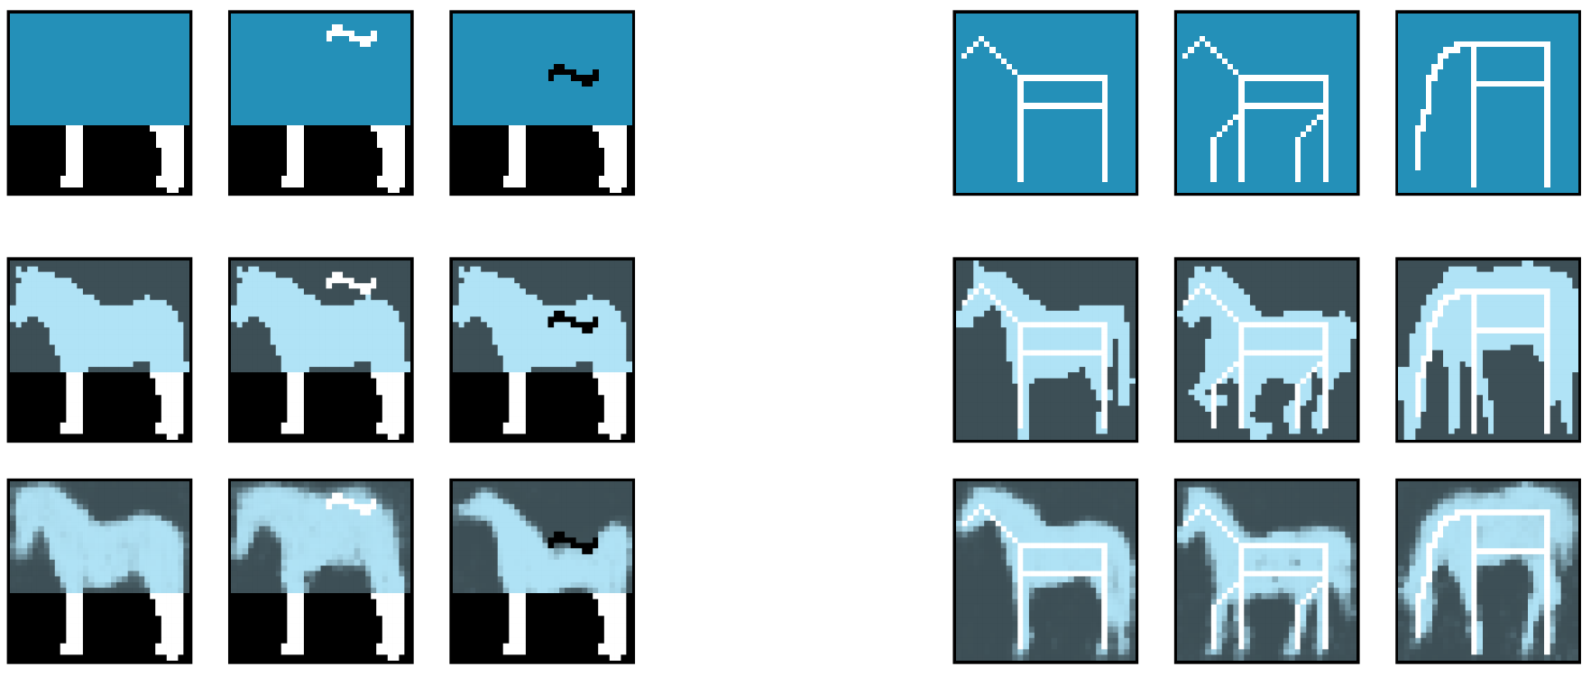
Example: ShapeBM
Used DBM-like structure to learn a shape prior for segmentation
Good showcase of generative completion abilities
Notes:
Explain specgram

Slide 64
Completing unknown data
Repeatedly sample from model
For any visible layer sample, clamp known locations to the known values
Notes:
Explain specgram

Slide 65
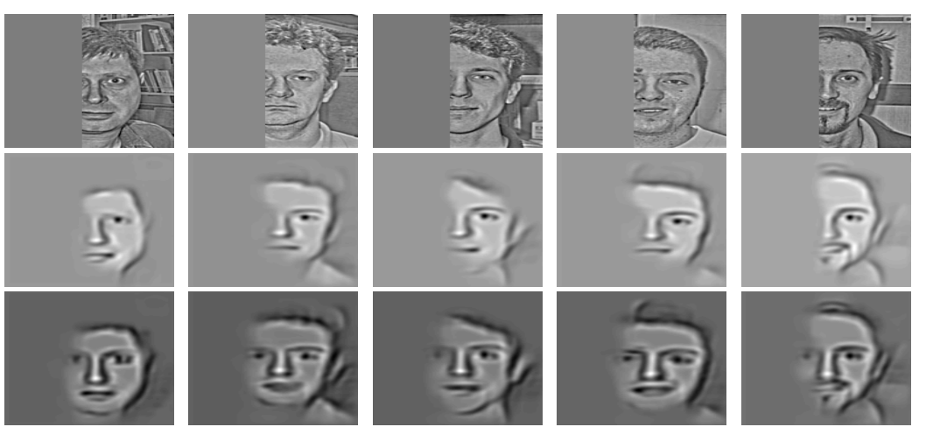
Extensions
Gaussian RBM for image data
Convolutional RBM

Slide 66
Accelerating Training
Most operations are implemented as large matrix multiplications
Use optimized BLAS libraries
Matlab, OpenBLAS, IntelMKL
GPUs can accelerate most operations
CUDA
Matlab Parallel Computing Toolbox
Theano

Slide 67
RBM Example Code
Example Matlab code

Slide 68
Additional Resources
http://goo.gl/UWtRWT
Neural Networks, deep learning, and sparse coding course videos from Hugo Larochelle
A Practical Guide to Training RBMs
http://www.cs.toronto.edu/~hinton/absps/guideTR.pdf

