Slide 1
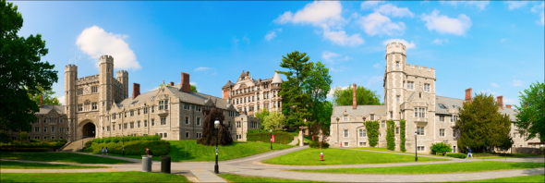
COS 429 PS3: Stitching a Panorama
Due November 10th

Slide 2
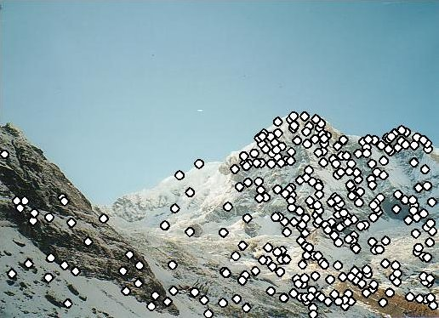
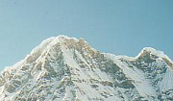
Matching Image Features
Feature Detection: Identify image features
Feature Description: Extract feature descriptor for each feature
Feature Matching: Find candidate matches between features
Feature Correspondence: Find consistent set of (inlier) correspondences between features
Kristen Grauman

Slide 3
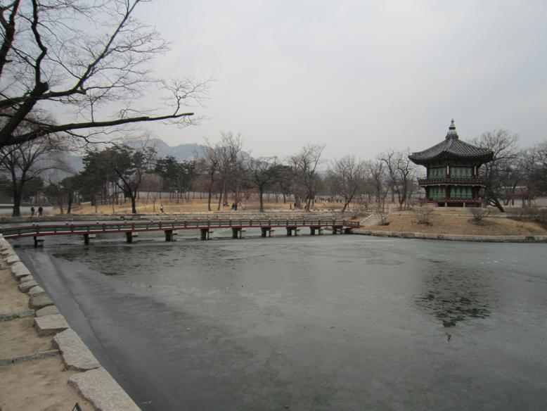
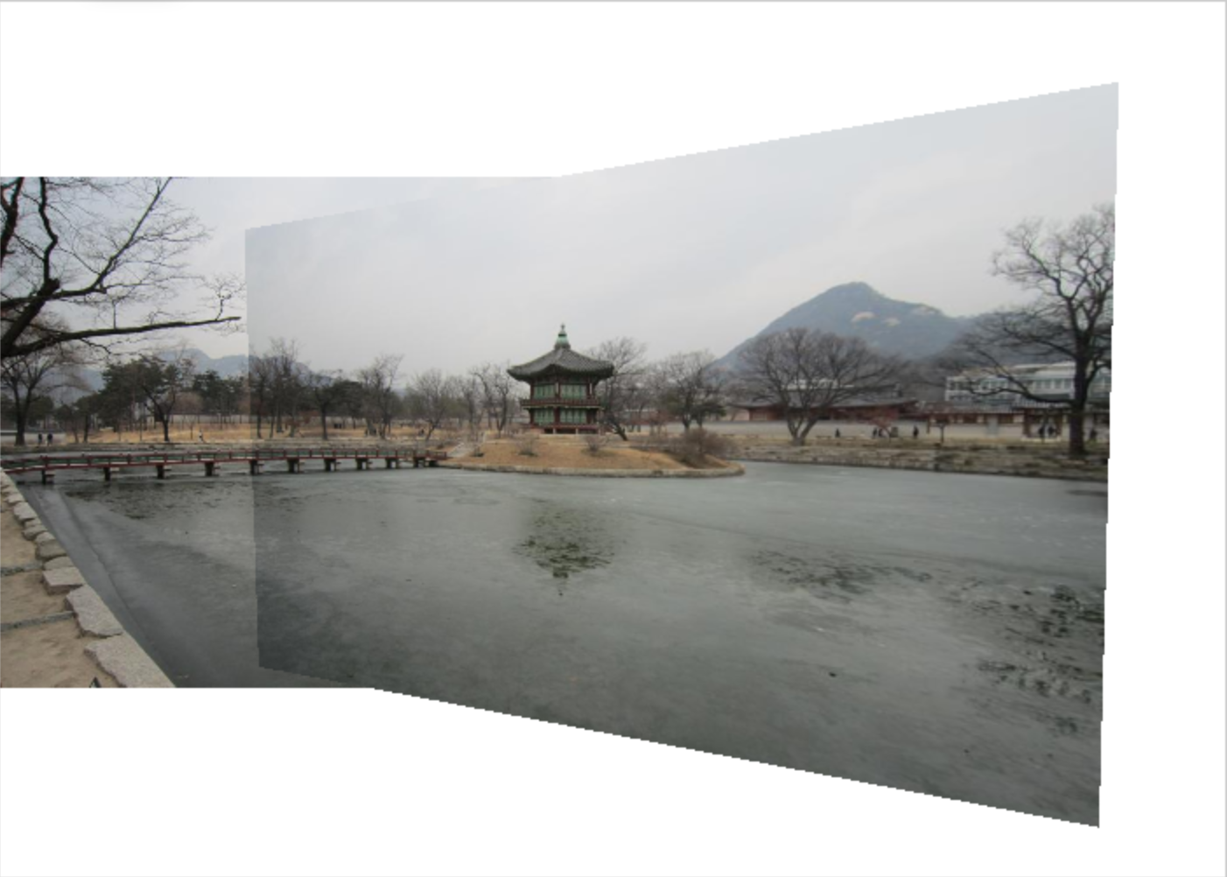
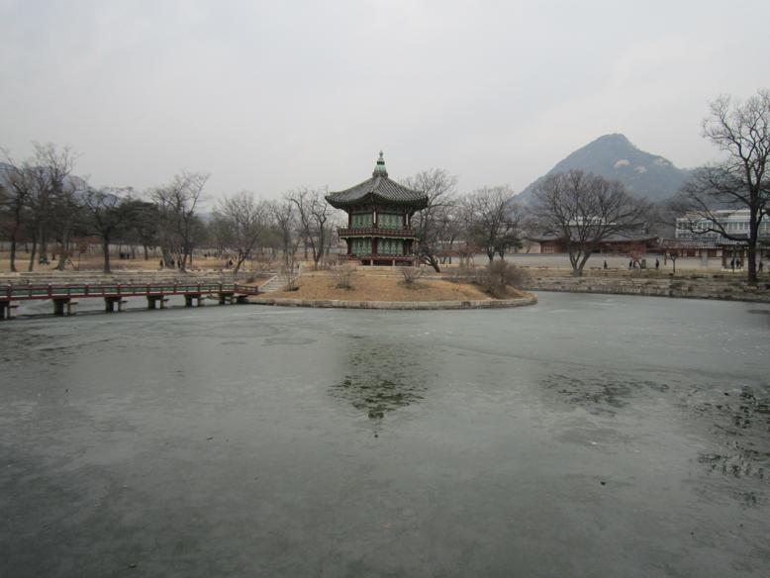
Assignment Overview

Slide 4
Problem 1: Preprocessing
Most feature descriptors only work with grayscale images
RGB image: 584 x 778 x 3
Grayscale image: 584 x 778
Convert color images to grayscale
Notes:
Color and saturation information removed

Slide 5
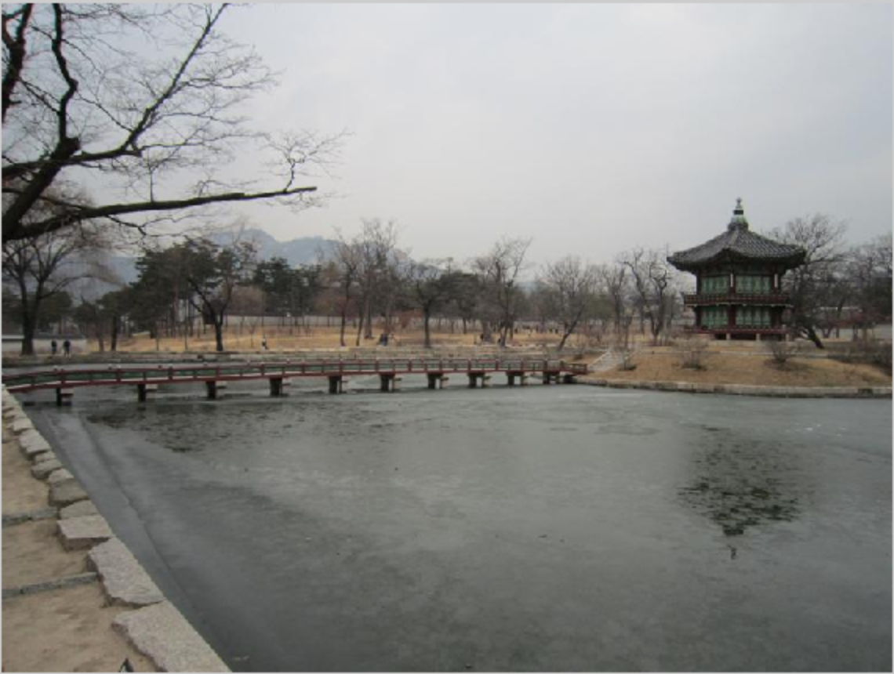
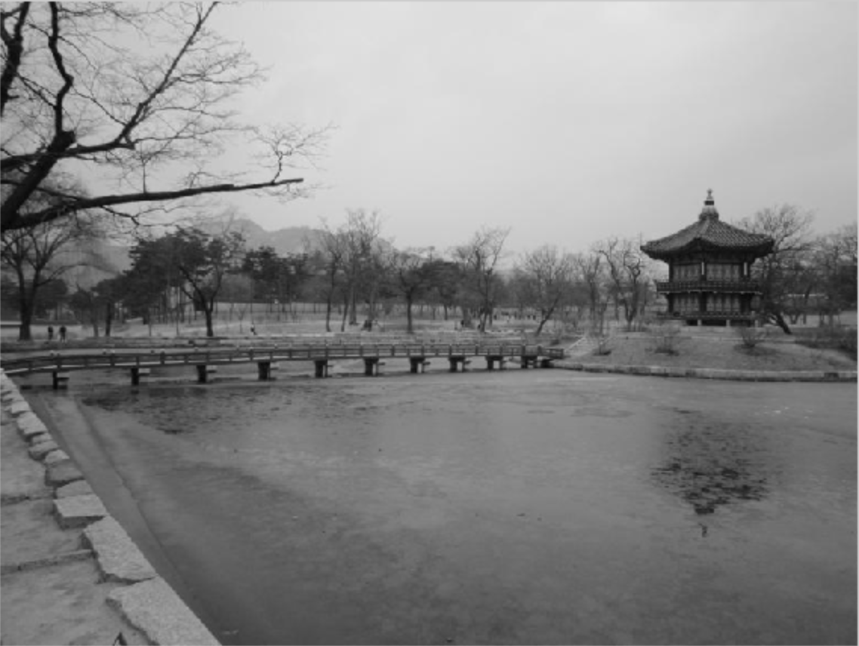
Problem 1: Preprocessing
To do:
Copy the lines of code you wrote in the report

Slide 6
Problem 2: Detecting Keypoints
Identify features in an image
Detector: SURF (Speed Up Robust Features)
Independently detect keypoints in both images
To do: Copy the lines of code you wrote in the report
Notes:
The SURF algorithm is based on the same principles and steps as SIFT but details in each step are different. The algorithm has three main parts: interest point detection, local neighborhood description and matching.

Slide 7
Problem 3: Extracting Descriptors
Extract feature descriptors for each keypoint
Derived from pixels surrounding an interesting point.
For keypoints in each image, generate feature descriptors
Notes:
% 'BRISK' Binary Robust Invariant Scalable Keypoints (BRISK)% 'FREAK' Fast Retina Keypoint (FREAK)% 'SURF' Speeded-Up Robust Features (SURF)% 'Block' Simple square neighborhood% 'Auto' Selects the extraction method based on the class of% input points. See the table above.%% Default: 'Auto'

Slide 8
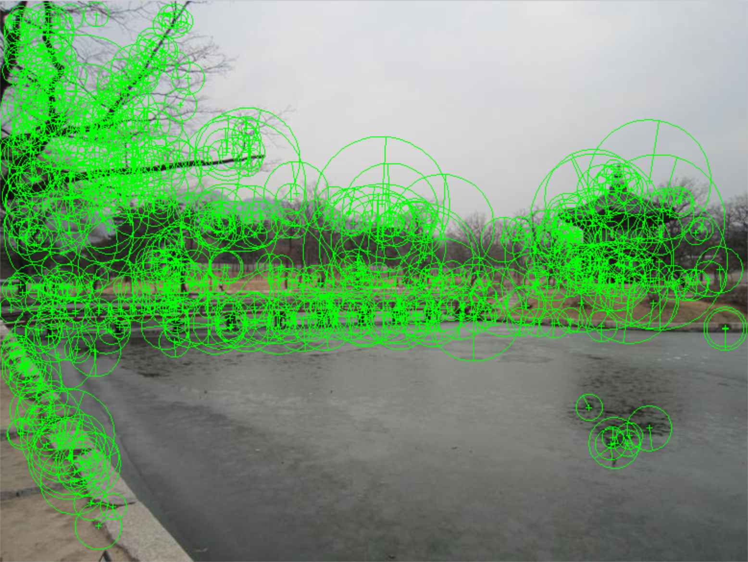
Problem 3: Extracting Descriptors
To do:
Copy the lines of code you wrote in the report

Slide 9
Problem 4: Matching Features
Find pairs of features in the two images that match
Possible strategies include Match Threshold, Nearest Neighbor Symmetric, and Nearest Neighbor Ratio
Find pairs of indices in feature list of image 1 and feature list of image 2 that match
Notes:
'Threshold': Only uses the match threshold. This method can return more than one match for each feature.
'NearestNeighborSymmetric': Only returns unique matches in addition to using the match threshold. A feature vector only matches to its nearest neighbor in the other feature set.
'NearestNeighborRatio': Eliminates ambiguous matches in addition to using the match threshold. A feature vector is matched to its nearest neighbor in the other feature set, when the nearest neighbor satisfies a ratio test. The ratio test compares the distances from the feature vector to its first and second nearest neighbors in the other feature set.

Slide 10
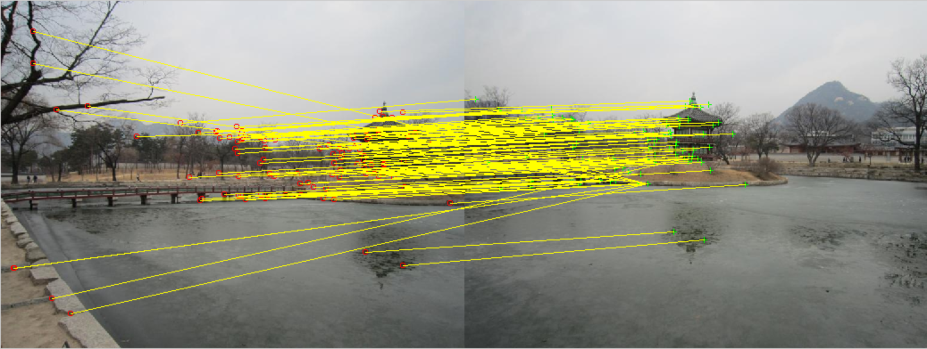
Problem 4: Matching Features

Slide 11
Problem 5: RANSAC to Estimate Homography
Exclude outlier matches
Compute a homography to map one image plane to the other
RANSAC (Random Sample Consensus)
Find inliers points and compute a transformation from image 2 to image 1
Returns the transformation from inlier_points2 to inlier_points1
Transform_type?
Similarity, Affine, Projective

Slide 12
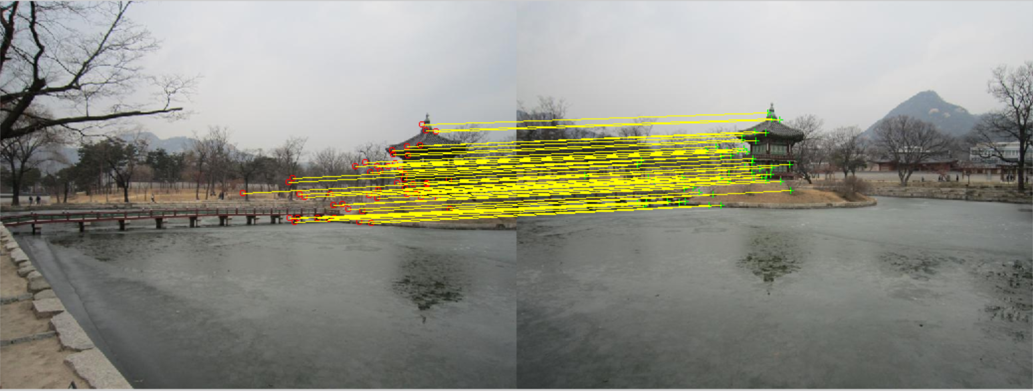
Problem 5: RANSAC to Estimate Homography

Slide 13
Problem 6: Stitching Panorama
Warp the two images to make a panorama
Code provided to warp the first image
To do:
Write similar code to warp and paste the second image to produce a final panoramic image
Add the resulting panorama to your report; copy the lines of code you wrote in the report

Slide 14
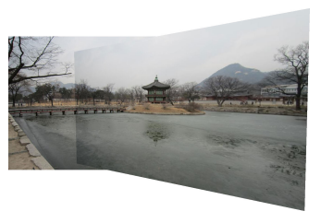
Problem 6: Stitching Panorama

Slide 15
Problem 7: Take Your Own Pictures for Princeton Campus
Task:
Take two pictures of Princeton’s campus, run the code to stitch them together
Include the original two photos and the final panorama in your report

Slide 16
What to Submit:
One PDF file report
One ZIP file containing all the source code, and a “ps3.m” file that takes no parameters as input and runs directly in MATLAB to generate the results in the pdf report

