Slide 1
Object Detection
COS429 Computer Vision

Slide 2
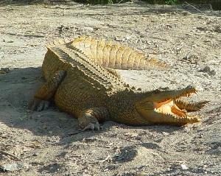
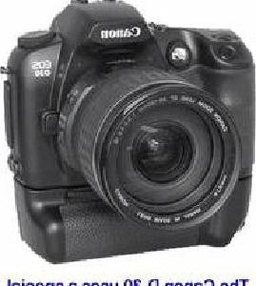
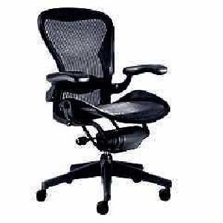
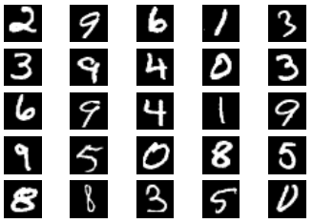
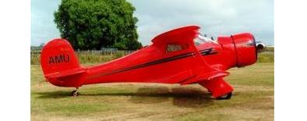
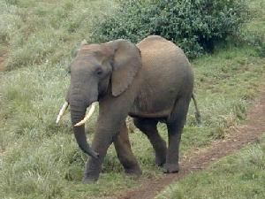
Image classification (mostly what you’ve seen)
$K$ classes
Task: Assign the correct class label to the whole image
Digit classification (MNIST)
Object recognition (Caltech-101, ImageNet, etc.)
Slides from Ross B. Girshick

Slide 3
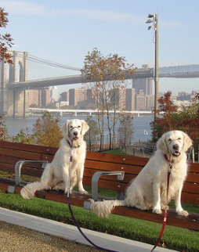
Classification vs. Detection
Dog
Bridge
Bridge
Dog
Dog
Easyish, these days
Still quite a lot harder
Slides from Ross B. Girshick

Slide 4
Problem formulation
The Visual World $≈K \text{object} \text{classes}$
{airplane, bird, motorbike, person, sofa, bg}
Person 0.7
YODA:
Yet another
Object
Detection
Algorithm
Motorbike 0.9
Input
Desired output
*Actual results may vary
Slides from Ross B. Girshick

Slide 5
PASCAL VOC object detection
After
Before the successful application of ConvNets
< 2 years
1.8x mAP
~5 years
Precision: higher is better
Slides from Ross B. Girshick

Slide 6
Sliding Window Object Detector
Build classifier that differentiate object patch from background patch.
…
Object or
Non-Object?

Slide 7
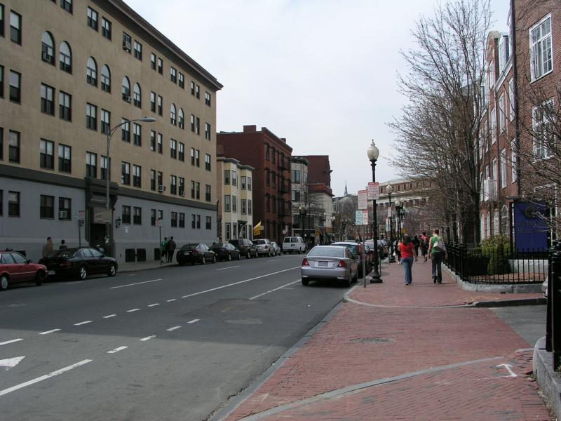
Sliding Window
Test patch at each location and scale

Slide 8
Sliding Window
Test patch at each location and scale
Note – Template did not change size

Slide 9
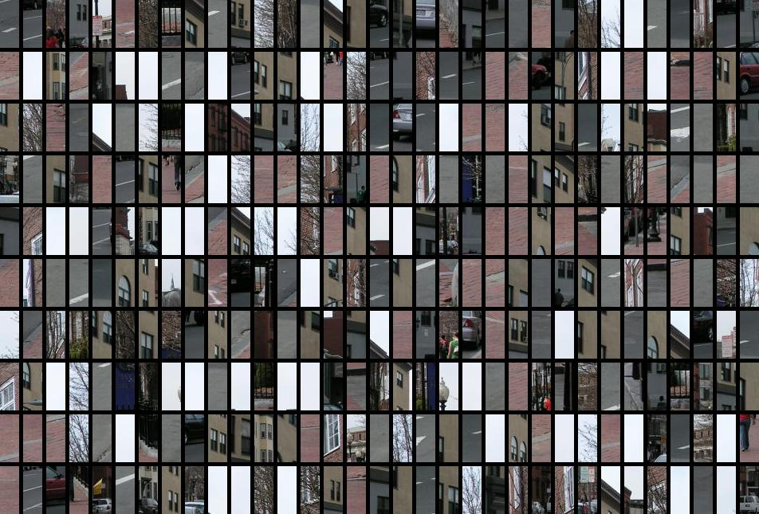
Each window is separately classified

Slide 10
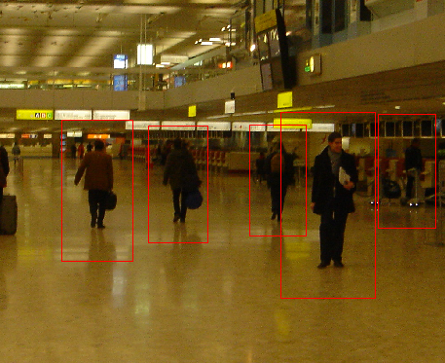
Non Maximum Suppression
Final Boxes
non-maximum suppression

Slide 11
Non Maximum Suppression
Score = 0.8
Score = 0.8
Score = 0.1

Slide 12
Non Maximum Suppression
Score = 0.8
Score = 0.8
Score = 0.1
Score = 0.1
“Overlap” score is below some threshold

Slide 13
Intersection Over Union
Truth
Prediction
=
/
Intersection
Over
Union

Slide 14
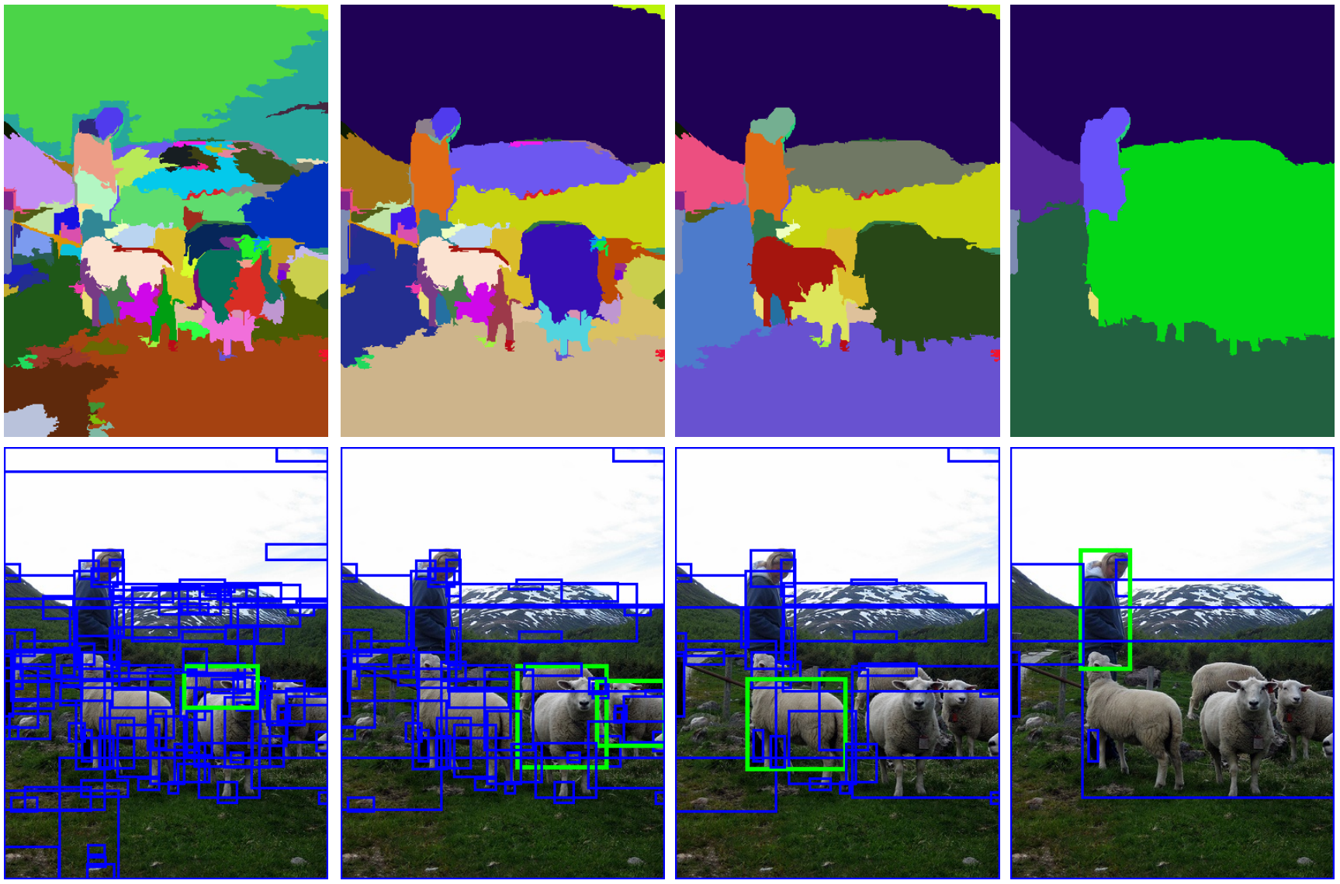
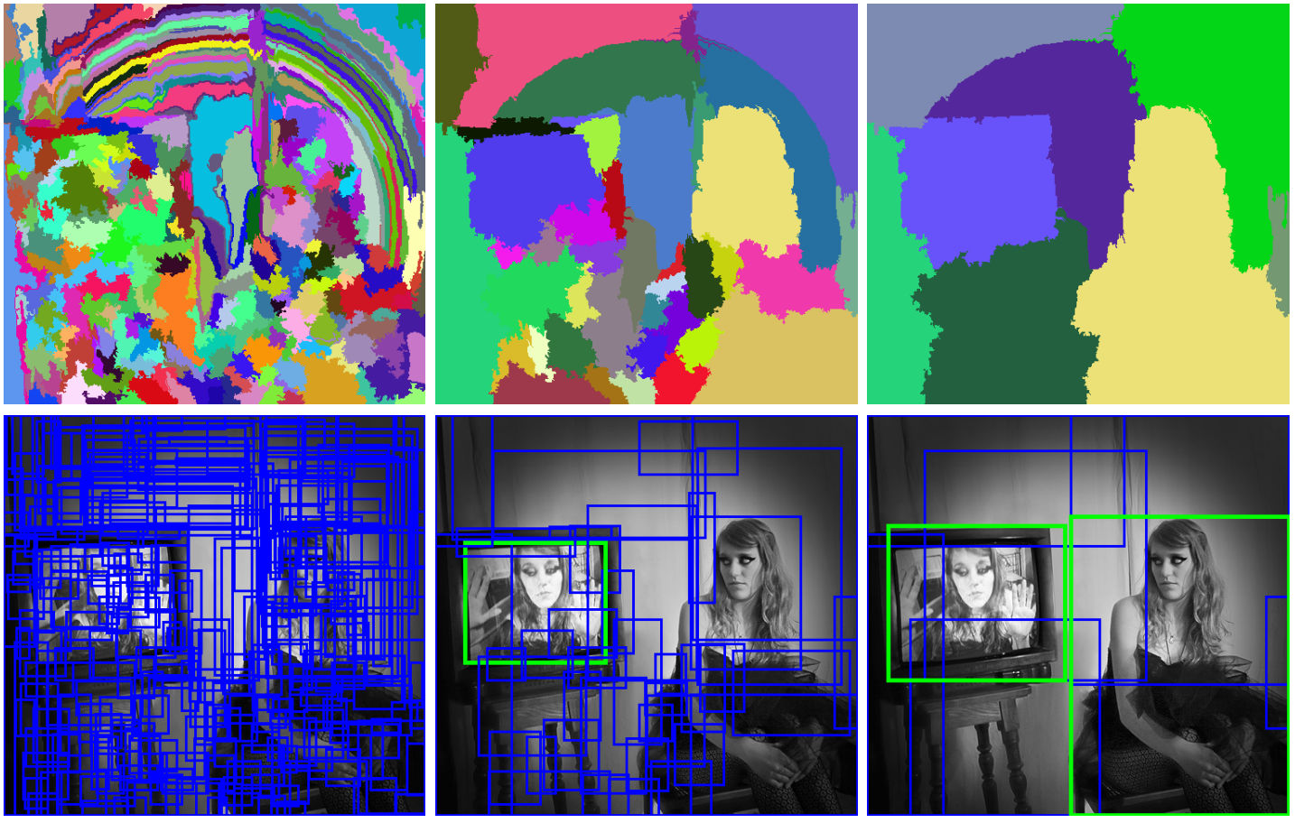
Region Proposal Generation
Uijlings, Jasper RR, et al. Selective search for object recognition. IJCV 2013

Slide 15
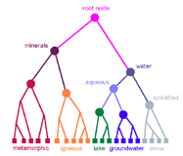
Region Proposal Generation

Slide 16
Region-based Convolution Networks (R-CNNs)
Input
image
Extract region
proposals (~2k / image)
e.g., selective search
[van de Sande, Uijlings et al.]
Compute CNN
features on
regions
Classify and refine
regions
[Girshick et al. CVPR’14]
Slides from Ross B. Girshick

Slide 17
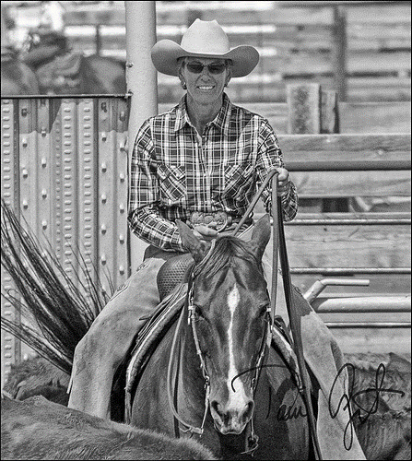
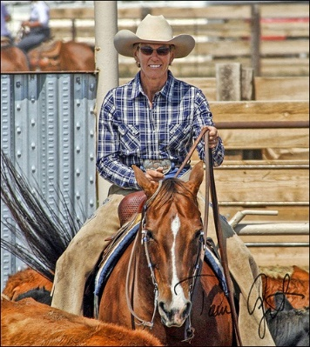
Fast R-CNN (Region-based Convolutional Networks)
Object box proposals (N)
e.g., selective search
A Fast R-CNN network
(VGG_CNN_M_1024)
Two output types:
1. NK regressed object
boxes
Minimal post-processing:
- Non-maximum suppression (NMS)
Object proposals comes from:
- Selective Search (2s / image) [van de Sande/Uijlings et al.]
- EdgeBoxes (0.2s / image) [Zitnick & Dollar]
- MCG (30s / image) [Arbelaez et al.]
- Etc.
2. $P\left(cls=k \right| box=n,$
$image)$
for each NK boxes
Image
Slides from Ross B. Girshick

Slide 18
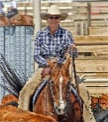
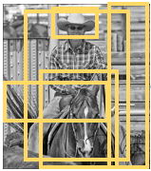
Zooming into the net
image comes in here, blob size = S x 3 x H x W (e.g., S = 1 or 5, H = 600, W = 1000)
(a bunch of conv layers
and whatnot)
2000 image regions come
in here, blob size = 2000 x 5
2000 x (4 * 21)
Pool5 blob size = 2000 x 512 x 6 x 6
2000 x 21
conv5 feature map blob size = S x 512 x H/16 x W/16
Slides from Ross B. Girshick

Slide 19
Zooming into the net
image comes in here, blob size = S x 3 x H x W (e.g., S = 1 or 5, H = 600, W = 1000)
RoI Pooling Layer:
- adaptive max pooling layer
- dynamically expands batch from S to R (e.g., 2000)
2000 image regions come
in here, blob size = 2000 x 5
2000 x (4 * 21)
Pool5 blob size = 2000 x 512 x 6 x 6
2000 x 21
conv5 feature map blob size = S x 512 x H/16 x W/16
Slides from Ross B. Girshick

Slide 20
Another view of the same thing
Outputs:
bbox
regressor
Deep
ConvNet
softmax
RoI
pooling
layer
FC
FC
FCs
RoI
projection
conv5
feature map
RoI feature
vector
For each RoI
These (top and bottom images) are the same
Slides from Ross B. Girshick

Slide 21
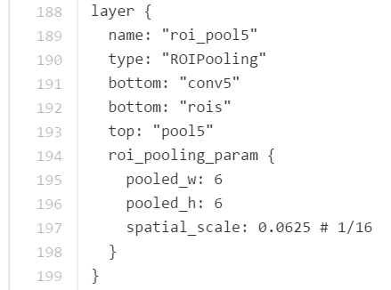
RoI Pooling Layer
Two inputs (“ins”)
Conv feature map: S x 512 x H x W
Regions of Interest: R x 5
5 comes from [r, x1, y1, x2, y2], where r in [0, R – 1] specifies an image batch index
Slides from Ross B. Girshick

Slide 22
The train-time net Single fine-tuning operation all in Caffe
Even more boxes and arrows
Let’s look at them
Slides from Ross B. Girshick

Slide 23
The train-time net (inputs)
Class labels: 128 x 21
B full images: B x 3 x H x W (e.g., B = 2, H = 600, W = 1000)
Bounding-box
regression targets: 128 x 84
RoIs: 128 x 5
(75% background)
Bounding-box
regression loss weights: 128 x 84
Zoomed area
Slides from Ross B. Girshick

Slide 24
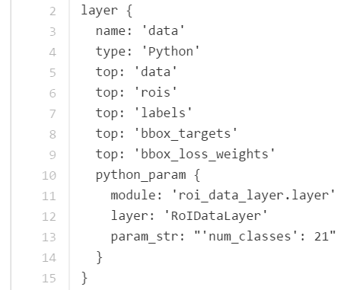
The train-time net (exotic data layers)
Custom data layer
Samples 2 images
From each sampled image, takes 64 RoIs
Input batch is initially 2 elements
Gets expanded by the RoI Pooling Layer to 128 elements
Outputs 5 “tops”
data [images]
rois [regions of interest]
labels [class labels for the rois]
bbox_targets [box regression targets]
bbox_loss_weights […details…]
Slides from Ross B. Girshick

Slide 25
The train-time net (multi-task losses)
Classification loss
(Cross-entropy)
+
Bounding-box regression loss
(“Smooth L1”)
Zoomed area
Slides from Ross B. Girshick

Slide 26
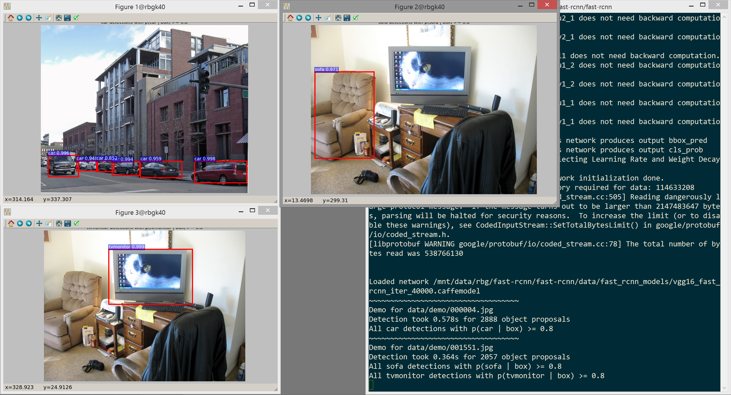
Slides from Ross B. Girshick

Slide 27
Faster R-CNN: Shaoqing Ren, Kaiming He, Ross Girshick, Jian Sun. Microsoft Research
The detection network also proposes objects
Marginal cost of proposals: 10ms
VGG16 runtime ~200ms including all steps
Higher mAP, faster
Region Proposal
Network shares
conv layers with
Fast R-CNN object
detection network
Slides from Ross B. Girshick

Slide 28
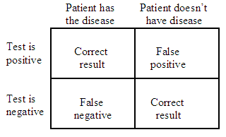
Evaluation: Precision & Recall
Truth
Object
No Object
Algorithm
Prediction
Object
True Positive
False Positive
No Object
False Negative
True Negative
Precision = TP / (TP + FP)
Recall = TP / (TP + FN)
Truth
Prediction
=
/
Intersection
Over
Union

Slide 29
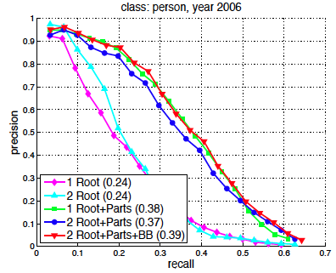
Evaluation: Precision & Recall

Slide 30
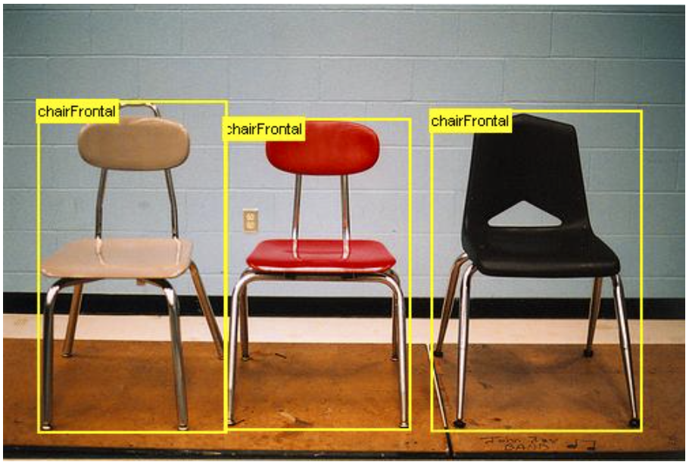
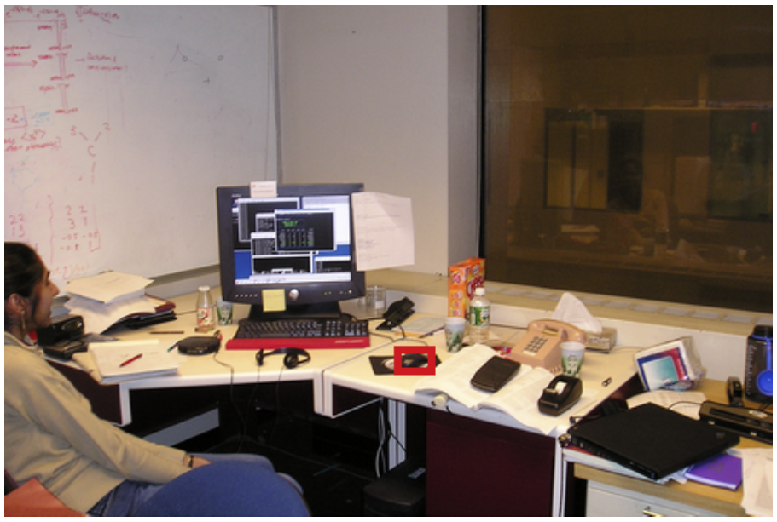
Data Bias?
PASCAL VOC
Grad Student Office

Slide 31
Context

Slide 32
