Slide 1
COS 429 PS5: Finding Nemo

Slide 2
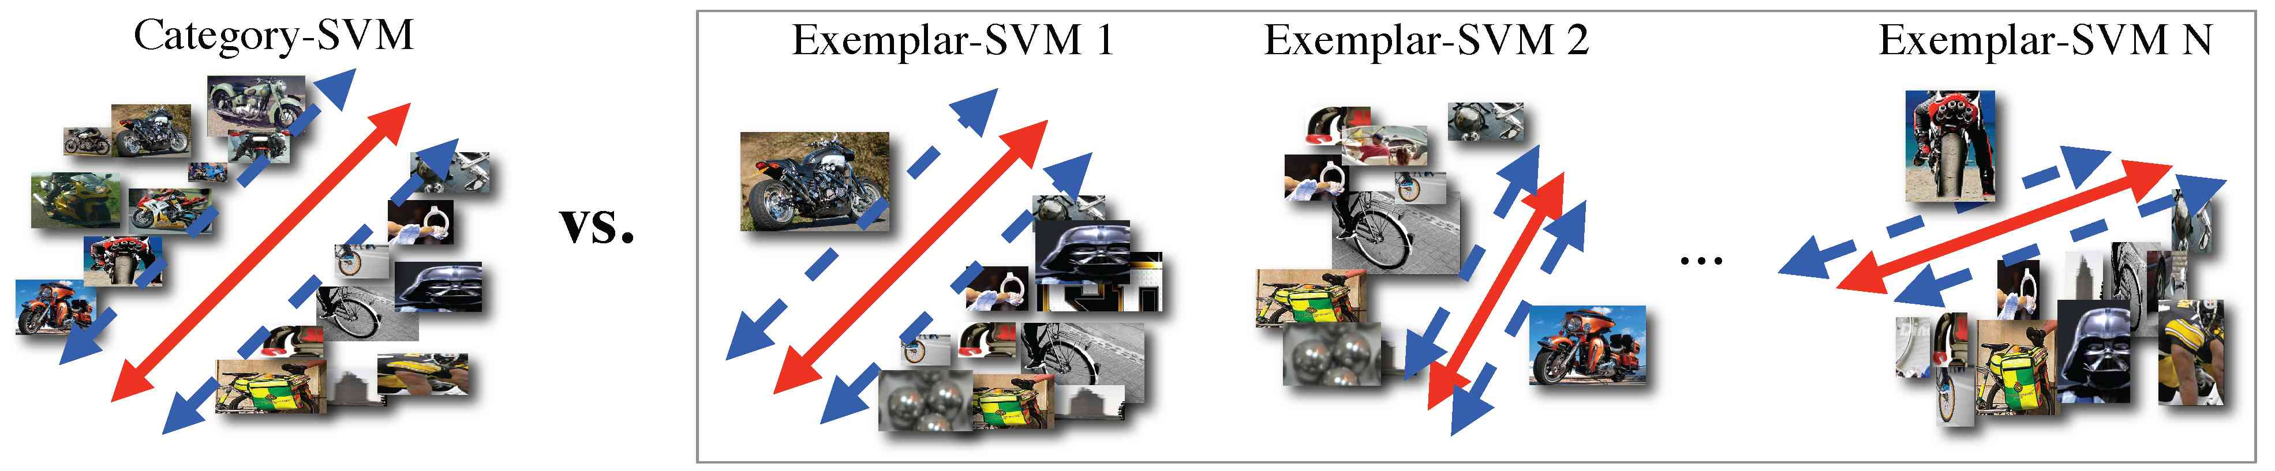
Exemplar-SVM
Still a rigid template,but train a separate SVM for each positive instance
For each category it can has exemplar with different size aspect ratio

Slide 3
Problem 1 Describe Steps
Training :
To train one exemplar SVM what we do
Testing :
For each image what we do ?
In this assignment we use 6 images as training and others as testing.

Slide 4
Problem 2 why use image pyramid ?
When we compute HoG for each image we compute the HoG for different scale of image.
What problem we are trying to solve here?
If there any alternative solution? Why not as good as this one ?

Slide 5
Problem 2 Why Non-Maximum Suppression?
Look at the code see where we do non-maximum suppression (call the function nmsMe).
What does it do?
Why we do this?

Slide 6
Problem 3 Visualizing Examplars
Visualize the exemplar image : Model.posRgb
Visualize the exemplar HoG feature : showHoG(Model.posfeature)
Visualize the trained svm weight : showHoG(Model.svm.w)

Slide 7
Problem 3 Visualizing Examplars
Try to understand the correspondences among the three visualization.
Describe the patterns in the HOG and SVM weight visualization.

Slide 8
Problem4 Testing Procedure
Goal : complete the function bbdet = testfeaturePym(imageRgb,Model)
What it does : slide one exemplar detector over the image to find Nemo
Past your code in the report.

Slide 9
Problem4 Testing Procedure
Basic steps (Listed in the code comments)
1. Compute feature pyramid
For each level of the feature pyramid
  Do convolution get the detection score for each window
  Convert the score to bounding box in image domain
3. Do non- maximum-suppression

Slide 10
  Convolution get the detection score
  Dot product between trained svm weight and feature for each window
    score = fconv(one level of feature, {weight}, 1, 1);
    The score stores at the left top corner of the window in feature domain.
  If image at this level is too small, will not do convolution on this and smaller level

Slide 11
  Convert the score to bounding box in image domain
  Use:
  the scale of the this level
  HOG bin size 8x8 pixels
  size of this exemplar
  Example in white board

Slide 12
Problem6 draw box
Paste result in report
Can you find Nemo? When it fails ?

Slide 13
Problem 7 Training Procedure
After you finish the function testfeaturePym Congratulations! You can train your own detectors.
Run rumMe.m with step.train =1
To train 6 exemplars and test on the images
What’s the difference of the results ?

Slide 14
[Extra Credit] Detecting Other Objects
Find an interesting object to detect
Get images
Get ground truth box by label it by yourself

Slide 15
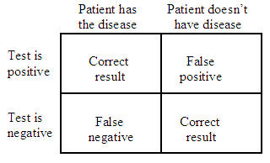
Evaluation: Precision & Recall
[Extra Credit ] Evaluation
Truth
Object
No Object
Algorithm
Prediction
Object
True Positive
False Positive
No Object
False Negative
True Negative
Precision = TP / (TP + FP)
Recall = TP / (TP + FN)
Truth
Prediction
=
/
Intersection
Over
Union

Slide 16
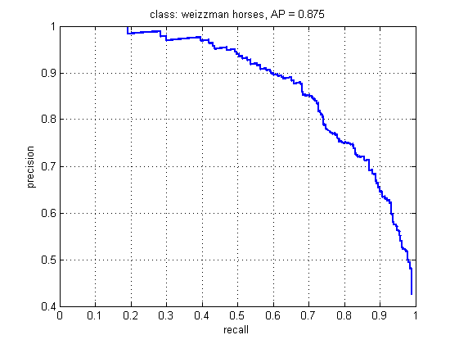
[Extra Credit ] Evaluation
X : recall = true positive / total ground truth
Y : precision = true positive / total detection

Slide 17
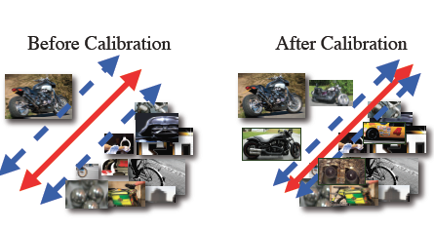
Calibration
Idea : make different exemplar detector's score compatible.
Good exemplar vs Bad exemplar

Slide 18
Calibration
Idea : make different exemplar detector's score compatible.
1. On Validation set :
Sort detection by score,
classify true/false detection
2. sigmoid function
Target Score
Good positive :
Similar with exemplar
1
negative:
-1
Detection Score
Detection Score
All detector’s scores are from 0 to 1.
The calibrated score reflects each detector’s presicion

Slide 19
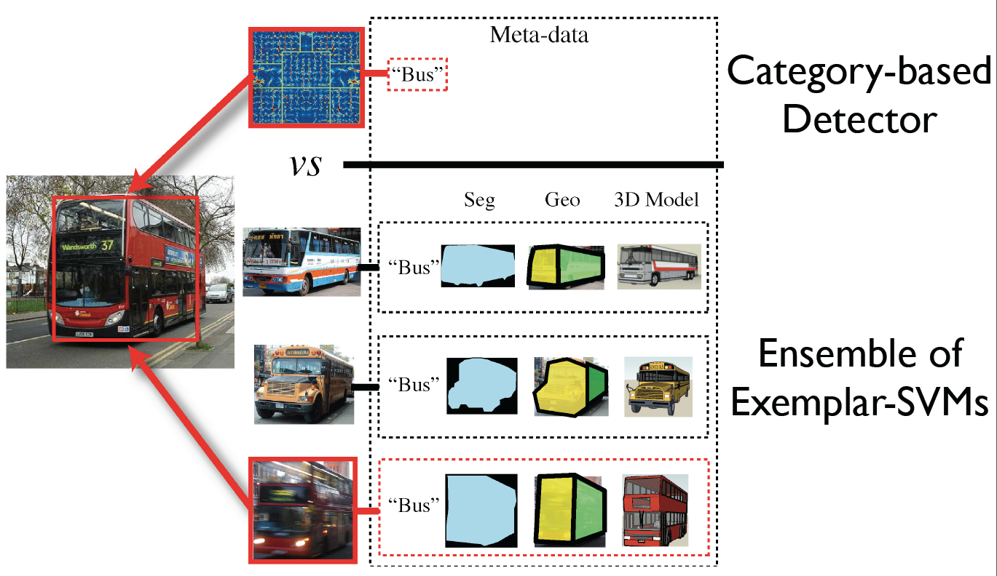
Extra Credit Label Transfer
Hints: http://www.cs.cmu.edu/~tmalisie/projects/iccv11/ paper and code

Slide 20
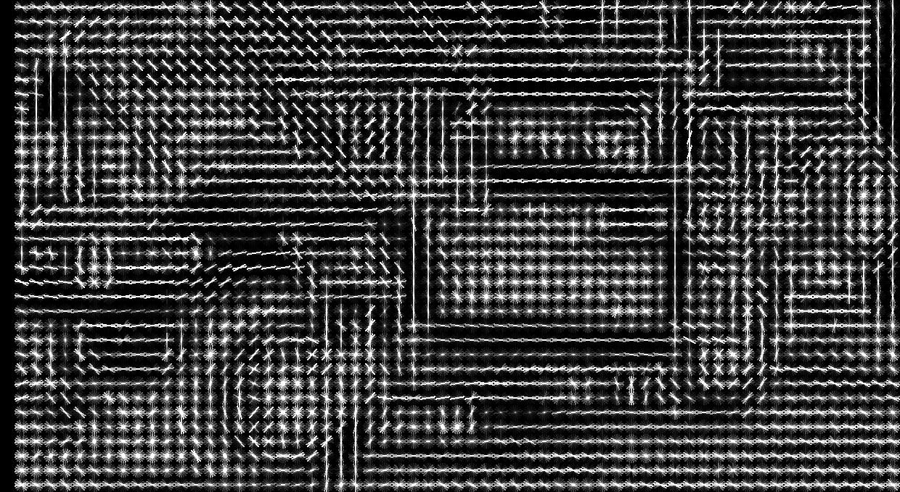
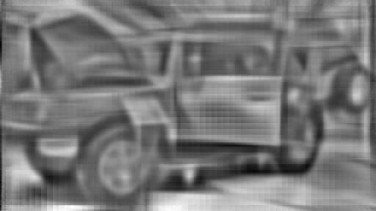
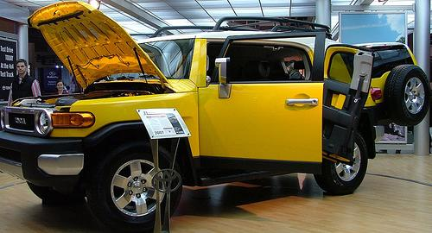
iHoG
Webpage :http://web.mit.edu/vondrick/ihog/
They have online demo and code for download
>> feat = features(im, 8);
>> ihog = invertHOG(feat);
>> imagesc(ihog);

