Slide 1
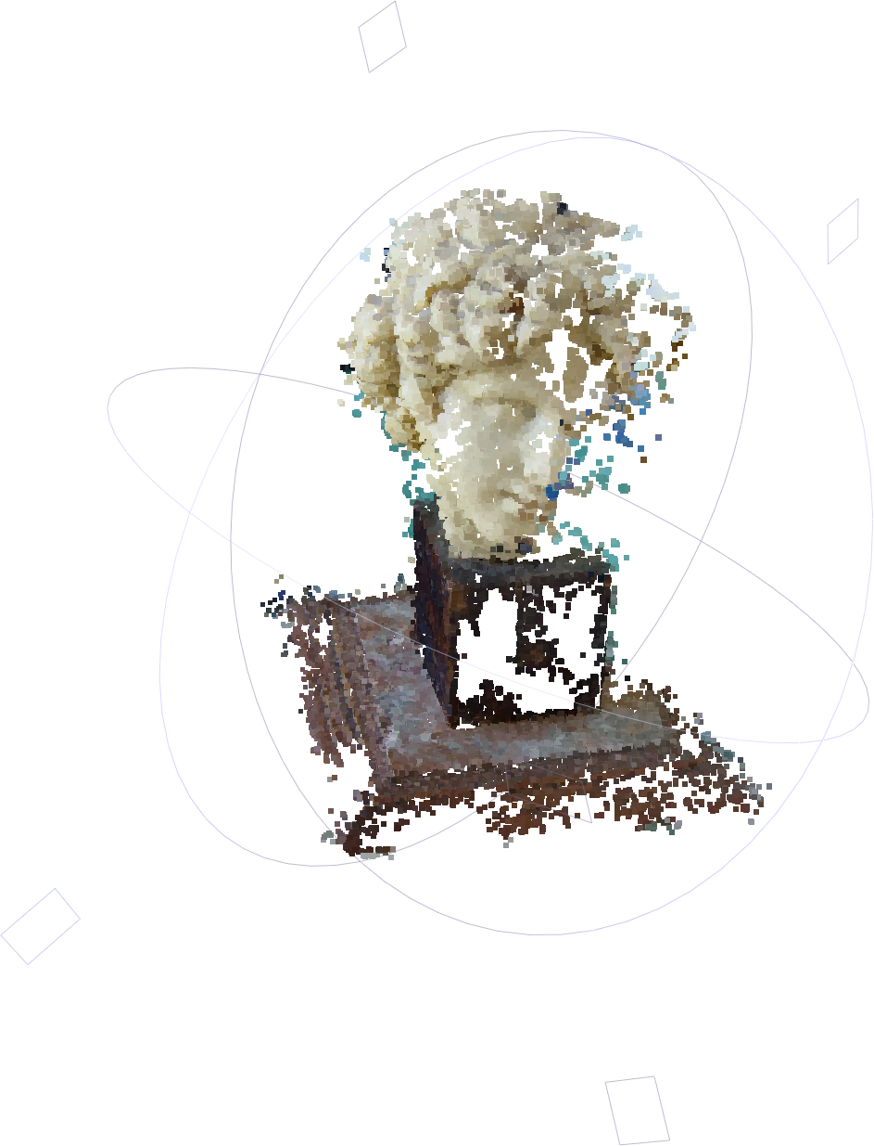
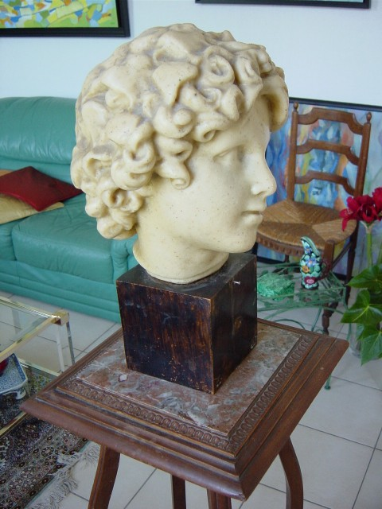
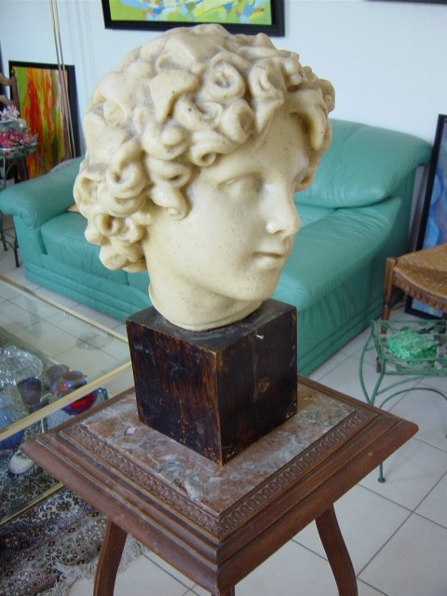
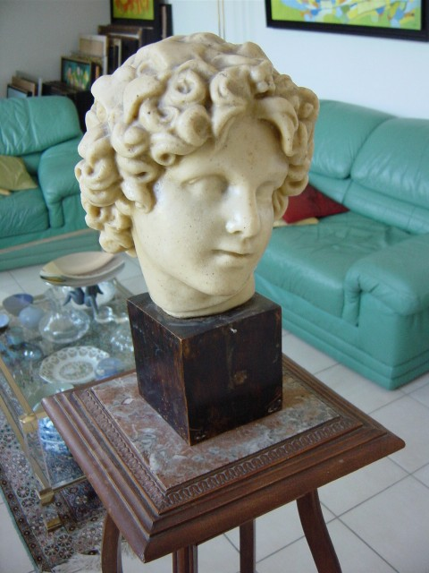
COS429 Computer Vision
Assignment 4 Cloning Yourself
+
+
=

Slide 2
Steps for 3D Reconstruction
Images → Points: Structure from Motion
Points → More points: Multiple View Stereo
Points → Meshes: Model Fitting
Meshes → Models: Texture Mapping
Images → Models: Image-based Modeling
+
=

Slide 3
Steps for 3D Reconstruction
Images → Points: Structure from Motion
Points → More points: Multiple View Stereo
Points → Meshes: Model Fitting
Meshes → Models: Texture Mapping
Images → Models: Image-based Modeling
+
=
+
+
=

Slide 4
Steps
Images → Points: Structure from Motion
Points → More points: Multiple View Stereo
Points → Meshes: Model Fitting
Meshes → Models: Texture Mapping
Images → Models: Image-based Modeling
+
=
+
+
=

Slide 5
Structure From Motion
Structure = 3D Point Cloud of the Scene
Motion = Camera Location and Orientation
SFM = Get the Point Cloud from Moving Cameras
Structure and Motion: Joint Problems to Solve
+
+
=
Notes:
Degree of free :6

Slide 6
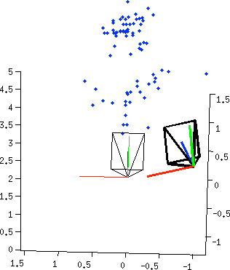
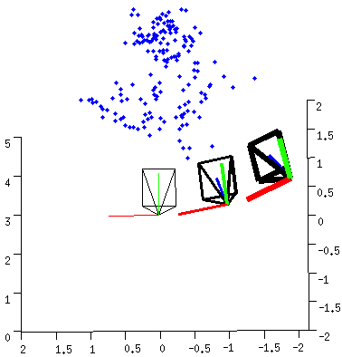
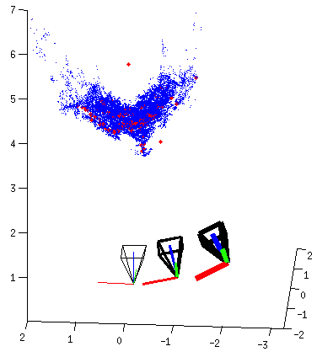
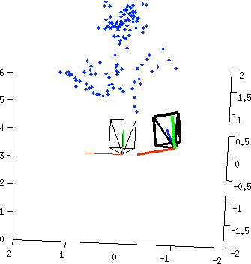
Pipeline
Structure from Motion (SFM)
Multi-view Stereo (MVS)

Slide 7
Pipeline
Structure from Motion (SFM)
Multi-view Stereo (MVS)

Slide 8
Two-view Reconstruction

Slide 9
Two-view Reconstruction

Slide 10
Two-view Reconstruction
keypoints
match
fundamental
matrix
essential
matrix
triangulation
[R|t]
keypoints

Slide 11
Keypoints Detection
keypoints
match
fundamental
matrix
essential
matrix
triangulation
[R|t]
keypoints

Slide 12
Descriptor for each point
SIFT
descriptor
SIFT
descriptor
keypoints
match
fundamental
matrix
essential
matrix
triangulation
[R|t]
keypoints

Slide 13
Same for the other images
SIFT
descriptor
SIFT
descriptor
SIFT
descriptor
SIFT
descriptor
keypoints
match
fundamental
matrix
essential
matrix
triangulation
[R|t]
keypoints

Slide 14
Point Match for correspondences
SIFT
descriptor
SIFT
descriptor
SIFT
descriptor
SIFT
descriptor
keypoints
match
fundamental
matrix
essential
matrix
triangulation
[R|t]
keypoints

Slide 15
Point Match for correspondences
SIFT
descriptor
SIFT
descriptor
SIFT
descriptor
SIFT
descriptor
keypoints
match
fundamental
matrix
essential
matrix
triangulation
[R|t]
keypoints

Slide 16
3. Fundamental Matrix
Image 1
R₁,t₁
Image 2
R₂,t₂

Slide 17
3. RANSAC to Estimate Fundamental Matrix
For many times
Pick 8 points
Compute a solution for using these 8 points
Count number of inliers that with close to 0
Pick the one with the largest number of inliers

Slide 18
4.Fundamental Matrix → Essential Matrix
Image 1
R₁,t₁
Image 2
R₂,t₂

Slide 19
5.Essential Matrix →
Image 1
R₁,t₁
Image 2
R₂,t₂

Slide 20
5. Essential Matrix →
Result 9.19. For a given essential matrix
and the first camera matrix , there are four possible choices for the second camera matrix :
Page 259 of the bible (Multiple View Geometry, 2nd Ed)

Slide 21
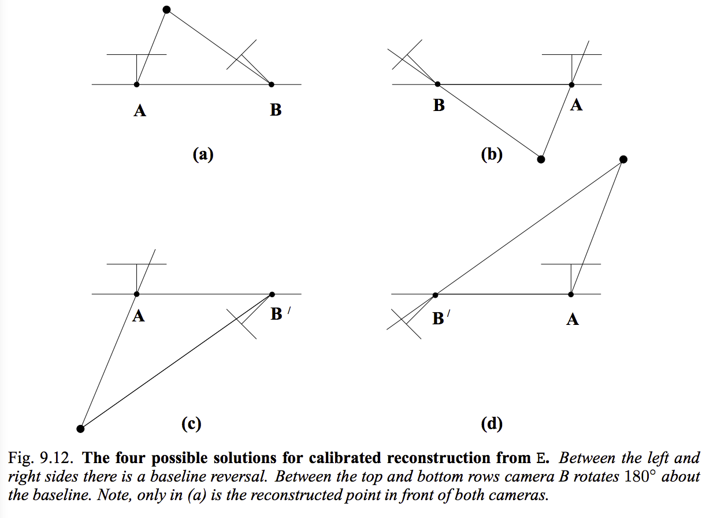
5. Four Possible Solutions
Page 260 of the bible (Multiple View Geometry, 2nd Ed)

Slide 22
Triangulation
Image 1
R₁,t₁
Image 2
R₂,t₂

Slide 23
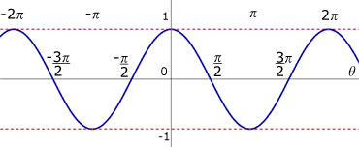
In front of the camera?
A point
Direction from camera center to point
Angle Between Two Vectors
Angle Between and View Direction
Just need to test

Slide 24
Pick the Solution
With maximal number of points in front of both cameras.
Page 260 of the bible (Multiple View Geometry, 2nd Ed)

Slide 25
Two-view Reconstruction
keypoints
match
fundamental
matrix
essential
matrix
triangulation
[R|t]
keypoints

Slide 26
Pipeline
Structure from Motion (SFM)
Multi-view Stereo (MVS)

Slide 27
Pipeline
Taught
Next

Slide 28
Merge Two Point Cloud

Slide 29
Merge Two Point Cloud
There can be only one

Slide 30
Merge Two Point Cloud
From the 1st and 2nd images, we have
and
From the 2nd and 3rd images, we have
and
Exercise: How to transform the coordinate system of the second point cloud to align with the first point cloud so that there is only one ?

Slide 31
Merge Two Point Cloud

Slide 32
Oops
See From a Different Angle

Slide 33
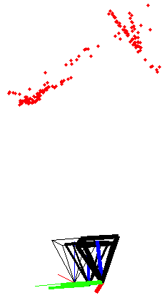
Bundle Adjustment

Slide 34
“America's Next Top Model”
Image 1
Image 3
R₁,t₁
R₃,t₃
Image 2
R₂,t₂

Slide 35
“America's Next Top Model”
Point 1
Point 2
Point 3
Image 1
Image 2
Image 3

Slide 36
Rethinking the SFM problem
Input: Observed 2D image position
Output:
Unknown Camera Parameters (with some guess)
Unknown Point 3D coordinate (with some guess)

Slide 37
Bundle Adjustment
A valid solution and
must let
Re-projection
=
Observation

Slide 38
Bundle Adjustment
A valid solution and
must let the Re-projection close to the Observation, i.e. to minimize the reprojection error

Slide 39
Assignment Problems

Slide 40
Problem 1: Run the SFMedu system
Run SFMedu2.m
May need to compile the priority_queue_1.0 package
Install MeshLab to view the point could
Take a snapshot

Slide 41
Problem 2: List the Major Steps
Read the code SFMedu2.m.
Summarize the major steps for
SfM
dense stereo matching
Hint: Compare the lecture notes and code side by side. Pick the part of lecture notes that match the code.

Slide 42
Problem 3: Principal Point
Read the code carefully to see what is the assumption for the principal points in this system
When this assumption is violated ?

Slide 43
Problem 4: Data Structure
See what are the fields of Graph
What is the data in each field?
Why each one is necessary for SfM system
function graph=pair2graph(pair,frames)
graph.f …
graph.Mot …
graph.Str …
graph.ObsVal …
graph.ObsIdx …
Point 1
Point 2
Point 3
Image 1
Image 2
Image 3
Camera
Points
Notes:
Because Matlab doesn’t support sparse 3D array, we have to break it down to a 2D sparse array ObsIdx to point to ObsVal where the actual pixel location (x and y) is stored.

Slide 44
Problem 5: Reconstruct Yourself
Tips:
good lighting
Subject don’t move
Enough texture
no motion blur
common overlapping

Slide 45
Problem 6: Compute the Reprojection Error
residuals = reprojectionResidual(ObsIdx,ObsVal,px,py,f,Mot,Str)
ObsIdx: index of KxN for N points observed by K cameras, sparse matrix
ObsVal: 2xM for M observations
px,py: principle points in pixels
f: focal length in pixels
Mot: 3x2xK for K cameras
-> need to use “RotationMatrix2AngleAxis” to covert the 3x3 matrix to 3 number vector AngleAxis representation
Str: 3xN for N points

Slide 46
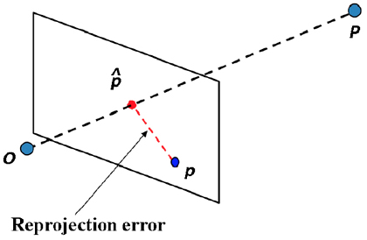
Problem 6: Compute the Reprojection Error
residuals = reprojectionResidual(ObsIdx,ObsVal,px,py,f,Mot,Str)
Average Reprojetion error = sqrt(sum(residuals.^2)/n)
n= number of points

Slide 47
Problem 7: Visualize the Reprojection Points
For each camera:
Transform points (Str) from word coordinate to camera coordinate (transformPtsByRt )
Project to 2D
Transform coordinate
xy(1,:) = -xy(1,:) + frames.imsize(2)/2;
Plot
Notes:
xy(1,:) = -xy(1,:) + frames.imsize(2)/2; xy(2,:) = -xy(2,:) + frames.imsize(1)/2;

Slide 48
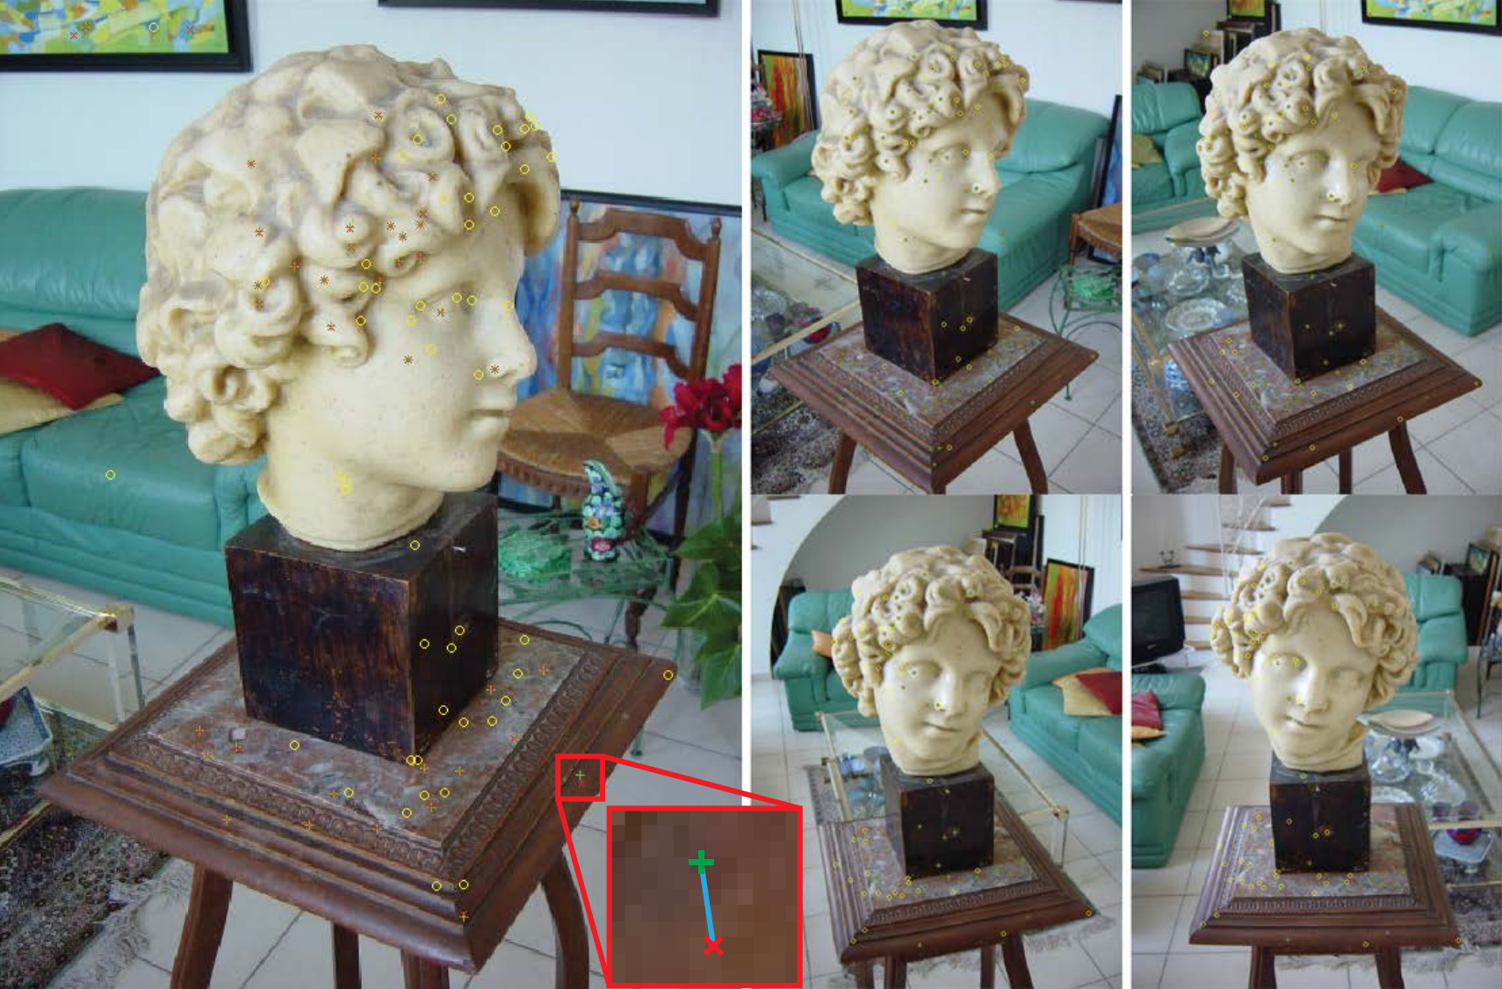
Problem 7: Visualize the Reprojection Points
red x: each observed keypoint
green +: reprojection of its 3D estimated location
blue line −: these two points are connected by a blue line
yellow o: porjection of points reconstruction from other views

Slide 49
Problem 8: Levenberg-Marquardt
[vec,resnorm,residuals,exitflag] =
^{lsqnonlin(}
@(x)reprojectionResidual(graph.ObsIdx,graph.ObsVal,px,py,f,x), [Mot(:);Str(:)]
^{,[],[],options);}
Try to minimize the sum of squares of function : reprojectionResidual
With function input : x
[Mot(:), Str(:)]: Initialization

Slide 50
Bundle Adjustment
A valid solution and
must let the Re-projection close to the Observation, i.e. to minimize the reprojection error

Slide 51
Problem 9: Motion Adjustment Only Problem 10: Structure Adjustment Only
Hint:
reprojectionResidual can also be called by
reprojectionResidual(ObsIdx,ObsVal,px,py,f,Mot,Str)
If we want to adjust motion which variable should be input ?

Slide 52
Problem 9: Motion Adjustment Only Problem 10: Structure Adjustment Only
x = lsqnonlin(fun,x0)
x = lsqnonlin(fun,x0) starts at the point x0 and finds a minimum of the sum of squares of the functions described in fun. fun should return a vector of values and not the sum of squares of the values. (The algorithm implicitly computes the sum of squares of the components of fun(x).)
http://www.mathworks.com/help/optim/ug/lsqnonlin.html

Slide 53
Problem 11: Why to Estimate the Essential Matrix?
Why not just do the bundle adjustment directly?
Is there other way to bypass the estimation of essential matrix?
Provide your answer in the report.

Slide 54
Q & A
+
+
=

