Slide 1
3D Shape Matching
Thomas Funkhouser
COS 429
Notes:
Good morning,
My talk will be about a 2D sketch interface
for a 3D model search engine.
This is joint work with a former undergraduate at Princeton,
Joyce Chen, and my advisor, Tom Funkhouser.

Slide 2
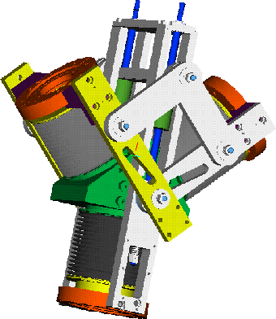
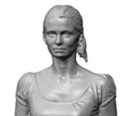
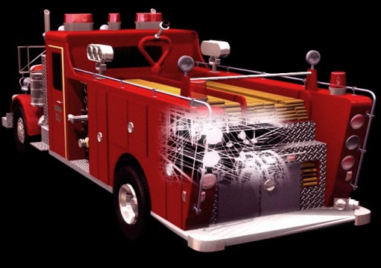
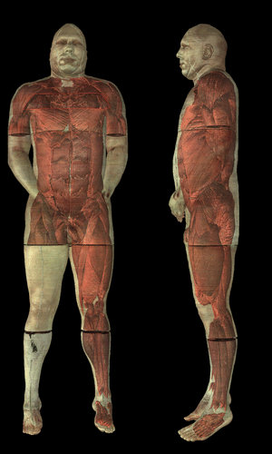
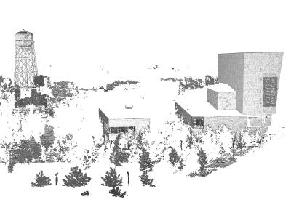
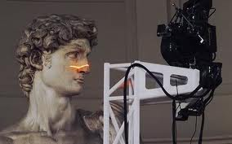
Motivation
Large repositories of 3D data are available
Computer Graphics
Mechanical CAD
Anthropometry
Medicine
Cultural Heritage
Site Monitoring

Slide 3
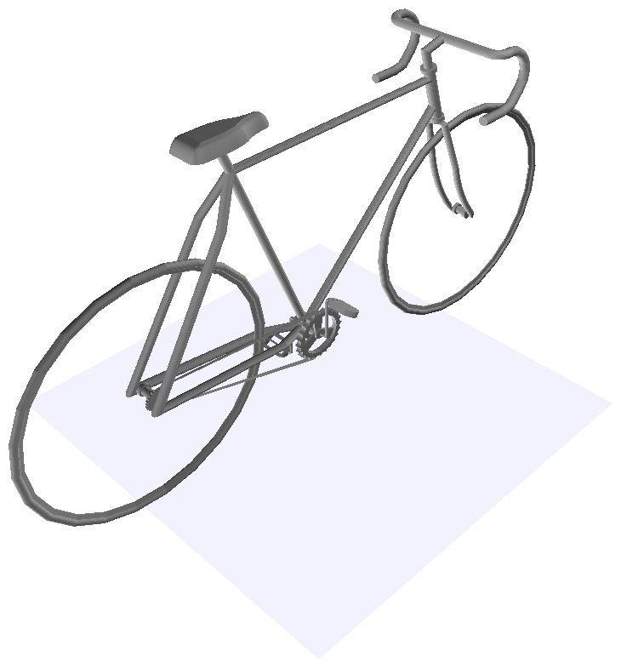
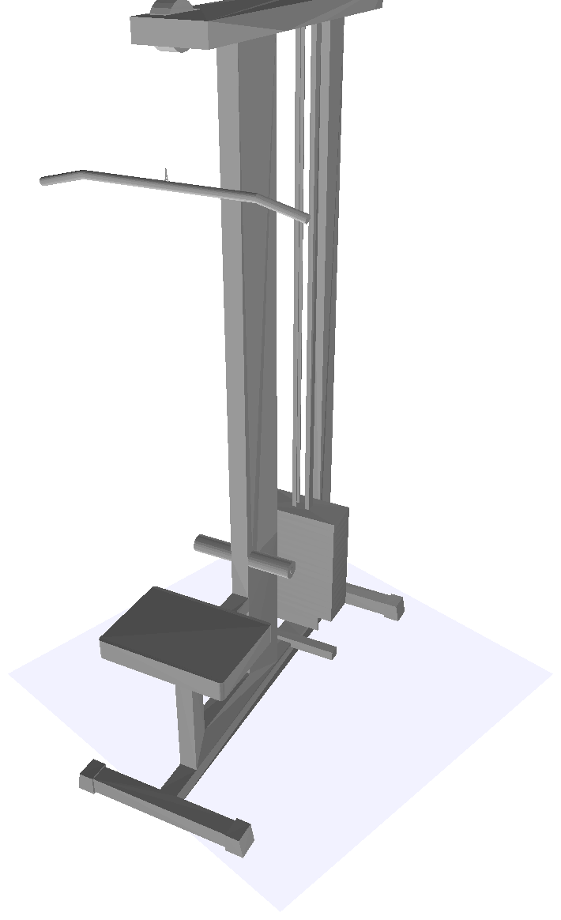
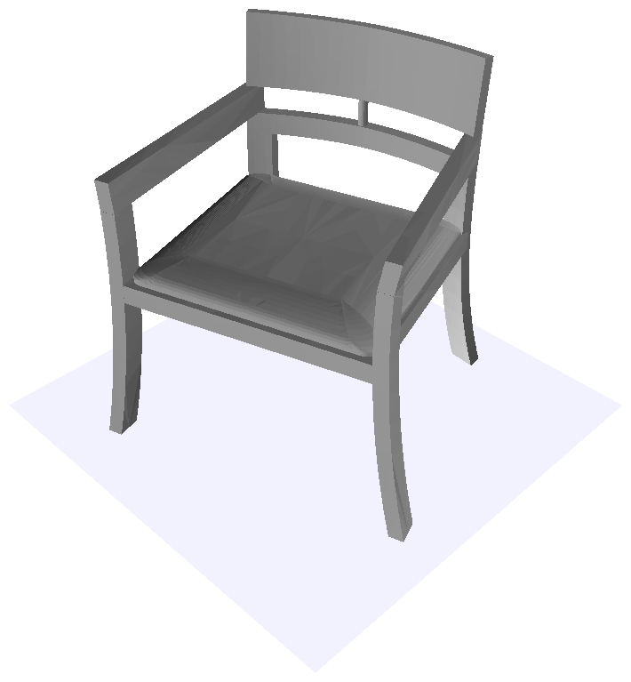
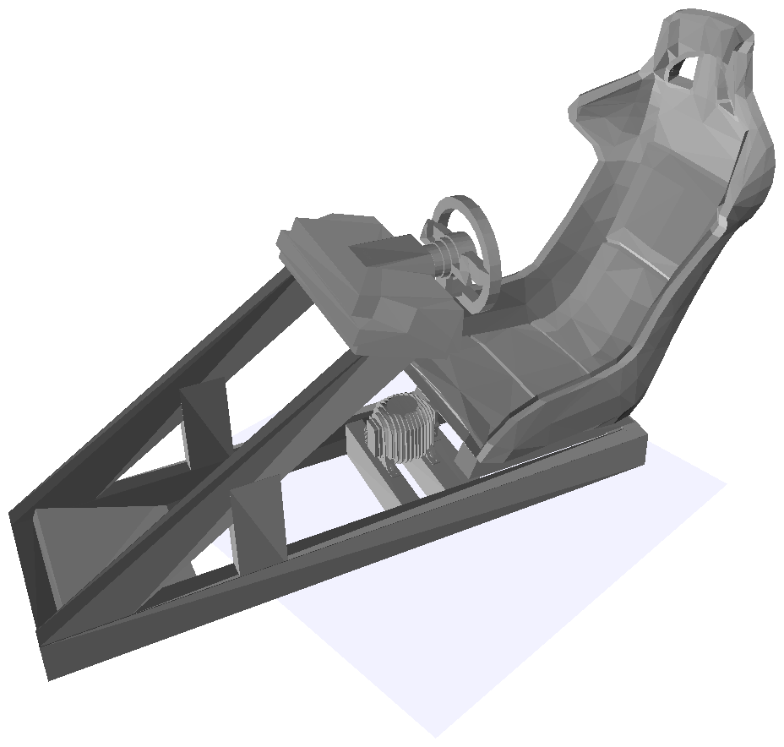
Problem
Most 3D data lacks structural, semantic, and functional annotations

Slide 4
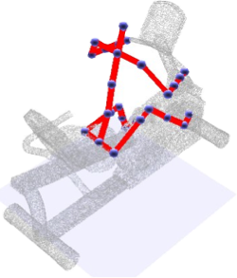
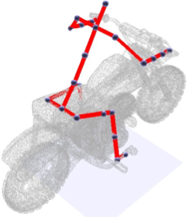
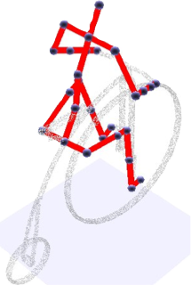
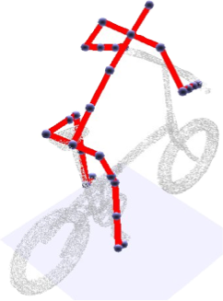
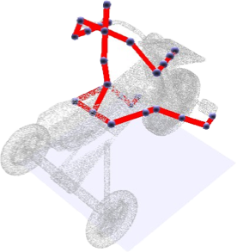
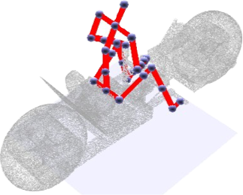
Goal
Infer structures, labels, functions, and relationships automatically from 3D data

Slide 5
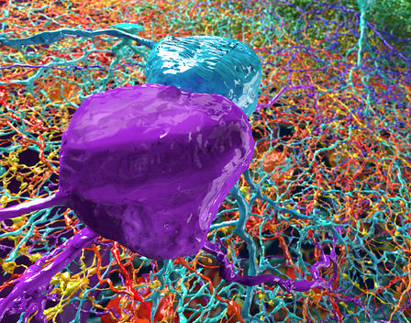
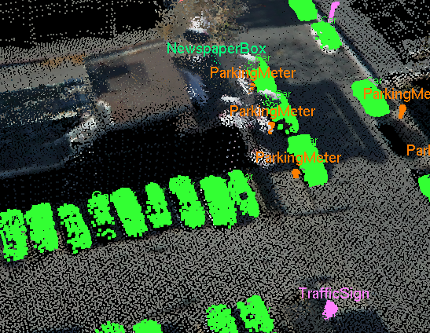
Shape Matching
Example applications:
  Archaeology
  Molecular biology
  Paleontology
  Neuroscience
  Urban planning
  Numismatics
  Geometric modeling
  Medicine
  Art
  etc.

Slide 6
Archaeology:
Matching Fresco Fragments

Slide 7
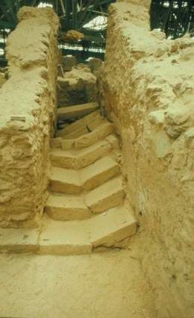
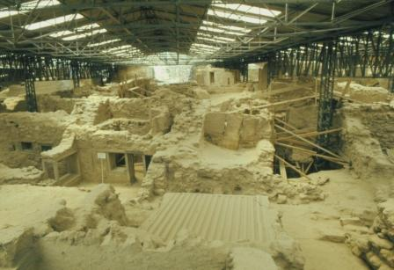
Akrotiri
Buried city discovered in 1967

Slide 8
Akrotiri
Buried city discovered in 1967

Slide 9
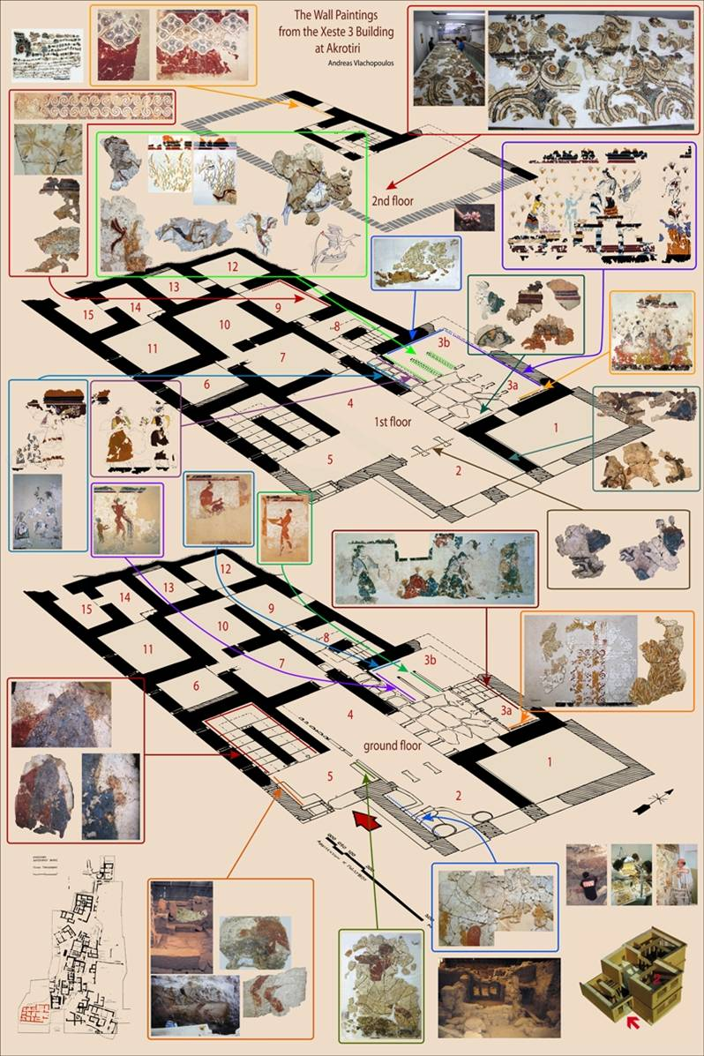
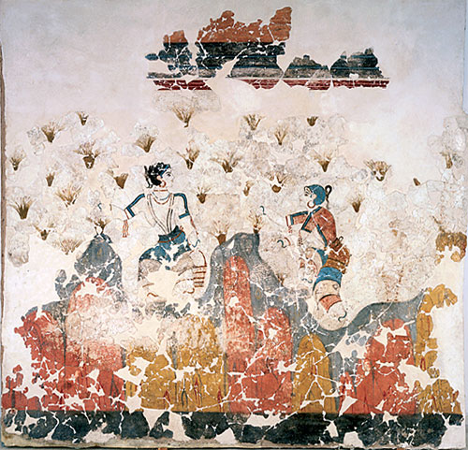
Akrotiri
Many walls were decorated with wall paintings

Slide 10
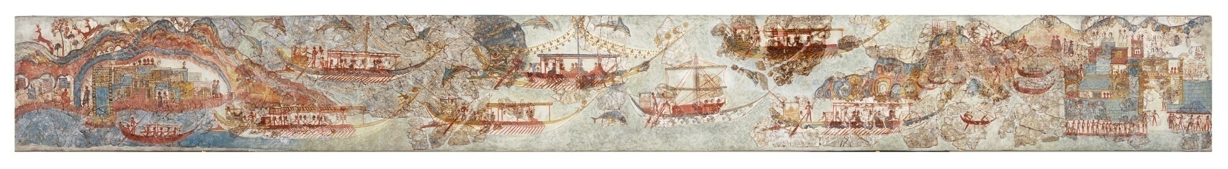
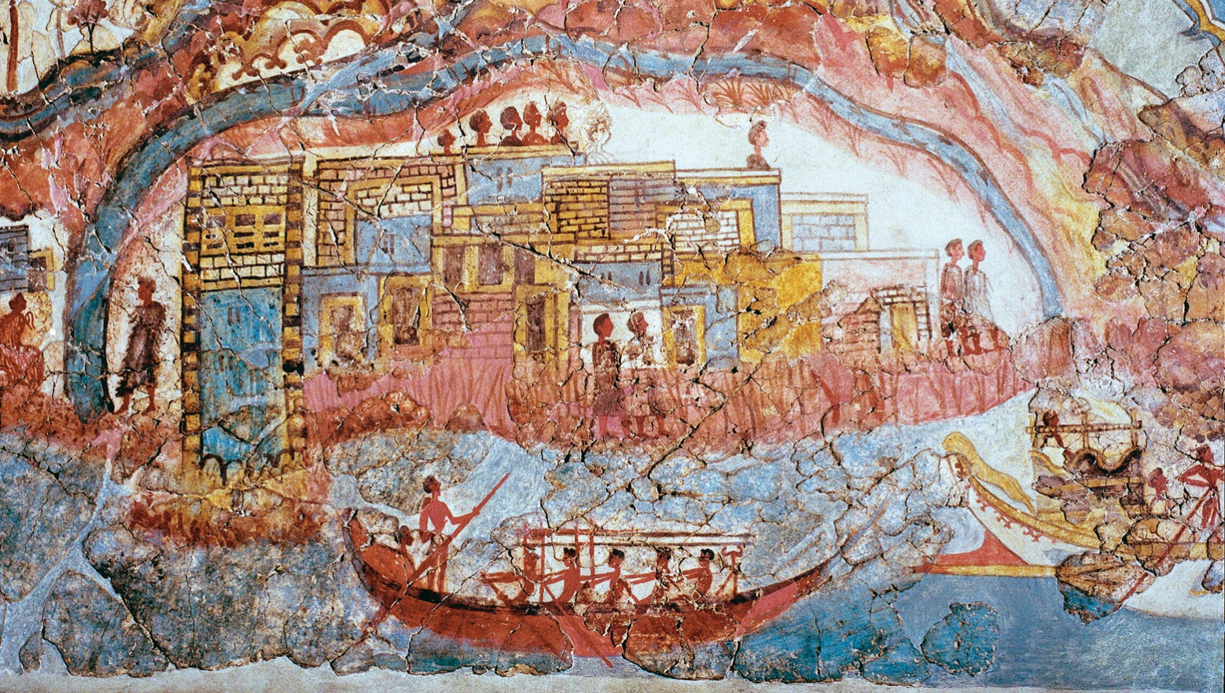
Akrotiri
Many walls were decorated with wall paintings

Slide 11
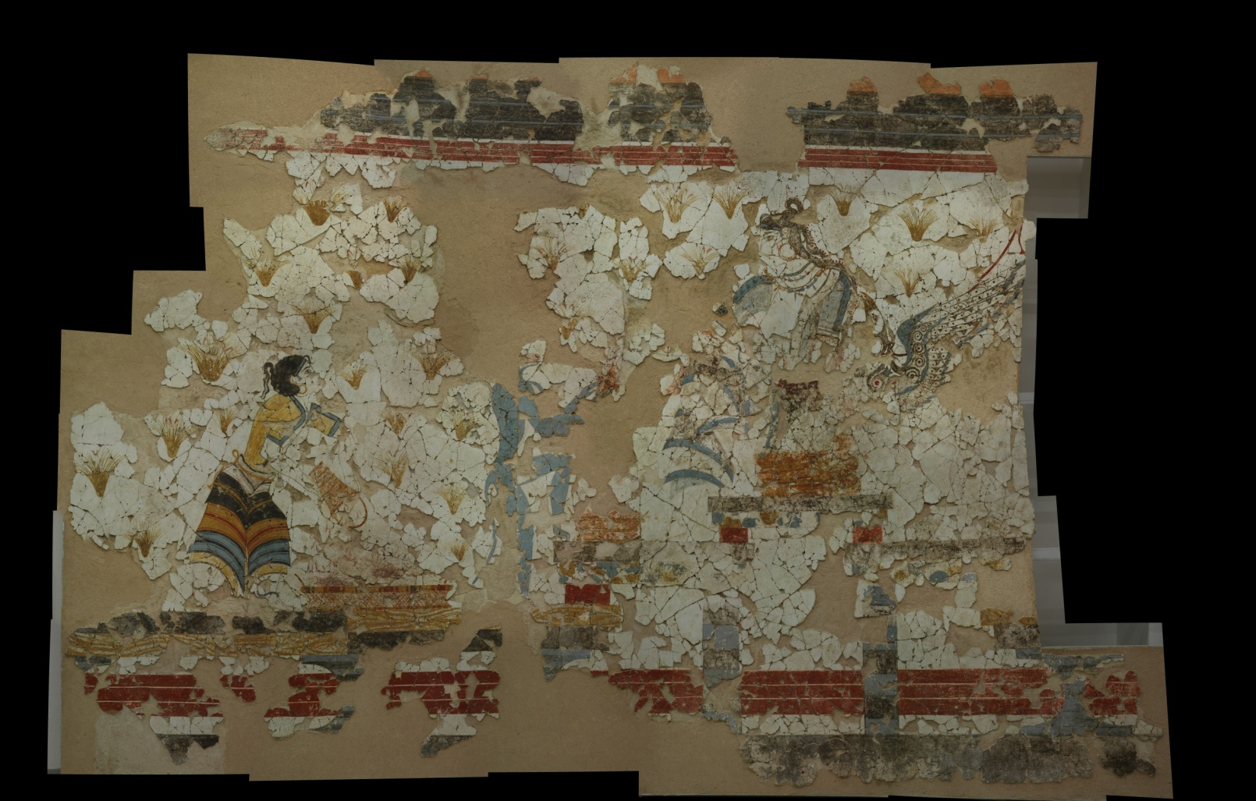
Akrotiri
… but most walls are shattered into fragments

Slide 12
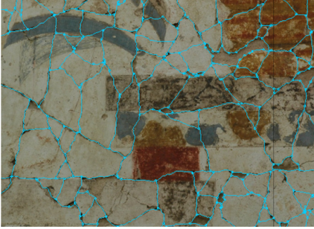
Akrotiri
… but most walls are shattered into fragments

Slide 13
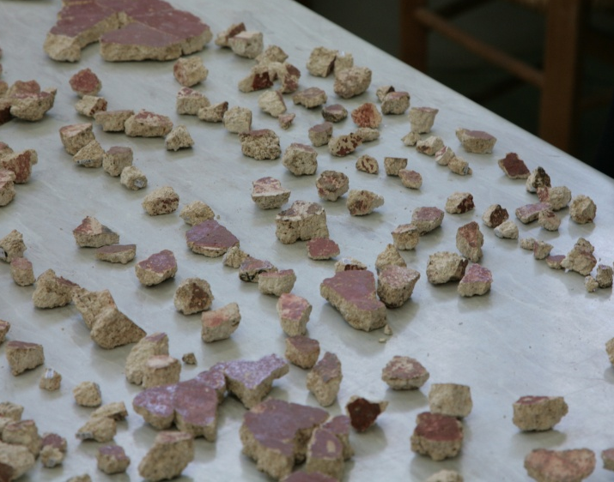
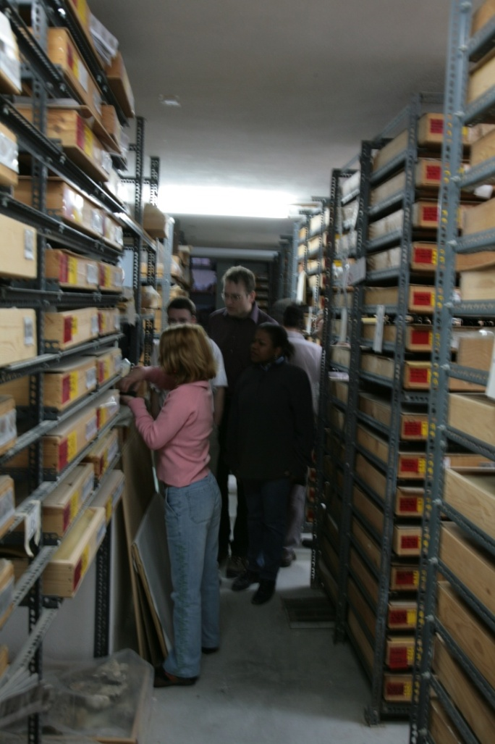
Challenge
… and re-assembling the fragments is difficult

Slide 14
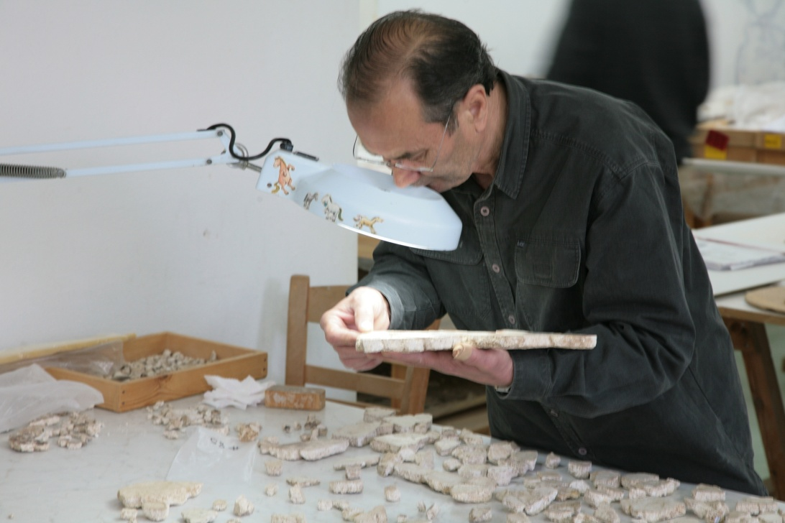
Challenge
… and re-assembling the fragments is difficult

Slide 15
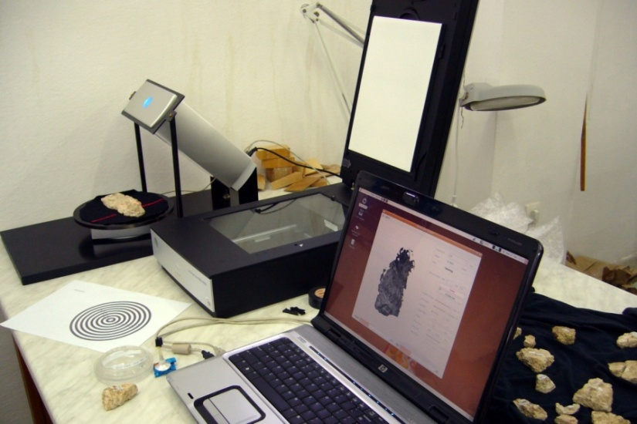
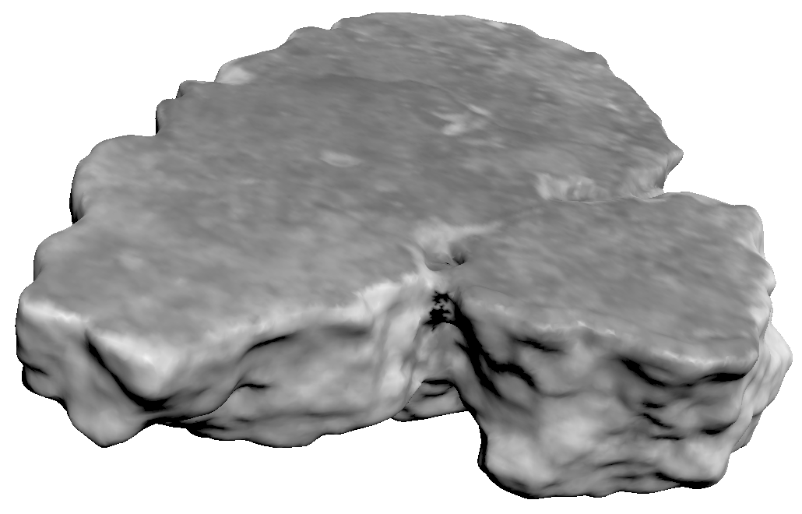
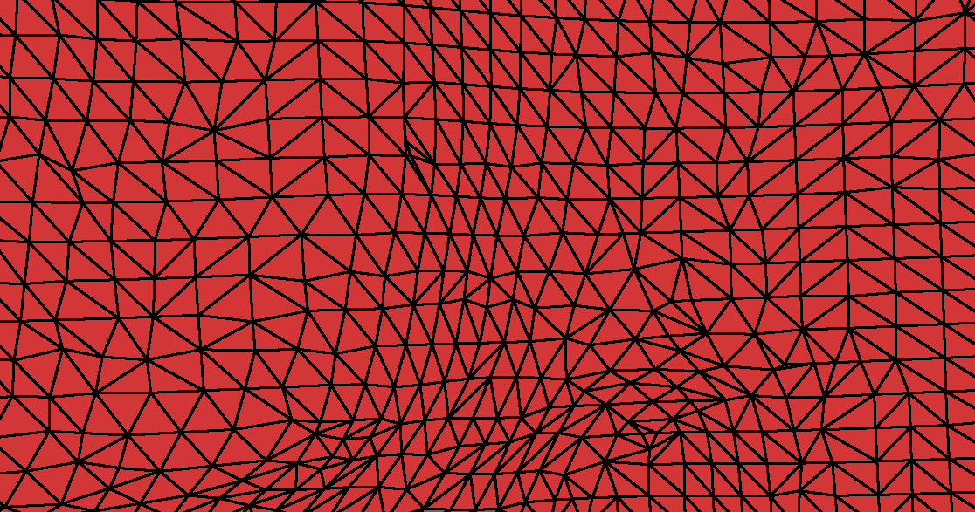
Computer-Assisted Reconstruction
1) Scan digital representations of fragments
Ribbon
Triangle
Mesh

Slide 16
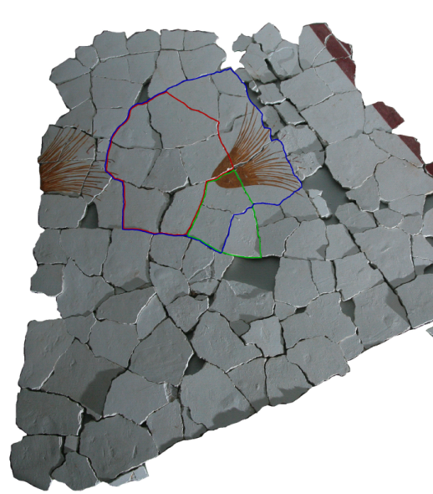
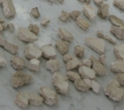
Computer-Assisted Reconstruction
2) Reconstruct frescoes with computer algorithms
Scanned Fragments
Reconstructed Fresco

Slide 17
Computer-Assisted Reconstruction
Scan
Fragments
Generate
Matches
Score
Matches
Verify
Matches

Slide 18
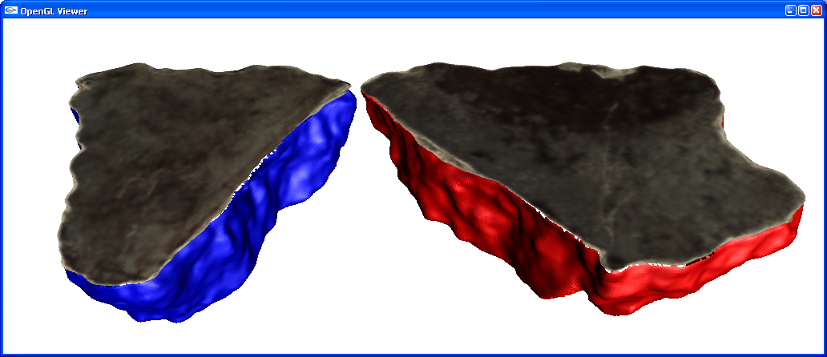
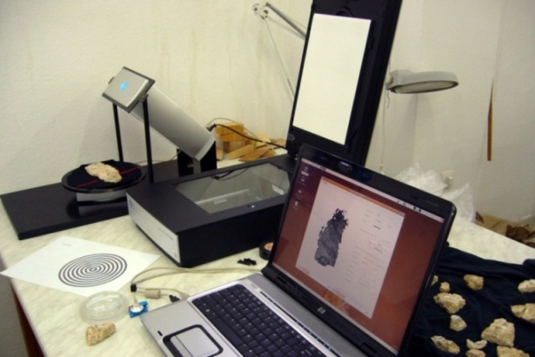
Computer-Assisted Matching
Scan
Fragments
Front
Surface
Color
Generate
Matches
Score
Matches
Scanning System
Fracture
Surface
Geometry
(ribbon)
Brown et al., SIGGRAPH 2008
Verify
Matches
Scanned Fragments

Slide 19
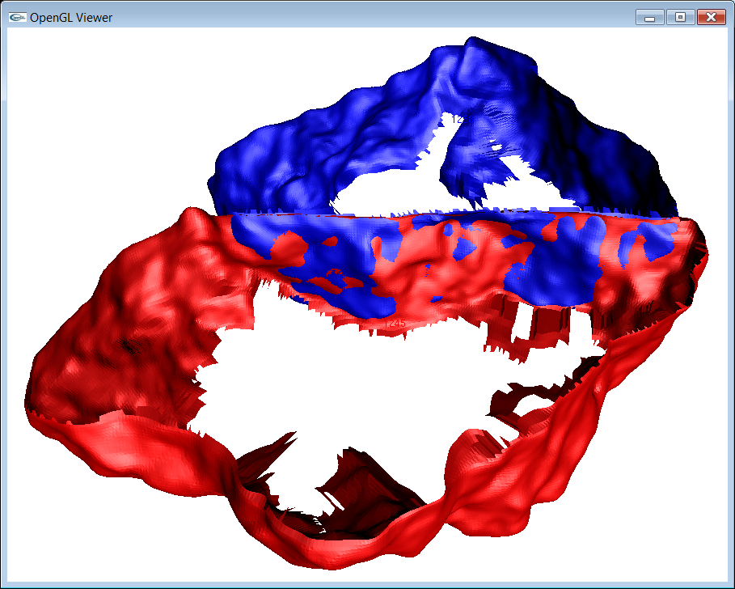
Computer-Assisted Matching
For every pair of fragments F₀ and F₁ …
Scan
Fragments
F₀
F₁
T
Generate
Matches
Generate candidate match for every
plausible aligning transformation T
F₁
Score
Matches
Candidate
Match
Verify
Matches
F₀

Slide 20
Computer-Assisted Matching
For every candidate match, compute
a score representing “how good it is”
Scan
Fragments
F₁
Generate
Matches
S(F₀,F₁,T)
Score
F₀
Score
Matches
Candidate Match
Verify
Matches

Slide 21
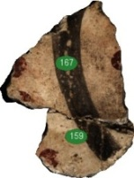
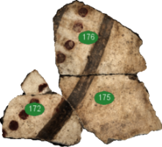
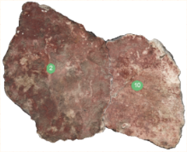

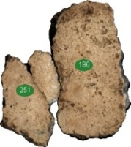
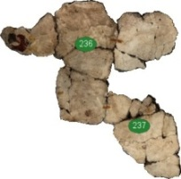
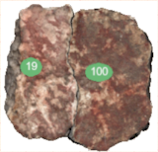
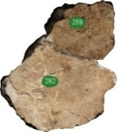
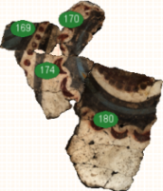

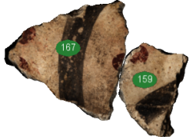

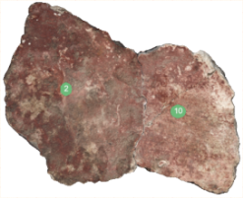
Computer-Assisted Matching
Sort the candidate matches by score, and
check top ones to see if they are correct
Scan
Fragments
Generate
Matches
Score
Matches
Candidate Matches
(millions)
Verify
Matches
Verified Correct Matches
(tens or hundreds)

Slide 22
Focus of This Talk
Goal: Develop a scoring method
that accurately estimates the
probability that a candidate match
is correct
Scan
Fragments
Generate
Matches
Score
Matches
Verify
Matches

Slide 23
Previous Methods
Most prior systems scored matches using functions
combining a few match properties with weights
  McBride et al., 2003
  Brown et al., 2008 (Ribbonmatcher Error)

Slide 24





Our Approach
Machine learning
  User provides example correct and incorrect matches
  System learns classifier to predict
  correctness of new candidate matches
  based on their properties
Candidate match
Machine
Learning
System
Classifier
Example
Matches
Score
(probability of match)

Slide 25
Computing Match Properties
Measure compatibility of fragments

Slide 26
Computing Match Properties
Measure compatibility of fragments
  ΔThickness = 0.1 mm
Thickness

Slide 27
Computing Match Properties
Measure compatibility of fragments
  ΔThickness = 0.1 mm
  ΔColor = 0.002
mean
mean
2
Color
Histogram
Color
Histogram

Slide 28
Computing Match Properties
Measure alignment of fragments
  ΔThickness = 0.1 mm
  ΔColor = 0.002
  ΔAlignment = 0.24 mm

Slide 29
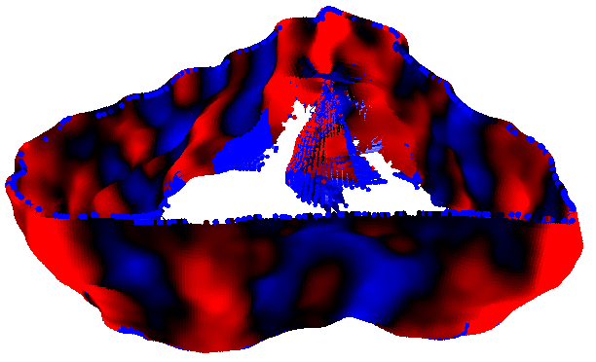
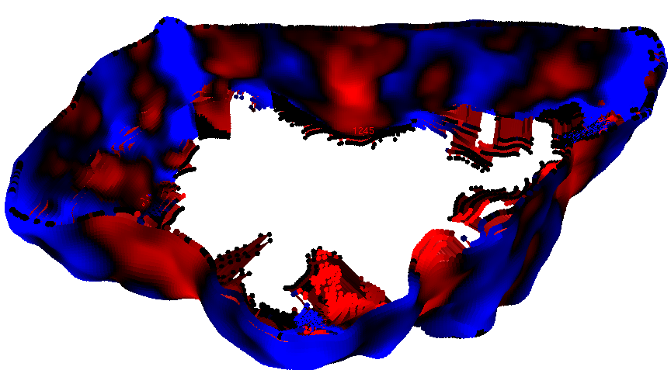
Computing Match Properties
Measure alignment of fragments
  ΔThickness = 0.1 mm
  ΔColor = 0.002
  ΔAlignment = 0.24 mm
  ΔCurvature = 0.06 mm⁻¹
Mean
Curvature
2mm
Negative curvature
Positive curvature

Slide 30
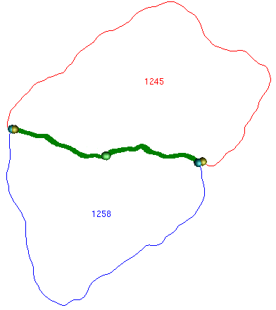
Computing Match Properties
Measure alignment of fragments
  ΔThickness = 0.1 mm
  ΔColor = 0.002
  ΔAlignment = 0.24 mm
  ΔCurvature = 0.06 mm⁻¹
  Length = 43.6 mm
  Overlap = 0.7 mm
  Min int. angle = 88 °
  Max ext. angle = 191 °
  Etc.

Slide 31


Computing Match Properties
Measure alignment of fragments
  ΔThickness = 0.1 mm
  ΔColor = 0.002
  ΔAlignment = 0.24 mm
  ΔCurvature = 0.06 mm⁻¹
  Length = 43.6 mm
  Overlap = 0.7 mm
  Min int. angle = 88 °
  Max ext. angle = 191 °
  Etc.

Slide 32
Computing Match Properties
Measure alignment of fragments
  ΔThickness = 0.1 mm
  ΔColor = 0.002
  ΔAlignment = 0.24 mm
  ΔCurvature = 0.06 mm⁻¹
  Length = 43.6 mm
  Overlap = 0.7 mm
  Min int. angle = 88 °
  Max ext. angle = 191 °
  Etc.
88 °

Slide 33
Computing Match Properties
Measure alignment of fragments
  ΔThickness = 0.1 mm
  ΔColor = 0.002
  ΔAlignment = 0.24 mm
  ΔCurvature = 0.06 mm⁻¹
  Length = 43.6 mm
  Overlap = 0.7 mm
  Min int. angle = 88 °
  Max ext. angle = 191 °
  Etc.
191 °

Slide 34


Computing Match Properties
In all, 64 properties per match

Slide 35
Learning a Scoring Function
Learn a classifier that predicts the probability that a match is correct based on its properties
0.1
0.7
0.0
0.6
0.3
0.6
0.8
0.1
···
1
0.2
0.7
0.1
0.5
0.3
0.6
0.9
0.0
···
1
0.9
0.2
0.8
0.1
0.7
0.2
0.1
0.9
···
0
Match Properties
Correct?
Training Set

Slide 36

Learning a Scoring Function
Classifier
  Decision Tree
    Each branch checks
    the value of a property
    Each leaf has
    linear regression model
    Produces score “roughly”
    modeling probability
    Selects good features
    automatically
Decision tree
learned on Synthetic Fresco

Slide 37
Learning a Scoring Function
Classifier
  Decision Tree
    Each branch checks
    the value of a property
    Each leaf has
    linear regression model
    Produces score “roughly”
    modeling probability
    Selects good features
    automatically
Truth =
-0.0013 * RibbonContactRMSD
+ 0 * RibbonContactArea
+ 0.0001 * RibbonContactPlanarity
+ 0.0005 * RibbonContact1mmMeanCurvatureL2
+ 0 * RibbonJointMinInteriorAngle
+ 0 * RibbonJointMaxExteriorAngle
- 0.0001 * ContourContactRMSD
- 0.0007 * ContourContact4mmHorizontalCurvatureL2
+ 0.0002
“Matches with large ContactRMSD are unlikely”
(score is near zero)
Decision tree
learned on Synthetic Fresco

Slide 38
Learning a Scoring Function
Classifier
  Decision Tree
    Each branch checks
    the value of a property
    Each leaf has
    linear regression model
    Produces score “roughly”
    modeling probability
    Selects good features
    automatically
Truth =
-5.1265 * RibbonContactRMSD
+ 0 * RibbonContactArea
+ 0.0138 * RibbonContactPlanarity
+ 0.012 * RibbonContact1mmMeanCurvatureL2
- 0.0286 * RibbonJointMinInteriorAngle
+ 0.0006 * RibbonJointMaxExteriorAngle
- 0.0011 * ContourContactRMSD
- 0.1677 * ContourContact4mmHorizontalCurvatureL2
+ 0.6273 * ContourContactMinLengthAreaFraction
+ 1.9331
“Matches with small ContactRMSD,
high Planarity, a small interior angle at least at one junction,
and a large relative contact length are likely to be correct”
(score is large)
Decision tree
learned on Synthetic Fresco

Slide 39
Experimental Data Sets
Synthetic Fresco
  Made specifically for this project
  Made in the style of Akrotiri wall paintings
  Destroyed purposely in 2007 A.D.
Tongeren Vrijthof
  Tongeren, Belgium
  Roman building
  Destroyed by fire between 1 A.D. – 300 A.D.
Akrotiri
  Thera (Santorini, Greece)
  Late Bronze Age settlement
  Destroyed by earthquake around 1650 B.C.

Slide 40
Experiment Design
Train on Fresco X
  Use ribbonmatcher to generate candidate matches
  Compute properties of candidate matches
  Mark candidate matches that are correct
  Learn classifier to predict correctness of matches
Test on Fresco Y
  Use ribbonmatcher to generate candidate matches
  Compute properties of candidate matches
  Mark candidate matches that are correct
  Apply classifier to predict correctness of (score) matches
  Sort matches by score, and plot precision vs. recall

Slide 41

Experiment Results
Testing on Synthetic Fresco:
Ribbonmatcher Error
(previous state-of-the-art)

Slide 42
Experiment Results
Testing on Synthetic Fresco:
}
Trained
Classifiers
Ribbonmatcher Error
(previous state-of-the-art)

Slide 43

Experiment Results
Testing on Tongeren Vrijthof Fresco:
}
Trained
Classifiers

Slide 44

Experiment Results
Testing on Akrotiri Fresco:
}
Trained
Classifiers

Slide 45
Results of Predictions
Totals of all predictions:
  Likely: 48 correct, 1 incorrect, 1 uncheckable
  Probable: 7 correct, 0 incorrect
  Possible: 25 correct, 19 incorrect, 1 uncheckable
  Maybe: 5 correct, 10 incorrect
  Remote: 2 correct, 15 incorrect
  Longshot: 0 incorrect, 14 incorrect
  Summary:
  87 correct matches
  36 missed (found by conservators)
  43 new (not found by conservators)

Slide 46



Follow up work …
Assembling matches into full reconstruction
Candidate
Matches
Reconstructed
Fresco

Slide 47
Molecular Biology:
Matching Protein Structures

Slide 48

Goal
Given a protein structure,
predict its molecular function
STAGKVIKCKAAVLWEEKKPFSIEEVEVAPPKAHEVRIKMVATGICRSDD
HVVSGTLVTPLPVIAGHEAAGIVESIGEGVTTVRPGDKVIPLFTPQCGKC
RVCKHPEGNFCLKNDLSMPRGTMQDGTSRFTCRGKPIHHFLGTSTFSQYT
VVDEISVAKIDAASPLEKVCLIGCGFSTGYGSAVKVAKVTQGSTCAVFGL
GGVGLSVIMGCKAAGAARIIGVDINKDKFAKAKEVGATECVNPQDYKKPI
QEVLTEMSNGGVDFSFEVIGRLDTMVTALSCCQEAYGVSVIVGVPPDSQN
LSMNPMLLLSGRTWKGAIFGGFKSKDSVPKLVADFMAKKFALDPLITHVL
PFEKINEGFDLLRSGESIRTILTF
Sequence
Structure

Slide 49

Goal
Given a protein structure,
predict its molecular function
(e.g., bound ligand type)
STAGKVIKCKAAVLWEEKKPFSIEEVEVAPPKAHEVRIKMVATGICRSDD
HVVSGTLVTPLPVIAGHEAAGIVESIGEGVTTVRPGDKVIPLFTPQCGKC
RVCKHPEGNFCLKNDLSMPRGTMQDGTSRFTCRGKPIHHFLGTSTFSQYT
VVDEISVAKIDAASPLEKVCLIGCGFSTGYGSAVKVAKVTQGSTCAVFGL
GGVGLSVIMGCKAAGAARIIGVDINKDKFAKAKEVGATECVNPQDYKKPI
QEVLTEMSNGGVDFSFEVIGRLDTMVTALSCCQEAYGVSVIVGVPPDSQN
LSMNPMLLLSGRTWKGAIFGGFKSKDSVPKLVADFMAKKFALDPLITHVL
PFEKINEGFDLLRSGESIRTILTF
Sequence
NAD
Structure

Slide 50

Observation
Similarities of 3D structures in binding sites
can reveal functional similarities
Subtilisin
(bacterial serine protease)
Chymotrypsin
(mammalian serine protease)

Slide 51





General Strategy
Match structure of query protein active site to others with known functions, and transfer annotations
NAD
ATP
NAD
FAD
Significant
Match
Query Protein
Active Site
FMN
Database

Slide 52

Previous Work
Predicting protein-ligand binding site locations
  SURFNET [Laskowski95]
  LIGSITE [Hendlich97]
  Pocketfinder [An04]
  CAST [Liang98]
  PASS [Brady00]
  FEATURE [Wei03, Yoon07]
  Q-SiteFinder [Laurie05]
  Solvent mapping [Silberstein03]
  Conservation (e.g., [Lichtarge02])
  etc.
1hld
SURFNET
[Laskowski96]

Slide 53


Previous Work
Geometric models of protein-ligand binding sites
  Grids [Goodford85]
  Templates [Wallace97]
  Shells [Wei98]
  Alpha shapes [Liang98]
  Pseudo-centers [Schmitt02]
  Surfaces [Kinoshita03]
  Radial extents [Morris05]
  etc.
Grid-based Model
of Binding Site

Slide 54










Previous Work
Efficient algorithms for matching site models
  Fast Fourier Transform [Katchalski-Katzir92]
  Association graphs [Artymiuk94]
  Geometric hashing [Wolfson97]
  Fast rotational matching [Kovacs02]
  Combinatorial expansion [Ferre04]
  Shape descriptors (e.g., [Funkhouser06])
  etc.
Frequency
Radius
Spherical Grid
Harmonics
Shape Descriptor

Slide 55

Problem
How find distinctive, partial regions of cavities?
How use them to match proteins?

Slide 56
Overview
Given query protein, and labeled target
Query Protein
Target Protein
(ATP-Binding)

Slide 57
Overview
Step 1: Locate cavities
Cavities
Query Protein
Target Protein
(ATP-Binding)

Slide 58
Overview
Step 2: Sample positions inside cavity
+
+
+
+
+
+
+
+
+
+
+
+
+
+
+
+
+
+
+
+
+
+
+
+
Sample
Positions
Query Protein
Target Protein
(ATP-Binding)

Slide 59

Overview
Step 3: Compute shape descriptors at every sample
+
+
+
+
+
+
+
+
+
+
+
+
+
+
+
+
+
+
+
+
+
+
+
+
Query Protein
Shape
Descriptor
Target Protein
(ATP-Binding)

Slide 60
Overview
Step 3: Compute shape descriptors at every sample
+
+
+
+
+
+
+
+
+
+
+
+
+
+
+
+
+
+
+
+
+
+
+
+
Query Protein
Target Protein
(ATP-Binding)

Slide 61
Overview
Step 4: Match all pairs of shape descriptors
+
+
+
+
+
O(N²)
+
+
+
+
+
+
+
+
+
+
+
+
+
+
+
+
+
+
+
Query Protein
Target Protein
(ATP-Binding)

Slide 62
Overview
Step 4: Match all pairs of shape descriptors
NOT!

Slide 63
Overview
Step 4: Select distinctive shape descriptors for target (ones learned to discriminate functional classes)
+
+
+
+
+
+
+
+
+
Distinctive
Shape
Descriptors
Query Protein
Target Protein
(ATP-Binding)

Slide 64
Overview
Step 5: Match query samples only to distinctive ones
+
+
+
O(kN)
+
+
+
+
+
+
Distinctive
Shape
Descriptors
Query Protein
Target Protein
(ATP-Binding)

Slide 65
Overview
Step 6: Report the best match(es)
Query Protein
Target Protein
(ATP-Binding)

Slide 66

Methods
Input: protein structure
3D Atomic Coordinates

Slide 67
Methods
1) Locate cavities
3D Atomic Coordinates

Slide 68
Methods
1) Locate cavities
  Form feature vector
  for every grid point
  Learn classifier [weka]
  to recognize ligands
  Use classifier to
  estimate probability
  of finding ligand
  at any grid point
  Ensure spatial
  coherence and
  consistency
3D Atomic Coordinates

Slide 69
Methods
1) Locate cavities
  Form feature vector
  for every grid point
    Ligsite [Hendlich97]
    Surfnet* [Laskowski95]
    Pocketfinder [An04]
    Distance from surface
    Multichain distances
    Cavity size and rank
3D Atomic Coordinates

Slide 70

Methods
1) Locate cavities
  Form feature vector
  for every grid point
    Ligsite [Hendlich97]
    Surfnet* [Laskowski95]
    Pocketfinder [An04]
    Distance from surface
    Multichain distances
    Cavity size and rank
0.7
Feature Vector
Ligsite [Hendlich97]

Slide 71

Methods
1) Locate cavities
  Form feature vector
  for every grid point
    Ligsite [Hendlich97]
    Surfnet* [Laskowski95]
    Pocketfinder [An04]
    Distance from surface
    Multichain distances
    Cavity size and rank
0.7
0.6
Feature Vector
Surfnet* [Laskowski95]

Slide 72

Methods
1) Locate cavities
  Form feature vector
  for every grid point
    Ligsite [Hendlich97]
    Surfnet* [Laskowski95]
    Pocketfinder [An04]
    Distance from surface
    Multichain distances
    Cavity size and rank
0.7
0.6
0.8
Feature Vector
Pocketfinder [An04]

Slide 73
Methods
1) Locate cavities
  Form feature vector
  for every grid point
    Ligsite [Hendlich97]
    Surfnet* [Laskowski95]
    Pocketfinder [An04]
    Distance from surface
    Multichain distances
    Cavity size and rank
0.7
0.6
0.8
2.1
0
23
1
Feature Vector

Slide 74

Methods
1) Locate cavities
  Form feature vector
  for every grid point
  Learn classifier [weka]
  to recognize ligands
  Use classifier to
  estimate probability
  of finding ligand
  at any grid point
  Ensure spatial
  coherence and
  consistency
Ligand Binding Probability Map

Slide 75

Methods
2) Sample most probable site locations
  128 samples
Sampled Ligand Binding Site Locations

Slide 76
Methods
3) Build shape descriptor for every sample location
  Harmonic shape descriptor
Spherical Harmonic Shape Descriptor

Slide 77

Methods
3) Build shape descriptor for every sample location
  Harmonic shape descriptor
  Three scales: 4Å, 8Å, & 12Å
8Ǻ
Spherical Harmonic Shape Descriptor

Slide 78
Methods
3) Build shape descriptor for every sample location
  Harmonic shape descriptor
  Three scales: 4Å, 8Å, & 12Å
12Ǻ
Spherical Harmonic Shape Descriptor

Slide 79

Methods
4) Compute “distinction” of every shape descriptor
NAD
ADP
FAD
ADP
FMN
Training Database

Slide 80

Methods
4) Compute “distinction” of every shape descriptor
NAD
ADP
FAD
ADP
FMN
Training Database

Slide 81
Methods
4) Compute “distinction” of every shape descriptor
NAD
ADP
FAD
ADP
FMN
Training Database
Match

Slide 82
Methods
4) Compute “distinction” of every shape descriptor
NAD
ADP
FAD
ADP
FMN
Training Database
Match List
ADP
ADP
ADP

Slide 83
Methods
4) Compute “distinction” of every shape descriptor
ADP
Match List
Distinction = 0.3
ADP
ADP
ADP
Distinction is measured by information retrieval metric

Slide 84
Methods
4) Compute “distinction” of every shape descriptor
ADP
Match List
Distinction = 0.9
ADP
ADP
ADP
Distinction is measured by information retrieval metric

Slide 85
Methods
4) Compute “distinction” of every shape descriptor
ADP
Match List
Distinction = 0.1
ADP
ADP
ADP
Distinction is measured by information retrieval metric

Slide 86

Methods
4) Compute “distinction” of every shape descriptor
Points shown red/big are most distinctive

Slide 87

Methods
4) Compute “distinction” of every shape descriptor
Points shown red/big are most distinctive

Slide 88

Methods
4a) Select only the most distinctive shape descriptors
Most Distinctive Shape Descriptors

Slide 89
Methods
4b) Represent target proteins (in known classes) with small set of distinctive shape descriptors
Most Distinctive Shape Descriptors

Slide 90

Methods
5) Match all shape descriptors of query protein to
most distinctive descriptors of labeled proteins
NAD
ADP
+
NAD
+
+
+
+
+
FAD
+
+
+
All
Shape Descriptors
of Query Protein
FMN
Best
Matches
Most Distinctive
Shape Descriptors
of Training Database

Slide 91
Methods
6) Make functional prediction based on best matches
  Nearest neighbor classifier
NAD
ADP
+
NAD
NAD
+
+
+
+
+
+
FAD
+
+
+
All
Shape Descriptors
of Query Protein
FMN
Best
Matches
Functional
Prediction
Most Distinctive
Shape Descriptors
of Training Database

Slide 92
Experiment Design
Leave-one-out classification experiments
NAD
ADP
NAD
+
NAD
NAD
+
+
+
+
+
+
FAD
+
+
+
Query
Protein
FMN
Best
Matches
Bound Ligand
Prediction
Target
Proteins
How often does predicted ligand type match?

Slide 93
Experimental Data Sets
Data Set 1: [Kahraman07]
  100 nonhomologous proteins with bound ligands in PDB
  9 ligand types
    AMP, ATP, FAD, FMN, GLC, HEM, NAD, PO4, Steroid
Data Set 2:
  157 nonhomologous proteins with
  both bound and unbound structures in PDB
  17 ligand types, 94 confusers (other ligand types)
    5GP, 8HG, A3P, ADP, AMP, ANP, ATP, C8E, GDP, HEM, MAL, NAD, OLA, RBF, SAM, SIA

Slide 94
Experimental Results – Data Set 1
Evaluation of classification performance:
Algorithm | Classification Rate | Preprocessing Time | Query Time
Proposed Method | 68% | 150 sec | 0.001 sec
12Å descriptor centered on bound ligand | 46% | 1 sec | 0.001 sec
FASTA | 19% | - | 2 sec
Random | 12% | - | -

Slide 95
Experimental Results – Data Set 1
Effect of selecting distinctive sites:
Algorithm | Classification Rate | Preprocessing Time | Query Time
Proposed Method | 68% | 150 sec | 0.001 sec
Without Distinctive Site Selection | 13% | 150 sec | 0.1 sec

Slide 96
Experimental Results – Data Set 2
Data Set 2 (157 bound and unbound structures):
Algorithm | Classification Rate
Distinctive Site Matching | 63% | 61%
FASTA | 3% | 3%
Random | 3% | 3%
Bound
Structures
Unbound
Structures

Slide 97
Paleontology:
Matching Fossil Surfaces

Slide 98


Goal
Automatically quantify the geometric similarity
of anatomical surfaces
Tupaia
Pan troglodytes
Pongo pygmaeus
Tarsius
Homo sapiens
Microcebus
Distal Radius
Mandibular Molar
[Boyer, Lipman, St. Clair, Puente, Patel, Funkhouser, Jernvall, and Daubechies, 2011]

Slide 99

Previous Work
Traditional Procrustes distance:
Human
Specified
Landmarks
X = { X_{i} }
Y = { Y_{i} }

Slide 100


Target Approach
New continuous Procrustes distance:
Map
x
M(x)
A
B

Slide 101

Surface Matching
Goal: find map between surfaces

Slide 102
Surface Matching
Goal: find map between surfaces
  Non-rigid
  Bijective
  Smooth
  Shape preserving
  Automatic
  Efficient computation
  Provide metric
  Semantic alignment

Slide 103
Applications
Registration
Comparison
Property transfer
Morphing
etc.

Slide 104

Possible Approach
Find feature correspondences and solve for
map that best aligns them
RANSAC
Hough transform
etc.
Scan A
Scan B
Best Rigid
Alignment
Suitable only for “low-dimensional” maps

Slide 105

Challenge
Many feature points are needed for most maps
between surfaces
Zeng et al., 2008]
Least Squares Conformal Map
(preserve angles as best as possible)

Slide 106

Problem
Automatically finding many correspondences
is difficult for surfaces

Slide 107




Key Observation
Any three point correspondences define a bijective, conformal map between genus zero surfaces
A1
A2
A1
Uniformization
A2
Surface
A
Bijective
Conformal
A3
A3
Bijective
Conformal
Mobius
Transformation
B1
B3
Bijective
Conformal
B2
B1
B3
Uniformization⁻¹
Surface
B
B2
Extended complex plane

Slide 108
Key Observation
We can search for the “lowest distortion” bijective, conformal map between genus zero surfaces using algorithms that sample triplets of correspondences (e.g., RANSAC, Hough transform, etc.)
  Polynomial-time algorithm
  for non-rigid surface mapping

Slide 109
Surface Mapping Algorithm
Example: RANSAC algorithm
  For i = 1 to ~N³
  Sample three points (A1,A2,A3) on surface A
  Sample three points (B1,B2,B3) on surface B
  Compute conformal map M: (A1,A2,A3)→(B1,B2,B3)
  Remember M if distortion is smallest

Slide 110


Surface Mapping Algorithm
Example: RANSAC algorithm
  For i = 1 to ~N³
  Sample three points (A1,A2,A3) on surface A
  Sample three points (B1,B2,B3) on surface B
  Compute conformal map M: (A1,A2,A3)→(B1,B2,B3)
  Remember M if distortion is smallest
A
B
A1
B1
A2
B3
B2
A2
B2
A3
A1
B1
A3
B3
Measure distortion by relative change of area
(deviation from isometry)

Slide 111

Surface Mapping Algorithm
Example: RANSAC algorithm
  For i = 1 to ~N³
  Sample three points (A1,A2,A3) on surface A
  Sample three points (B1,B2,B3) on surface B
  Compute conformal map M: (A1,A2,A3)→(B1,B2,B3)
  Remember M if distortion is smallest
A
B
A1
A2
B3
A2
B2
B2
A3
A1
B1
B1
A3
B3
Measure distortion by relative change of area
(deviation from isometry)

Slide 112
Surface Mapping Algorithm
RANSAC algorithm properties:
  Non-rigid
  Bijective
  Smooth
  Shape preserving
  Automatic
  Efficient computation
  Provides metric
  Semantic alignment?

Slide 113


Experimental Results
Data:
  51 pairs of meshes representing animals from
  TOSCA and SHREC Watertight data sets
Methodology:
  Predict surface maps
  Compare to ground truth
  semantic correspondences
Notes:
Short version
Manually labeled feature points

Slide 114

Experimental Results
Evaluation:
For every point with
a ground truth
correspondence,
measure geodesic
distance between
predicted correspondence
and ground truth
correspondence
2. Plot fraction of points within
geodesic error threshold
Predicted
Truth
}
Error

Slide 115

Experimental Results
Results:
100%
90%
80%
RANSAC
(Mobius)
70%
60%
Fraction of correspondences
within distance threshold
50%
40%
Heat Kernel Maps
30%
GMDS
20%
10%
0%
0
0.05
0.10
0.15
o.20
0.25
Geodesic distance threshold (x1/sqrt(area))

Slide 116

Application
Embedding based on new distance

Slide 117

Application
Clustering based on new distance
Species Groups of Galaga Genus

Slide 118
Application
Classification based on nearest-neighbors
Mandibular Molar | # Groups | # Objects | New Distance | Human Landmarks
Genus | 24 | 99 | 90.9% | 91.9%
Family | 17 | 106 | 92.5% | 94.3%
Order | 5 | 116 | 94.8% | 95.7%
First Metatarsal | # Groups | # Objects | New Distance | Human1 Landmarks | Human2 Landmarks
Genus | 13 | 59 | 79.9% | 76.3% | 88.1%
Family | 9 | 61 | 91.8% | 83.6% | 93.4%
Superfamily | 2 | 61 | 100% | 100% | 100%
Distal Radius | # Groups | # Objects | New Distance | Human Landmarks
Genus | 4 | 45 | 84.4% | 77.7%

Slide 119

Application
Propagating correspondences

Slide 120


Summary
Shape matching applications:
  Archaeology
  Molecular biology
  Paleontology
  Neuroscience
  Urban planning
  Numismatics
  Geometric modeling
  Medicine
  Art
  etc.

Slide 121
Summary
3D shape matching uses many of the same
techniques as 2D image analysis
  Feature detectors
  Feature descriptors
  Feature matching
  etc.

Slide 122


A Quick Diversion …
Images courtesy of
Georgia Tech and
www.dreamhorse.com
Which is harder to recognize by a computer?
3D Model
2D Image

Slide 123
Summary
3D shape matching uses many of the same
techniques as 2D image analysis
  Feature detectors
  Feature descriptors
  Feature matching
  etc.
except, …
  Fewer high-frequency features
  More complex topology
  Irregular sampling
  One more dimension
  etc.

Slide 124
Acknowledgments
Archaeology
  Brown, Dobkin, Doumas, Garcia-Castelano, Rusinkiewicz, Shin, Steiglitz, Strife, Toler-Franklin, Vlachopoulos, Weiss, Weyrich
Structural bioinformatics
  Capra, Glaser, Kahraman, Kazhdan, Lazkowski, Morris, Najmanovich, Shilane, Singh, Thornton
Paleontology
  Boyer, Daubechies, Jernvall, Lipman, Patel, Puente,
  St. Clair

