Slide 1

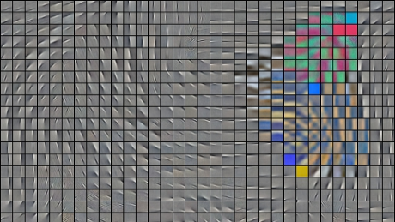
This is how the brain really works
COS429 Computer Vision

Slide 2

The Deep Learning Saga
http://www.youtube.com/watch?v=mlXzufEk-2E

Slide 3

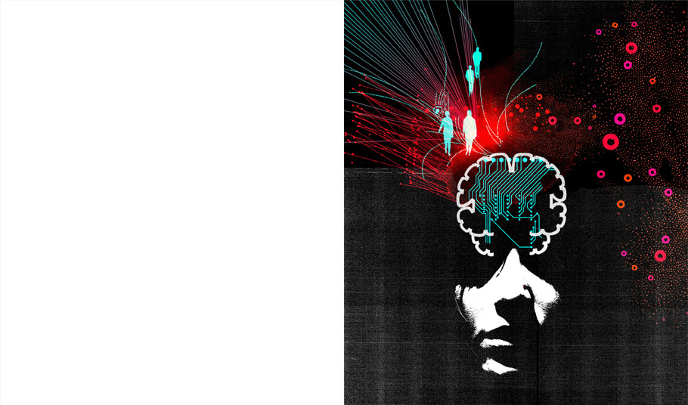
Deep Learning
With massive amounts of computational power, machines can now recognize objects and translate speech in real time. Artificial intelligence is finally getting smart.

Slide 4


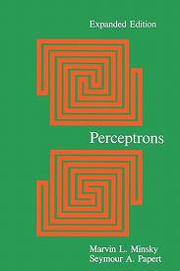
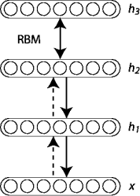
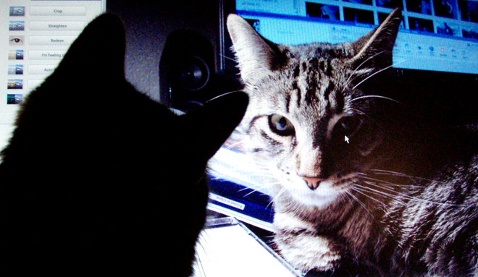
Neural Net Events
Convolutional neural networks
founded by
Warren McCulloch and Walter Pitts
ImageNet classification over millions of images
back propagation by Rumelhart and Hinton
1969
2006
2012
1943
1986
1998
2012
criticism by Minsky in his book “Perceptron”
deep belief networks by Hinton
Google
CAT

Slide 5


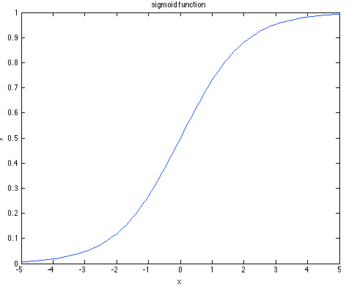

Neural Networks
basic building blocks
neuron
where f is a activation function:
input
output
sigmoid is bounded between 0 and 1
monotonically increasing
differentiation:

Slide 6

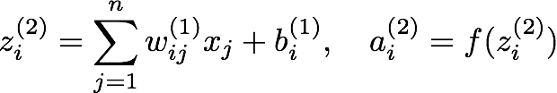










Neural Networks
representation
feed-forward
for each neuron in the next layer:
compactly:
globally models a function:
where W and b are model parameters

Slide 7


Neural Networks
supervised learning
define a loss function over the true label and the model prediction, such as squared error / cross entropy.
use gradient descent to optimize the model parameter.
back propagation
learning rate

Slide 8















Neural Networks
back propagation
is just the chain rule to derive gradients.
minimize
just one sample
for illustration:
chain rule:

Slide 9


Neural Networks
back propagation
is just the chain rule to derive gradients.
minimize
just one sample
for illustration:
chain rule:

Slide 10


Neural Networks
back propagation
is just the chain rule to derive gradients.
minimize
just one sample
for illustration:
chain rule:

Slide 11
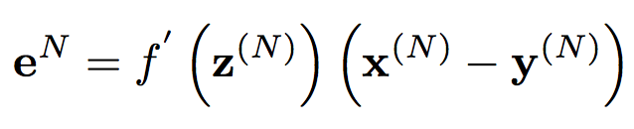
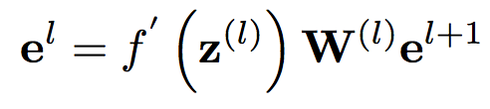
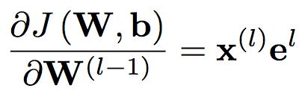
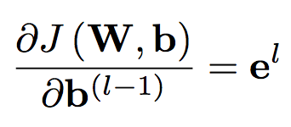
A change in z can affect all the nodes which are connected to a's output.
This means that in order to compute the sensitivity for a unit, we should first sum over the next layer’s sensitivies corresponding to units that are connected to this unit, and multiply each of those connections by the associated weights defined at next layer. We then multiply this quantity by the derivative of the activation function evaluated at the current layer’s pre-activation inputs.
Therefore, as Sebastian Seung pointed out, the “error” e which we propagate backwards through the network can be thought of as “sensitivities” of each unit with respect to perturbations of the bias b.

Slide 12
Neural Networks
learning algorithm for neural nets
initialize:
for iter = 1 : epochs
feed_forward(); // computing activations for all layers
back_prop(); // compute the partial derivatives respect to W, b
// update
end

Slide 13




Neural Networks
toy example: (linear identity activation function)
1
0
1
1

Slide 14
Neural Networks
toy example: (linear identity activation function)
1
0
1
1

Slide 15
Neural Networks
batch gradient descent & stochastic gradient descent
use a mini-batch instead of all samples
to evaluate one gradient step
e.x. 100 training data, 5 mini-batch, each 20 data
recall
minimize
y
we have to compute and average all the training sample gradients in order to perform one gradient descent step
too costly!
each sample has already provide some information where to go
x
shuffle the data

Slide 16
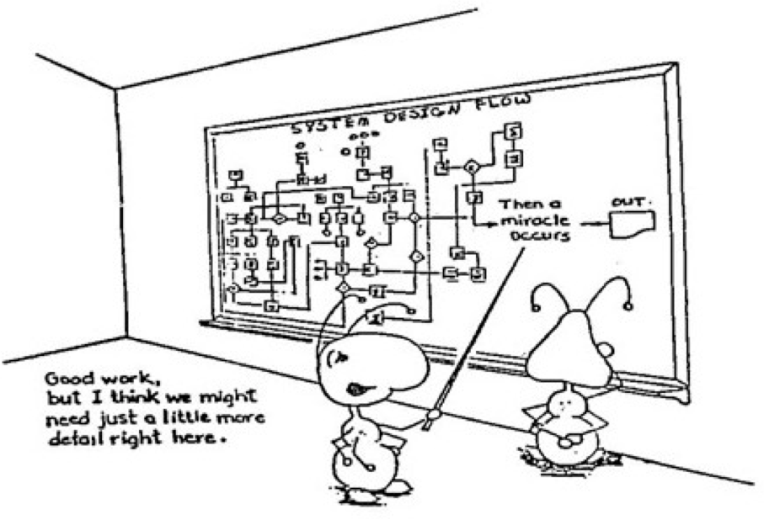

Slide 17
Neural Networks
stochastic gradient descent algorithm
initialize:
for iter = 1 : epochs
shuffle the data
for batch = 1 : num_batch
feed_forward(); // computing activations for all layers
back_prop(); // compute the partial derivatives respect to W, b
// update
end
end

Slide 18

Neural Networks
stochastic gradient descent practical issues:
how to initialize W,b?
small values. e.x. W to be 0.01*N(0,1), b to be 0
how to set the learning rate?
set the learning rate so that:
linearly decreasing when necessary
how to set the size of mini-batch?
cannot be too big, 20 - 50 is fine

Slide 19



Neural Networks
more sophisticated way to update parameters
weight decay:
momentum:
brings robustness to stochastic gradient descent

Slide 20
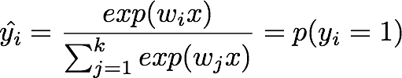
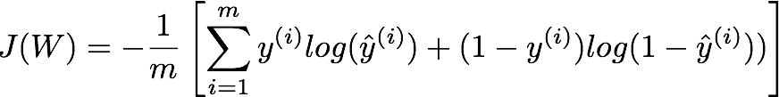

Neural Networks
softmax classifier
label is in 1-k coding scheme
cost function:
last layer
derivatives: (back prop)

Slide 21
Convolutional Neural Networks
why convolutional?
for images, too many model parameters
locality and stationarity of features

Slide 22
Convolutional Neural Networks
detection
layers
convolution

Slide 23
Convolutional Neural Networks
pooling :
reduce the size of representations
allow small translation invariance.
feature map
figure from roger grosse tutorial
common pooling techniques:
max pooling, average pooling

Slide 24
Convolutional Neural Networks
convolution network is just a combination of convolution layers, pooling layers and fully connected layers
(ﬁgure from LeNet tutorial, http://deeplearning.net/tutorial/lenet.html)

Slide 25
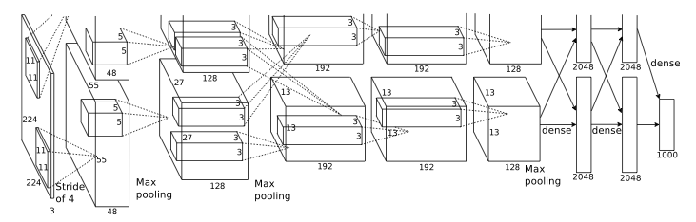
Convolutional Neural Networks
practical example: ImageNet Classification
softmax
classifier
architecture:
8 layers in total
first 5 are convolutional
last 3 are fully connected
max-pooling in the 1,2,5th layer
stride
(ﬁgure from Krizhevsky, Alex et al 2012)

Slide 26

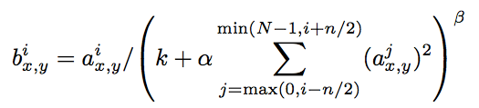
Convolutional Neural Networks
details:
activation function : ReLU
local normal contrast:
normalize at the same spatial location
over different feature maps
overlapping pooling: pooling size 3 with stride 2
size=3
stride=2

Slide 27
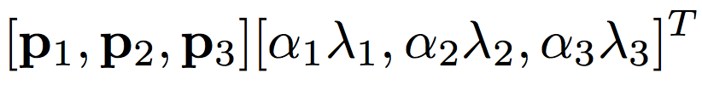
Convolutional Neural Networks
reduce over-fitting:
training 1.2 million images for 60 million parameters
data augmentation:
extracting random 224*224 patches from the 256*256 images and horizontal refections. This results in an increase by a factor of 2048.
altering the intensities of the RGB channels, object identity is invariant to the illumination. Add each RGB pixel in each training image by
where are the 3 - 1 eigenvectors and are eigen values
of 3 - 3 covariance matrix of RGB pixels

Slide 28
Convolutional Neural Networks
reduce over-fitting:
dropout:
an efficient way to combining different model predictions.
for each forward pass and each back propagation, randomly defunctions every neuron with probability 0.5. (setting the activation to zero)
testing: using all of the neurons behaves like combining different model predictions
dropout

Slide 29
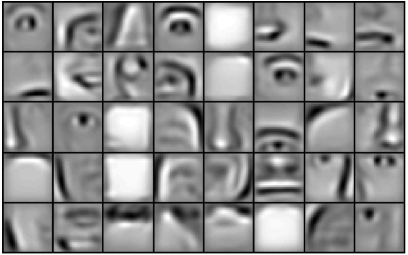
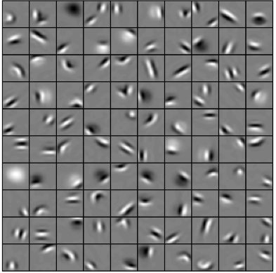
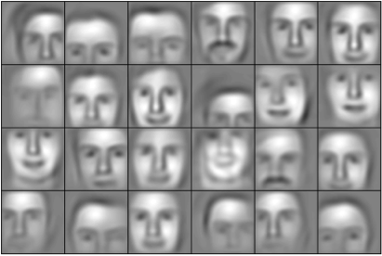
Convolutional Neural Networks
filter visualization:
(Honglak Lee et al 2009)

Slide 30
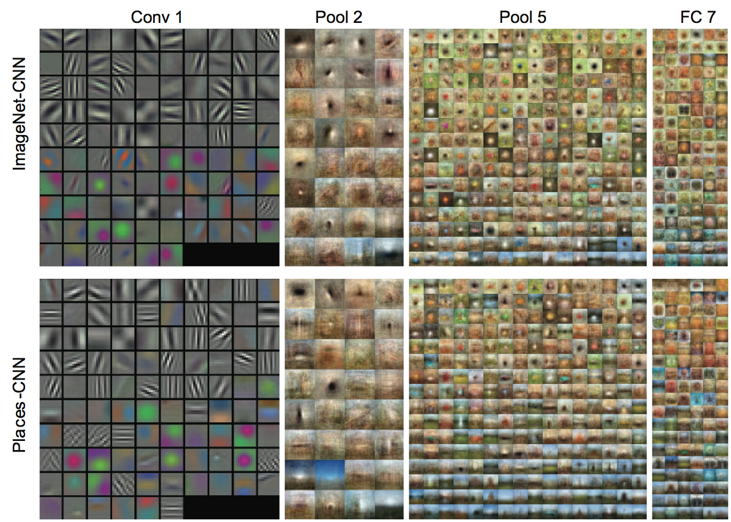
Learned Features
B. Zhou, A. Lapedriza, J. Xiao, A. Torralba, and A. Oliva
Learning Deep Features for Scene Recognition using Places Database
Advances in Neural Information Processing Systems 27 (NIPS2014)

Slide 31
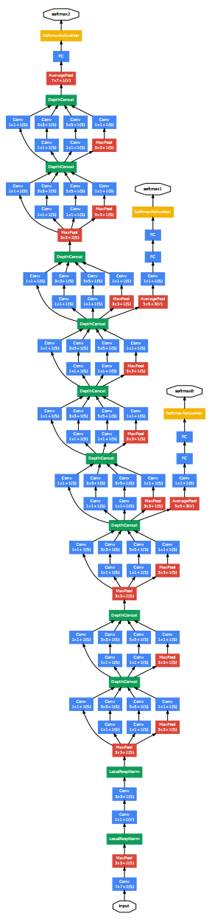
State-of-the-art: GoogLeNet
Paper: http://arxiv.org/abs/1409.4842
Implementation: http://vision.princeton.edu/projects/2014/places/GoogLeNet/

Slide 32


Convolutional Neural Networks
practical implementation tips:
(do not contain activation functions)
feed forward:
back prop:

Slide 33


Convolutional Neural Networks
filter visualization:
first layer: what pattern is most likely to turn on this neuron?

Slide 34

Convolutional Neural Networks
filter visualization:
higher layers: difficult, a linear combination of previous layers.

Slide 35
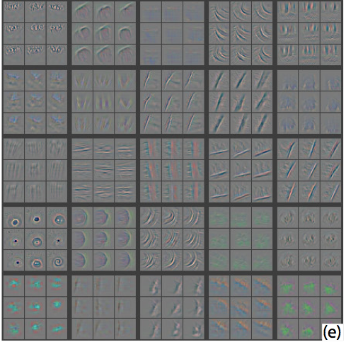
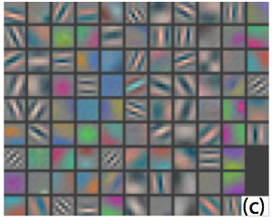
Convolutional Neural Networks
filter visualization:
filters learned
(Matthew D. Zeiler et al 2013)

Slide 36
Convolutional Neural Networks
online web demo:
http://cs.stanford.edu/people/karpathy/convnetjs/
matlab code demo

Slide 37
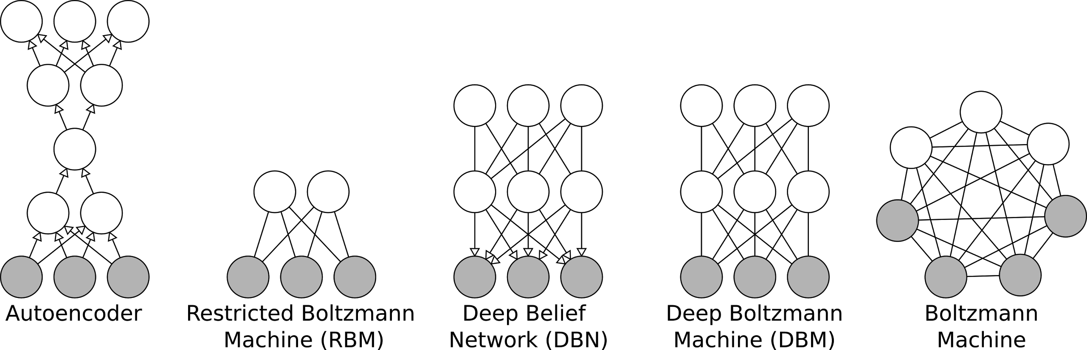
Other Deep Neural Networks

Slide 38
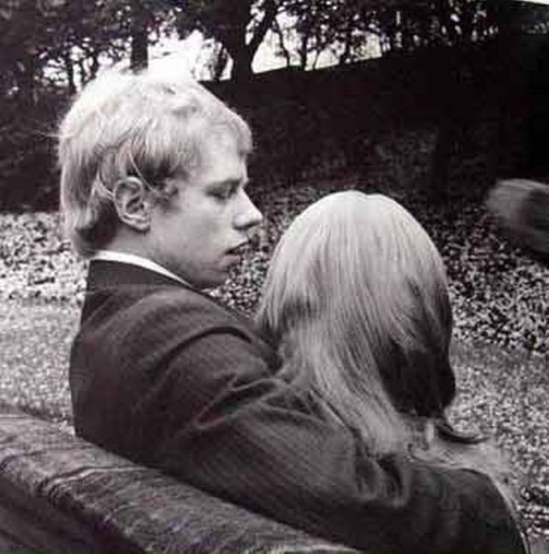
3D Shape Representation

Slide 39
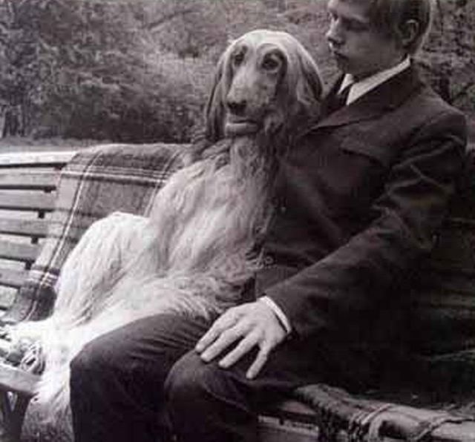
Life is just a matter of perspective!
Notes:
Here is another thing I learnt from my wife.

Slide 40
3D Shape Representation

Slide 41
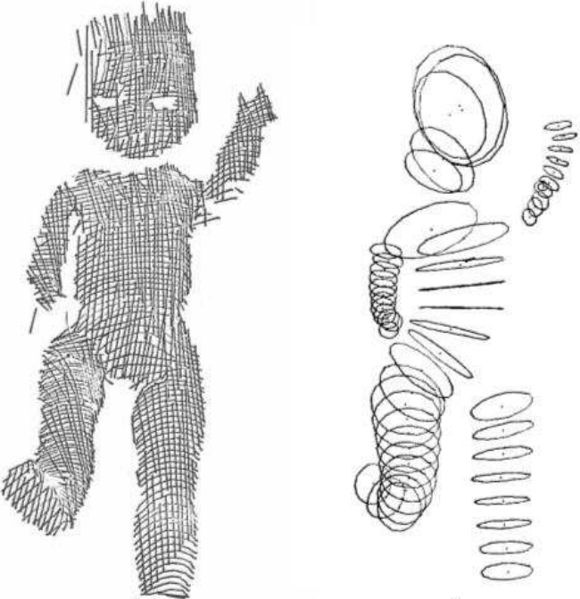
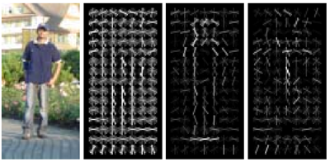
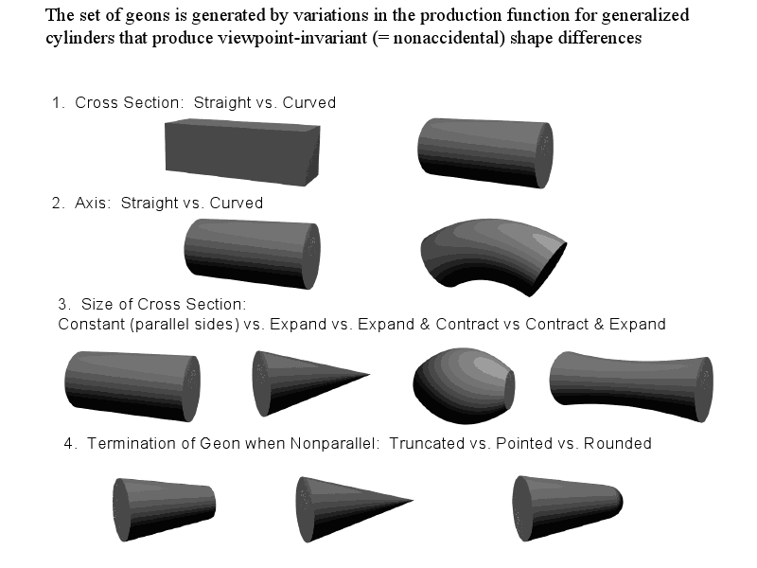
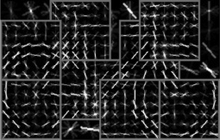
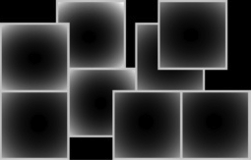
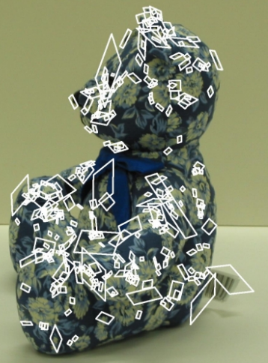
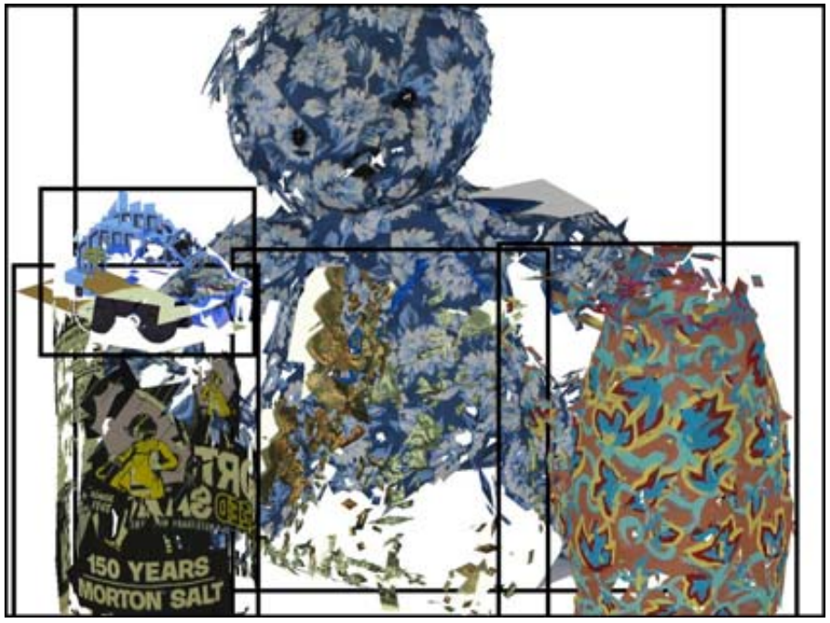
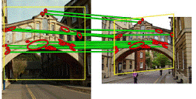
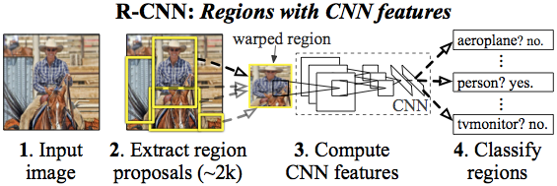
3D Shape Representation?
Theory
The state-of-the-arts
Dalal & Triggs 2005
Geon
Generalized Cylinder
Instance-level Matching
Felzenszwalb et al. 2010
Rothganger et al. 2006
Philbin et al. 2007
Girshick et al. 2014

Slide 42

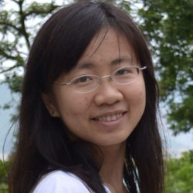
Data-driven 3D Feature/
3D Shape Representation
Learn from Big 3D Data (not hand-defined)
Able to generalize (not just memorize NN)
Compositional (from parts to whole object)
Z. Wu, S. Song, A. Khosla, X. Tang, J. Xiao
3D ShapeNets for 2.5D Object Recognition and Next-Best-View Prediction
Under review of NIPS 2014 (arXiv preprint)
Zhirong Wu
Shuran Song

Slide 43
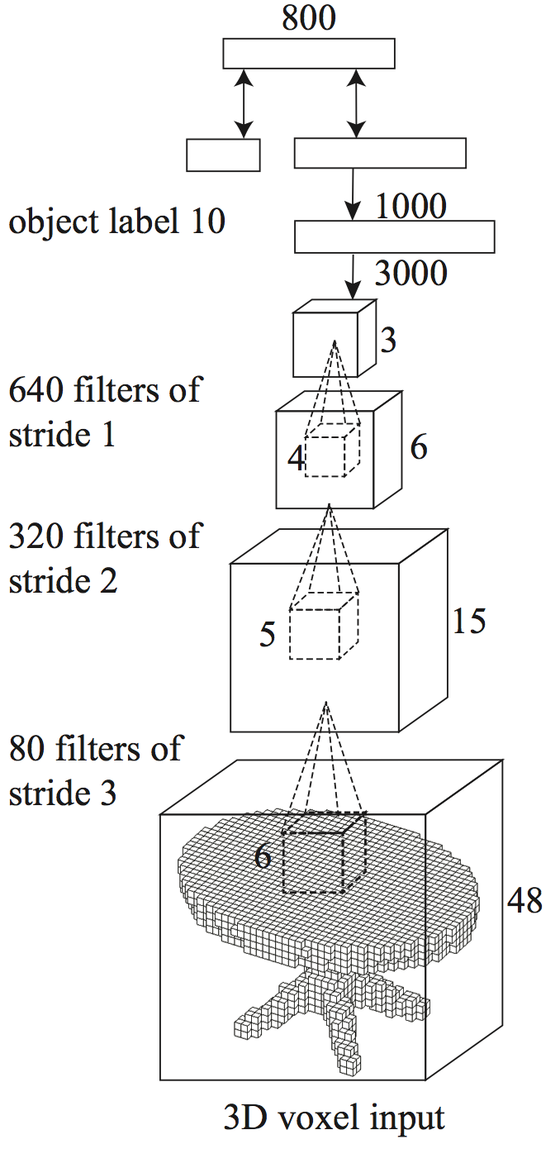
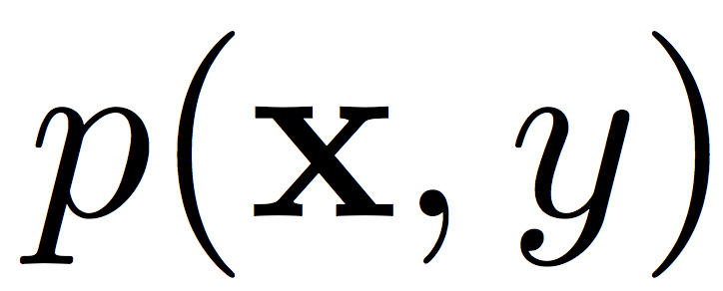
3D ShapeNets
Convolutional Deep
Belief Network
Visualization at Different Layers
Notes:
As I told you earlier, I am a big fans of deep learning.

Slide 44
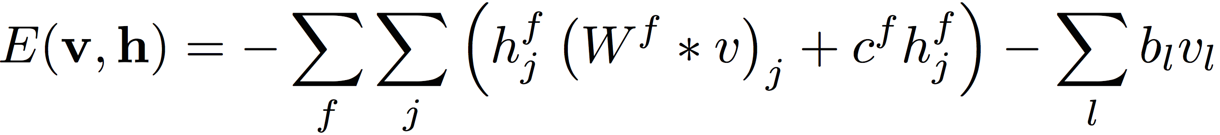
Architecture
Convolutional to reduce parameters
No pooling to reduce reconstruction error
The energy of a convolutional layer:
hidden unit
visible unit
convolutional filter
share the same bias term
unique bias term to facilitate reconstruction
Convolutional Deep
Belief Network
Notes:
During pre-training of the first layer, we collect learning signal only to receptive fields which are non-empty. Because of the nature of data, empty spaces occupy a large portion of the whole volume, which has no information for RBM and would distract the learning. Our experiment shows that ig- noring those learning signals during gradient computation results in more meaningful filters.
to reduce convolution border artifacts. The labels are presented as standard one of K softmax variables. All of our training data are manually aligned to the same direction. The final architecture of our model is in Figure 2(a). The

Slide 45
Architecture
Input: 42 × 42 × 42 voxel grid with 3-cell padding
Label: standard one of K softmax variables
Layer 1: 80 filters of size 6 and stride 3
Layer 2: 320 filters of size 5 and stride 2
Layer 3: 640 filters of size 4
Layer 4: fully connected RBM with 3000 hidden units
Layer 5: fully connected RBM with 1000 hidden units
Layer 6: multinomial label + Bernoulli feature
forms an associate memory (undirected)
Convolutional Deep
Belief Network
Notes:
During pre-training of the first layer, we collect learning signal only to receptive fields which are non-empty. Because of the nature of data, empty spaces occupy a large portion of the whole volume, which has no information for RBM and would distract the learning. Our experiment shows that ig- noring those learning signals during gradient computation results in more meaningful filters.
to reduce convolution border artifacts. The labels are presented as standard one of K softmax variables. All of our training data are manually aligned to the same direction. The final architecture of our model is in Figure 2(a). The

Slide 46
Princeton ModelNet
Notes:
Following the great tradition of WordNet and ImageNet from princeton,
We feel that we are obligated to call our dataset Princeton ModelNet.

Slide 47
Princeton ModelNet
585 categories 127,915 CAD models

Slide 48
Training
Data: orientation aligned CAD models + labels
Pre-training:
Lower four layers are trained by CD
First layer: only use non-empty receptive fields
Last layer:
  trained by FPCD
  duplicate the label units by 10
Fine-tuning: wake sleep but keep weights tied
wake: propagate data bottom up and use the activations to collect the positive learning signal
sleep: maintain a persistent chain on the topmost layer and propagate the data top down to collect the negative learning signal
Convolutional Deep
Belief Network
Notes:
During pre-training of the first layer, we collect learning signal only to receptive fields which are non-empty. Because of the nature of data, empty spaces occupy a large portion of the whole volume, which has no information for RBM and would distract the learning. Our experiment shows that ig- noring those learning signals during gradient computation results in more meaningful filters.
This fine-tuning procedure mimics the recognition and generation behavior of the model and works well in practice. We find that this overall generative fine-tuning is critical for shape completion performance

Slide 49
3D ShapeNets
Convolutional Deep
Belief Network
Visualization at Different Layers
Notes:
As I told you earlier, I am a big fans of deep learning.

Slide 50
As a 3D Shape Prior
Sampled Models

Slide 51
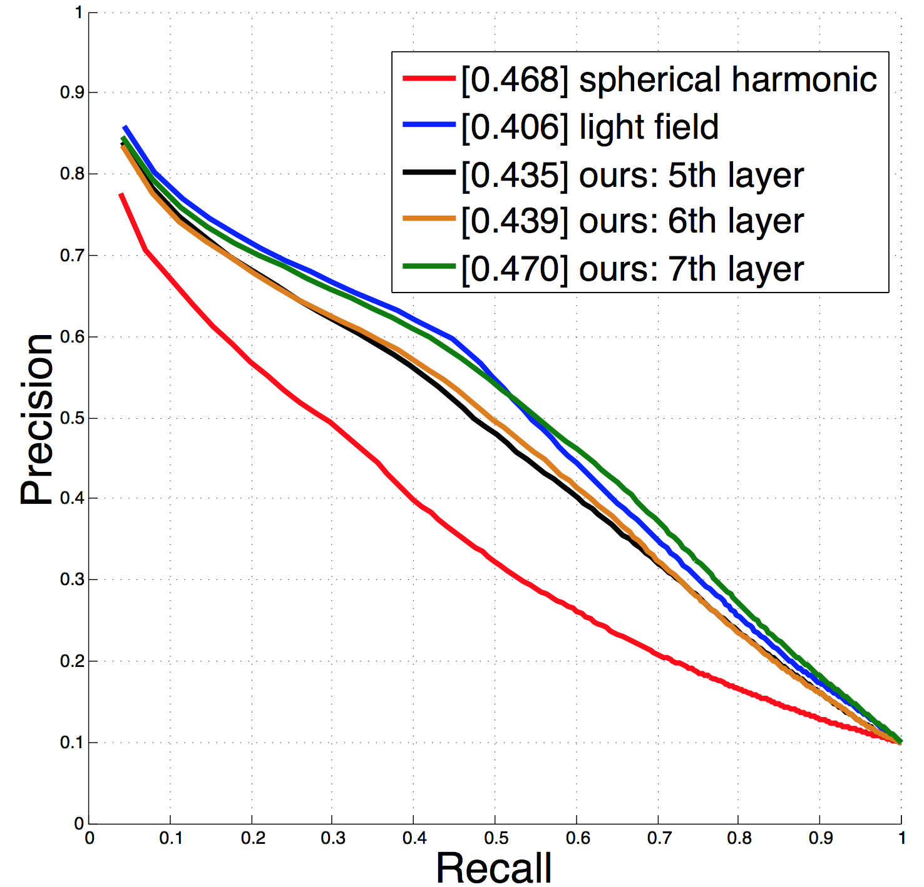
As a 3D Feature Extractor
Feature | Accuracy
spherical harmonic | 82.0%
light field | 86.1%
ours: 5th layer | 86.5%
ours: 6th layer | 83.7%
ours: 7th layer | 82.0%
Mesh Classification
Mesh Retrieval

Slide 52
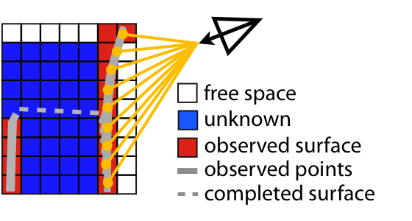
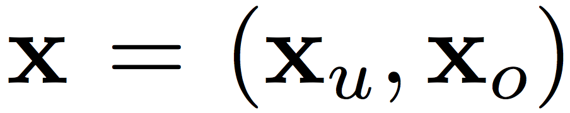
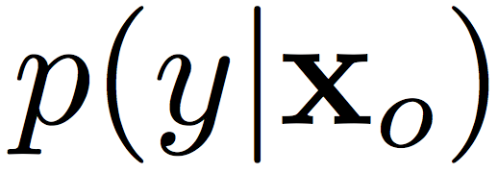
2.5D Object Recognition
Gibbs sampling with clamping

Slide 53
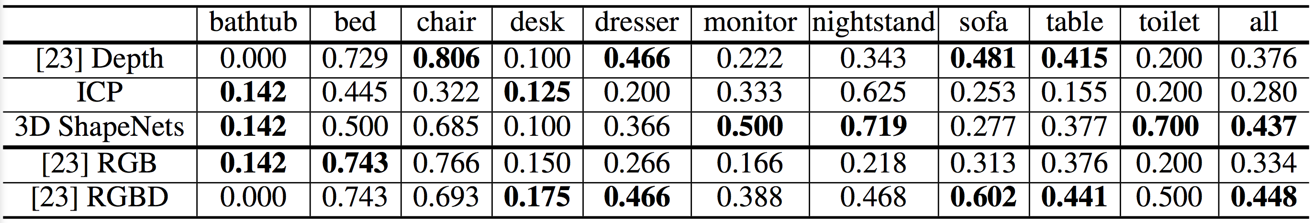
2.5D Object Recognition
[*] R. Socher, B. Huval, B. Bhat, C. D. Manning, and A. Y. Ng.
Convolutional-recursive deep learning for 3d object classification. In NIPS 2012.

Slide 54

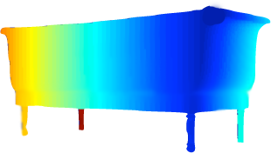
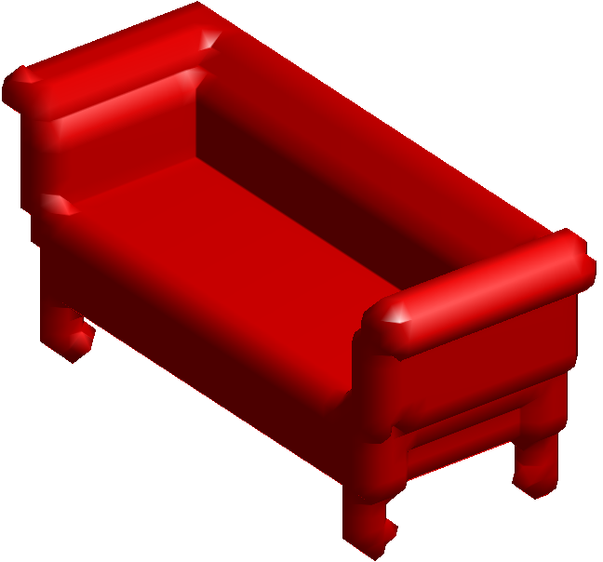

Next-Best-View for Recognition
Depth map from
the back of a sofa
3D ShapeNets
Next-Best-View
Aha!
It is a sofa!
?
sofa?
dresser?
Not sure.
Look from
another view?
Volumetric representation
What is it?
bathtub?
Where to look next?
New depth map

Slide 55
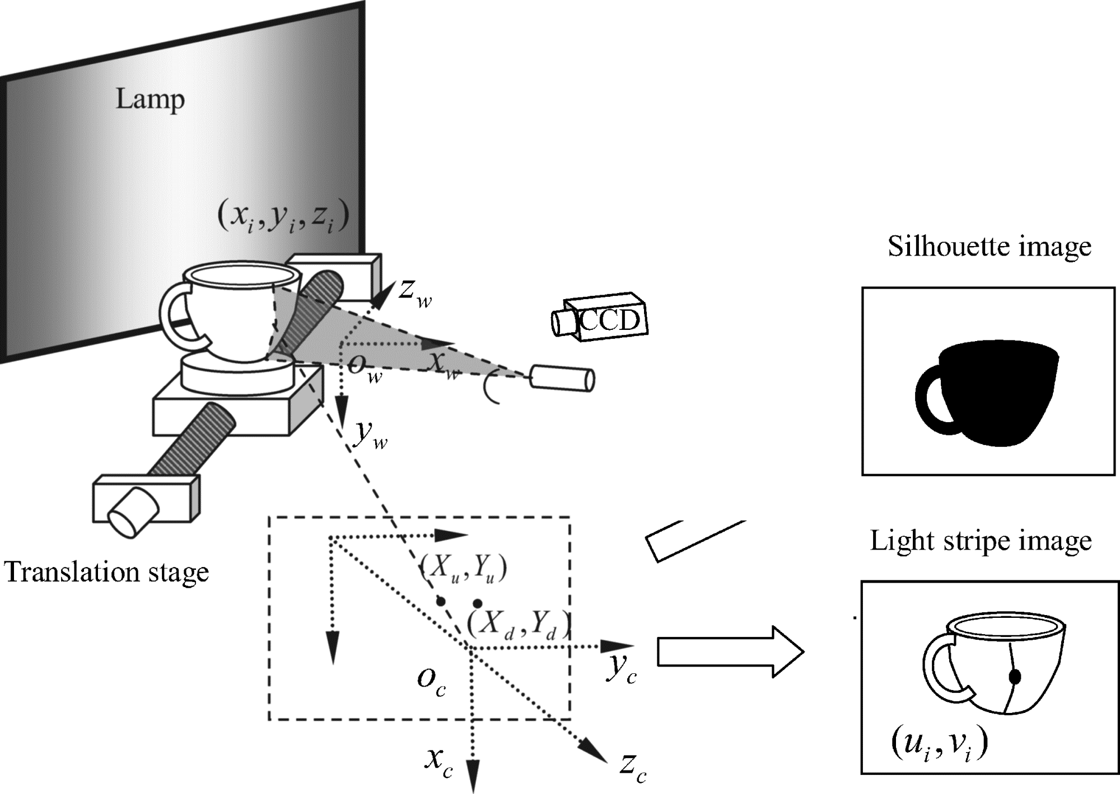
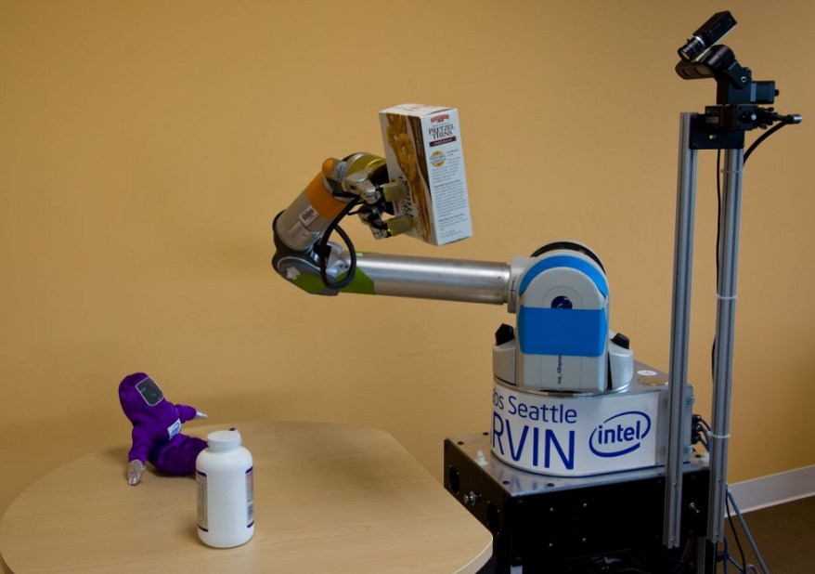
Next-Best-View for Reconstruction
Method of scanning-path determination for color three-dimensional laser measurement
C. Sun, P. Wang, L. Tao and S. Chen
Opt. Eng. 2008
Autonomous Generation of Complete 3D Object Models Using Next Best View Manipulation Planning
M. Krainin, B. Curless, and D. Fox
ICRA 2011
View Planning for Automated 3D Object Reconstruction and Inspection
Survey: W. Scott, G. Roth, and J.F. Rivest
The ACM Computing Surveys, 2003

Slide 56
Next-Best-View for Recognition

Slide 57
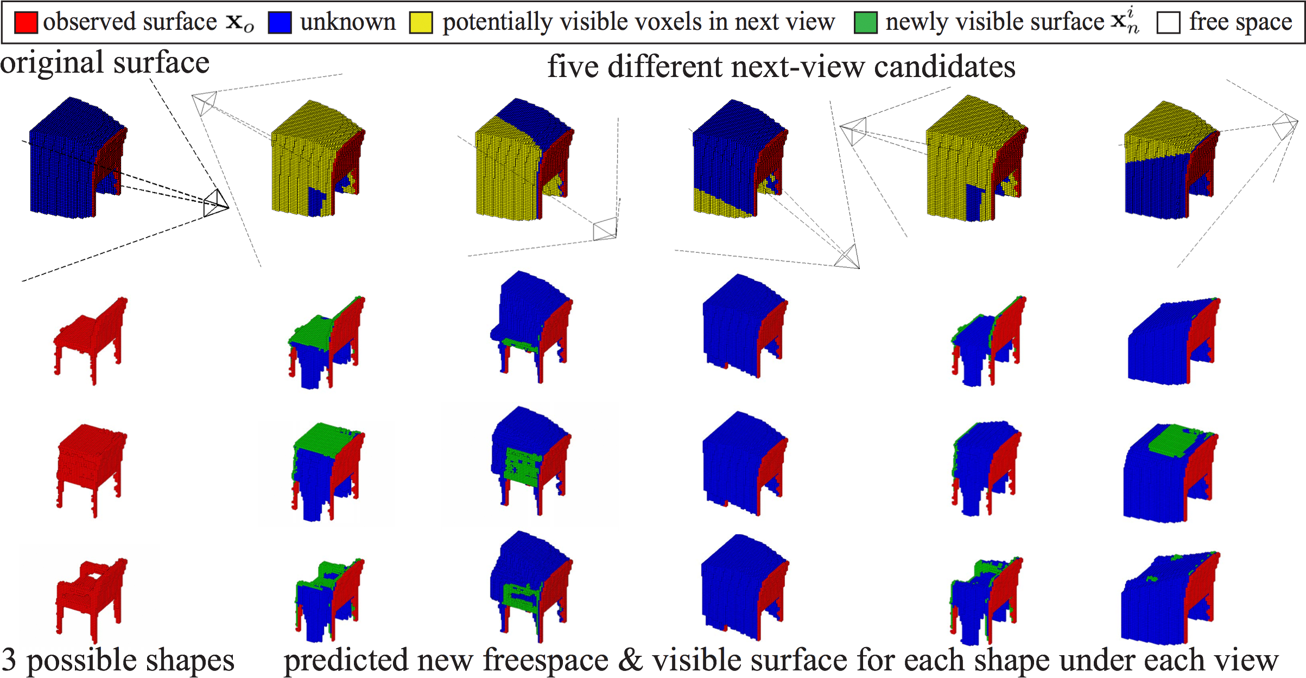
Next-Best-View for Recognition
A view with the potential to see distinctive parts of objects (e.g. arms of chairs) may be a better next view.
Simulate for different views on different samples and get the benefit on reducing recognition uncertainty.
Notes:
Add animation to explain next best view better

Slide 58

Next-Best-View for Recognition

Slide 59





Next-Best-View for Recognition
Calculated by:
sampling enough
do the 3D rendering to obtain 2.5D depth map in order to get from
then take each to calculate
Information Theory: the reduction of entropy is the mutual information between and conditioned on .

Slide 60

Next-Best-View for Recognition
Recognition Accuracy from Two Views.
Based on the algorithms’ choice, we obtain the actual depth map for the next view and recognize the objects using two views by our 3D ShapeNets to compute the accuracies.

Slide 61
Shape Completion
Depth
Truth
3D ShapeNets
NN

Slide 62

Review of this course
Low Level Vision
(Image Processing)
(Image In, Image Out)
Mid Level Vision
(Geometry and
3D Reconstruction)
High Level Vision
(Recognition)

Slide 63








Low Level Vision
(Image Processing)
(Image In, Image Out)
Low Level Features
Mid Level Vision
(Geometry and
3D Reconstruction)
Mid Level Features
High Level Vision
(Recognition)
High Level Features
Receptive Field

Slide 64
CV ≠ Applied Machine Learning
Physics ≠ Applied Math
Early marriage of AI and CV
➔ Early divorce of AI and CV
➔ Maybe time for remarrying?
CV is an experimental science
  Think about physics at the beginning

Slide 65
Quiz
Write your name, netid, student id on the first page
Do not turn to the next page until you are asking to and we start timing.

