Slide 1

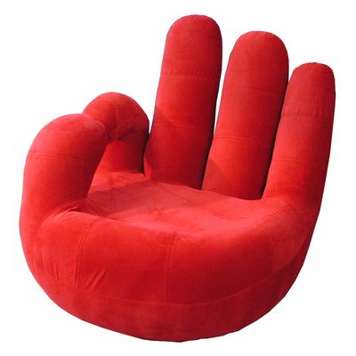

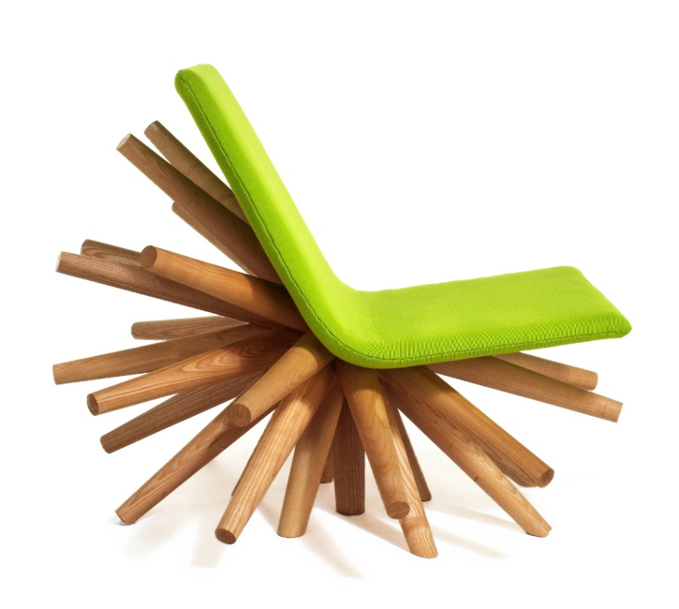

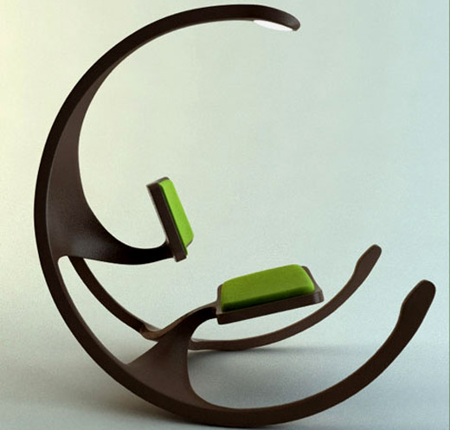
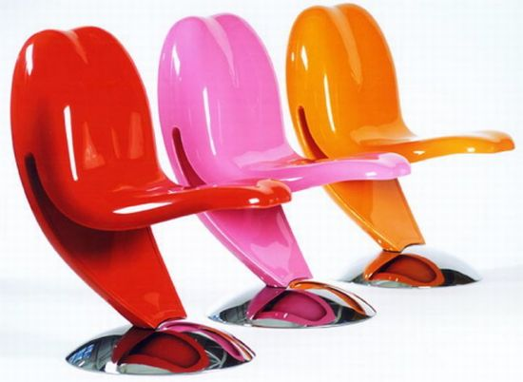
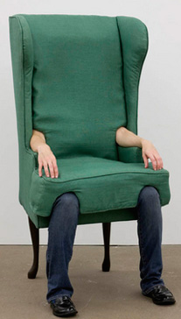
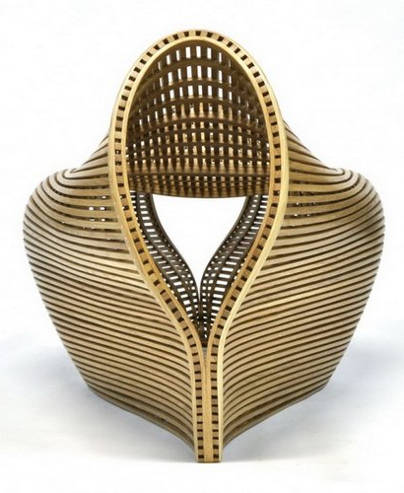
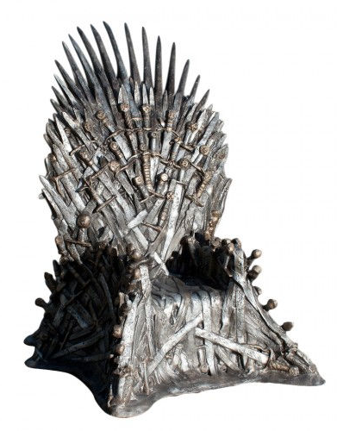
What is a Chair?
COS429 Computer Vision
Notes:
The one-hour tutorial about 3D reconstruction

Slide 2

The object

Slide 3
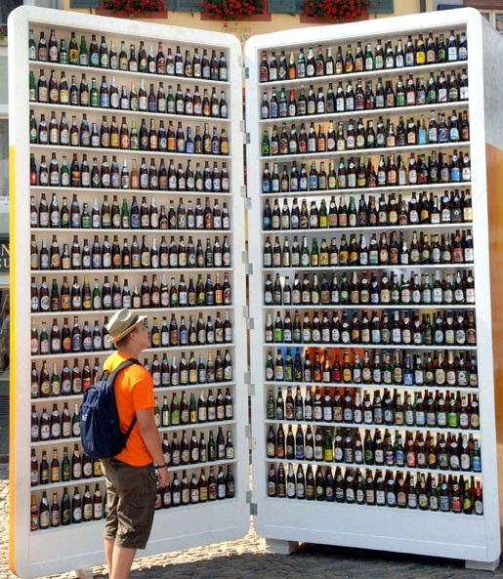
The texture
The object

Slide 4
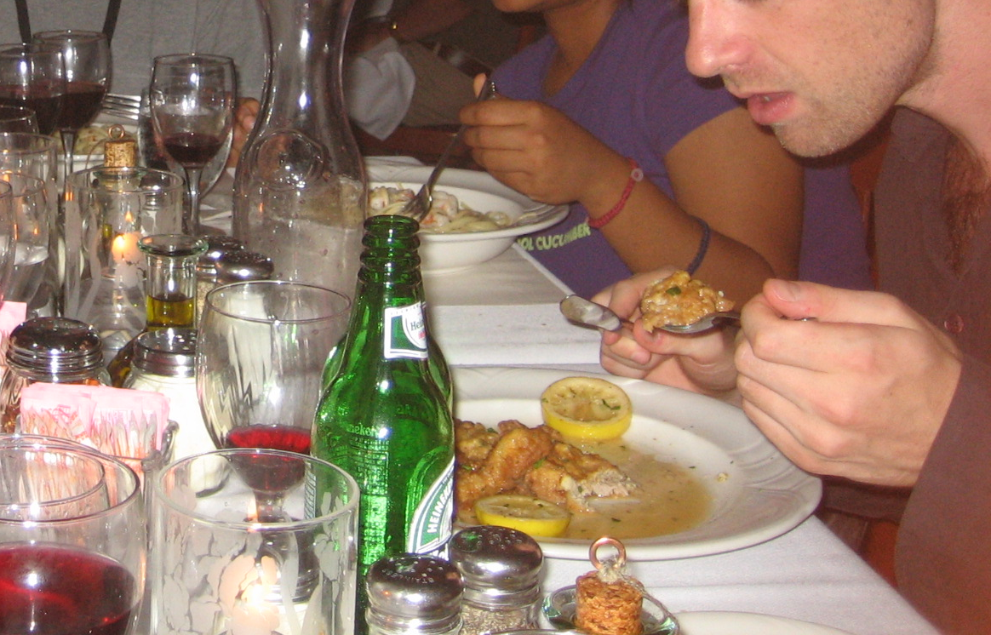
The texture
The object
The scene

Slide 5
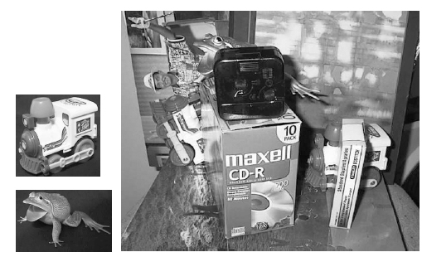
Instances vs. categories
Instances
Find these two toys
Categories
Find a bottle:
Can nail it
Can’t do
unless you do not
care about few errors…

Slide 6
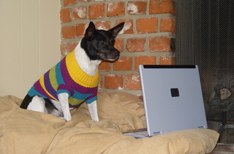
Why do we care about recognition?
Perception of function: We can perceive the 3D shape, texture, material properties, without knowing about objects. But, the concept of category encapsulates also information about what can we do with those objects.
“We therefore include the perception of function as a proper –indeed, crucial- subject for vision science”, from Vision Science, chapter 9, Palmer.

Slide 7

The perception of function
Direct perception (affordances): Gibson
Flat surface
Horizontal
Knee-high
…
Sittable
upon
Mediated perception (Categorization)
Flat surface
Horizontal
Knee-high
…
Chair
Sittable
upon
Chair
Chair
Chair?

Slide 8
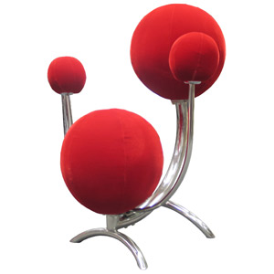
Direct perception
Some aspects of an object function can be perceived directly
Functional form: Some forms clearly indicate to a function (“sittable-upon”, container, cutting device, …)
Sittable-upon
Sittable-upon
It does not seem easy
to sit-upon this…
Sittable-upon

Slide 9
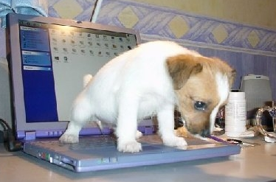
Direct perception
Some aspects of an object function can be perceived directly
Observer relativity: Function is observer dependent
From http://lastchancerescueflint.org

Slide 10
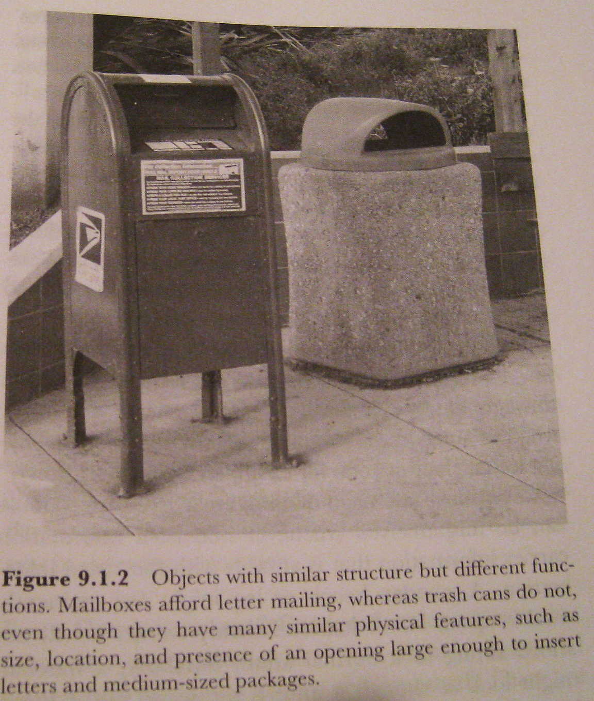
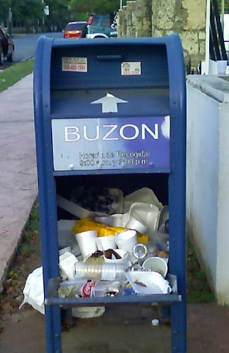
Limitations of Direct Perception
Objects of similar structure might have very different functions
Not all functions seem to be available from direct visual information only.
The functions are the same at some level of description: we can put things inside in both and somebody will come later to empty them. However, we are not expected to put inside the same kinds of things…

Slide 11
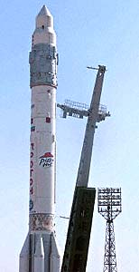

Limitations of Direct Perception
Visual appearance might be a very weak cue to function
Propulsion system
Strong protective surface
Something that looks like a door
Sure, I can travel to space on this object

Slide 12
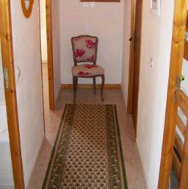

Object recognition
Is it really so hard?
Find the chair in this image
Output of normalized correlation
This is a chair

Slide 13
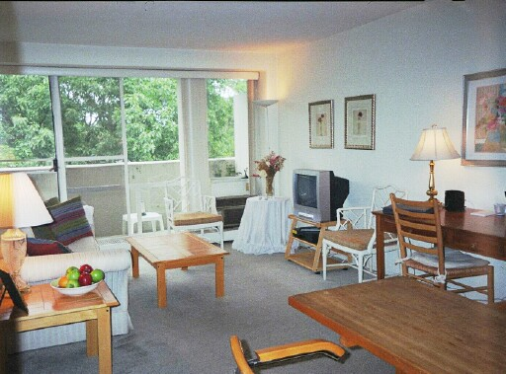
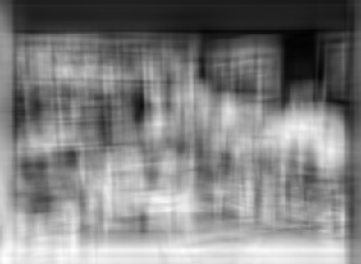
Object recognition
Is it really so hard?
Find the chair in this image
Pretty much garbage
Simple template matching is not going to make it
My biggest concern while making this slide was:
how do I justify 50 years of research, and this course, if this experiment did work?

Slide 14
Object recognition
Is it really so hard?
Find the chair in this image
A “popular method is that of template matching, by point to point correlation of a model pattern with the image pattern. These techniques are inadequate for three-dimensional scene analysis for many reasons, such as occlusion, changes in viewing angle, and articulation of parts.” Nivatia & Binford, 1977.

Slide 15
Why is object recognition a hard task?

Slide 16
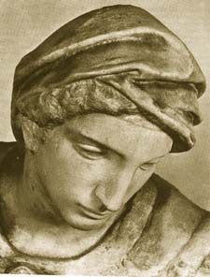
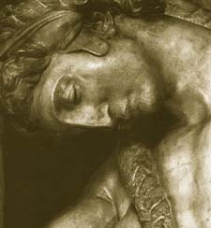
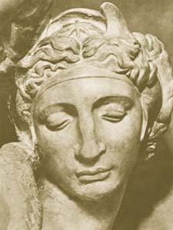
Challenges 1: view point variation
Michelangelo 1475-1564
Slides: course object recognition
ICCV 2005

Slide 17

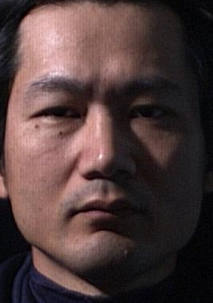
Challenges 2: illumination
slide credit: S. Ullman

Slide 18
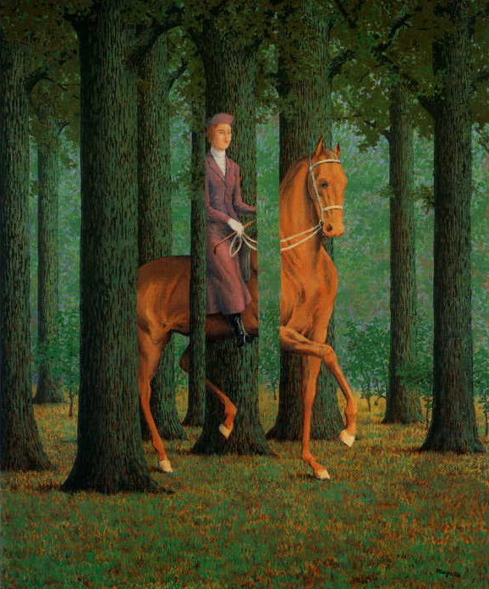
Challenges 3: occlusion
Magritte, 1957
Slides: course object recognition
ICCV 2005

Slide 19
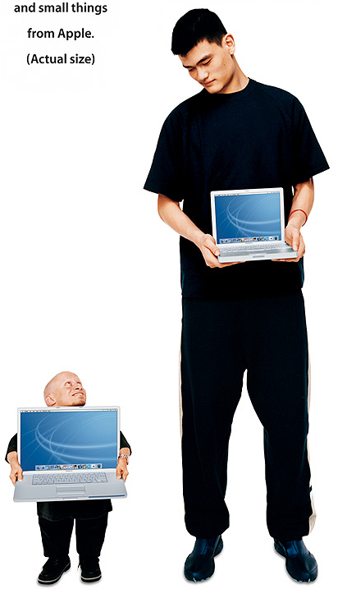
Challenges 4: scale
Slides: course object recognition
ICCV 2005

Slide 20
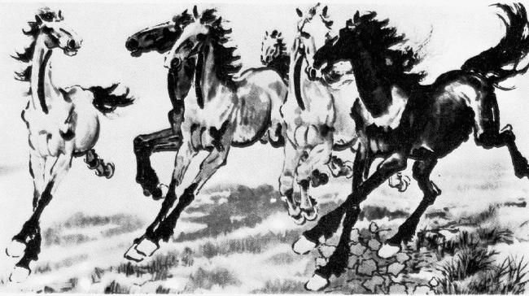
Challenges 5: deformation
Slides: course object recognition
ICCV 2005
Xu, Beihong 1943

Slide 21

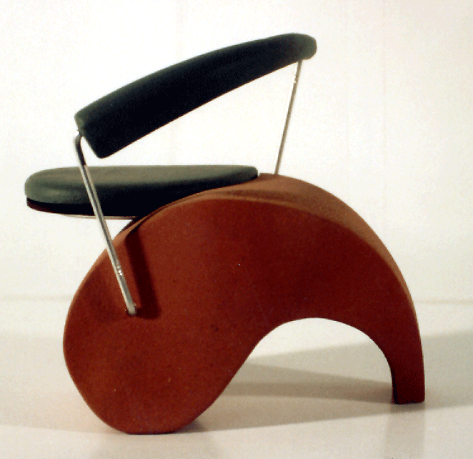
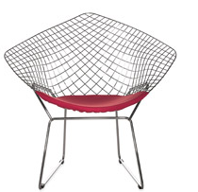


Challenges 6: intra-class variation
Slides: course object recognition
ICCV 2005

Slide 22
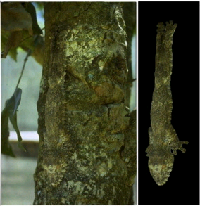
Challenges 7: background clutter
Brady, M. J., & Kersten, D. (2003). Bootstrapped learning of novel objects. J Vis, 3(6), 413-422

Slide 23
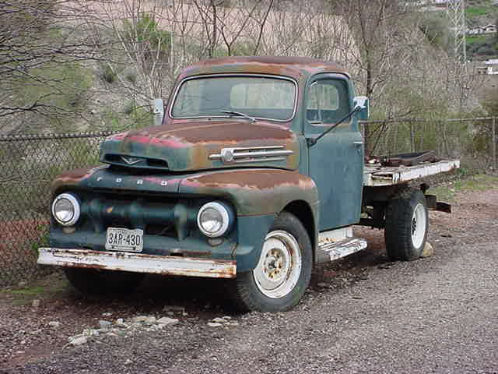
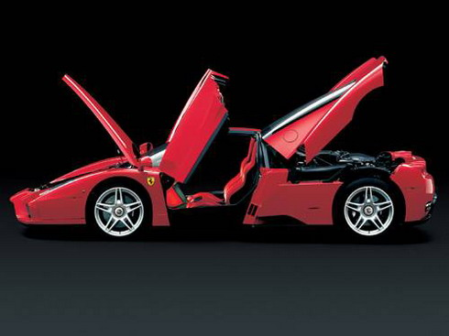
Which level of categorization is the right one?
Car is an object composed of:
a few doors, four wheels (not all visible at all times), a roof,
front lights, windshield
?
If you are thinking in buying a car, you might want to be a bit more specific about
your categorization.

Slide 24
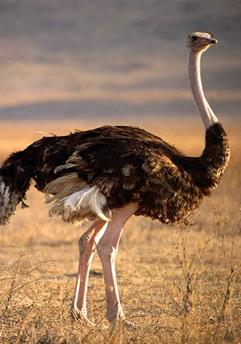
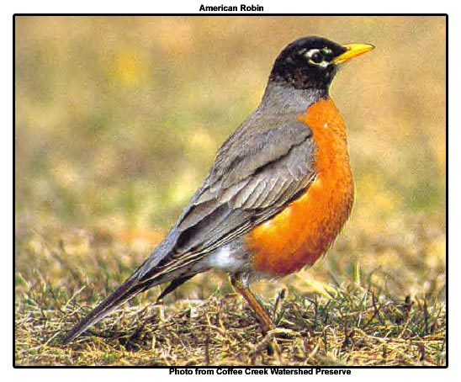
Entry-level categories
(Jolicoeur, Gluck, Kosslyn 1984)
Typical member of a basic-level category are categorized at the expected level
Atypical members tend to be classified at a subordinate level.
A bird
An ostrich

Slide 25
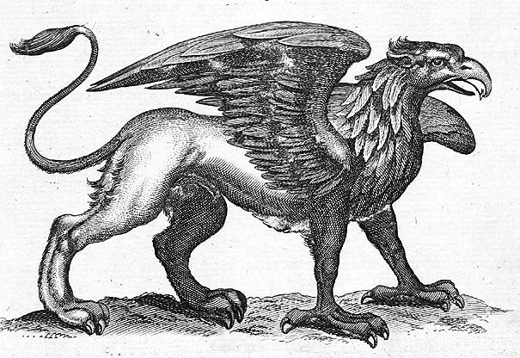
Creation of new categories
A new class can borrow information from similar categories

Slide 26
Object recognition
Is it really so hard?
Yes, object recognition is hard…
(or at least it seems so for now…)

Slide 27
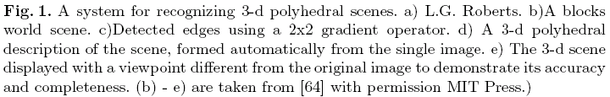
So, let’s make the problem simpler:
Block world
Nice framework to develop fancy math, but too far from reality…
Object Recognition in the Geometric Era: a Retrospective. Joseph L. Mundy. 2006

Slide 28
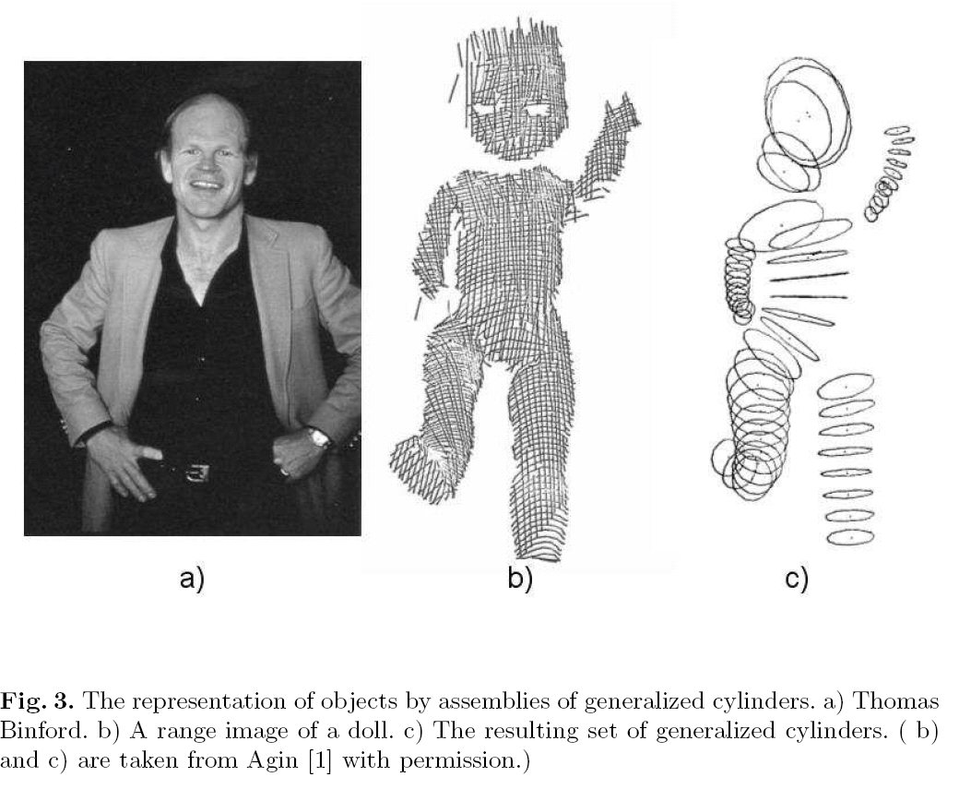
Binford and generalized cylinders
Object Recognition in the Geometric Era: a Retrospective. Joseph L. Mundy. 2006

Slide 29
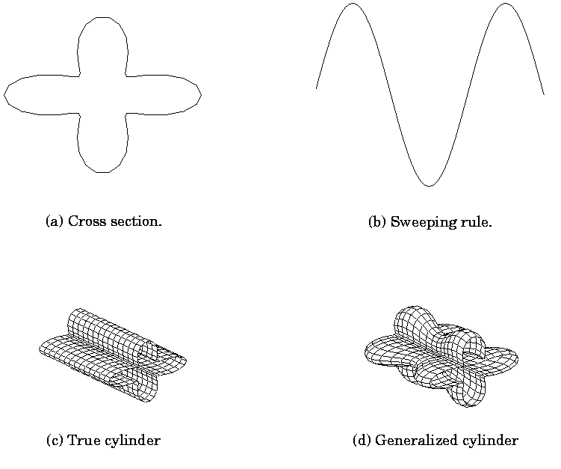
Binford and generalized cylinders

Slide 30

Recognition by components
Irving Biederman
Recognition-by-Components: A Theory of Human Image Understanding.
Psychological Review, 1987.

Slide 31
Recognition by components
The fundamental assumption of the proposed theory, recognition-by-components (RBC), is that a modest set of generalized-cone components, called geons (N = 36), can be derived from contrasts of five readily detectable properties of edges in a two-dimensional image: curvature, collinearity, symmetry, parallelism, and cotermination.
The “contribution lies in its proposal for a particular vocabulary of components derived from perceptual mechanisms and its account of how an arrangement of these components can access a representation of an object in memory.”

Slide 32
A do-it-yourself example
We know that this object is nothing we know
We can split this objects into parts that everybody will agree
We can see how it resembles something familiar: “a hot dog cart”
“The naive realism that emerges in descriptions of nonsense objects may be reflecting the workings of a representational system by which objects are identified.”

Slide 33
Hypothesis
Hypothesis: there is a small number of geometric components that constitute the primitive elements of the object recognition system (like letters to form words).
“The particular properties of edges that are postulated to be relevant to the generation of the volumetric primitives have the desirable properties that they are invariant over changes in orientation and can be determined from just a few points on each edge.”
Limitation: “The modeling has been limited to concrete entities with specified boundaries.” (count nouns) – this limitation is shared by many modern object detection algorithms.

Slide 34
Constraints on possible models of recognition
Access to the mental representation of an object should not be dependent on absolute judgments of quantitative detail
The information that is the basis of recognition should be relatively invariant with respect to orientation and modest degradation.
Partial matches should be computable. A theory of object interpretation should have some principled means for computing a match for occluded, partial, or new exemplars of a given category.

Slide 35
Stages of processing
“Parsing is performed, primarily at concave regions, simultaneously with a detection of nonaccidental properties.”

Slide 36
Non accidental properties
Certain properties of edges in a two-dimensional image are taken by the visual
system as strong evidence that the edges in the three-dimensional world contain those same properties.
Non accidental properties, (Witkin & Tenenbaum,1983): Rarely be produced by accidental alignments of viewpoint and object features and consequently are generally unaffected by slight variations in viewpoint.
image
?

Slide 37
Examples:
Colinearity
Smoothness
Symmetry
Parallelism
Cotermination

Slide 38
The high speed and accuracy of determining a given nonaccidental relation {e.g., whether some pattern is symmetrical) should be contrasted with performance in making absolute quantitative judgments of variations in a single physical attribute,
such as length of a segment or degree of tilt or curvature.
Object recognition is performed by humans in around 100ms.

Slide 39
Recoverable
Unrecoverable
“If contours are deleted at a vertex they can be restored, as long as there is no accidental filling-in. The greater disruption from vertex deletion is expected on the basis of their importance as diagnostic image features for the components.”

Slide 40
From generalized cylinders to GEONS
“From variation over only two or three levels in the nonaccidental relations of four attributes of generalized cylinders, a set of 36 GEONS can be generated.”
Geons represent a restricted form of generalized cylinders.

Slide 41
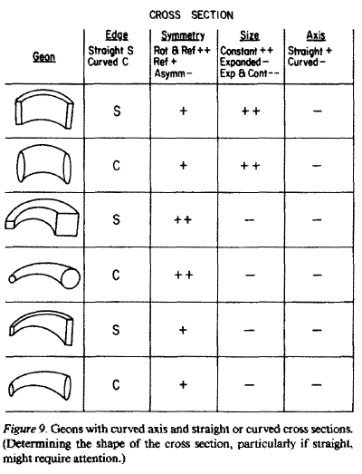
More GEONS

Slide 42
Objects and their geons

Slide 43
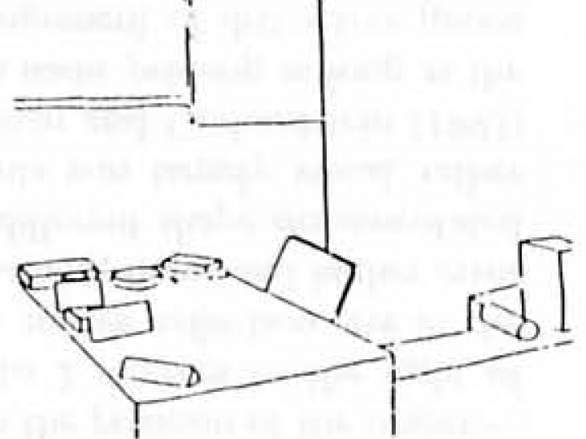
Scenes and geons
Mezzanotte & Biederman

Slide 44
Supercuadrics
Introduced in computer vision by A. Pentland, 1986.

Slide 45
What is missing?
The notion of geometric structure.
Although they were aware of it, the previous works put more emphasis on defining the primitive elements than modeling their geometric relationships.

Slide 46
The importance of spatial arrangement

Slide 47
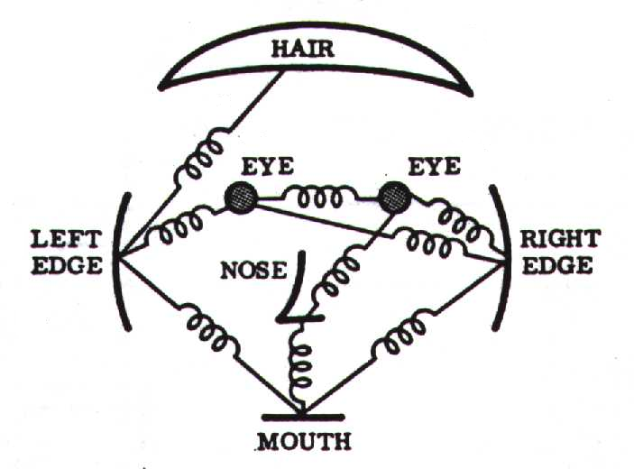
Parts and Structure approaches
With a different perspective, these models focused more on the geometry than on defining the constituent elements:
Fischler & Elschlager 1973
Yuille ‘91
Brunelli & Poggio ‘93
Lades, v.d. Malsburg et al. ‘93
Cootes, Lanitis, Taylor et al. ‘95
Amit & Geman ‘95, ‘99
Perona et al. ‘95, ‘96, ’98, ’00, ’03, ‘04, ‘05
Felzenszwalb & Huttenlocher ’00, ’04
Crandall & Huttenlocher ’05, ’06
Leibe & Schiele ’03, ’04
Many papers since 2000
Figure from [Fischler & Elschlager 73]

Slide 48
Representation
Object as set of parts
  Generative representation
Model:
  Relative locations between parts
  Appearance of part
Issues:
  How to model location
  How to represent appearance
  Sparse or dense (pixels or regions)
  How to handle occlusion/clutter
We will discuss these models more in depth later

Slide 49
But, despite promising initial results…things did not work out so well (lack of data, processing power, lack of reliable methods for low-level and mid-level vision)
Instead, a different way of thinking about object detection started making some progress: learning based approaches and classifiers, which ignored low and mid-level vision.
Maybe the time is here to come back to some of the earlier models, more grounded in intuitions about visual perception.

Slide 50
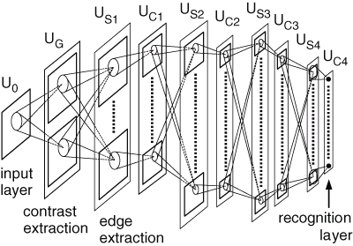
Neocognitron
Fukushima (1980). Hierarchical multilayered neural network
S-cells work as feature-extracting cells. They resemble simple cells of the primary visual cortex in their response.
C-cells, which resembles complex cells in the visual cortex, are inserted in the network to allow for positional errors in the features of the stimulus. The input connections of C-cells, which come from S-cells of the preceding layer, are fixed and invariable. Each C-cell receives excitatory input connections from a group of S-cells that extract the same feature, but from slightly different positions. The C-cell responds if at least one of these S-cells yield an output.

Slide 51
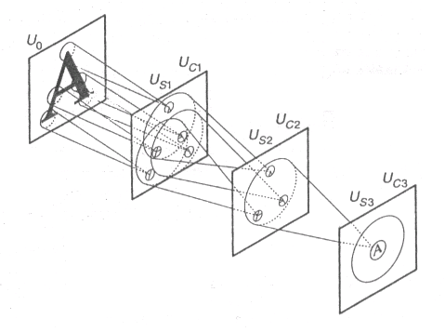
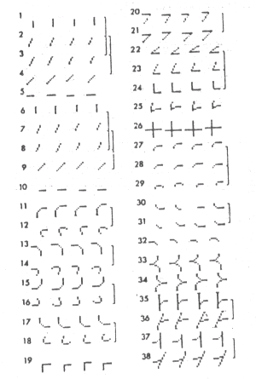
Neocognitron
Learning is done greedily for each layer

Slide 52
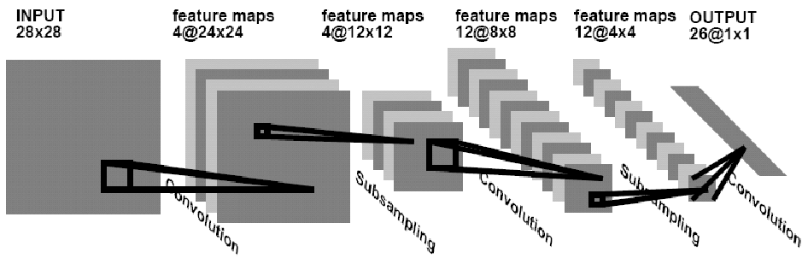
Convolutional Neural Network
Le Cun et al, 98
The output neurons share all the intermediate levels

Slide 53
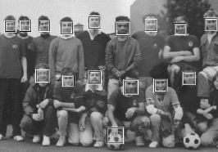
Face detection and the success of learning based approaches
The representation and matching of pictorial structures Fischler, Elschlager (1973).
Face recognition using eigenfaces M. Turk and A. Pentland (1991).
Human Face Detection in Visual Scenes - Rowley, Baluja, Kanade (1995)
Graded Learning for Object Detection - Fleuret, Geman (1999)
Robust Real-time Object Detection - Viola, Jones (2001)
Feature Reduction and Hierarchy of Classifiers for Fast Object Detection in Video Images - Heisele, Serre, Mukherjee, Poggio (2001)
….

Slide 54
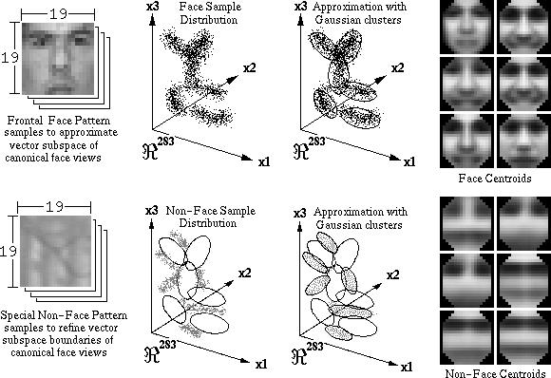
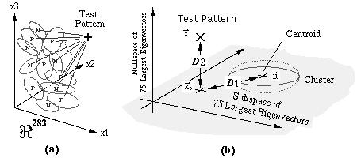
Distribution-Based Face Detector
Learn face and nonface models from examples [Sung and Poggio 95]
Cluster and project the examples to a lower dimensional space using Gaussian distributions and PCA
Detect faces using distance metric to face and nonface clusters

Slide 55
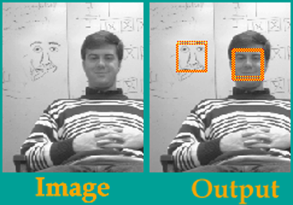
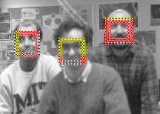
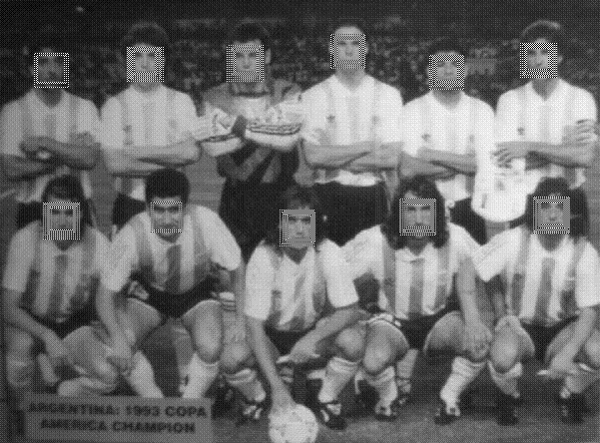
Distribution-Based Face Detector
Learn face and nonface models from examples [Sung and Poggio 95]
Training Database
1000+ Real, 3000+ VIRTUAL
50,0000+ Non-Face Pattern

Slide 56

Neural Network-Based Face Detector
Train a set of multilayer perceptrons and arbitrate a decision among all outputs [Rowley et al. 98]

Slide 57





Slide 58



Slide 59





Faces everywhere
http://www.marcofolio.net/imagedump/faces_everywhere_15_images_8_illusions.html

Slide 60
Rapid Object Detection Using a Boosted Cascade of Simple Features
Paul Viola Michael J. Jones
Mitsubishi Electric Research Laboratories (MERL)
Cambridge, MA
Most of this work was done at Compaq CRL before the authors moved to MERL
Manuscript available on web:
http://citeseer.ist.psu.edu/cache/papers/cs/23183/http:zSzzSzwww.ai.mit.eduzSzpeoplezSzviolazSzresearchzSzpublicationszSzICCV01-Viola-Jones.pdf/viola01robust.pdf
Notes:
While the title of this talk emphasizes the application of our ideas to an important real-world task
There are two nice ideas which could have broader impact in machine learning

Slide 61


Face detection

Slide 62









Families of recognition algorithms
Voting models
Shape matching
Deformable models
Bag of words models
Viola and Jones, ICCV 2001
Heisele, Poggio, et. al., NIPS 01
Schneiderman, Kanade 2004
Vidal-Naquet, Ullman 2003
Berg, Berg, Malik, 2005
Cootes, Edwards, Taylor, 2001
Csurka, Dance, Fan, Willamowski, and Bray 2004
Sivic, Russell, Freeman, Zisserman,
ICCV 2005
Rigid template models
Constellation models
Fischler and Elschlager, 1973
Burl, Leung, and Perona, 1995
Weber, Welling, and Perona, 2000
Fergus, Perona, & Zisserman, CVPR 2003
Sirovich and Kirby 1987
Turk, Pentland, 1991
Dalal & Triggs, 2006
Notes:
Not historical order. In fact, all families co-exist and benefit from each other.

Slide 63









Discriminative vs. generative
Generative model
(The artist)
0.1
0.05
0
0
10
20
30
40
50
60
70
x = data
Discriminative model
(The lousy painter)
1
0.5
0
0
10
20
30
40
50
60
70
x = data
Classification function
1
-1
0
10
20
30
40
50
60
70
80
x = data
Notes:
The first question that we might have, specially after seeing the other parts of this course, is why to use a discriminative approach?
This slide shows one of the arguments some times used to illustrate the advantage that a discriminative framework might have over a generative framework.
It is important to not that most of the time, generative models are also lousy painters. Generative models do not try to have a full generative model up to the pixel level. In fact, those cases, as the ones reviewed before in which the generative model is applied only to a set of sparse features are in fact a mixture of a discriminative method (for the low level vision part) and a generative method (for the high level vision part). Even if there is no discriminative training, the choice of the representation is given by our experience as vision researchers exploring alternatives until one works: just as a discriminative method will do.

Slide 64

























Discriminative methods
Object detection and recognition is formulated as a classification problem.
The image is partitioned into a set of overlapping windows
… and a decision is taken at each window about if it contains a target object or not.
Decision boundary
Background
Where are the screens?
Bag of image patches
Computer screen
In some feature space
Notes:
Object detection and recognition is formulated as a classification problem. The image is partitioned into a set of overlapping windows, and a decision is taken at each window about if it contains a target object or not.
Each window is represented by extracting a large number of features that encode information such as boundaries, textures, color, spatial structure.
The classification function, that maps an image window into a binary decision, is learnt using methods such as SVMs, boosting or neural networks.

Slide 65









Discriminative methods
Nearest neighbor
Neural networks
10⁶ examples
Shakhnarovich, Viola, Darrell 2003
Berg, Berg, Malik 2005
…
LeCun, Bottou, Bengio, Haffner 1998
Rowley, Baluja, Kanade 1998
…
Support Vector Machines and Kernels
Conditional Random Fields
Guyon, Vapnik
Heisele, Serre, Poggio, 2001
…
McCallum, Freitag, Pereira 2000
Kumar, Hebert 2003
…

Slide 66





Formulation
Formulation: binary classification
…
x₁
x₂
x₃
…
x_{N}
x_{N+1}
x_{N+2}
…
x_{N+M}
Features x =
Labels
y =
-1
+1
-1
-1
?
?
?
Training data: each image patch is labeled
as containing the object or background
Test data
Classification function
Where belongs to some family of functions
Minimize misclassification error
(Not that simple: we need some guarantees that there will be generalization)
Notes:
In many cases, F(x) will give a real value and the classification is perform with a Threshold. If F(x)>0 then y =+1

Slide 67
Object representations
Explicit 3D models: use volumetric representation. Have an explicit model of the 3D geometry of the object.
Appealing but hard to get it to work…

Slide 68

Object representations
Implicit 3D models: matching the input 2D view to view-specific representations.
Not very appealing but somewhat easy to get it to work…

Slide 69
Class experiment

Slide 70
Class experiment
Experiment 1: draw a horse (the entire body, not just the head) in a white piece of paper.
Do not look at your neighbor! You already know how a horse looks like… no need to cheat.

Slide 71
Class experiment
Experiment 2: draw a horse (the entire body, not just the head) but this time chose a viewpoint as weird as possible.

Slide 72



3D object categorization
Despite we can categorize all three pictures as being views of a horse, the three pictures do not look as being equally typical views of horses. And they do not seem to be recognizable with the same easiness.
by Greg Robbins

Slide 73
Canonical Perspective
Examples of canonical perspective:
Experiment (Palmer, Rosch & Chase 81): participants are shown views of an object and are asked to rate “how much each one looked like the objects they depict”
(scale; 1=very much like, 7=very unlike)
In a recognition task, reaction time correlated with the ratings.
Canonical views are recognized faster at the entry level.
From Vision Science, Palmer

Slide 74

Canonical Viewpoint
Clocks are preferred as purely frontal

Slide 75

CVPR 2005
Histograms of oriented gradients for human detection
[Navneet Dalal and Bill Triggs, 2005]

Slide 76


Human detection with HOG: Basic Steps
1. Map image to feature Space (HOG)

Slide 77






Human detection with HOG: Basic Steps
1. Map image to feature Space (HOG)
2. Training with positive and negative (linear SVM)
positive training examples
negative training examples

Slide 78

Human detection with HOG: Basic Steps
1. Map image to feature Space (HOG)
2. Training with positive and negative (linear SVM)
3. Testing : scan image in all scale and all location
Binary classification on each location

Slide 79

Image pyramid
Problem :
Bounding box size is different for the same
object (different depth)
Solution 1:
Resize the box and do multiple convolution?
Not ideal :
It will change the feature dimension, need to retrain the SVM for each scale.

Slide 80
Image pyramid
Solution 2:
Resize the image and do multiple convolution?-> image pyramid
Image is smaller ~ box is bigger
Image is larger ~ box is smaller

Slide 81
Human detection with HOG: Basic Steps
1. Map image to feature Space (HOG)
2. Training with positive and negative (linear SVM)
3. Testing : scan image in all scale and all location
Binary classification on each location

Slide 82


Human detection with HOG: Basic Steps
1. Map image to feature Space (HOG)
2. Training with positive and negative (linear SVM)
3. Testing : scan image in all scale and all location
4. Report box： non-maximum suppression
Final Boxes
Detector response map
After thresholding
After non-maximum suppression

Slide 83
Summary of Basic object detection Steps
Training:
Train a classifier describe the detection target
Testing :
Detection by binary classification on all location

Slide 84
HOG descriptor
Notes:
Pedro Felipe Felzenszwalb’ s implementation

Slide 85







HOG: Gradients
Compress image to 64x128 pixels
Convolution with [-1 0 1] [-1;0; 1] filters
Compute gradient magnitude + direction
For each pixel: take the color channel with greatest magnitude as final gradient

Slide 86


HOG: Cell histograms
Divide the image to cells, each cell 8x8 pixels
Snap each pixel’s direction to one of 18 gradient orientations
Build histogram pre-cell using magnitudes

Slide 87

Histogram interpolation example
Interpolated trilinearly:
  Bilinearly into spatial cells
  Linearly into orientation bins

Slide 88
Normalization
Cell
Current cell : 1x18 histogram
Cell
Block: 2x2 cell
overlapping with current cell
contrast sensitive features: 18 orientation -> 18 dim
contrast insensitive features: 9 orientation -> 9 dim
Normalize 4 times by its neighbor blocks, and average them
3. texture features: sum of the magnitude over all orientation and normalize 4 time,not average -> 4 dim
In total each cell : 18+9+4 dimension of feature
Notes:
Shortly explain l2hys

Slide 89






Final Descriptor
Concatenation the normalized histogram
Visualization:

Slide 90

HOG Descriptor:
Compute gradients on an image
region of 64x128 pixels
Compute histograms on ‘cells’ of
typically 8x8 pixels (i.e. 8x16 cells)
Normalize histograms within
overlapping blocks of cells
Concatenate histograms
It is a typical procedure of feature extraction !

Slide 91
Feature Engineering
Developing a feature descriptor requires a lot of engineering
  Testing of parameters (e.g. size of cells, blocks, number of cells in a block, size of overlap)
  Normalization schemes
An extensive evaluation was performed to make these design desiccations
It’s not only the idea, but also the engineering effort

Slide 92


Problem ?
Single, rigid template usually not enough to represent a category.
Many object categories look very different from different viewpoints, or style
Many objects (e.g. humans) are articulated, or have parts that can vary in configuration

Slide 93
Solution :
Exemplar SVM: Ensemble of Exemplar-SVMs for Object Detection and Beyond
Part Based Model

Slide 94

Exemplar-SVM
Still a rigid template,but train a separate SVM for each positive instance
For each category it can has exemplar with different size aspect ratio

Slide 95
Benefit from Exemplar-SVM ?
Handel the intra-category variance naturally, without using complicated model.
Compare to nearest neighbor approach: make use of negative data and train a discriminative object detector
Explicit correspondence from detection result to training exemplar

Slide 96

Benefit from Exemplar-SVM ?
Explicit correspondence from detection result to training exemplar
We not only know it is train,but also its orientation and type!

Slide 97

Benefit from Exemplar-SVM ?
We can do even more

Slide 98


Training Exemplar-SVM
Objective Function:
-1
h(x) =0
-1
Learn the w that minimize the objective function, equivalent to maximize the margin

Slide 99

Hard Negative Mining
Windows from images not containing any in-class instances: but there is too many!
2,000 images x 10,000 windows per image = 20M negatives
Find ones that you get wrong by a search, and train on these hard ones

Slide 100
Hard Negative Mining
Input : Positive : exemplar E
Negative : images and bounding boxes for this category
    N={(J₁,B₁), (J₂,B₂),…(J_{m},B_{m})}
Initialize: random pick m patches N_{random} from N that not overlap with
[SV,b,w]=trainSVM(E, N_{random})
Hard negative mining
While : i != m or N_{hard} not empty
for i= 1to n do
D = detect(b,w,J_{i})
N_{i}= D.conf > threshold & D not overlap with B_{i}
Add Ni to N_{hard}
if |N_{hard}| > memory-limit, then break;
end
[SV^{new},b^{new},w^{new}]=trainSVM(E, [N_{random,}SV])
SV = [SV; SV^{new}]
end

Slide 101

Embarrassingly Parallel

Slide 102


Part Based detector
Objects are represented by features of parts and spatial relations between parts

Slide 103
Part Based detector
How to defined the parts for one object category
How to represent their spatial relation shape
How to combine parts detection and spatial relations to obtained the final detection

Slide 104






Structure models
Voting models
Constellation models
Deformable models
Many parts (>100)
Few parts (~6)
No parts

Slide 105


From wikipedia: Perhaps the most famous part of the work is chapter XVII, "The Comparison of Related Forms," where Thompson explored the degree to which differences in the forms of related animals could be described by means of relatively simple mathematical transformations.

Slide 106
Structure models
Voting models
Constellation models
Deformable models
Many parts (>100)
Few parts (~6)
No parts
Bag of words
No structure!

Slide 107

Object
Bag of ‘words’
Slide credit: Fei fei

Slide 108

Analogy to documents
China is forecasting a trade surplus of $90bn (£51bn) to $100bn this year, a threefold increase on 2004's $32bn. The Commerce Ministry said the surplus would be created by a predicted 30% jump in exports to $750bn, compared with a 18% rise in imports to $660bn. The figures are likely to further annoy the US, which has long argued that China's exports are unfairly helped by a deliberately undervalued yuan. Beijing agrees the surplus is too high, but says the yuan is only one factor. Bank of China governor Zhou Xiaochuan said the country also needed to do more to boost domestic demand so more goods stayed within the country. China increased the value of the yuan against the dollar by 2.1% in July and permitted it to trade within a narrow band, but the US wants the yuan to be allowed to trade freely. However, Beijing has made it clear that it will take its time and tread carefully before allowing the yuan to rise further in value.
Of all the sensory impressions proceeding to the brain, the visual experiences are the dominant ones. Our perception of the world around us is based essentially on the messages that reach the brain from our eyes. For a long time it was thought that the retinal image was transmitted point by point to visual centers in the brain; the cerebral cortex was a movie screen, so to speak, upon which the image in the eye was projected. Through the discoveries of Hubel and Wiesel we now know that behind the origin of the visual perception in the brain there is a considerably more complicated course of events. By following the visual impulses along their path to the various cell layers of the optical cortex, Hubel and Wiesel have been able to demonstrate that the message about the image falling on the retina undergoes a step-wise analysis in a system of nerve cells stored in columns. In this system each cell has its specific function and is responsible for a specific detail in the pattern of the retinal image.
China, trade,
surplus, commerce,
exports, imports, US,
yuan, bank, domestic,
foreign, increase,
trade, value
sensory, brain,
visual, perception,
retinal, cerebral cortex,
eye, cell, optical
nerve, image
Hubel, Wiesel
Slide credit: Fei fei

Slide 109


DPM : Object Detection with
Discriminatively Trained Part Based Models
P. Felzenszwalb, R. Girshick, D. McAllester, D. Ramanan, Object Detection with Discriminatively Trained Part Based Models, PAMI 32(9), 2010

Slide 110
DPM: overview
• Each category detector has mixture of deformable part models (components)
• Each component has global template + deformable parts
• Fully trained from bounding boxes alone
(Latent SVM)

Slide 111


DPM: component
Each category detector has mixture of component for different aspect ratio (handle intra-class variance)
Each component has a it’s own DPM model

Slide 112

Deformable part models
Model encodes local appearance + pairwise geometry
Source: Deva Ramanan
Notes:
We can visualize this model, more simply as a collection of templates, each representing the local appearance of a part. These templates are constrained to be in relative spatial arrangements by springs that connect pairs of parts. This model, originally introduced 30 years ago, has a rich history in vision.

Slide 113

DPM: component

Slide 114


Example models
Source: Deva Ramanan

Slide 115


Example models
Source: Deva Ramanan

Slide 116


Example models

Slide 117


Slide 118


PASCAL Visual Object Challenge
5000 training images
5000 testing images
20 everyday object categories
aeroplane bike bird boat bottle bus car cat chair cow table dog horse motorbike person plant sheep sofa train tv
Source: Deva Ramanan
Notes:
I’ll discuss object recognition within the context of the PASCAL Visual Object Challenge. This is an annual image benchmark competition that is widely considered to be the most difficult and realistic testbed for object detection. The dataset consists of 10,000 Flickr images labeled with 20 everyday object categories, split into a training and test set with held-out labels. Given the labeled training images on the left, the challenge is to learn models that produce accurate bounding box labels on the test images. In this talk, I will describe our winning entry into this competition.

Slide 119


5 years of PASCAL people detection
average
precision
1% to 45% in 5 years
Discriminative mixtures of star models 2007-2010 Felzenszwalb, McAllester, Ramanan CVPR 2008
Felzenszwalb, Girshick, McAllester, and Ramanan PAMI 2009
Source: Deva Ramanan

Slide 120

Evaluation: Precision & Recall
Truth
Object
No Object
Algorithm
Prediction
Object
True Positive
False Positive
No Object
False Negative
True Negative
Precision = TP / (TP + FP)
Recall = TP / (TP + FN)
Truth
Prediction
=
/
Intersection
Over
Union

Slide 121

Evaluation: Precision & Recall

Slide 122

Table

Slide 123


Slide 124
Concept Review
Object vs. Scene vs. Texture
Instances vs. categories
Mediated vs. Directed
Entry-level vs. Fine-grained
Knowledge-based vs. Data-driven
Explicit 3D vs. Implicit 3D (view-based)
Whole vs. parts
Discriminative vs. generative
Structure vs. Bag-of-Words

