Slide 1

Life story of a 3D point
COS429 Computer Vision

Slide 2

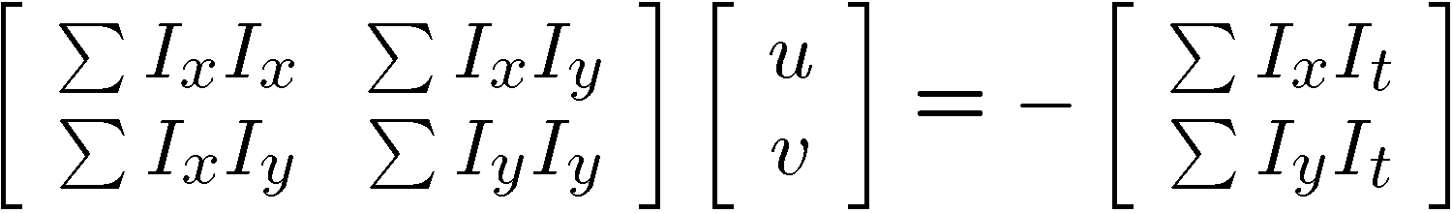


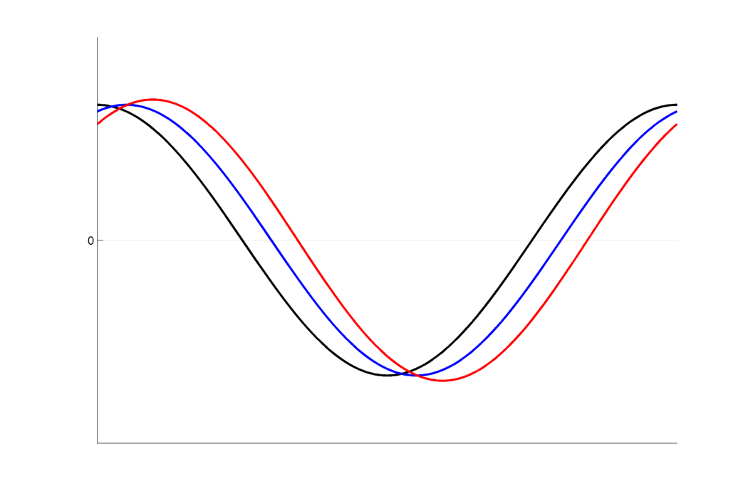



Last Time: Motion
Lagrangian
  Optical Flow
  Refraction Wiggles
Eulerian
  Video Magnification
  Visual Microphone
    https://www.youtube.com/watch?v=FKXOucXB4a8
Intensity
Implied
Translation
0
Space

Slide 3
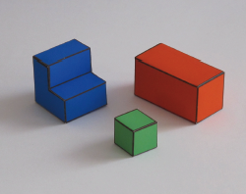
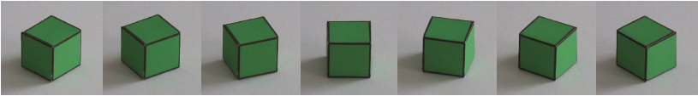



Last Last Time: Simple World
Occlusion
Horizontal 3D edge
Change of
Surface orientation
Vertical 3D edge
A simple world
A catalog of edges
Generic view assumption
Constrained solver
Edge detection: Canny
Line detection
  RANSAC
  Hough transformation
Contact edge
Shadow boundary

Slide 4
Camera Projection

Slide 5

Camera Projection

Slide 6
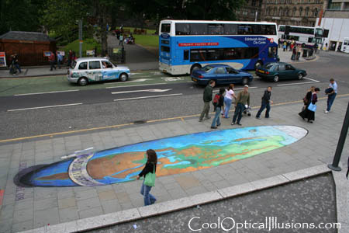
Camera Projection

Slide 7

Müller-Lyer Illusion
http://www.michaelbach.de/ot/sze_muelue/index.html

Slide 8
Dimensionality Reduction Machine (3D to 2D)
3D world
2D image
What have we lost?
Slide by A. Efros
Figures © Stephen E. Palmer, 2002

Slide 9
The Basics: My Life Story

Slide 10

My Life Story

Slide 11
My Life Story

Slide 12
My Life Story

Slide 13
My Life Story

Slide 14
I am a 3D Point

Slide 15
I am a 3D Point

Slide 16
I am a 3D Point

Slide 17
I am small

Slide 18
I am sexy
People loves to take picture of me.

Slide 19
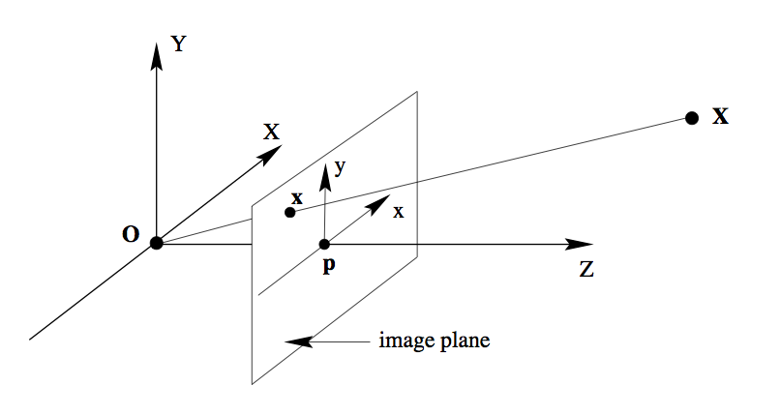
When they take a picture:

Slide 20
Similar Triangle

Slide 21
Similar Triangle

Slide 22
When they take a picture:
Up to a scale

Slide 23




Homogeneous Coordinates
homogeneous image
coordinates
homogeneous scene
coordinates
Converting from homogeneous coordinates

Slide 24
Why the image plane is in front?
Image Plane
Image Plane
The World
Camera Center
Camera Center
Image Plane
The World

Slide 25
When they take a picture:
Picture

Slide 26
When they take a picture:
Matlab Image Column
Picture
Matlab Image Row

Slide 27
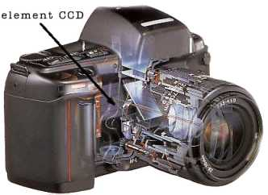
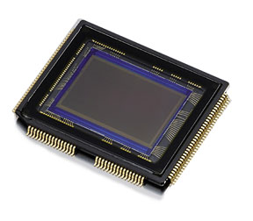
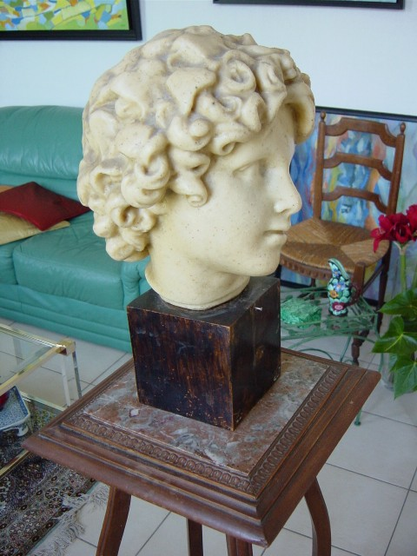
When they take a picture:
We let to take care of this as well.
Unit of is pixel
World Unit: e.g. Meters
Image Unit: Pixels

Slide 28

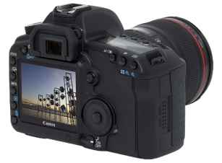
A Tale of Two Coordinate Systems
v
y
COP
u
Camera
w
o
x
Two important coordinate systems:
1. World coordinate system
2. Camera coordinate system
z
“The World”

Slide 29
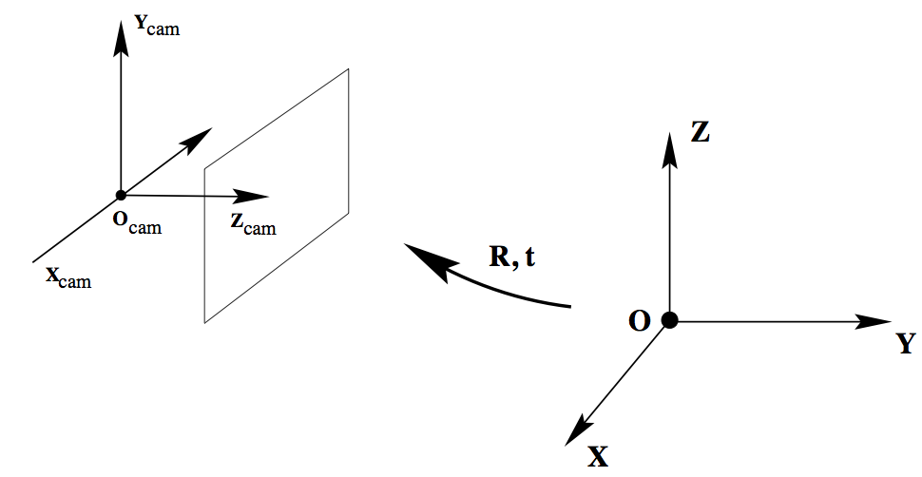
I live in a real world
Model-view
Transformation
Camera Coordinate System
World Coordinate System

Slide 30
World Coor. → Camera Coor.
Camera Parameter
Camera Projection Matrix
Intrinsic
Extrinsic

Slide 31
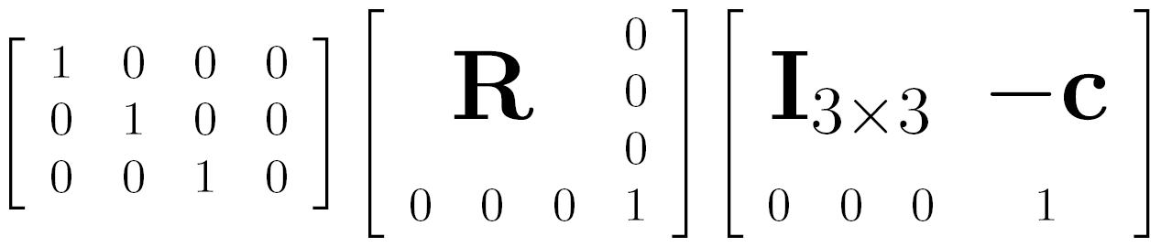

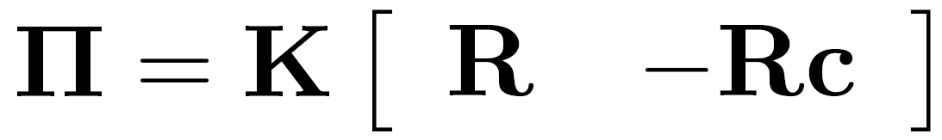
Different notation
intrinsics
projection
rotation
translation

Slide 32
Camera parameters
How many numbers do we need to describe a camera?
We need to describe its pose in the world
We need to describe its internal parameters

Slide 33
Extrinsic Camera Parameters

Slide 34
I am sexy
When people take a picture of me:

Slide 35
I am very sexy
When people take two pictures with same camera setting:

Slide 36
I am very very sexy
When people take three pictures with same camera setting:

Slide 37
I am very very sexy
Image 1
Image 3
R₁,t₁
R₃,t₃
Image 2
R₂,t₂

Slide 38

I join “America's Next Top Model”

Slide 39
I join “America's Next Top Model”
Image 1
Image 3
R₁,t₁
R₃,t₃
Image 2
R₂,t₂

Slide 40
I join “America's Next Top Model”
Point 1
Point 2
Point 3
Image 1
Image 2
Image 3
Same Camera Same Setting = Same

Slide 41
Triangulation
Image 1
Image 3
R₁,t₁
R₃,t₃
Image 2
R₂,t₂

Slide 42
Triangulation
Image 1
Image 3
R₁,t₁
R₃,t₃
Image 2
R₂,t₂

Slide 43
So Far

Slide 44
I am a 3D Point

Slide 45
Similar Triangle

Slide 46
Similar Triangle

Slide 47
When they take a picture:
Up to a scale

Slide 48
A Tale of Two Coordinate Systems
v
y
COP
u
Camera
w
o
x
Two important coordinate systems:
1. World coordinate system
2. Camera coordinate system
z
“The World”

Slide 49
I live in a real world
Model-view
Transformation
Camera Coordinate System
World Coordinate System

Slide 50
World Coor. → Camera Coor.
Camera Parameter
Camera Projection Matrix
Intrinsic
Extrinsic

Slide 51
Intrinsic Camera Parameters

Slide 52
Focal Length

Slide 53


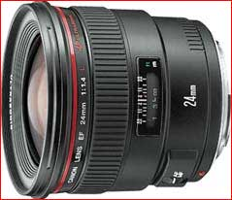

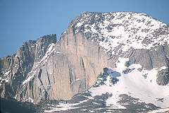
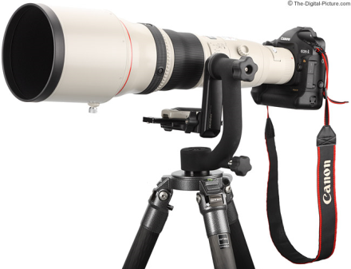
Focal length
Can think of as “zoom”
Related to field of view
24mm
50mm
200mm
800mm

Slide 54
Principle point offset
  especially when images are cropped (Internet)
Object
z
IMG
x
IMG
IMG
y

Slide 55
Skew

Slide 56
When is skew non-zero?
arctan(1/s)
1
γ
for CCD/CMOS, always s=0
Image from image, s≠0 possible
(non coinciding principal axis)
resulting camera:

Slide 57
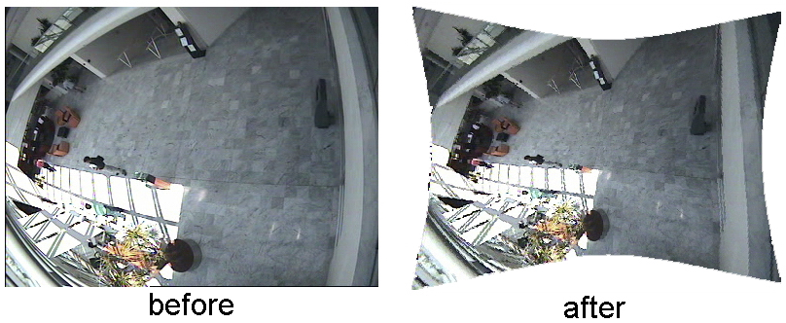
Lens Distortion
Radial distortion (due to optics of the lens)

Slide 58
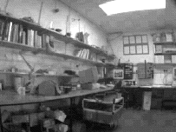
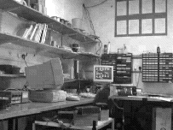
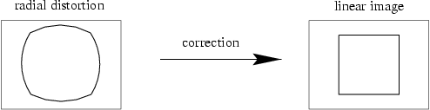
Radial distortion
short and long focal length

Slide 59
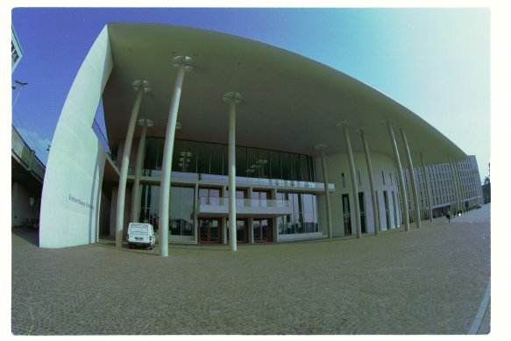
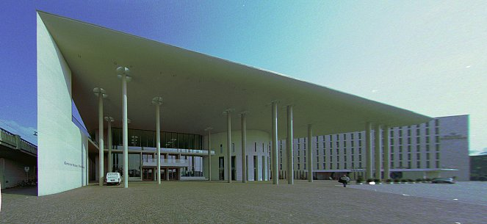
Correcting radial distortion
from Helmut Dersch

Slide 60
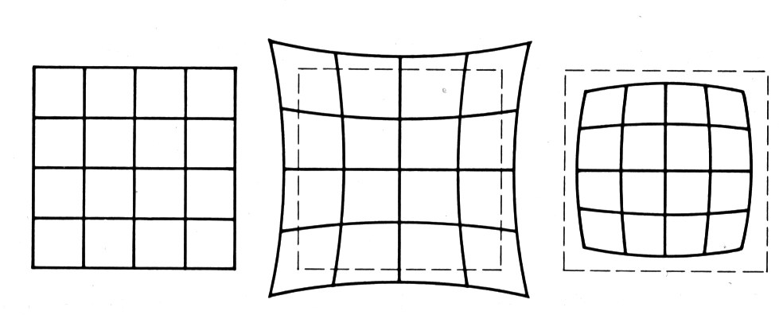
Distortion
No distortion
Pin cushion
Barrel
Radial distortion of the image
  Caused by imperfect lenses
  Deviations are most noticeable for rays that pass through the edge of the lens

Slide 61
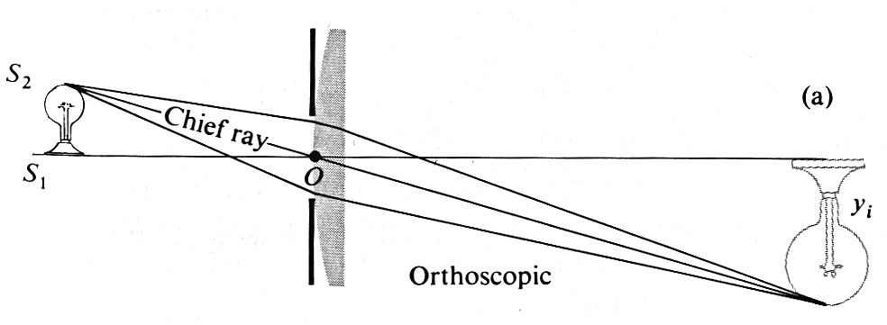
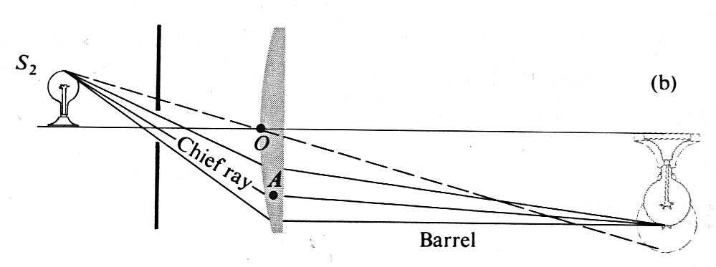
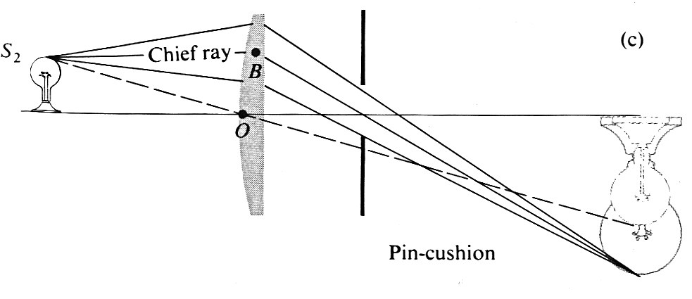
Distortion

Slide 62
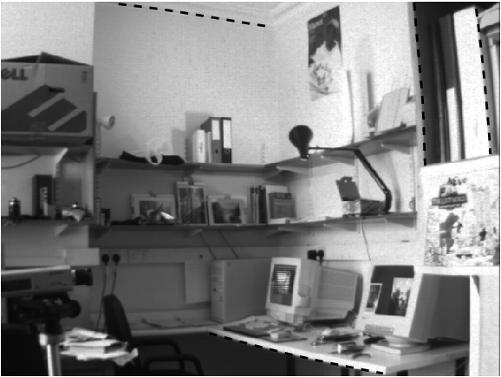
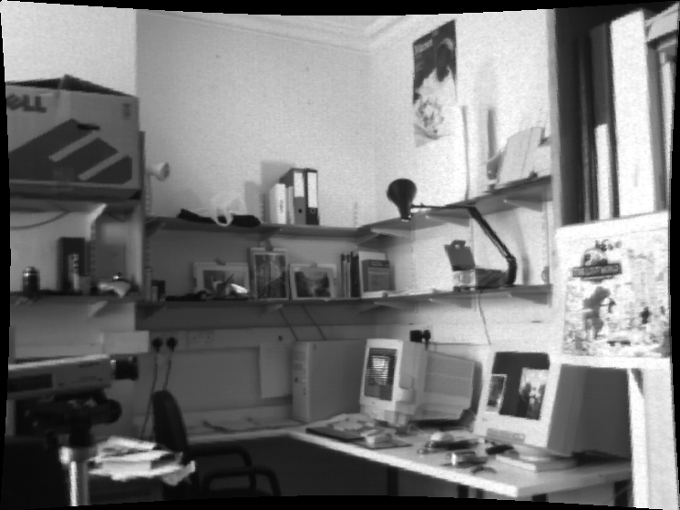

Slide 63

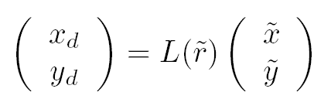

Slide 64
Film Distortion

Slide 65
Perspective distortion
What does a sphere project to?
Image source: F. Durand

Slide 66
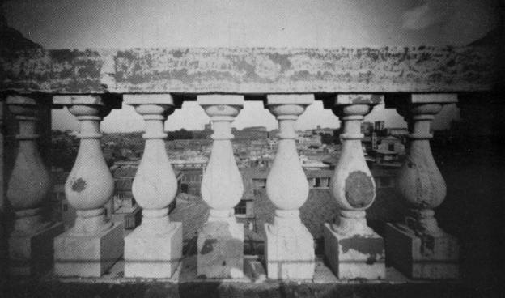
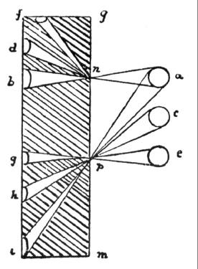
Perspective distortion
The exterior columns appear bigger
The distortion is not due to lens flaws
Problem pointed out by Da Vinci
Slide by F. Durand

Slide 67

Perspective distortion: People

Slide 68
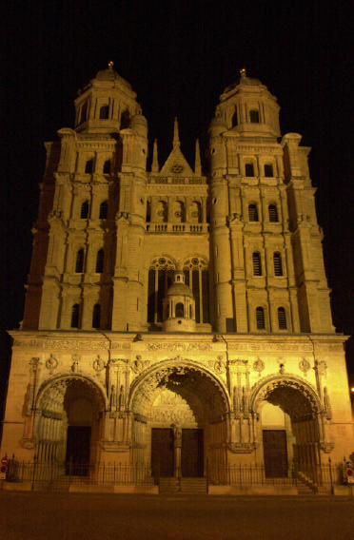
Perspective distortion
Problem for architectural photography: converging verticals
Source: F. Durand

Slide 69
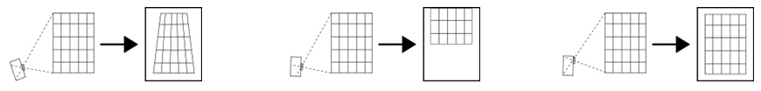
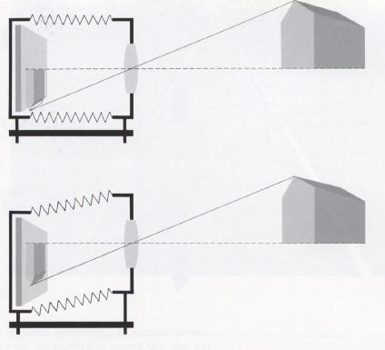
Perspective distortion
Problem for architectural photography: converging verticals
Solution: view camera (lens shifted w.r.t. film)
Tilting the camera upwards results in converging verticals
Keeping the camera level, with an ordinary lens, captures only the bottom portion of the building
Shifting the lens upwards results in a picture of the entire subject
http://en.wikipedia.org/wiki/Perspective_correction_lens
Source: F. Durand

Slide 70
Perspective distortion
Problem for architectural photography: converging verticals
Result:
Source: F. Durand

Slide 71
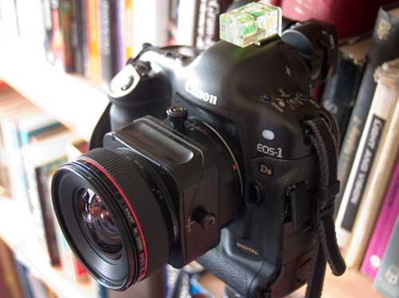
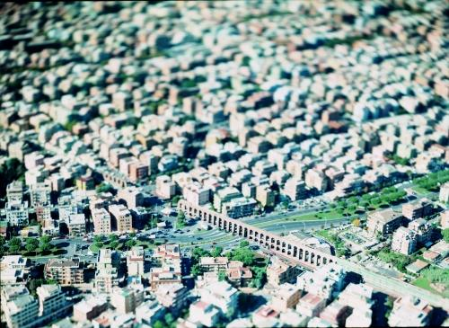
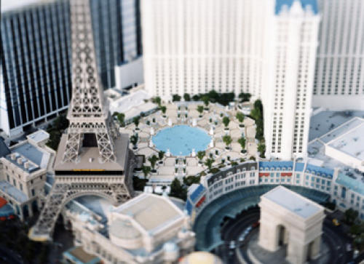
Tilt-shift
http://www.northlight-images.co.uk/article_pages/tilt_and_shift_ts-e.html
Titlt-shift images from Olivo Barbieri
and Photoshop imitations

Slide 72
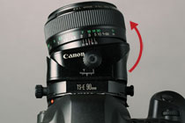

Tilt-shift
Canon TS-E 24mm f/3.5L II

Slide 73
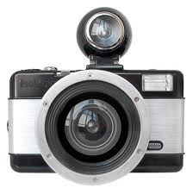
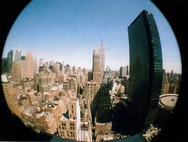
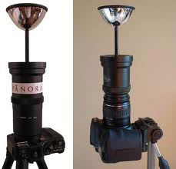
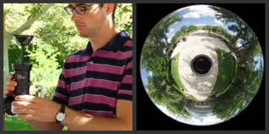

Other Camera Models
Fisheye
Mirror
Panorama
Tilt-Shift Lens
Biological Eyes
http://www.popgadget.net/2006/07/fisheye_camera.php
http://www.0-360.com/
http://sun360.csail.mit.edu

Slide 74
Panoramic Projection

Slide 75
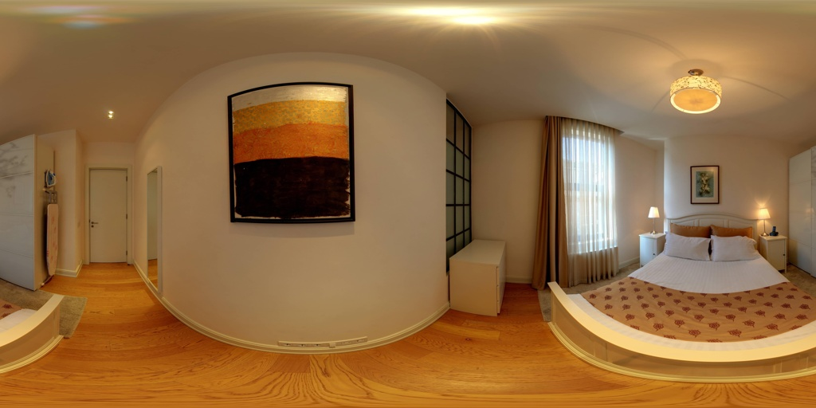
A typical image

Slide 76
Why Panorama?
Sometimes, you don’t have a choice.
road
bus
car

Slide 77
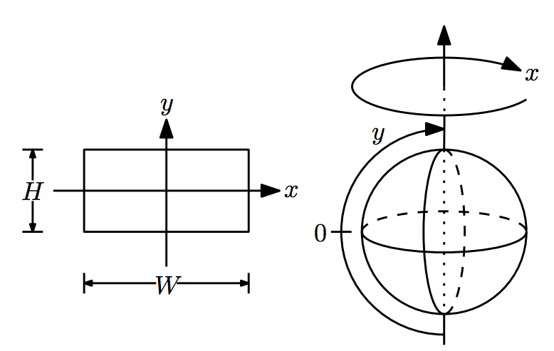
Equirectangular Projection
http://vision.princeton.edu/projects/2012/SUN360/supp_final/panorama.pdf

Slide 78
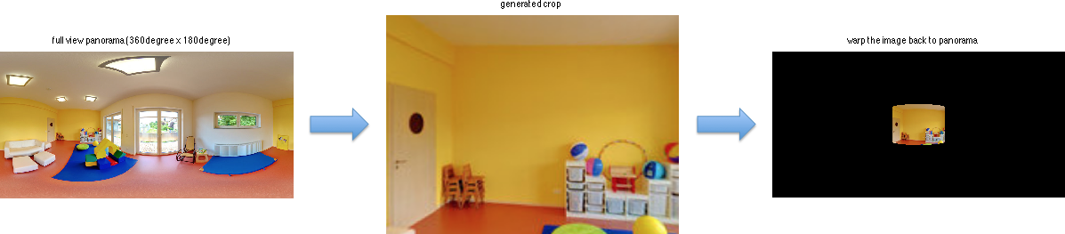
Panorama Coordinate System

Slide 79
3D World here
Regular Image
panorama

Slide 80
Exercise

Slide 81
Panorama 512x1024
What is the focal length?

Slide 82
Orthographic Projection

Slide 83
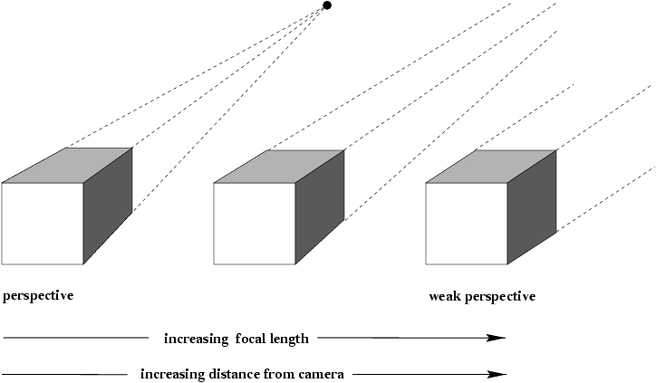
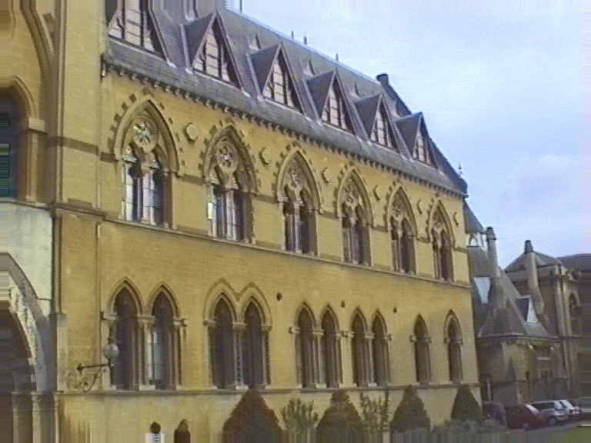
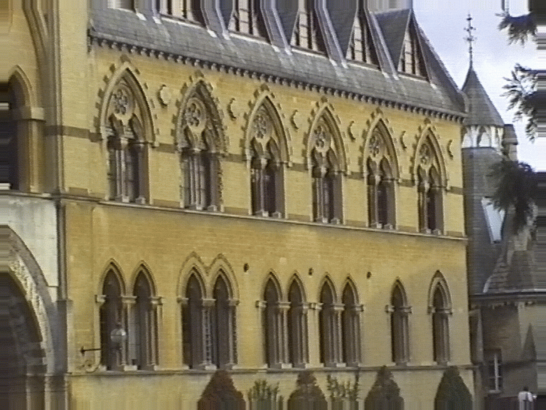
Affine cameras

Slide 84
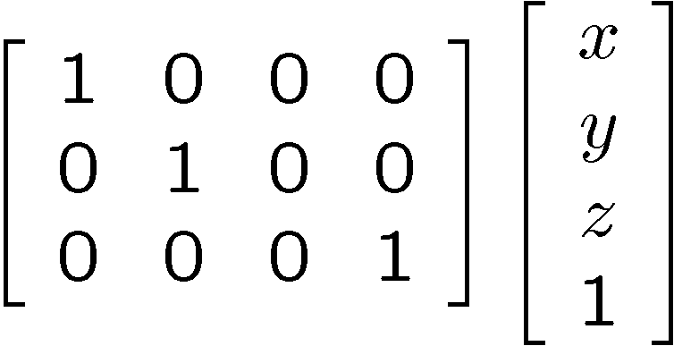
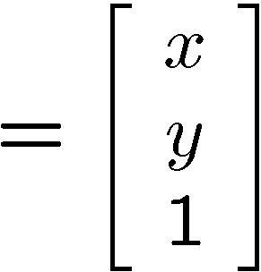

Orthographic projection
Special case of perspective projection
  Distance from the COP to the PP is infinite
  Good approximation for telephoto optics
  Also called “parallel projection”: (x, y, z) → (x, y)
  What’s the projection matrix?
Image
World

Slide 85



Orthographic projection

Slide 86



Perspective projection

Slide 87

What is a camera?
Deﬁnition: A camera is a two-parameter linear family of lines—that is, a degenerate regulus (rank-3 family), or a non-degenerate linear congruence (rank-4 family).
What is a Camera? J Ponce, 2009

Slide 88
Coordinate System Transformation

Slide 89
Popular Camera Coordinate System
z
z
y
Object
Object
Object
x
IMG
x
IMG
x
IMG
z
y
y
Good Vision Researchers
Lazy Grad Students
Crazy Graphics Guru ☺
OpenGL
Right-Handed Coordinate System
y
z
Object
IMG
x
Evil Microsoft DirectX ☺ = Left-Handed Coordinate System

Slide 90
Coordinate Systems
Object Coordinate System
World Coordinate System
Camera Coordinate System
Concatenation of Coordinate Transformation

Slide 91
Camera Calibration

Slide 92
Camera calibration
Goal: estimate the camera parameters
Version 1: solve for projection matrix (SFM)
  Version 2: solve for camera parameters separately
    intrinsic (focal length, principle point, pixel size)
    extrinsic (rotation angles, translation)
    radial distortion

Slide 93

Calibration using a reference object
Place a known object in the scene
  identify correspondence between image and scene
  compute mapping from scene to image
Requirement
  must know geometry very accurately
  must know 3D->2D correspondence

Slide 94

Chromaglyphs
Courtesy of Bruce Culbertson, HP Labs
http://www.hpl.hp.com/personal/Bruce_Culbertson/ibr98/chromagl.htm

Slide 95

Estimating the projection matrix
Place a known object in the scene
  identify correspondence between image and scene
  compute mapping from scene to image

Slide 96


Direct linear calibration

Slide 97

Direct linear calibration
Can solve for m_{ij} by linear least squares
Use matlab A\b

Slide 98
Direct linear calibration
Advantage:
  Very simple to formulate and solve
Disadvantages:
  Doesn’t tell you the camera parameters
  Doesn’t model radial distortion
  Hard to impose constraints (e.g., known f)
  Doesn’t minimize the right error function
  (meaningless algebraic error, not geometric error)
For these reasons, nonlinear methods are preferred
  Define error function E between projected 3D points and image positions
    E is nonlinear function of intrinsics, extrinsics, radial distortion
  Minimize E using nonlinear optimization techniques

Slide 99
Algebraic Error vs. Geometric Error
Our goal
Algebraic error:
Ap = 0 ⬄ min Ap
Geometric error:
Practice: initialize by algebraic solution, then use nonlinear optimization (e.g. ceres-solver)

Slide 100

Alternative: multi-plane calibration
Images courtesy Jean-Yves Bouguet, Intel Corp.
Advantage
  Only requires a plane
  Don’t have to know positions/orientations
  Good code available online! (including in OpenCV)
    Matlab version by Jean-Yves Bouget: http://www.vision.caltech.edu/bouguetj/calib_doc/index.html
    Zhengyou Zhang’s web site: http://research.microsoft.com/~zhang/Calib/

Slide 101

Vanishing Lines & Points
Ames Room

Slide 102
Projection properties
Many-to-one: any points along same ray map to same point in image
Points → points
Lines → lines (collinearity is preserved)
  But line through focal point projects to a point
Planes → planes (or half-planes)
  But plane through focal point projects to line

Slide 103

Projection properties
Parallel lines converge at a vanishing point
  Each direction in space has its own vanishing point
  But parallels parallel to the image plane remain parallel

Slide 104

Three point perspective

Slide 105
Vanishing lines
v₁
v₂
Multiple Vanishing Points
  Any set of parallel lines on the plane define a vanishing point
  The union of all of these vanishing points is the horizon line
    also called vanishing line
  Note that different planes (can) define different vanishing lines

Slide 106
Vanishing lines
Multiple Vanishing Points
  Any set of parallel lines on the plane define a vanishing point
  The union of all of these vanishing points is the horizon line
    also called vanishing line
  Note that different planes (can) define different vanishing lines

Slide 107
Computing vanishing points
V
P₀
D

Slide 108
Computing vanishing points
V
P₀
D
Properties
  P∞ is a point at infinity, v is its projection
  Depends only on line direction
  Parallel lines P₀ + tD, P₁ + tD intersect at P∞

Slide 109
Computing vanishing lines
v₁
l
v₂
C
l
ground plane
Properties
  l is intersection of horizontal plane through C with image plane
  Compute l from two sets of parallel lines on ground plane
  All points at same height as C project to l
    points higher than C project above l
  Provides way of comparing height of objects in the scene

Slide 110
Computing vanishing points (from lines)
v
q₂
q₁
p₂
p₁
Intersect p₁q₁ with p₂q₂
Least squares version
  Better to use more than two lines and compute the “closest” point of intersection
  See notes by Bob Collins for one good way of doing this:
    http://www-2.cs.cmu.edu/~ph/869/www/notes/vanishing.txt

Slide 111

Notes:
Is this parachuter higher or lower than the person taking this picture?
Lower—he is below the horizon

Slide 112


Fun with vanishing points

Slide 113
So Far

Slide 114
I am a 3D Point

Slide 115
Similar Triangle

Slide 116
Similar Triangle

Slide 117
When they take a picture:
Up to a scale

Slide 118
A Tale of Two Coordinate Systems
v
y
COP
u
Camera
w
o
x
Two important coordinate systems:
1. World coordinate system
2. Camera coordinate system
z
“The World”

Slide 119
Coordinate Systems
Object Coordinate System
World Coordinate System
Camera Coordinate System
Concatenation of Coordinate Transformation

Slide 120
I live in a real world
Model-view
Transformation
Camera Coordinate System
World Coordinate System

Slide 121
World Coor. → Camera Coor.
Camera Parameter
Camera Projection Matrix
Intrinsic
Extrinsic

Slide 122
Intrinsics

Slide 123
Changing Focal Length vs. Imresize
https://lh6.googleusercontent.com/-0K4Cw3Is0kY/TyaI58QcbPI/AAAAAAAAGNA/xmD6WcFIeyc/w426-h319/ani.fun.with.focal.length.gif
http://www.cs.cmu.edu/afs/cs.cmu.edu/academic/class/15463-f08/www/proj0/www/fpalermo/Zoom_1.gif
http://www.cs.cmu.edu/afs/andrew/scs/cs/15-463/f07/proj0/www/lisachan/Police.gif

Slide 125
Perspective distortion
The exterior columns appear bigger
The distortion is not due to lens flaws
Problem pointed out by Da Vinci
Slide by F. Durand

Slide 126
Equirectangular Projection
http://vision.princeton.edu/projects/2012/SUN360/supp_final/panorama.pdf

Slide 127
Orthographic projection

Slide 128
Perspective projection

Slide 129
Coordinate Systems
Object Coordinate System
World Coordinate System
Camera Coordinate System
Concatenation of Coordinate Transformation

Slide 130
Estimating the projection matrix
Place a known object in the scene
  identify correspondence between image and scene
  compute mapping from scene to image

Slide 131
Algebraic Error vs. Geometric Error
Our goal
Algebraic error:
Ap = 0 ⬄ min Ap
Geometric error:
Practice: initialize by algebraic solution, then use nonlinear optimization (e.g. ceres-solver)

Slide 132
Computing vanishing points
V
P₀
D
Properties
  P∞ is a point at infinity, v is its projection
  Depends only on line direction
  Parallel lines P₀ + tD, P₁ + tD intersect at P∞

Slide 133
Computing vanishing lines
v₁
l
v₂
C
l
ground plane
Properties
  l is intersection of horizontal plane through C with image plane
  Compute l from two sets of parallel lines on ground plane
  All points at same height as C project to l
    points higher than C project above l
  Provides way of comparing height of objects in the scene

Slide 134
Single View Reconstruction

Slide 135
Perspective cues

Slide 136
Perspective cues

Slide 137
Perspective cues

Slide 138
Comparing heights
Vanishing
Point

Slide 139
Measuring height
5.4
5
How high is the camera?
Camera height
4
3.3
3
2.8
2
1

Slide 140
Measuring height without a ruler
C
Z
ground plane
Compute Z from image measurements
  Need more than vanishing points to do this

Slide 141
The cross ratio
A Projective Invariant
  Something that does not change under projective transformations (including perspective projection)
The cross-ratio of 4 collinear points
P₄
P₃
P₂
P₁
Can permute the point ordering
  4! = 24 different orders (but only 6 distinct values)
This is the fundamental invariant of projective geometry

Slide 142
Don’t know camera extrinsics
∞
scene cross ratio
T (top of object)
t
r
R (reference point)
C
H
b
R
image cross ratio
v_{Z}
B (bottom of object)
ground plane
scene points represented as
image points as

Slide 143



Measuring height
v_{z}
r
vanishing line (horizon)
t₀
t
v_{x}
v
v_{y}
H
R
H
b₀
b
image cross ratio

Slide 144
Measuring height
v_{z}
r
t₀
vanishing line (horizon)
t₀
v_{x}
v
v_{y}
m₀
t₁
b₀
b₁
b
What if the point on the ground plane b₀ is not known?
  Here the guy is standing on the box, height of box is known
  Use one side of the box to help find b₀ as shown above

Slide 145

3D Modeling from a photograph
Single view metrology.

Slide 146


3D Modeling from a photograph
St. Jerome in his Study, H. Steenwick
Flagellation, Piero della Francesca
Single view metrology.

Slide 147

Single View Panorama
(extrinsic known)

Slide 148

Putting Objects in Perspective
An object’s height in the image can be determined from its height in the world and the viewpoint

Slide 149
Summary

Slide 150
THE equation you need to remember

