Slide 1

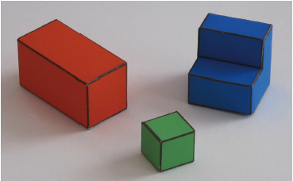
Let's make the world simpler
COS429 Computer Vision

Slide 2

Last Last Time: Image filtering
1
1
1
1
1
1
1
1
1
0 | 0 | 0 | 0 | 0 | 0 | 0 | 0 | 0 | 0
0 | 0 | 0 | 0 | 0 | 0 | 0 | 0 | 0 | 0
0 | 0 | 0 | 90 | 90 | 90 | 90 | 90 | 0 | 0
0 | 0 | 0 | 90 | 90 | 90 | 90 | 90 | 0 | 0
0 | 0 | 0 | 90 | 90 | 90 | 90 | 90 | 0 | 0
0 | 0 | 0 | 90 | 0 | 90 | 90 | 90 | 0 | 0
0 | 0 | 0 | 90 | 90 | 90 | 90 | 90 | 0 | 0
0 | 0 | 0 | 0 | 0 | 0 | 0 | 0 | 0 | 0
0 | 0 | 90 | 0 | 0 | 0 | 0 | 0 | 0 | 0
0 | 0 | 0 | 0 | 0 | 0 | 0 | 0 | 0 | 0
 | 0 | 10 | 20
0 | 0 | 0 | 0 | 0 | 0 | 0 | 0 | 0 | 0
0 | 0 | 0 | 0 | 0 | 0 | 0 | 0 | 0 | 0
0 | 0 | 0 | 90 | 90 | 90 | 90 | 90 | 0 | 0
0 | 0 | 0 | 90 | 90 | 90 | 90 | 90 | 0 | 0
0 | 0 | 0 | 90 | 90 | 90 | 90 | 90 | 0 | 0
0 | 0 | 0 | 90 | 0 | 90 | 90 | 90 | 0 | 0
0 | 0 | 0 | 90 | 90 | 90 | 90 | 90 | 0 | 0
0 | 0 | 0 | 0 | 0 | 0 | 0 | 0 | 0 | 0
0 | 0 | 90 | 0 | 0 | 0 | 0 | 0 | 0 | 0
0 | 0 | 0 | 0 | 0 | 0 | 0 | 0 | 0 | 0
Credit: S. Seitz
Notes:
ones, divide by 9

Slide 3
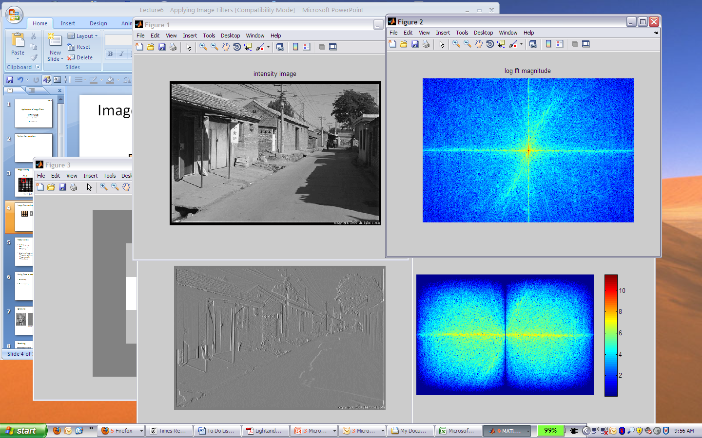
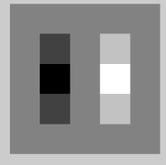
Filtering in spatial domain
1
0
-1
2
0
-2
1
0
-1
*
=

Slide 4
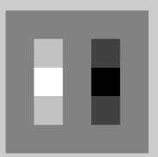

Filtering in frequency domain
FFT
FFT
=
Inverse FFT

Slide 5
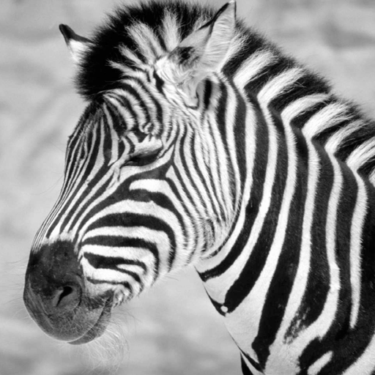
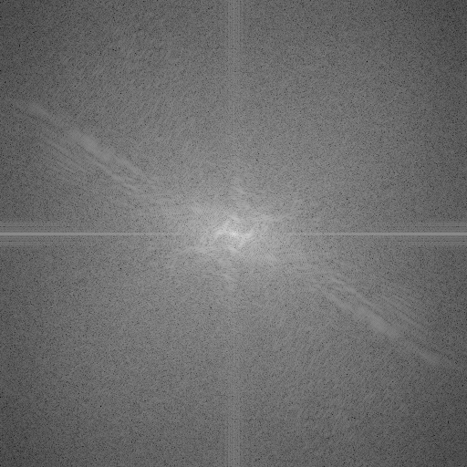
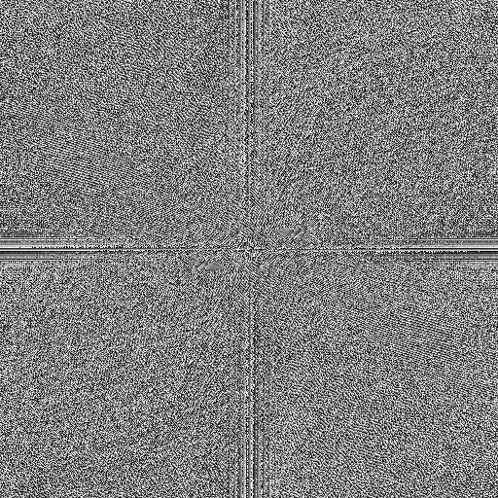
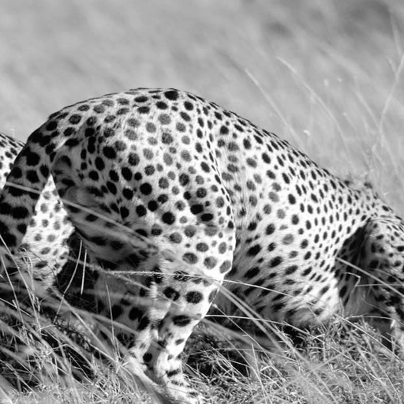
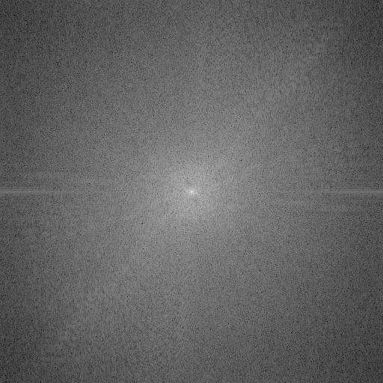
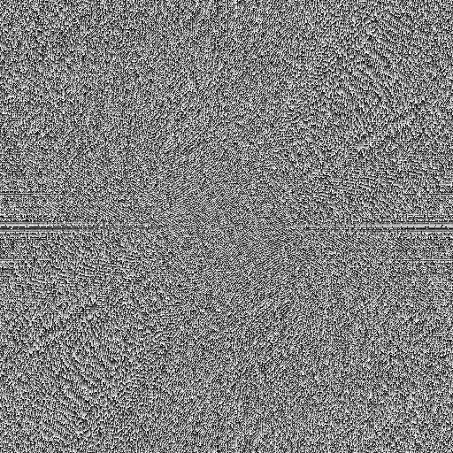
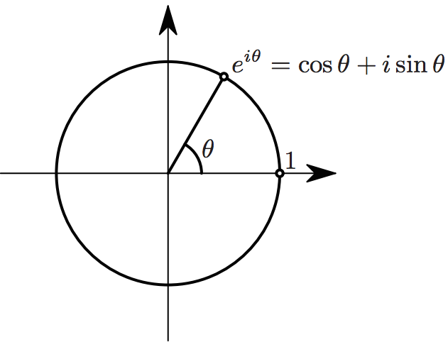

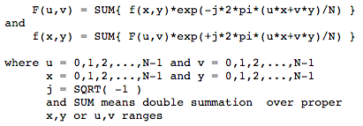
Phase and Magnitude
all natural images have about the same magnitude transform
hence, phase seems to matter, but magnitude largely doesn’t
Magnitude
Phase
log(abs(fftshift(im_fft)))

Slide 6
Last Time: Inverse Ill Pose Problem
4
1=ab
3
b
Hyperbola of feasible solutions
2
1
0
1
2
3
4
a

Slide 7
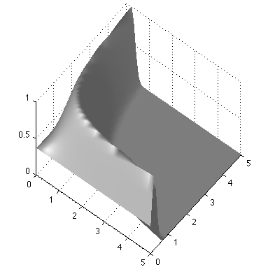
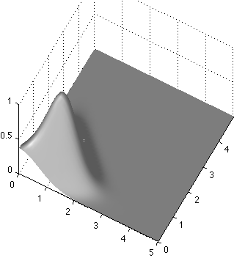
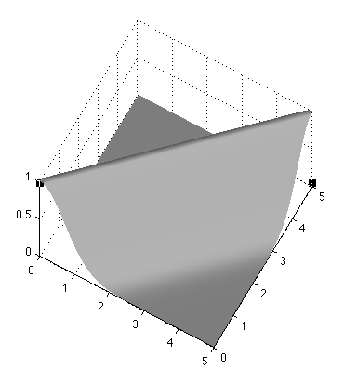
Last Time: Inverse Ill Pose Problem
Use P(a, b | y = 1) = k P(y=1|a, b) P(a, b)
Likelihood function
P(a, b | y = 1)
a=b=1
b
a
Prior probability
b
if a>0, b>0
a
= 0 otherwise
b
a

Slide 8
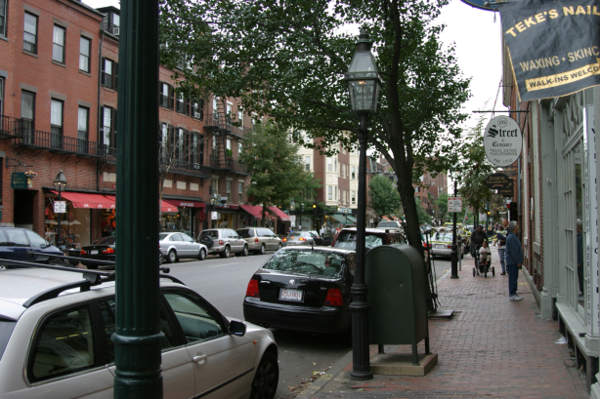
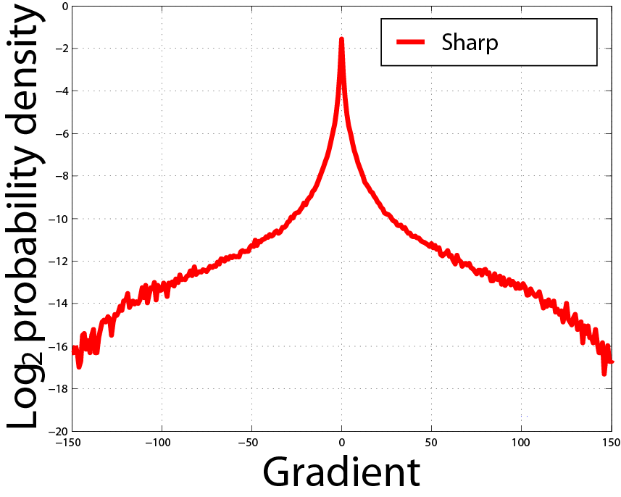
Natural image statistics
Characteristic distribution with heavy tails
Histogram of image gradients
FIELD, D. 1994. What is the goal of sensory coding? Neural Computation 6, 559–601.

Slide 9
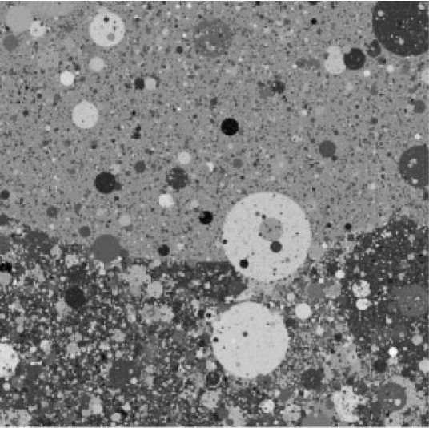
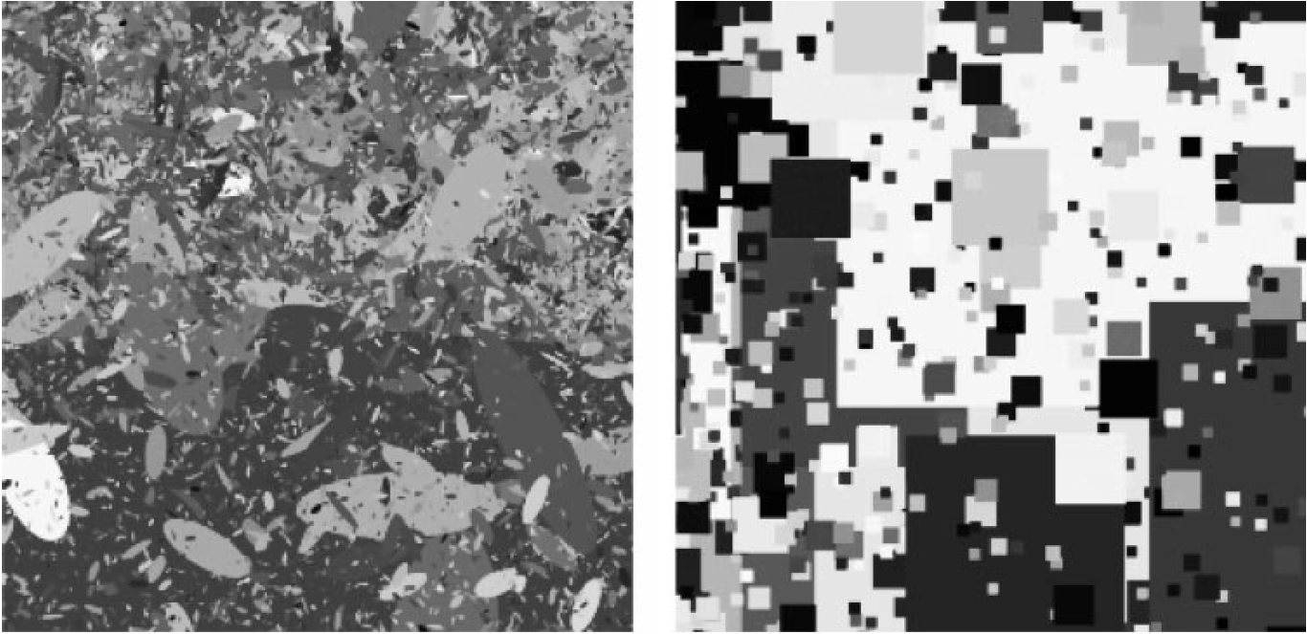
Dead leaves models
Introduced in the 60’s by Matheron (67) and popularized by Ruderman (97)
From Lee, Mumford and Huang 2001

Slide 10
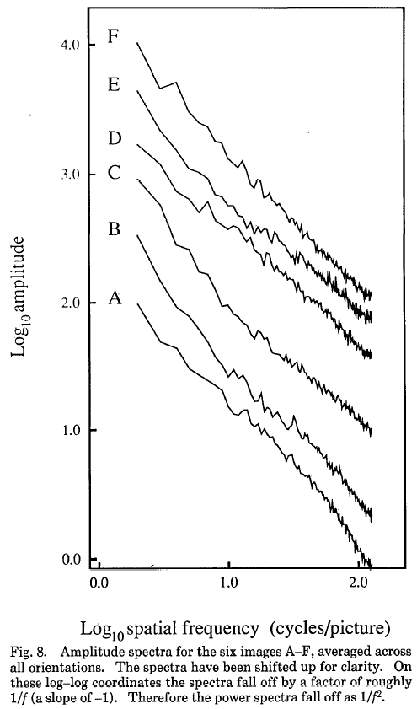
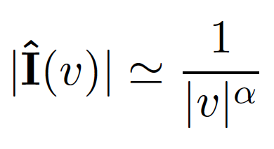
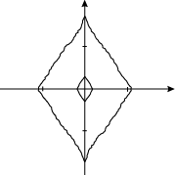
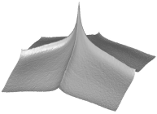
Statistics of Images
Power spectra
fall off as
Spectra
Low spatial frequencies
1/vª
High
spatial
frequencies
Vertical
v_{y}
Horizontal
v_{x}
High SF
Low SF
D. J. Field, "Relations between the statistics of natural images and
the response properties of cortical cells," J. Opt. Soc. Am. A 4, 2379- (1987)

Slide 11
Natural Image Statistics
Motivation: Separating into components
Deal with ill pose: Bayesian Approach!
Application 1: Denoising
Application 2: Intrinsic Image
Application 3: Reflection Separation
Application 4: Deblurring
Application 5: Digital Forensics

Slide 12



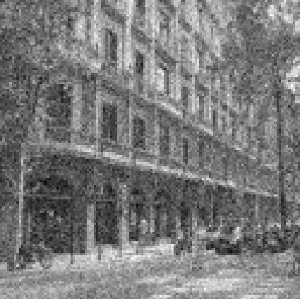

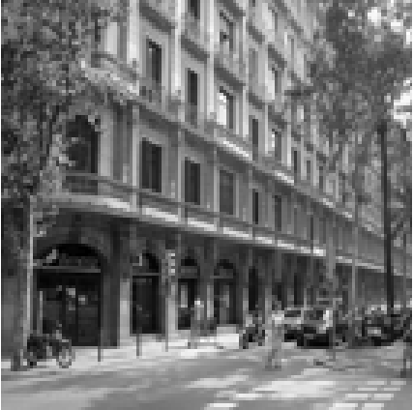
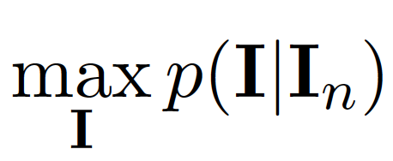
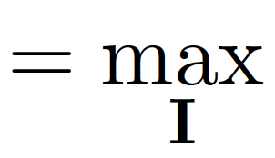
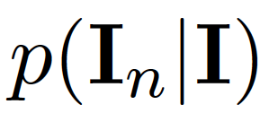
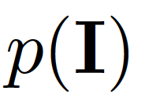
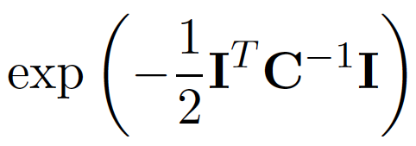

Denoising
Decomposition of a noisy image
=
+
White Gaussian noise:
N(0, σ_{n}²)
Natural image
Find I(x,y) that maximizes the posterior (maximum a posteriory, MAP):
x
likelihood
prior
x

Slide 13
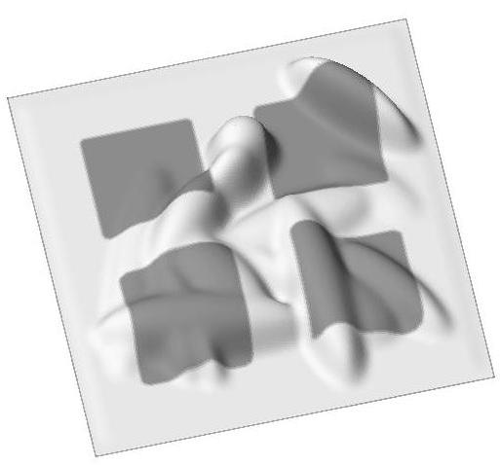
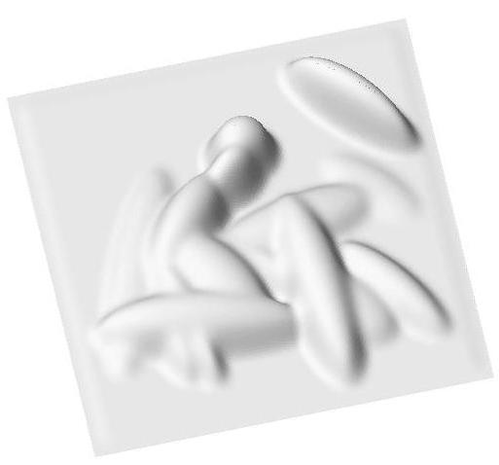

Goal: Intrinsic images
Image
Shading Image
Reflectance Image
Slide: Marshal Tappen

Slide 14
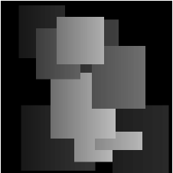
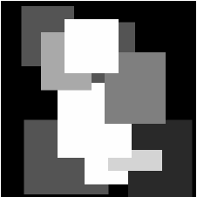

Retinex
=
x
Again, we are trying to solve an ill-posed problem:
24 = ? x ?
From M. Tappen, PhD

Slide 15
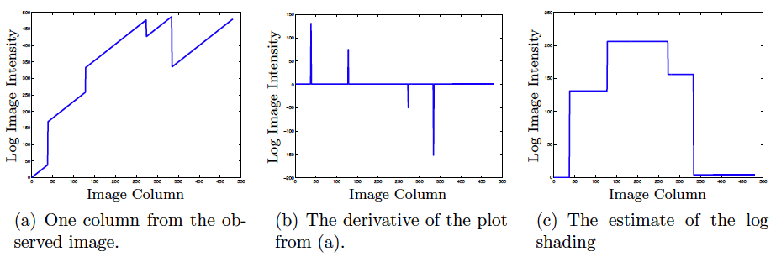
Retinex
too small? let it be zero!
From M. Tappen, PhD
[1 -1]
log
[1 -1]^{T}
From M. Tappen, PhD

Slide 16

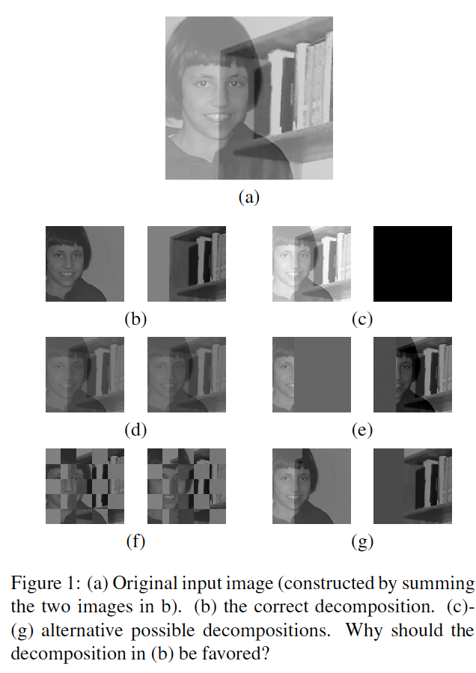

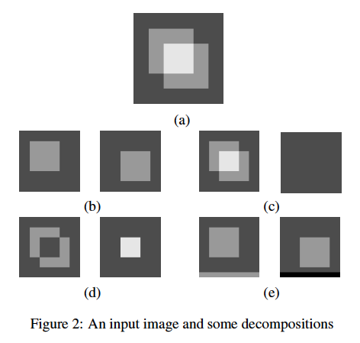

Slide 17
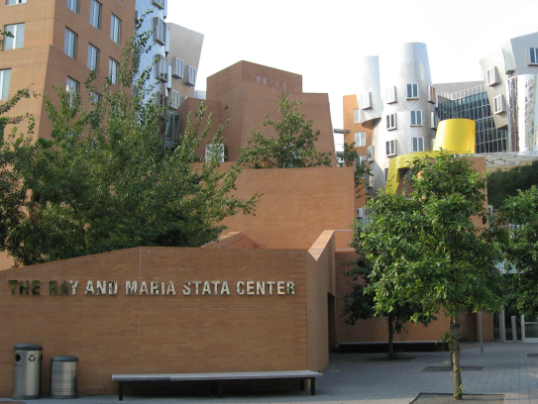
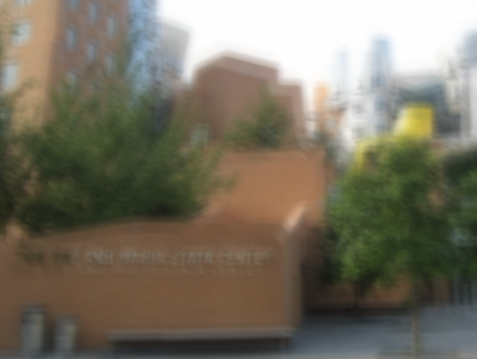
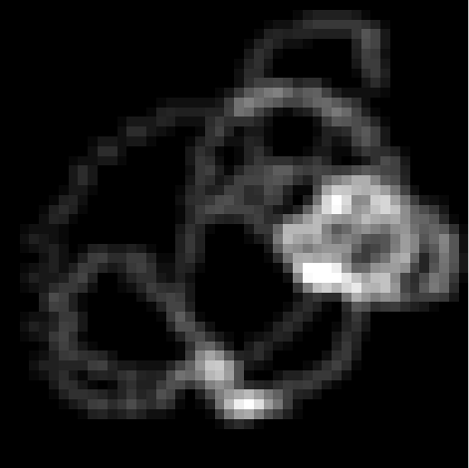
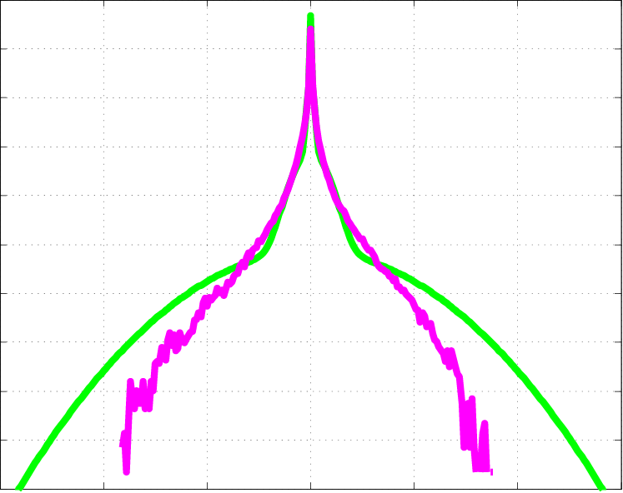
Three sources of information
1. Reconstruction constraint:
⊗
=
Estimated
blur kernel
Estimated sharp image
Input blurry image
2. Image prior:
3. Blur prior:
Positive
&
Sparse
Distribution of gradients
Notes:
Add in + noise
Three things we know.
Reconstruct to the blurry image plus noise.

Slide 18

Image circulated on internet
http://www.cs.dartmouth.edu/farid/publications/deception09.pdf
http://www.cs.dartmouth.edu/farid/publications/significance06.pdf

Slide 19
Vision is hard!

Slide 20
The structure of ambient light
Notes:
100 million miles

Slide 21
The structure of ambient light

Slide 22
The Plenoptic Function
Adelson & Bergen, 91
The intensity P can be parameterized as:
P
(θ, φ,
λ,
t,
X, Y, Z)
“The complete set of all convergence points constitutes the permanent possibilities of vision.” Gibson
Notes:
The significance of the plenoptic function is this: The world is made of three-dimensional objects, but these objects do not communicate their properties directly to an observer. Rather, the objects fill the space around them with the pattern of light rays that constitutes the plenoptic function, and the observer takes samples from this function. The plenoptic function serves as the sole communication link between physical objects and their corre- sponding retinal images.

Slide 23


Slide 24
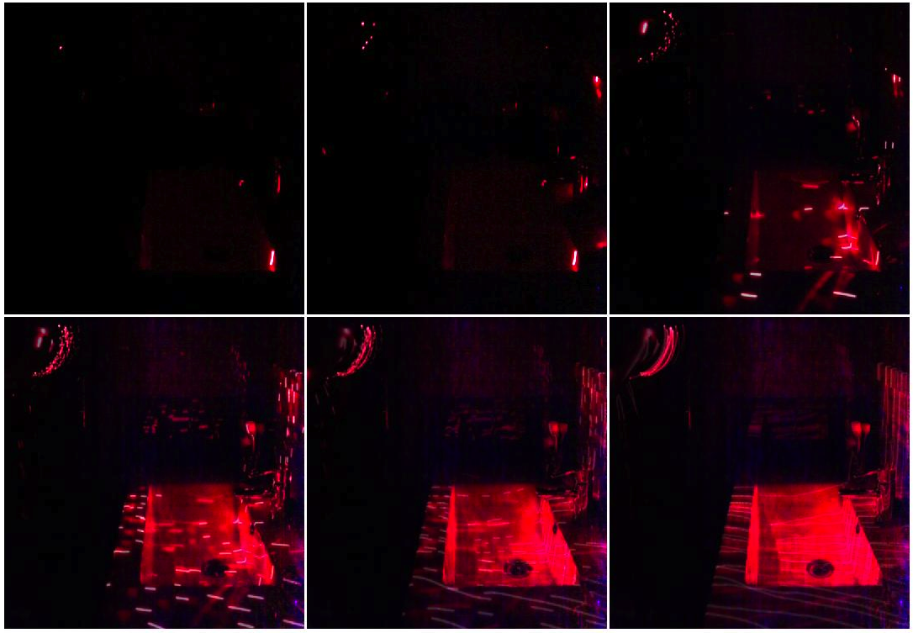
1
5
50
200
600
1300

Slide 25
1
5
50
200
600
1300

Slide 26
1
5
50
200
600
1300

Slide 27
1
5
50
200
600
1300

Slide 28
1
5
50
200
600
1300

Slide 29
1
5
50
200
600
1300

Slide 30
Vision is hard because the world is complicated!
Better Vision Algorithm
Or, just to make the world simpler!

Slide 31
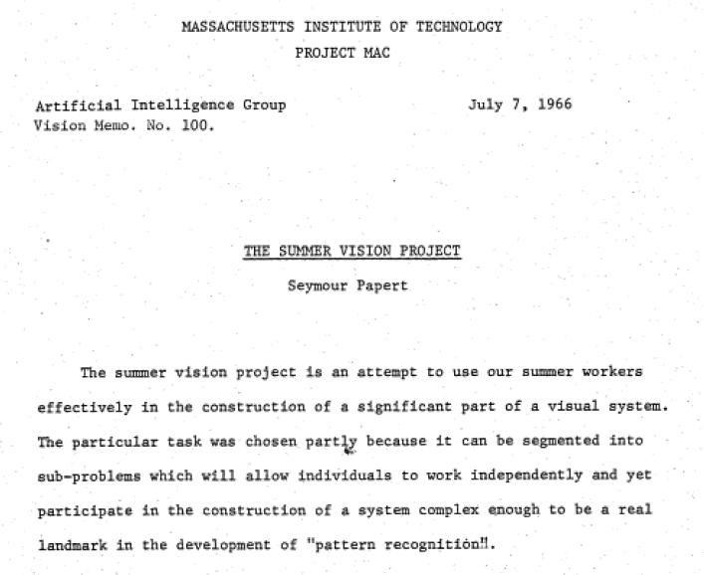

Slide 32
The “three weeks” vision project
The goal of PS2 is
to solve computer vision in 3 weeks

Slide 33
A Simple Visual System
A simple world
A simple image formation model
A simple goal

Slide 34
Today
A simple world
A catalog of edges
Generic view assumption
Constrained solver
Edge detection: Canny
Line detection
  RANSAC
  Hough transformation

Slide 35
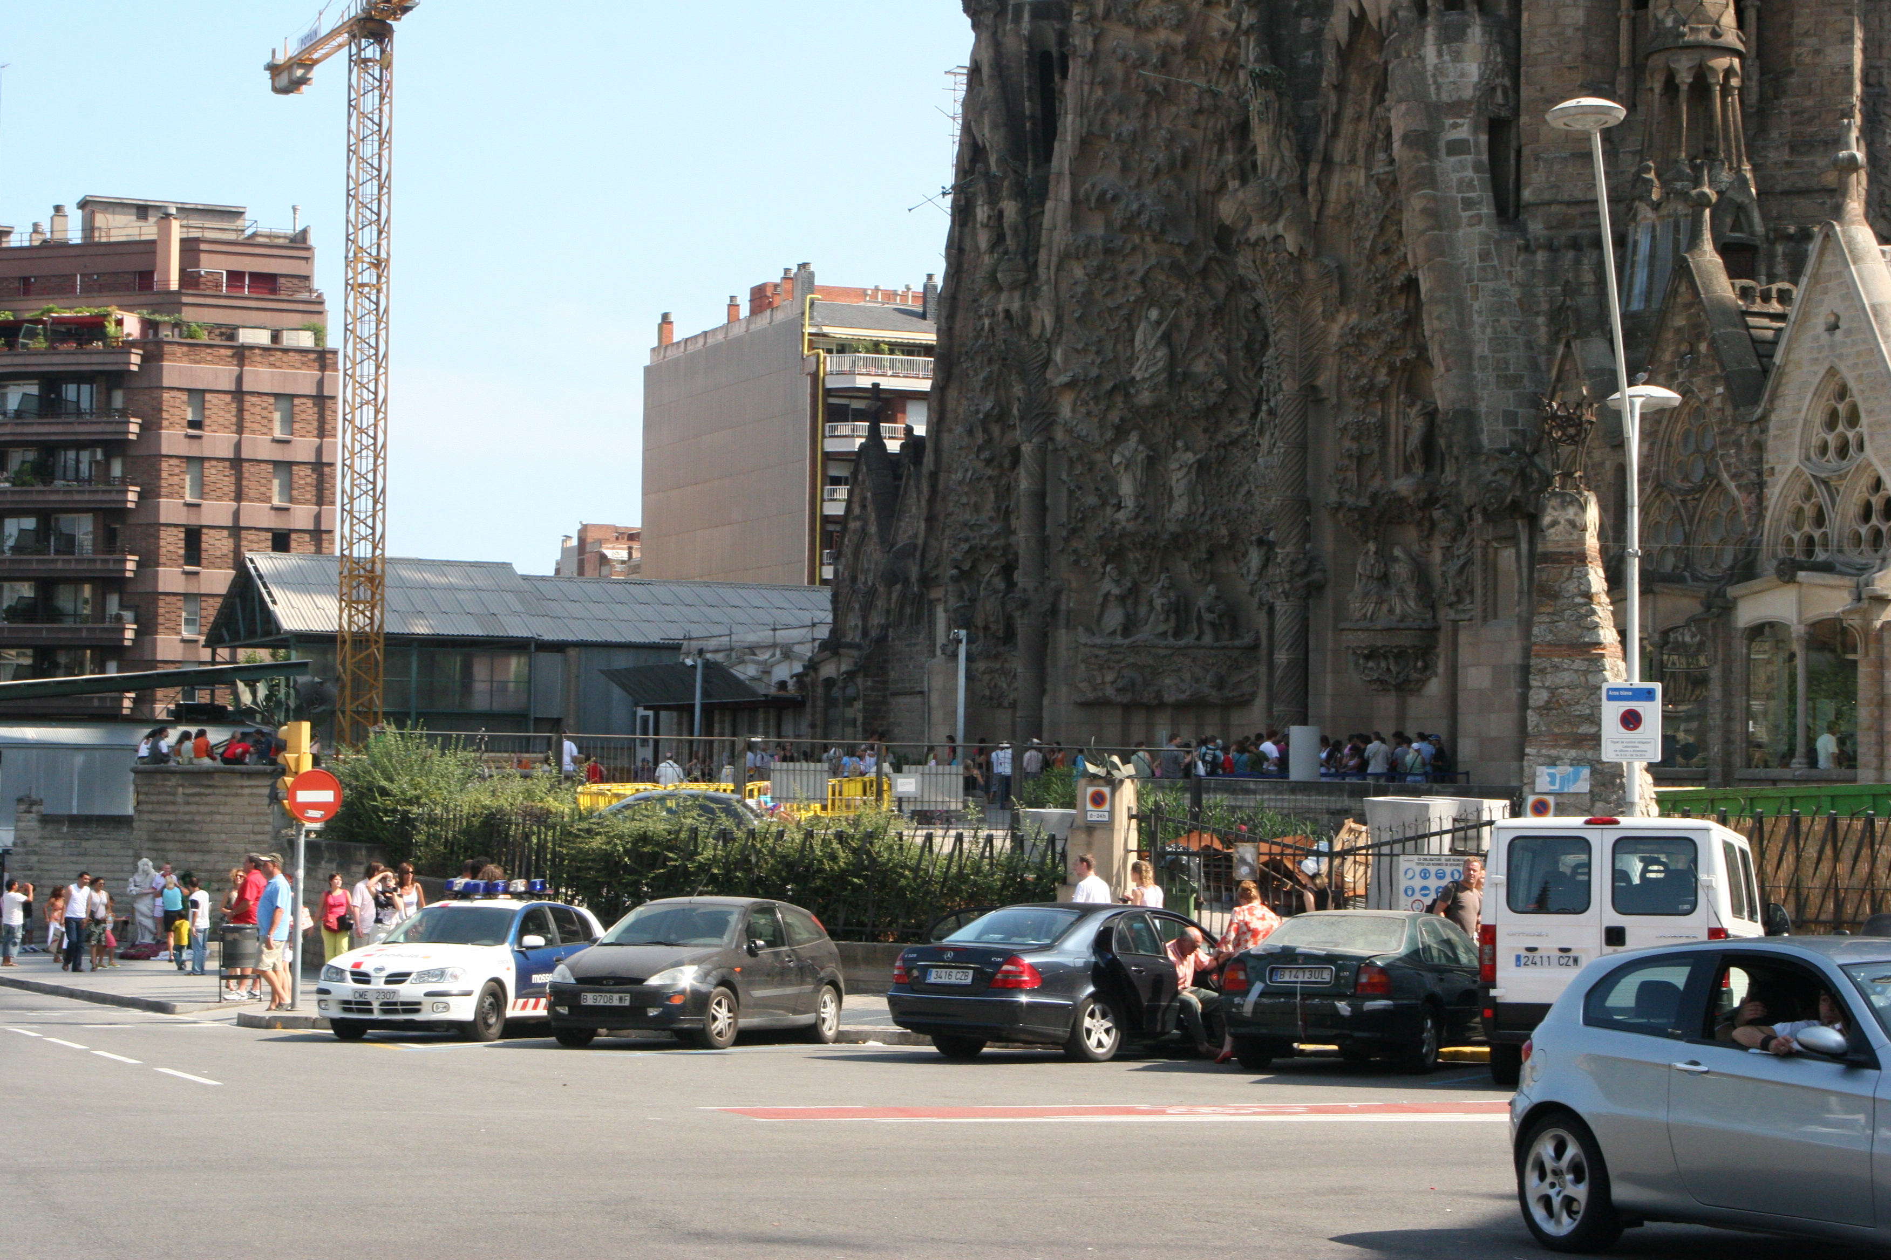
A Simple World

Slide 36
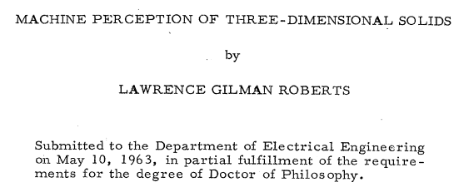
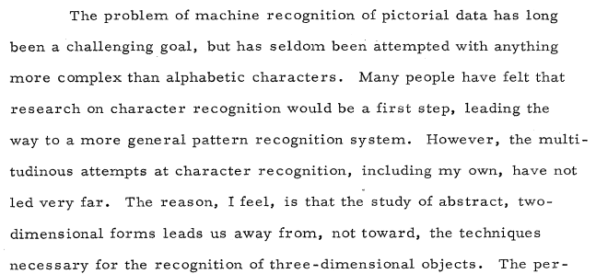
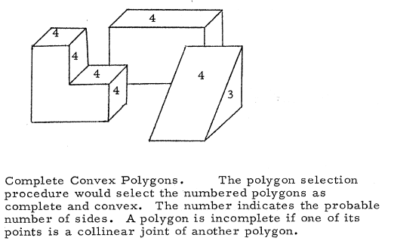
A Simple World
http://www.packet.cc/files/mach-per-3D-solids.html

Slide 37

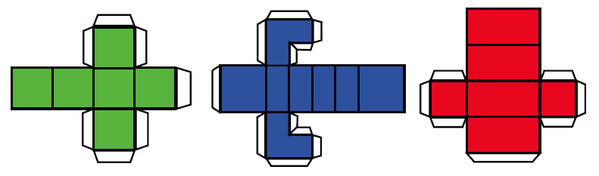

A Simple World

Slide 38
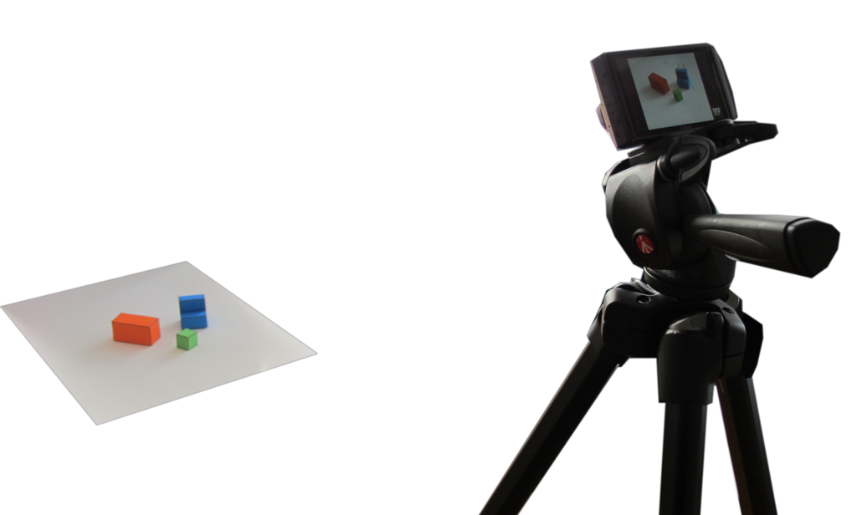
A simple image formation model
Simple world rules:
Surfaces can be horizontal or vertical.
Objects will be resting on a white horizontal ground plane

Slide 39
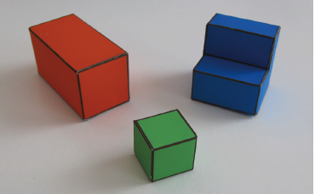

A simple image formation model
Perspective projection
Parallel (orthographic) projection

Slide 40



A simple image formation model
World reference system
Camera plane
(right-handed reference system)

Slide 41

A simple image formation model
Image and projection of the world
coordinate axes into the image plane
World coordinates
image
coordinates
World coordinates
x =
X + x₀
y =
cos(θ) Y – sin(θ) Z + y₀
image coordinates

Slide 42
image coordinates
World coordinates
image plane

Slide 43

A simple goal
To recover the 3D structure of the world
We want to recover X(x,y), Y(x,y), Z(x,y) using as input I(x,y)

Slide 44

Why is this hard?
Sinha & Adelson 93

Slide 45
Why is this hard?
Sinha & Adelson 93

Slide 46
Why is this hard?
Sinha & Adelson 93

Slide 47


A simple visual system
The input image
I(x,y)
0
y
255
x

Slide 48

Proposition 1. The primary task of early vision is to deliver a small set of useful measurements about each observable location in the plenoptic function.
Proposition 2. The elemental operations of early vision involve the measurement of local change along various directions within the plenoptic function.
Goal: to transform the image into other representations (rather than pixel values) that makes scene information more explicit
Adelson, Bergen. 91
Cavanagh, Perception 95

Slide 49
Today
A simple world
A catalog of edges
Generic view assumption
Constrained solver
Edge detection: Canny
Line detection
  RANSAC
  Hough transformation

Slide 50
Object boundaries
Changes in surface orientation:
Occlusion boundaries: in this simple world, we will position the objects in such a way that objects do not occlude each other.
Contact edges: this is an edge between two objects but with no depth discontinuity.
Shadow edges: this can be harder than it seems. In this simple world, shadows are soft creating slow transitions between dark and light.

Slide 51
Edges
Occlusion
Horizontal 3D edge
Change of
Surface orientation
Vertical 3D edge
Contact edge
Shadow boundary

Slide 52





Finding edges in the image
Image gradient:
Approximation image derivative:
Edge strength
Edge orientation:
Edge normal:

Slide 53

Finding edges in the image

Slide 54



Edge classification
Figure/ground segmentation
Occlusion edges
  Occlusion edges are owned by the foreground
Contact edges

Slide 55
Today
A simple world
A catalog of edges
Generic view assumption
Constrained solver
Edge detection: Canny
Line detection
  RANSAC
  Hough transformation

Slide 56
Generic view assumption
3D world
3D world
Image
3D world
Generic view assumption: the observer should not assume that he has a special
position in the world… The most generic interpretation is to see a vertical line as a
vertical line in 3D.
Freeman, 93

Slide 57


Non-accidental properties
D. Lowe, 1985
Biederman_RBC_1987

Slide 58




Non-accidental properties in the simple world
generic
generic
generic
accidental
generic
generic
generic
Using E(x,y)
Using θ(x,y)

Slide 59
Today
A simple world
A catalog of edges
Generic view assumption
Constrained solver
Edge detection: Canny
Line detection
  RANSAC
  Hough transformation

Slide 60
From edges to surface constraints
Ground
Y(x,y) = 0 if (x,y) belongs to a ground pixel
Contact edge
Y(x,y) = 0 if (x,y) belongs to foreground and is a contact edge
Next, things get a bit more complicated.

Slide 61


From edges to surface constraints
How can we relate the information in the pixels with 3D surfaces in the world?
Vertical edges
World coordinates
x =
X + x₀
y =
cos(θ) Y – sin(θ) Z + y₀
image coordinates
Given the image, what can we say about X, Y and Z in the pixels that belong
to a vertical edge?
Z = constant along the edge

Slide 62


From edges to surface constraints
Horizontal edges
World coordinates
x =
X + x₀
y =
cos(θ) Y – sin(θ) Z + y₀
image coordinates
Given the image, what can we say about X, Y and Z in the pixels that belong
to an horizontal 3D edge?
Y = constant along the edge
Where t is the vector parallel to the edge

Slide 63

From edges to surface constraints
What happens where there are no edges?
?
Assumption of planar faces:
i.e. change of change is zero
Information has to be propagated from the edges

Slide 64
A simple inference scheme
All the constraints are linear
if (x,y) belongs to a ground pixel
if (x,y) belongs to a vertical edge
if (x,y) belongs to an horizontal edge
if (x,y) is not an edge

Slide 65

Discrete approximation
We can transform every differential constrain into a discrete linear constraint on Y(x,y)
Y(x,y)
111 | 115 | 113 | 111 | 112 | 111 | 112 | 111
135 | 138 | 137 | 139 | 145 | 146 | 149 | 147
163 | 168 | 188 | 196 | 206 | 202 | 206 | 207
180 | 184 | 206 | 219 | 202 | 200 | 195 | 193
189 | 193 | 214 | 216 | 104 | 79 | 83 | 77
191 | 201 | 217 | 220 | 103 | 59 | 60 | 68
195 | 205 | 216 | 222 | 113 | 68 | 69 | 83
199 | 203 | 223 | 228 | 108 | 68 | 71 | 77
dY
dx
≈ Y(x,y) – Y(x-1,y)
-1 | 1
A slightly better approximation
(it is symmetric, and it averages horizontal derivatives over 3 vertical locations)
-1 | 0 | 1
-2 | 0 | 2
-1 | 0 | 1

Slide 66
Discrete approximation
Transform the “image” Y(x,y) into a column vector:
x=2, y=2
dY
Y(x,y)
dx
≈ Y(x,y) – Y(x-1,y) = Y(2,2) – Y(1,2)=
 |  |  |  |  | -1 |  |  |  | 1
x=0
y=0

Slide 67
A simple inference scheme
Y
b
=
Constraint weights
A Y = b
Y = (A^{T}A)⁻¹ A^{T}b
Matlab
Y = A\b;

Slide 68




Results
X
Edge strength
3D orientation
Y
Edge normals
Contact edges
Z
Depth discontinuities

Slide 69

Changing view point
Input
New view points:

Slide 70

Violations of simple world assumptions
Shading is due to painted stripes

Slide 71
Violations of simple world assumptions
Shading is due to illumination

Slide 72


Violations of simple world assumptions

Slide 73

Impossible steps

Slide 74

Impossible steps

Slide 75
What is missing?
Recognition
The system can not do simple tasks like counting the number of cubes.

Slide 76
Different Approach
A different approach to the one discussed here is model based scene interpretation where we could have a set of predefined models of the objects that can be present in the scene and the system should try to decide if they are present or not in the image, and recover their parameters (pose, color, etc.)
Recognition allows indexing properties that are not directly available in the image. For instance, we can infer the shape of the invisible surfaces. Recognizing each geometric figure also implies extracting the parameters of each figure (pose, size, ...).

Slide 77



3D Cuboid Detector
Input image
Output detections
detect
Synthesized New Views
http://vision.princeton.edu/projects/2012/SUNprimitive/

Slide 78


Scoring Function

Slide 79
Scoring Function

Slide 80
Scoring Function

Slide 81
Scoring Function

Slide 82

Scoring Function
Image (2D)
Unit Cuboid (3D)

Slide 83
Scoring Function

Slide 84

SUN Primitive Database
Notes:
General scenes

Slide 85
What objects are cuboids?

Slide 86






Easy Cases

Slide 87






Detection Result

Slide 88






Multiple Instances

Slide 89






2D vs 3D
Ground truth
2D Detector
3D Detector

Slide 90






Cylinder Detection

Slide 91






Pyramid Detection

Slide 92
Today
A simple world
A catalog of edges
Generic view assumption
Constrained solver
Edge detection: Canny
Line detection
  RANSAC
  Hough transformation

Slide 93

Image Analysis
  Let’s look at gradients
f(x)
f'(x)
x

Slide 94
Image Gradients
For 2D function f(x,y), the partial derivative is:
For discrete data, we can approximate using finite differences:

Slide 95




Image Gradients
The gradient of an image:
The magnitude of the gradient:
The direction of the gradient:
Notes:
give definition of partial derivative: lim h->0 [f(x+h,y) – f(x,y)]/h

Slide 96
Computing Image Gradients
This is a convolution with two simple filters:
-1 1
-1 1
1 -1
or

Slide 97

Computing Image Gradients
Other common gradient filters:

Slide 98


Computing Image Gradients
We usually limit high frequencies when computing gradient
x

Slide 99

Computing Image Gradients
We usually limit high frequencies when computing gradient
x

Slide 100

Computing Image Gradients
Useful fact #1: differentiation
“commutes” with convolution
Useful fact #2: Gaussian is
separable:

Slide 101


Computing Image Gradients
Thus, combine smoothing with gradient computation:

Slide 102



Computing Image Gradients
Can use different sigma to find gradients at different “scales”
1 pixel
3 pixels
7 pixels

Slide 103

Gradient Analysis
How are image gradients useful?

Slide 104

Edges
An edge is a place of rapid change in the image intensity function
intensity function
(along horizontal scanline)
image
first derivative
edges correspond to
extrema of derivative

Slide 105
Edges
Silhouette
Boundary
Convex
Crease
Shadow
Boundary
Concave Crease

Slide 106

Edges

Slide 107

Edges

Slide 108




Edge Detection
Useful for many applications in vision
  Segmentation
  Camera pose estimation
  3D reconstruction
  Object classification
  Object recognition
  etc.

Slide 109
Canny Edge Detector
1. Filter image with derivative of Gaussian
2. Find magnitude and orientation of gradient
3. Non-maximum suppression
4. Hysteresis thresholding

Slide 110


Canny Edge Detector
Original Image
Smoothed Gradient Magnitude

Slide 111

Canny Edge Detector
Nonmaximum suppression
  Eliminate all but local maxima in gradient magnitude
  (sqrt of sum of squares of x and y components)
  At each pixel p look along direction of gradient:
  if either neighbor is bigger, set p to zero
  In practice, quantize direction to horizontal,
  vertical, and two diagonals
  Result: “thinned edge image”

Slide 112

Canny Edge Detector
Smoothed gradient magnitude
Non-maximum suppression

Slide 113
Canny Edge Detector
Final stage: thresholding
Simplest: use a single threshold
Better: use two thresholds
  Find chains of touching edge pixels, all ≥ τ _{low}
  Each chain must contain at least one pixel ≥ τ _{high}
  Helps eliminate dropouts in chains, without being too susceptible to noise
  “Thresholding with hysteresis”

Slide 114

Canny Edge Detector
Non-maximum suppression
Canny edges

Slide 115
Canny Edge Detector
Original Image
Canny edges

Slide 116
Summary of Canny Edge Detector
1. Filter image with derivative of Gaussian
2. Find magnitude and orientation of gradient
3. Non-maximum suppression:
  Thin wide “ridges” down to single pixel width
4. Hysteresis thresholding:
  Define two thresholds: low and high
  Use the high threshold to start edge curves and the low threshold to continue them

Slide 117
Today
A simple world
A catalog of edges
Generic view assumption
Constrained solver
Edge detection: Canny
Line detection
  RANSAC
  Hough transformation

Slide 118
Goal
Extract “structural features” from an image
  Non-accidental
  properties

Slide 119
Goal
What types of “structure” are in this image?

Slide 120
Goal
What types of “structure” are in this image?
  Straight lines
  Parallel lines
  Symmetric
  pairs of lines
  Trapezoids
  Monochromatic
  regions
  etc.

Slide 121

Goal
What types of “structure” are in this image?

Slide 122
Goal
What types of “structure” are in this image?
  Circles
  Ellipses
  Symmetries in
  color and texture
  etc.

Slide 123
Structure Detection
Algorithms for “structure detection”
  Line detection
  Circle detection
  Symmetry detection

Slide 124
Line Detection
Let’s first consider how to detect lines
Input
Output

Slide 125
Line Detection
Let’s first consider how to detect lines
Input
Overlay

Slide 126
Line Detection
Desirable properties of a line detection algorithm?

Slide 127
Line Detection
Desirable properties of a line detection algorithm:
  Straight, long lines only
  Few missed or extra lines
  Provides confidence of
  prediction for each pixel
  Robust to differences
  in occlusion, noise,
  scale, rotation, translation,
  slight non-straightness,
  brightness, etc.
  Efficient computation

Slide 128
Line Detection
Not the same as edge detection:
  Edges are small-scale,
  local properties
  Lines are large-scale,
  structural properties

Slide 129


Line Detection
Applications:
  Removing radial distortion
  Camera pose estimation
  Segmentation
  Scene classification
  Object detection
  etc.

Slide 130

Line Detection
Applications:
  Removing radial distortion
  Camera pose estimation
  Segmentation
  Scene classification
  Object detection
  etc.

Slide 131
Line Detection
Please propose a line detection algorithm
Input
Output

Slide 132


Line Detection
OK, but what about this harder example?
Input
Output

Slide 133


Line Detection
This one?
Input
Output

Slide 134
Today
A simple world
A catalog of edges
Generic view assumption
Constrained solver
Edge detection: Canny
Line detection
  RANSAC
  Hough transformation

Slide 135
RANSAC in General
RANdom SAmple Consensus
Take many random samples of data
  Compute fit for each sample
  See how many points agree
  Remember the best

Slide 136

RANSAC for Line Detection
At beginning:
  Compute gradient direction N and magnitude G
Iterate:
  Randomly choose a pixel p
  Choose a line L through p
  Compute how well
  other pixels “support” L
At end:
  Report the line L* with
  the most “support”
Input

Slide 137

RANSAC for Line Detection
At beginning:
  Compute gradient direction N and magnitude G
Iterate:
  Randomly choose a pixel p
  Choose a line L through p
  Compute how well
  other pixels “support” L
At end:
  Report the line L* with
  the most “support”
Gradient Magnitude (G)

Slide 138
RANSAC for Line Detection
At beginning:
  Compute gradient direction N and magnitude G
Iterate:
  Randomly choose a pixel p
  Choose a line L through p
  Compute how well
  other pixels “support” L
At end:
  Report the line L* with
  the most “support”
p
Point p and Normal N(p)

Slide 139
RANSAC for Line Detection
At beginning:
  Compute gradient direction N and magnitude G
Iterate:
  Randomly choose a pixel p
  Choose a line L through p
  Compute how well
  other pixels “support” L
At end:
  Report the line L* with
  the most “support”
N(p)
p
Line L through p

Slide 140
RANSAC for Line Detection
At beginning:
  Compute gradient direction N and magnitude G
Iterate:
  Randomly choose a pixel p
  Choose a line L through p
  Compute how well
  other pixels “support” L
At end:
  Report the line L* with
  the most “support”
N(p)
p
L
Line L through p

Slide 141
RANSAC for Line Detection
At beginning:
  Compute gradient direction N and magnitude G
Iterate:
  Randomly choose a pixel p
  Choose a line L through p
  Compute how well
  other pixels “support” L
At end:
  Report the line L* with
  the most “support”
N(p)
L
N(q)
q
“inliers”
Compute support

Slide 142
RANSAC for Line Detection
At beginning:
  Compute gradient direction N and magnitude G
Iterate:
  Randomly choose a pixel p
  Choose a line L through p
  Compute how well
  other pixels “support” L
At end:
  Report the line L* with
  the most “support”

Slide 143
RANSAC for Line Detection
At beginning:
  Compute gradient direction N and magnitude G
Iterate:
  Randomly choose a pixel p
  Choose a line L through p
  Compute how well
  other pixels “support” L
At end:
  Report the line L* with
  the most “support”
p
Point p and Normal N(p)

Slide 144
RANSAC for Line Detection
At beginning:
  Compute gradient direction N and magnitude G
Iterate:
  Randomly choose a pixel p
  Choose a line L through p
  Compute how well
  other pixels “support” L
At end:
  Report the line L* with
  the most “support”
N(p)
L
p
Line L through p

Slide 145
RANSAC for Line Detection
At beginning:
  Compute gradient direction N and magnitude G
Iterate:
  Randomly choose a pixel p
  Choose a line L through p
  Compute how well
  other pixels “support” L
At end:
  Report the line L* with
  the most “support”
N(q)
N(p)
L
q
Compute support

Slide 146
RANSAC for Line Detection
At beginning:
  Compute gradient direction N and magnitude G
Iterate:
  Randomly choose a pixel p
  Choose a line L through p
  Compute how well
  other pixels “support” L
At end:
  Report the line L* with
  the most “support”
L*
Line L* with most support

Slide 147
RANSAC for Line Detection
Many possible variants:
  How to choose L?
    Point (and local gradient)
    Point and angle
    Two points
    Three points
    etc.
  How compute “support” for L?
    ∑ G(q) |N(p)•N(q)|
    Optimize L to fit “inliers”
    etc.

Slide 148
RANSAC for Line Detection
Many possible variants:
  How to choose L?
    Point (and local gradient)
    Point and angle
    Two points
    Three points
    etc.
  How compute “support” for L?
    ∑ G(q) |N(p)•N(q)|
    Optimize L to fit “inliers”
    etc.
θ
L
p
Line through point with angle

Slide 149
RANSAC for Line Detection
Many possible variants:
  How to choose L?
    Point (and local gradient)
    Point and angle
    Two points
    Three points
    etc.
  How compute “support” for L?
    ∑ G(q) |N(p)•N(q)|
    Optimize L to fit “inliers”
    etc.
p1
L
p2
Line through two points

Slide 150
RANSAC for Line Detection
Many possible variants:
  How to choose L?
    Point (and local gradient)
    Point and angle
    Two points
    Three points
    etc.
  How compute “support” for L?
    ∑ G(q) |N(p)•N(q)|
    Optimize L to fit “inliers”
    etc.
p1
p3
p2
L
Line through three points

Slide 151
RANSAC for Line Detection
Many possible variants:
  How to choose L?
    Point (and local gradient)
    Point and angle
    Two points
    Three points
    etc.
  How compute “support” for L?
    ∑ G(q) |N(p)•N(q)|
    Optimize L to fit “inliers”
    etc.
L
“inliers”

Slide 152
RANSAC for Line Detection
Many possible variants:
  How to choose L?
    Point (and local gradient)
    Point and angle
    Two points
    Three points
    etc.
  How compute “support” for L?
    ∑ G(q) |N(p)•N(q)|
    Optimize L to fit “inliers”
    etc.
L
“inliers”

Slide 153
RANSAC for Line Detection
At beginning:
  Compute gradient direction N and magnitude G
Iterate:
  Randomly choose a pixel p
  Choose a line L through p
  Compute how well
  other pixels “support” L
At end:
  Report the line L* with
  the most “support”
L

Slide 154
RANSAC for Line Detection
At beginning:
  Compute gradient direction N and magnitude G
Iterate:
  Randomly choose a pixel p
  Choose a line L through p
  Compute how well
  other pixels “support” L
At end:
  Report the line L* with
  the most “support”
How many iterations?
What is running time?
L

Slide 155
RANSAC for Line Detection
S = # samples (iterations)
T = time to evaluate each sample
n = width/height of image
d = degrees of freedom in
line parameterization
Running time = O (ST) = O(n^{d})
  S = O(n^{d-1})
  T = O(n)
n
L
n

Slide 156
RANSAC in General
RANdom SAmple Consensus
Take many random subsets of data
  Compute fit for each sample
  See how many points agree
  Remember the best
What else could this algorithm detect?

Slide 157

RANSAC for Circle Detection
Detecting circles:
  Randomly choose three
  pixels p1, p2, and p3
  Compute a circle C
  through p1, p2, and p3
  Compute how well
  other pixels “support” C
p1
p3
p2

Slide 158
RANSAC for Circle Detection
Detecting circles:
  Randomly choose three
  pixels p1, p2, and p3
  Compute a circle C
  through p1, p2, and p3
  Compute how well
  other pixels “support” C
What is the running time?
p1
p3
p2

Slide 159
RANSAC for Circle Detection
Detecting circles:
  Randomly choose three
  pixels p1, p2, and p3
  Compute a circle C
  through p1, p2, and p3
  Compute how well
  other pixels “support” C
How can we improve
the running time?
p1
p3
p2

Slide 160
RANSAC for Circle Detection
Possible parameterizations for circles:
  6 dof: three points
  5 dof: two points, one angle
  4 dof: one point, one angle,
  one radius
p1
p3
p2

Slide 161
RANSAC for Circle Detection
Possible parameterizations for circles:
  6 dof: three points
  5 dof: two points, one angle
  4 dof: one point, one angle,
  one radius
p1
θ
p2

Slide 162
RANSAC for Circle Detection
Possible parameterizations for circles:
  6 dof: three points
  5 dof: two points, one angle
  4 dof: one point, one angle,
  one radius
  3 dof: one point, one radius
r
θ
p

Slide 163

The RANSAC Song
http://danielwedge.com/ransac/

Slide 164
Today
A simple world
A catalog of edges
Generic view assumption
Constrained solver
Edge detection: Canny
Line detection
  RANSAC
  Hough transformation

Slide 165
Hough Transform
Like RANSAC, except visit pixels p one-by-one and accumulate “support” (vote) for all primitives containing p in hash table bins
Image
Hough Space

Slide 166
Hough Transform
At beginning:
  Initialize all Hough space bins to zero
For each pixel sample p:
  Add support to all Hough space bins representing
  primitives containing p
At end:
  Find the Hough space bin(s) with the most support

Slide 167
Hough Transform for Line Detection
Example:
Image
Hough Space

Slide 168
Hough Transform for Line Detection
Example:
Image
Hough Space

Slide 169
Hough Transform for Line Detection
Example:
Image
Hough Space

Slide 170
Hough Transform for Line Detection
Example:
Image
Hough Space

Slide 171
Hough Transform for Line Detection
Example:
Image
Hough Space

Slide 172
Hough Transform for Line Detection
Example:
Image
Hough Space

Slide 173
Hough Transform for Line Detection
Example:
Image
Hough Space

Slide 174
Hough Transform for Line Detection
Key question: how to parameterize Hough space?

Slide 175
Hough Transform for Line Detection
A 2 dof parameterization for lines: y = ax+b
Parameters: a and b
dy
dx
a=dy/dx
b

Slide 176
Hough Transform for Line Detection
Every point in image lies on “line” of bins in
Hough space with this parameterization
b
a
Image
Hough Space

Slide 177
Hough Transform for Line Detection
Problems with slope / intercept parameterization
  Non-uniform sampling of directions
  Can’t represent vertical lines
dy
dx
a=dy/dx
b

Slide 178
Hough Transform for Line Detection
Alternative: angle / distance parameterization
  Line represented as (r,θ ) where
    x cos θ + y sin θ = r
    r = – cos θ • x – sin θ • y
    N(L) = (cos θ, sin θ)
    dist(L, p)= x cos θ + y sin θ - r
L
p = (x, y)
r
N(L)
(x0, y0)
θ

Slide 179
Hough Transform for Line Detection
Alternative: angle / distance parameterization
  Line represented as (r,θ ) where
    x cos θ + y sin θ = r
    r = – cos θ • x – sin θ • y
    N(L) = (cos θ, sin θ)
    dist(L, p)= x cos θ + y sin θ - r
    L(r, θ) ≈ L(-r, θ + π)
L
p = (x, y)
-r
N(L)
θ

Slide 180

Hough Transform for Line Detection
Alternative: angle / distance parameterization
  Line represented as (r,θ )
    + Uniform sampling of angles
    -- Lines through point
    lie on sinusoid in (r,θ )

Slide 181

Hough Transform for Line Detection
Alternative: angle / distance parameterization
  Line represented as (r,θ )
    + Uniform sampling of angles
    -- Lines through point
    lie on sinusoid in (r,θ )

Slide 182

Hough Transform for Line Detection
Most people use angle / distance parameterization
  Line represented as (r,θ )

Slide 183
Hough Transform for Line Detection
Issue: How to select bucket size?

Slide 184
Hough Transform for Line Detection
Issue: How to select bucket size?
  Too small: poor performance on noisy data
  Too large: poor accuracy, possibility of false positives

Slide 185
Hough Transform for Line Detection
Issue: How to select bucket size?
  Too small: poor performance on noisy data
  Too large: poor accuracy, possibility of false positives
One solution:
  Large buckets + refinement
Initial guess
from Hough transform

Slide 186
Hough Transform for Line Detection
Issue: How to select bucket size?
  Too small: poor performance on noisy data
  Too large: poor accuracy, possibility of false positives
One solution:
  Large buckets + refinement
Least-squares
minimization

Slide 187
Hough Transform for Line Detection
Issue: How to select bucket size?
  Too small: poor performance on noisy data
  Too large: poor accuracy, possibility of false positives
One solution:
  Large buckets + refinement

Slide 188
Hough Transform in General
What else can be detected with a Hough transform?
  Circles
  Ellipses
  Boxes
  Symmetries
  etc.
Anything that can be parameterized
(in a small number of dimensions)

Slide 189
Hough Transform for Circle Detections
2D circles have 3 degrees of freedom
  Possible parameterization = 2D position and radius
So, each pixel gives rise to 2D sheet of values in
3D Hough space

Slide 190
Hough Transform for Symmetry Detection
Symmetry transform:
  Vote for midpoints between pixels

Slide 191

Hough Transform for Symmetry Detection
Symmetry transform:
  Vote for midpoints between pixels

Slide 192

Hough Transform for Symmetry Detection
Symmetry transform:
  Vote for midpoints between pixels

Slide 193


Hough Transform for Symmetry Detection
Symmetry transform:
  Vote for midpoints between pixels
  Weight votes by functions of
  distances, gradients, directions,
  etc.
Reisfeld, et. al.

Slide 194



Hough Transform for Symmetry Detection
Symmetry transform:
  Used for eye detection!!!
Input
Hough Votes
Feature detections

Slide 195

Hough Transform for Symmetry Detection
Reflective symmetry transform:
  Vote for bisector lines

Slide 196
Hough Transform and RANSAC
Very general computational techniques:
  Useful for detecting anything
  that can be parameterized
  in a low-dimensional space

Slide 197
Hough Transform vs. RANSAC?
How are algorithms similar / different?

Slide 198

Combine Edges and Lines
Detect edges locally
  Canny algorithm
Detect lines globally
  Hough algorithm
Combine

Slide 199





Combine Edges and Lines
Input
Output
Hough Transform
Canny edges
Strong Hough lines

Slide 200
Summary
Problem:
  Structure detection
Focus: line detection
  RANSAC
  Hough transform
Extensions
  Circles and other primitives
  Symmetries
Applications
  Segmentation
  Alignment

Slide 201
Today
A simple world
A catalog of edges
Generic view assumption
Constrained solver
Edge detection: Canny
Line detection
  RANSAC
  Hough transformation

