Slide 1

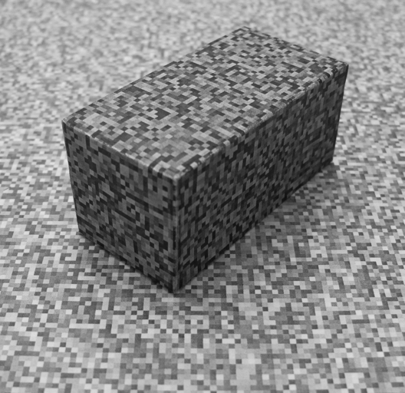
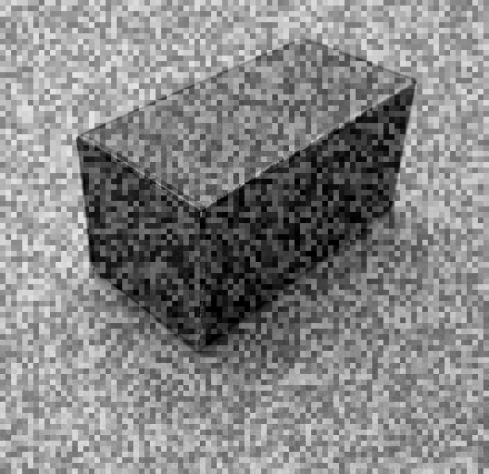
Natural Image Statistics
COS429 Computer Vision

Slide 2

Last Time: Image filtering
1
1
1
1
1
1
1
1
1
0 | 0 | 0 | 0 | 0 | 0 | 0 | 0 | 0 | 0
0 | 0 | 0 | 0 | 0 | 0 | 0 | 0 | 0 | 0
0 | 0 | 0 | 90 | 90 | 90 | 90 | 90 | 0 | 0
0 | 0 | 0 | 90 | 90 | 90 | 90 | 90 | 0 | 0
0 | 0 | 0 | 90 | 90 | 90 | 90 | 90 | 0 | 0
0 | 0 | 0 | 90 | 0 | 90 | 90 | 90 | 0 | 0
0 | 0 | 0 | 90 | 90 | 90 | 90 | 90 | 0 | 0
0 | 0 | 0 | 0 | 0 | 0 | 0 | 0 | 0 | 0
0 | 0 | 90 | 0 | 0 | 0 | 0 | 0 | 0 | 0
0 | 0 | 0 | 0 | 0 | 0 | 0 | 0 | 0 | 0
 | 0
0 | 0 | 0 | 0 | 0 | 0 | 0 | 0 | 0 | 0
0 | 0 | 0 | 0 | 0 | 0 | 0 | 0 | 0 | 0
0 | 0 | 0 | 90 | 90 | 90 | 90 | 90 | 0 | 0
0 | 0 | 0 | 90 | 90 | 90 | 90 | 90 | 0 | 0
0 | 0 | 0 | 90 | 90 | 90 | 90 | 90 | 0 | 0
0 | 0 | 0 | 90 | 0 | 90 | 90 | 90 | 0 | 0
0 | 0 | 0 | 90 | 90 | 90 | 90 | 90 | 0 | 0
0 | 0 | 0 | 0 | 0 | 0 | 0 | 0 | 0 | 0
0 | 0 | 90 | 0 | 0 | 0 | 0 | 0 | 0 | 0
0 | 0 | 0 | 0 | 0 | 0 | 0 | 0 | 0 | 0
Credit: S. Seitz
Notes:
ones, divide by 9

Slide 3
Last Time: Image filtering
1
1
1
1
1
1
1
1
1
0 | 0 | 0 | 0 | 0 | 0 | 0 | 0 | 0 | 0
0 | 0 | 0 | 0 | 0 | 0 | 0 | 0 | 0 | 0
0 | 0 | 0 | 90 | 90 | 90 | 90 | 90 | 0 | 0
0 | 0 | 0 | 90 | 90 | 90 | 90 | 90 | 0 | 0
0 | 0 | 0 | 90 | 90 | 90 | 90 | 90 | 0 | 0
0 | 0 | 0 | 90 | 0 | 90 | 90 | 90 | 0 | 0
0 | 0 | 0 | 90 | 90 | 90 | 90 | 90 | 0 | 0
0 | 0 | 0 | 0 | 0 | 0 | 0 | 0 | 0 | 0
0 | 0 | 90 | 0 | 0 | 0 | 0 | 0 | 0 | 0
0 | 0 | 0 | 0 | 0 | 0 | 0 | 0 | 0 | 0
 | 0 | 10
0 | 0 | 0 | 0 | 0 | 0 | 0 | 0 | 0 | 0
0 | 0 | 0 | 0 | 0 | 0 | 0 | 0 | 0 | 0
0 | 0 | 0 | 90 | 90 | 90 | 90 | 90 | 0 | 0
0 | 0 | 0 | 90 | 90 | 90 | 90 | 90 | 0 | 0
0 | 0 | 0 | 90 | 90 | 90 | 90 | 90 | 0 | 0
0 | 0 | 0 | 90 | 0 | 90 | 90 | 90 | 0 | 0
0 | 0 | 0 | 90 | 90 | 90 | 90 | 90 | 0 | 0
0 | 0 | 0 | 0 | 0 | 0 | 0 | 0 | 0 | 0
0 | 0 | 90 | 0 | 0 | 0 | 0 | 0 | 0 | 0
0 | 0 | 0 | 0 | 0 | 0 | 0 | 0 | 0 | 0
Credit: S. Seitz
Notes:
ones, divide by 9

Slide 4
Last Time: Image filtering
1
1
1
1
1
1
1
1
1
0 | 0 | 0 | 0 | 0 | 0 | 0 | 0 | 0 | 0
0 | 0 | 0 | 0 | 0 | 0 | 0 | 0 | 0 | 0
0 | 0 | 0 | 90 | 90 | 90 | 90 | 90 | 0 | 0
0 | 0 | 0 | 90 | 90 | 90 | 90 | 90 | 0 | 0
0 | 0 | 0 | 90 | 90 | 90 | 90 | 90 | 0 | 0
0 | 0 | 0 | 90 | 0 | 90 | 90 | 90 | 0 | 0
0 | 0 | 0 | 90 | 90 | 90 | 90 | 90 | 0 | 0
0 | 0 | 0 | 0 | 0 | 0 | 0 | 0 | 0 | 0
0 | 0 | 90 | 0 | 0 | 0 | 0 | 0 | 0 | 0
0 | 0 | 0 | 0 | 0 | 0 | 0 | 0 | 0 | 0
 | 0 | 10 | 20
0 | 0 | 0 | 0 | 0 | 0 | 0 | 0 | 0 | 0
0 | 0 | 0 | 0 | 0 | 0 | 0 | 0 | 0 | 0
0 | 0 | 0 | 90 | 90 | 90 | 90 | 90 | 0 | 0
0 | 0 | 0 | 90 | 90 | 90 | 90 | 90 | 0 | 0
0 | 0 | 0 | 90 | 90 | 90 | 90 | 90 | 0 | 0
0 | 0 | 0 | 90 | 0 | 90 | 90 | 90 | 0 | 0
0 | 0 | 0 | 90 | 90 | 90 | 90 | 90 | 0 | 0
0 | 0 | 0 | 0 | 0 | 0 | 0 | 0 | 0 | 0
0 | 0 | 90 | 0 | 0 | 0 | 0 | 0 | 0 | 0
0 | 0 | 0 | 0 | 0 | 0 | 0 | 0 | 0 | 0
Credit: S. Seitz
Notes:
ones, divide by 9

Slide 5
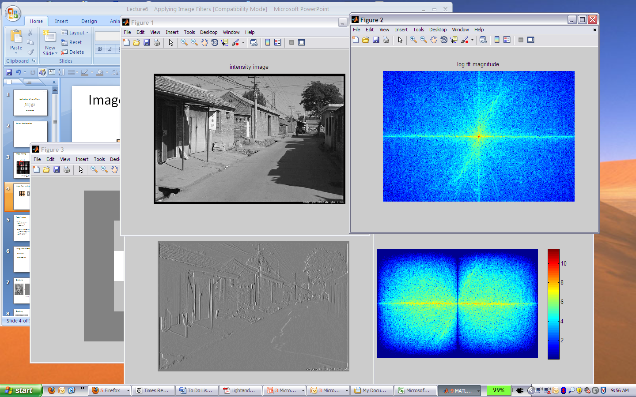
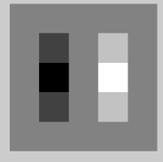
Filtering in spatial domain
1
0
-1
2
0
-2
1
0
-1
*
=

Slide 6
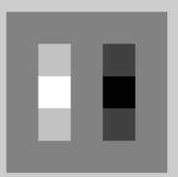

Filtering in frequency domain
FFT
FFT
=
Inverse FFT

Slide 7
Last Time
Filtering in frequency domain
  Can be faster than filtering in spatial domain (for large filters)
  Can help understand effect of filter
  Algorithm:
    Convert image and filter to fft (fft2 in matlab)
    Pointwise-multiply ffts
    Convert result to spatial domain with ifft2

Slide 8
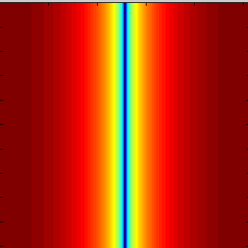
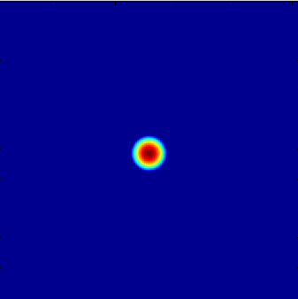

Last Time
Linear filters for basic processing
  Edge filter (high-pass)
  Gaussian filter (low-pass)
[-1 1]
Gaussian
FFT of Gradient Filter
FFT of Gaussian

Slide 9
Last Time
Applications of filters
  Template matching (SSD or Normxcorr2)
    SSD can be done with linear filters, is sensitive to overall intensity
  Gaussian pyramid
    Coarse-to-fine search, multi-scale detection
  Downsampling
    Need to sufficiently low-pass before downsampling

Slide 10
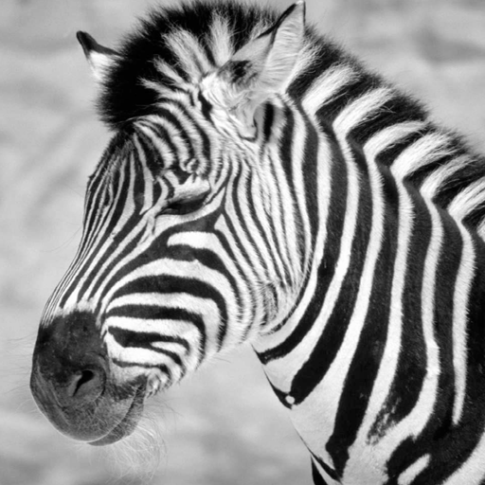
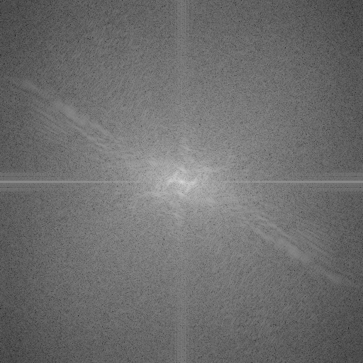
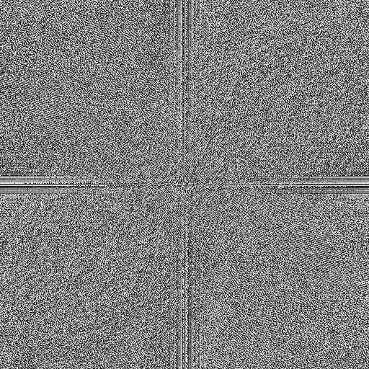
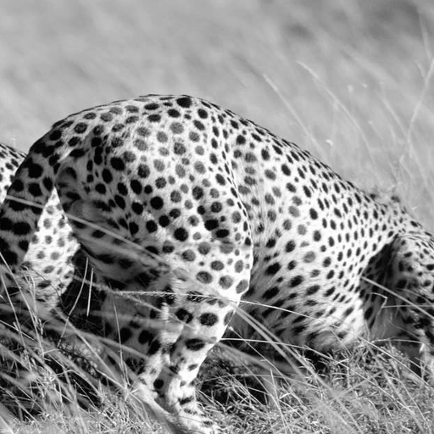
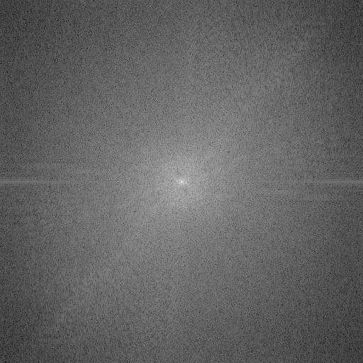
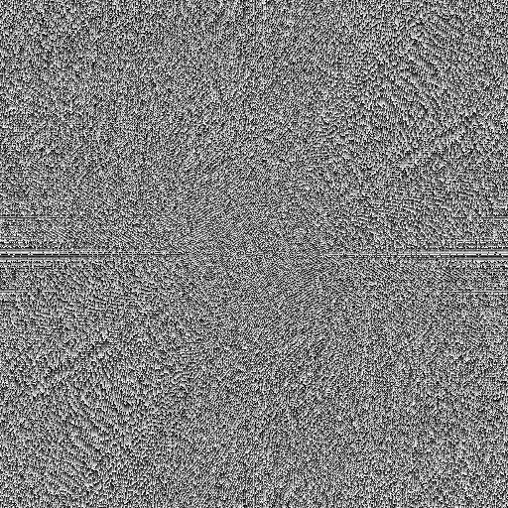
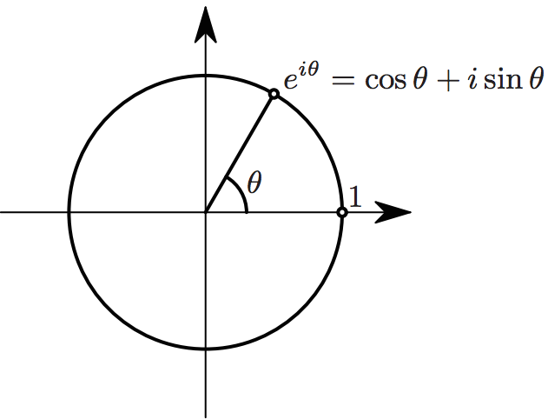

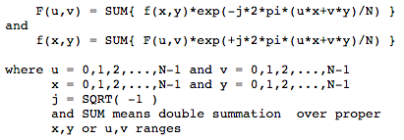
Phase and Magnitude
all natural images have about the same magnitude transform
hence, phase seems to matter, but magnitude largely doesn’t
Magnitude
Phase
log(abs(fftshift(im_fft)))

Slide 11
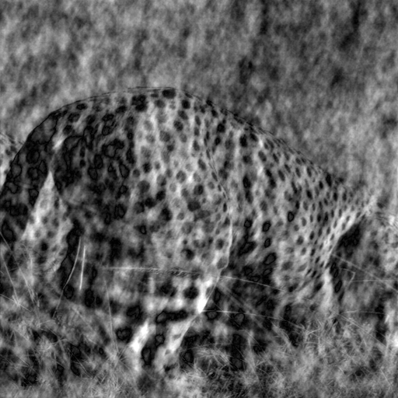
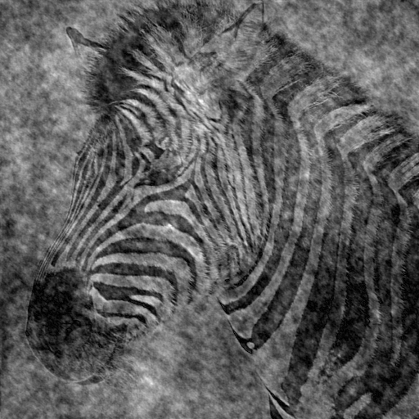
Demo: Take two pictures, swap the phase transforms, compute the inverse - what does the result look like?
Image with cheetah phase
(and zebra magnitude)
Image with zebra phase
(and cheetah magnitude)
Computer Vision - A Modern Approach - Set: Pyramids and Texture - Slides by D.A. Forsyth

Slide 12
Natural Image Statistics
COS429 Computer Vision

Slide 13
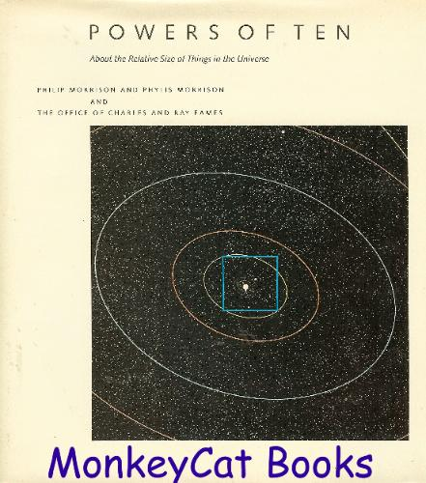
Numbers
seconds since big bang: ~ 10¹⁷
atoms in the universe: ∼10⁸⁰
65×65 8-bit gray-scale images:
256^{65x65} ∼ 10¹⁰⁰⁰⁰

Slide 14
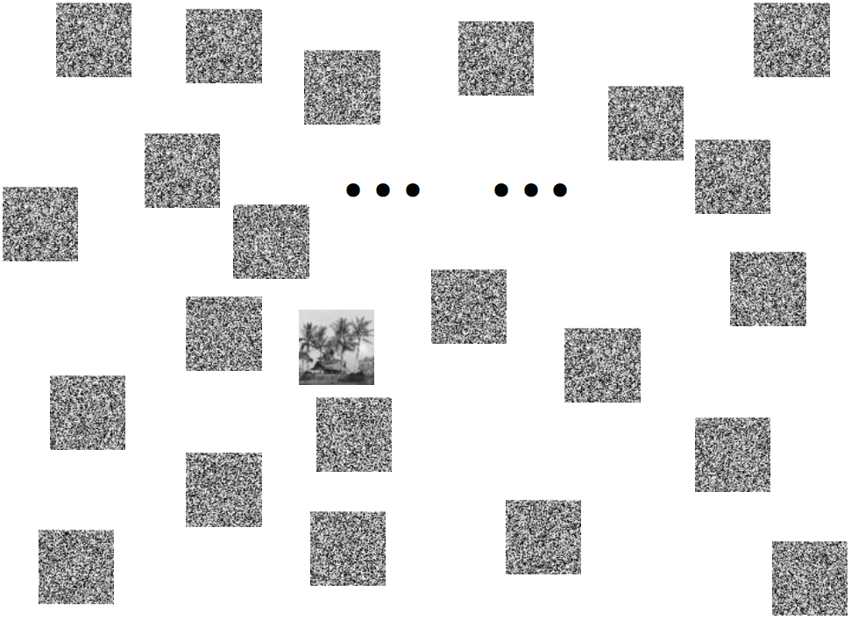
“The distribution of natural images is complicated. Perhaps it is something like beer foam, which is mostly empty but contains a thin mesh-work of fluid which fills the space and occupies almost no volume. The fluid region represents those images which are natural in character.”
[Ruderman 1996]

Slide 15

Natural Image Statistics
Natural images are rare in image space
They distinguish by nonrandom structures
Common statistical properties of natural images is the focal element in the study of natural image statistics
http://www.naturalimagestatistics.net

Slide 16
What are we tuned to?
The visual system is tuned to process structures typically found in the world.

Slide 17

Demo inspired from D. Field

Slide 18
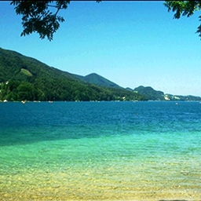
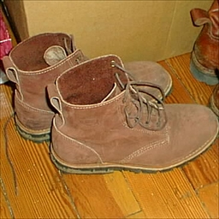
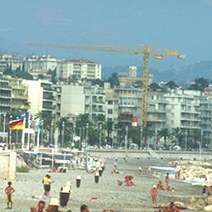
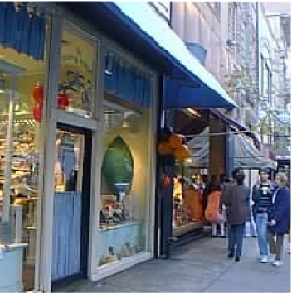
Remember these images

Slide 19
Did you saw this image?

Slide 20
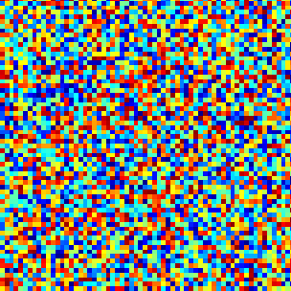
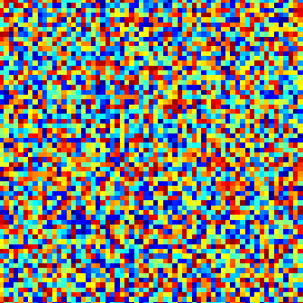
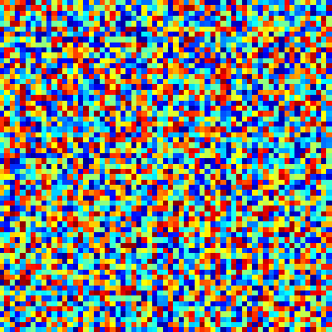
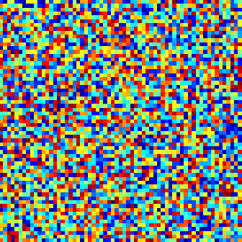
Remember these images
Test 2

Slide 21
Did you saw this image?

Slide 22
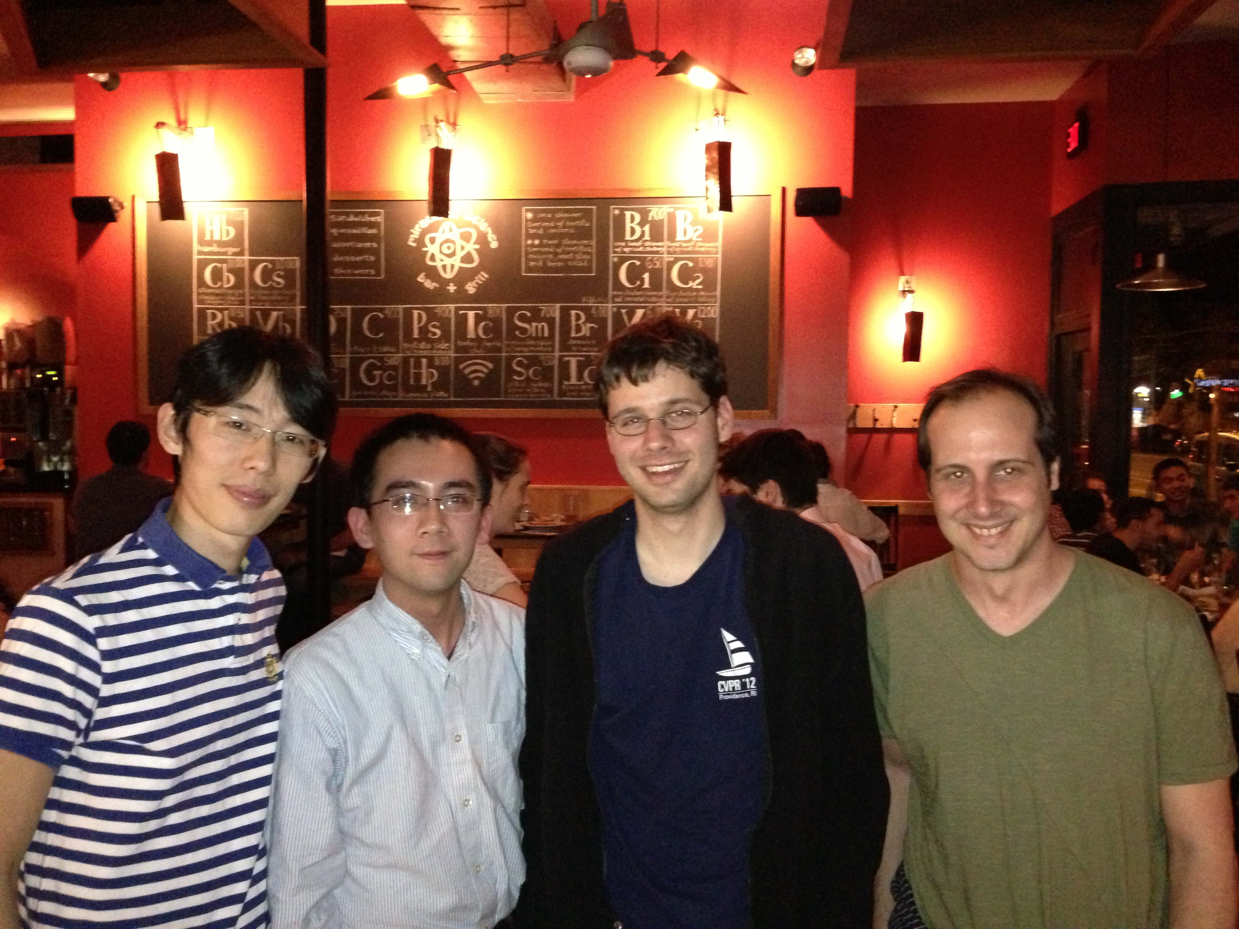
“The aim of computer vision is to overfit to our visual world”
-- remark by Antonio Torralba (after his third beer)

Slide 23
Visual Worlds

Slide 24
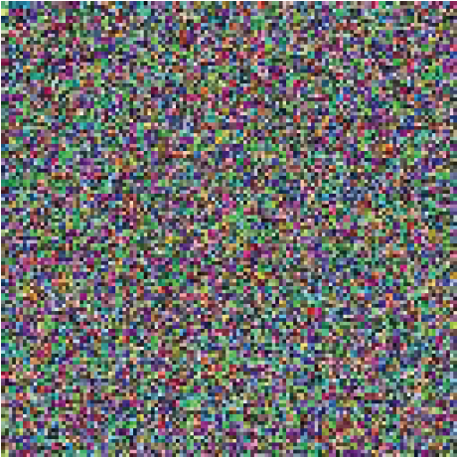
Visual Worlds

Slide 25
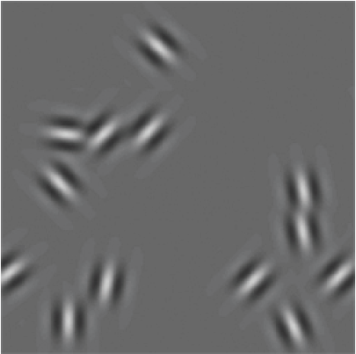
Visual Worlds

Slide 26
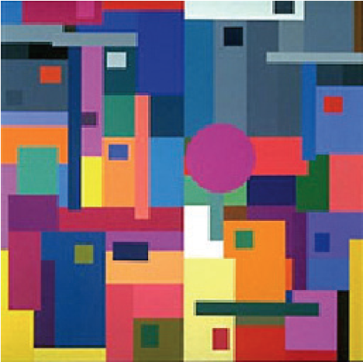
Visual Worlds
Mondrian

Slide 27
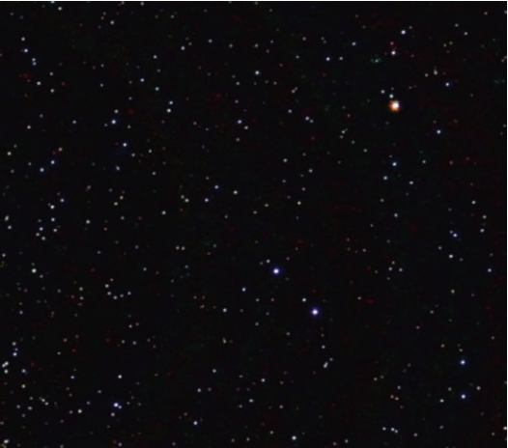
Visual Worlds

Slide 28
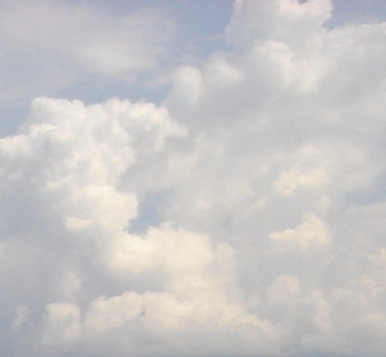
Visual Worlds

Slide 29
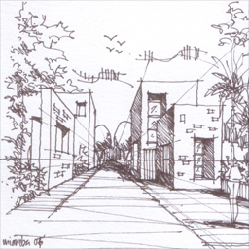
Visual Worlds

Slide 30
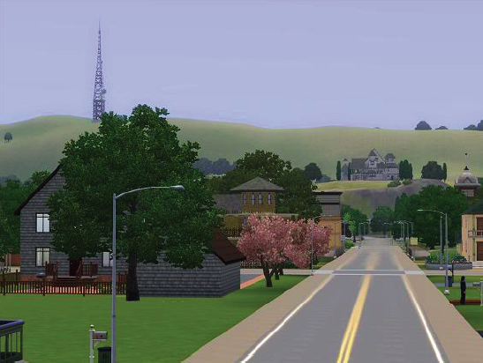
Visual Worlds

Slide 31
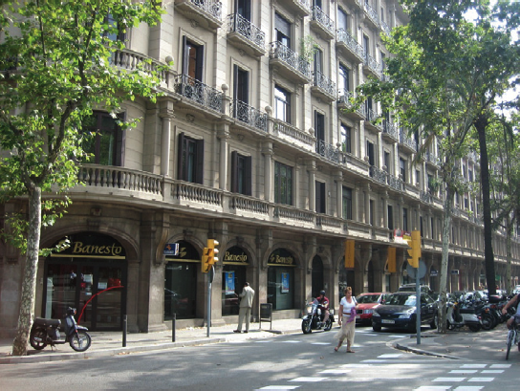
Visual Worlds

Slide 32
Natural Image Statistics
Motivation: Separating into components
Deal with ill pose: Bayesian Approach!
Application 1: Denoising
Application 2: Intrinsic Image
Application 3: Reflection Separation
Application 4: Deblurring
Application 5: Digital Forensics

Slide 33

Separating images into components

Slide 34
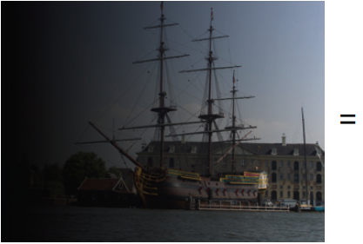
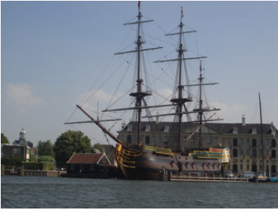

X

Slide 35
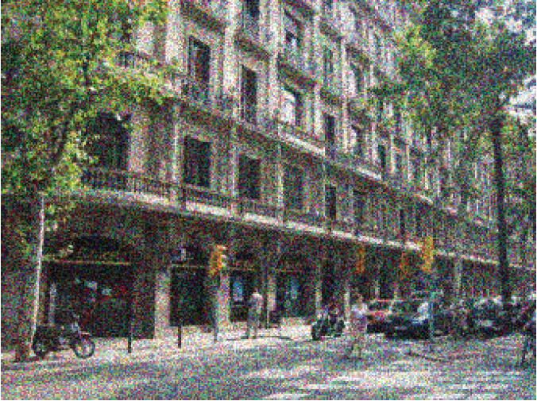
Separating images into components

Slide 36
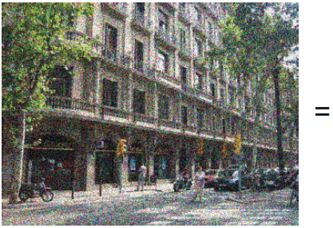
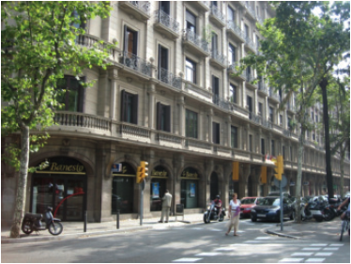

Separating images into components
+

Slide 37
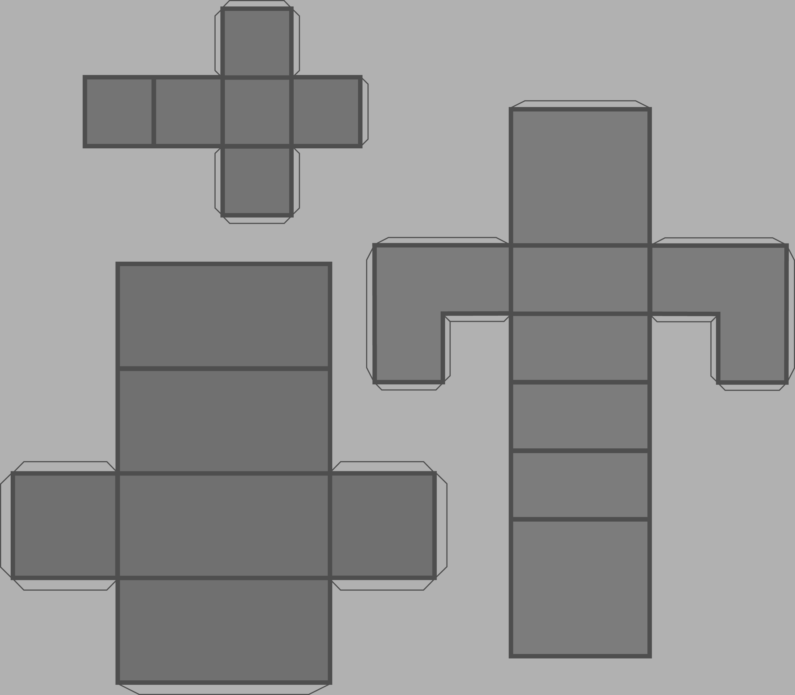
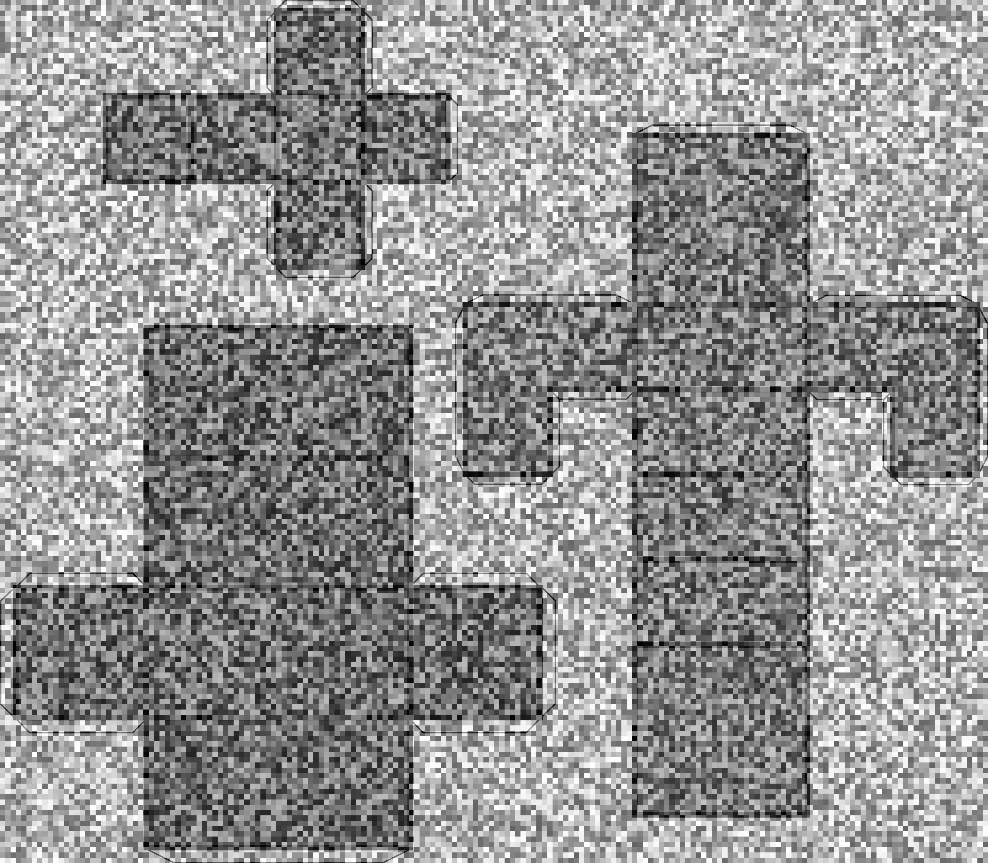
Noise on the image vs. noise in the world
The noise in the world, it is called texture by its friends

Slide 38
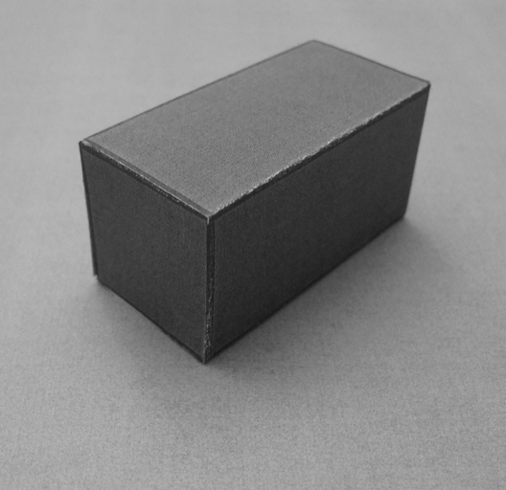
Noise or texture?

Slide 39
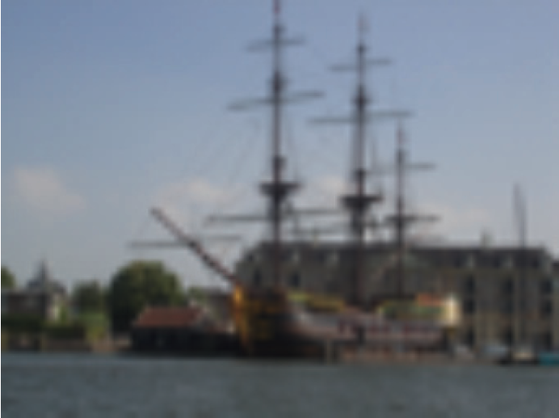
Separating images into components

Slide 40
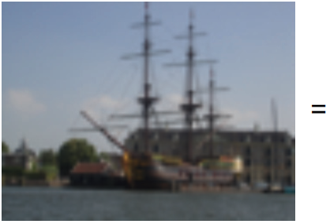
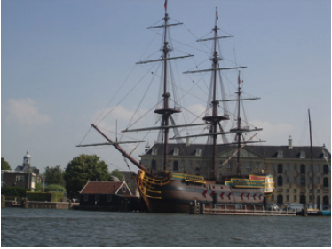
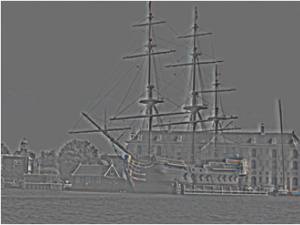
-

Slide 41
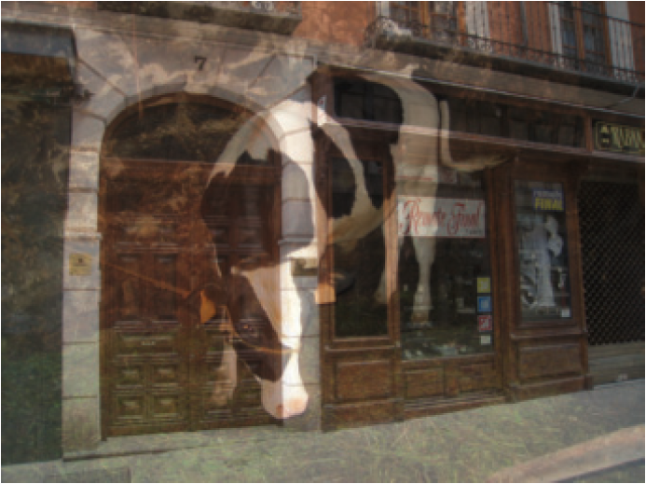
Separating images into components

Slide 42
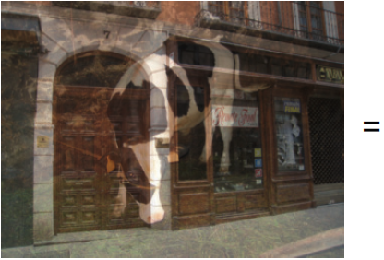


+

Slide 43
combination of 0s and 1s
“Computers are born to treat everything equally. That is why they are dumb. We need to teach them to be prejudice and discriminative.”
-- remark by Jianxiong (after his N+1 beer)
need prior
selective

Slide 44
Natural Image Statistics
Motivation: Separating into components
Deal with ill pose: Bayesian Approach!
Application 1: Denoising
Application 2: Intrinsic Image
Application 3: Reflection Separation
Application 4: Deblurring
Application 5: Digital Forensics

Slide 45
Prototypical Vision Problem
Observe some product of two numbers, say 1.0
What were those two numbers?
i.e., 1 = ab. Find a and b.
Compare this with the prototypical graphics problem: here are two numbers; what is their product?

Slide 46
Inverse Ill Pose Problem
4
1=ab
3
b
Hyperbola of feasible solutions
2
1
0
1
2
3
4
a

Slide 47
Bayesian approach
Want to calculate: max P(a, b | y = 1)
a,b
Bayes rule
Use P(a, b | y = 1) = k P(y=1|a, b) P(a, b)
Posterior probability
Likelihood function
Prior probability

Slide 48



Bayesian approach
Use P(a, b | y = 1) = k P(y=1|a, b) P(a, b)
Likelihood function
P(a, b | y = 1)
a=b=1
b
a
Prior probability
b
If a>0, b>0
a
= 0 otherwise
b
a

Slide 49


Statistical modeling of images

Slide 50


Slide 51

Statistical modeling of images
The pixel

Slide 52
Statistical modeling of images
Assumptions:
Independence: All pixels are independent.
Stationarity: The distribution of pixel intensities does not depend on image location.

Slide 53


Fitting the model
Counts
Pixel intensity

Slide 54

Sampling new images
Sample

Slide 55



Sampling new images
Sample

Slide 56




The importance of distribution of intensities

Slide 57
Statistical modeling of images
The pixel

Slide 58
Statistical modeling of images
The pixel
Another pixel

Slide 59






Δ = 1
Δ = 2
C
Δ = 10
Δ = 40
horizontal
vertical
Δ

Slide 60


Dead leaves models
Introduced in the 60’s by Matheron (67) and popularized by Ruderman (97)
From Lee, Mumford and Huang 2001

Slide 61
Remember? Phase and Magnitude
Curious fact
  all natural images have about the same magnitude transform
  hence, phase seems to matter, but magnitude largely doesn’t
Demonstration
  Take two pictures, swap the phase transforms, compute the inverse - what does the result look like?

Slide 62






Randomizing the phase

Slide 63




Fourier Characteristics of Images
Power spectra
fall off as
Spectra
Low spatial frequencies
1/vª
High
spatial
frequencies
Vertical
v_{y}
Horizontal
v_{x}
High SF
Low SF
D. J. Field, "Relations between the statistics of natural images and
the response properties of cortical cells," J. Opt. Soc. Am. A 4, 2379- (1987)

Slide 64





Fourier Characteristics of Images
v_{y}
Spectra
v_{y}
v_{x}
v_{x}
Field (87)
Natural scenes
(6000 images)
1/fª
v_{y}
v_{x}
v_{y}
v_{y}
v_{x}
v_{x}
Man-made scenes
(6000 images)
  Torralba and Oliva, Statistics of Natural Image Categories. Network: Computation in Neural Systems 14 (2003) 391-412.
Notes:
Each scene category is made with different building blocks. Different scene categories show different spectral signatures.

Slide 65
Natural Image Statistics
Motivation: Separating into components
Deal with ill pose: Bayesian Approach!
Application 1: Denoising
Application 2: Intrinsic Image
Application 3: Reflection Separation
Application 4: Deblurring
Application 5: Digital Forensics

Slide 66









Denoising
Decomposition of a noisy image
=
+

Slide 67




Denoising
Decomposition of a noisy image
=
+
White Gaussian noise:
N(0, σ_{n}²)
Natural image
Find I(x,y) that maximizes the posterior (maximum a posteriory, MAP):
x
likelihood
prior

Slide 68


Denoising
Decomposition of a noisy image
=
+
White Gaussian noise:
N(0, σ_{n}²)
Natural image
Find I(x,y) that maximizes the posterior (maximum a posteriory, MAP):
x
likelihood
prior
x

Slide 69



Denoising
x
likelihood
prior
x
The solution is:
(note this is a linear operation)
This can also be written in the Fourier domain, with C = EDE^{T}:
Wiener filter
More details: http://www.cns.nyu.edu/pub/lcv/simoncelli05a-preprint.pdf
4.7 Statistical Modeling of Photographic Images

Slide 70


Decomposition of a noisy image
=
+

Slide 71


Slide 72

x
=

Slide 73


=
+
=
+

Slide 74
Natural Image Statistics
Motivation: Separating into components
Deal with ill pose: Bayesian Approach!
Application 1: Denoising
Application 2: Intrinsic Image
Application 3: Reflection Separation
Application 4: Deblurring
Application 5: Digital Forensics

Slide 75

Edges

Slide 76
[-1 1]
PS2

Slide 77

[-1 1]
PS2
[-1, 1]
=
h[m,n]
f[m,n]
g[m,n]

Slide 78

[-1 1]^{T}
PS2
[-1, 1]^{T}
=
h[m,n]
f[m,n]
g[m,n]

Slide 79



Observation: Sparse filter response

Slide 80
Back to the image
?

Slide 81
Reconstruction from derivatives
PS2
F = H G
c
1 | -1
 | 1 | -1
 |  | 1 | -1
 |  |  | 1 | -1
 |  |  |  | 1 | -1
 |  |  |  |  | 1 | -1
 |  |  |  |  |  | 1 | -1
 |  |  |  |  |  |  | 1
c
=
If we have multiple filter outputs:
c
c
=
[-1 1]
c
[-1 1]^{T}
If the transformation H is not invertible, we can compute the pseudo-inverse:
^
G = (H^{T}H)⁻¹ H^{T} F

Slide 82

Reconstruction
[1 -1]
[1 -1]^{T}

Slide 83

Editing the edge image
[1 -1]
[1 -1]^{T}

Slide 84



Thresholding edges

Slide 85


Gradient Domain Image Editing
Poisson Image Editing
http://graphics.cs.cmu.edu/projects/gradient-paint/

Slide 86


Intrinsic images

Slide 87
Separating images into components

Slide 88
X

Slide 89



Slide 90


Some wise old men

Slide 91


Forming an Image
Illuminate the surface to get:
Surface (Height Map)
Shading Image
The shading image is the interaction of the shape
of the surface and the illumination
Slide: Marshal Tappen

Slide 92


Painting the Surface
Scene
Image
Add a reflectance pattern to the surface. Points inside the squares should reflect less light
Slide: Marshal Tappen

Slide 93

Goal: Intrinsic images
Image
Shading Image
Reflectance Image
Slide: Marshal Tappen

Slide 94

Simplest Algorithm Ever: Retinex
E.H. Land, J.J. McCANN - Journal of the Optical society of America, 1971
The reflectance tends to be constant across space except for abrupt changes at the transitions between objects or pigments. Thus a reflectance change shows itself as step edge in an image, while illuminance changes gradually over space. By this argument one can separate reflectance change from illuminance change by taking spatial derivatives: High derivatives are due to reflectance and low ones are due to illuminance.

Slide 95



Retinex
=
x
Again, we are trying to solve an ill-posed problem:
24 = ? x ?
From M. Tappen, PhD

Slide 96

Retinex
too small? let it be zero!
From M. Tappen, PhD
[1 -1]
log
[1 -1]^{T}
From M. Tappen, PhD

Slide 97


Slide 98


Slide 99
Craik-O'Brien-Cornsweet effect

Slide 100


Slide 101
Knill and Kersten's illusion

Slide 102
This illusion highlights
the importance of
scene interpretation.
The effect is gone
Knill and Kersten's illusion
and it comes back when
the gradient is not explained
by the shape.

Slide 103
Natural Image Statistics
Motivation: Separating into components
Deal with ill pose: Bayesian Approach!
Application 1: Denoising
Application 2: Intrinsic Image
Application 3: Reflection Separation
Application 4: Deblurring
Application 5: Digital Forensics

Slide 104



Separating reflection
When we take a picture through a window, the image we obtain is often a linear superposition of two images: the image of the scene beyond the window plus the image of the scene reflected by the window. Decomposing the single input image into two images is a massively ill-posed problem

Slide 105





Slide 106
Natural Image Statistics
Motivation: Separating into components
Deal with ill pose: Bayesian Approach!
Application 1: Denoising
Application 2: Intrinsic Image
Application 3: Reflection Separation
Application 4: Deblurring
Application 5: Digital Forensics

Slide 107


Overview
Original
Deblur
Notes:
Here is a photo blurred by camera shake. Our algorithm takes this image and removes the camera shake, giving a sharp image, like the one on the right.

Slide 108


Close-up
Original
Naïve Sharpening
Our algorithm
Notes:
Double image in eyes

Slide 109
Why does picture appear blurry?

Slide 110


Let’s take a photo
Blurry result

Slide 111

Slow-motion replay

Slide 112


Slow-motion replay
Motion of camera
Notes:
Even though you thought the camera was still, in fact lots of things happening while the shutter is open.

Slide 113


Image formation process
=
⊗
Blur
kernel
Blurry image
Sharp image
Input to algorithm
Desired output
Convolution
operator
Model is approximation
Notes:
Start with: we use the following model. …….
Approximation since there are lots of effects we don’t model.

Slide 114
Why is this hard?
Simple analogy:
11 is the product of two numbers.
What are they?
No unique solution:
11 = 1 x 11
11 = 2 x 5.5
11 = 3 x 3.667
etc…..
Need more information !!!!

Slide 115

Multiple possible solutions
Sharp image
Blur kernel
=
⊗
=
⊗
Blurry image
=
⊗
Notes:
Say middle one does convolve back to blurry. Goal to get true image.

Slide 116


Natural image statistics
Characteristic distribution with heavy tails
Histogram of image gradients
FIELD, D. 1994. What is the goal of sensory coding? Neural Computation 6, 559–601.

Slide 117


Blury images have different statistics
Histogram of image gradients

Slide 118


Parametric distribution
Histogram of image gradients
Use parametric model of sharp image statistics
Notes:
We use green curve which was fit to the red curve. We use this distribution for all examples in the paper. Remove blur curve

Slide 119
Uses of natural image statistics
Denoising [Roth and Black 2005]
Superresolution [Tappen et al. 2005]
Intrinsic images [Weiss 2001]
Inpainting [Levin et al. 2003]
Reflections [Levin and Weiss 2004]
Video matting [Apostoloff & Fitzgibbon 2005]
Corruption process assumed known
Notes:
In all these papers, it is assumed that the corruption process, such as the blur kernel, is known.

Slide 120
Existing work on image deblurring
Software algorithms:
  Extensive literature in signal processing community
  Mainly Fourier and/or Wavelet based
  Strong assumptions about blur
  → not true for camera shake
Assumed forms of blur kernels
  Image constraints are frequency-domain power-laws
Notes:
Previous methods have used image statistics in the form of FD power-laws but these a weak constraints that do not preserve local image structure.

Slide 121




Hardware approaches
Existing work on image deblurring
Image stabilizers
Dual cameras
Coded shutter
Ben-Ezra and
Nayar 2004
Raskar et al. SIGGRAPH 2006
This approach can be combined with these hardware methods
Notes:
There are a variety of hardware approaches, for example, image stabilizers move the light path to correct for camera motion. Ben-ezra and nayar propose adding a second, video camera to estimate the camera motion. Also the next paper in the session proposes to flutter the shutter to remove blur when the camera or object motion within the scene is known.
These methods all require you to modify the camera, while our approach works with any blurry image.

Slide 122


Slide 123

Three sources of information
1. Reconstruction constraint:
⊗
=
Estimated
blur kernel
Estimated sharp image
Input blurry image
2. Image prior:
3. Blur prior:
Positive
&
Sparse
Distribution of gradients
Notes:
Add in + noise
Three things we know.
Reconstruct to the blurry image plus noise.

Slide 124


Slide 125


Slide 126


Slide 127


Slide 128
How do we use this information?
Obvious thing to do:
  Combine 3 terms into an objective function
  Run conjugate gradient descent
  This is Maximum a-Posteriori (MAP)

Slide 129




Results from MAP estimation
Input blurry image
Maximum a-Posteriori (MAP)
Variational Bayes

Slide 130


Image artifacts & estimated kernels
Blur kernels
Image patterns
Note: blur kernels were inferred from large image patches,
NOT the image patterns shown
Notes:
Comment about not runnnig on yther patches themselves.
Shape important, not profile. Can’t always find these patterns in all images….

Slide 131
Natural Image Statistics
Motivation: Separating into components
Deal with ill pose: Bayesian Approach!
Application 1: Denoising
Application 2: Intrinsic Image
Application 3: Reflection Separation
Application 4: Deblurring
Application 5: Digital Forensics

Slide 132

Detecting fake images

Slide 133

Visual Worlds
Prof. Hany Farid,
Dartmouth University

Slide 134



How do you tell if an image is fake?
+
=
http://www.life.com/archive/realfake

Slide 135

Image circulated on internet
http://www.cs.dartmouth.edu/farid/publications/deception09.pdf
http://www.cs.dartmouth.edu/farid/publications/significance06.pdf

Slide 136



The source images

Slide 137




Slide 138

IEEE Transactions on Signal Processing, 53(2):845-850, 2005

Slide 139

Easily classified photographic images

Slide 140

Easily classified photorealistic images

Slide 141
Summary
Use P(a, b | y = 1) = k P(y=1|a, b) P(a, b)
Likelihood function
P(a, b | y = 1)
a=b=1
b
a
Prior probability
b
If a>0, b>0
a
= 0 otherwise
b
a

Slide 142
Natural image statistics
Characteristic distribution with heavy tails
Histogram of image gradients
FIELD, D. 1994. What is the goal of sensory coding? Neural Computation 6, 559–601.

Slide 143
Statistics of Images
Power spectra
fall off as
Spectra
Low spatial frequencies
1/vª
High
spatial
frequencies
Vertical
v_{y}
Horizontal
v_{x}
High SF
Low SF
D. J. Field, "Relations between the statistics of natural images and
the response properties of cortical cells," J. Opt. Soc. Am. A 4, 2379- (1987)

Slide 144




http://en.wikipedia.org/wiki/How_to_Lie_with_Statistics

