Slide 1
Crowd-Sourcing
Simin Chen

Slide 2
Amazon Mechanical Turk
Advantages
On demand workforce
Scalable workforce
Qualified workforce
Pay only if satisfied

Slide 3
Terminology
Requestors
HITs (Human Intelligence Tasks)
Assignment
Workers (‘Turkers’)
Approval and Payment
Qualification

Slide 4
Amazon Turk Pipeline

Slide 5
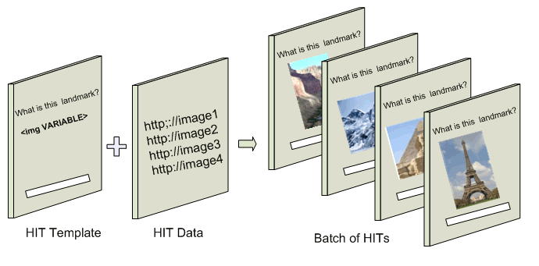
HIT Template
HTML page that presents HITs to workers
Non-variable: all workers see the same page
Variable: every HIT has the same format, but different content

Slide 6
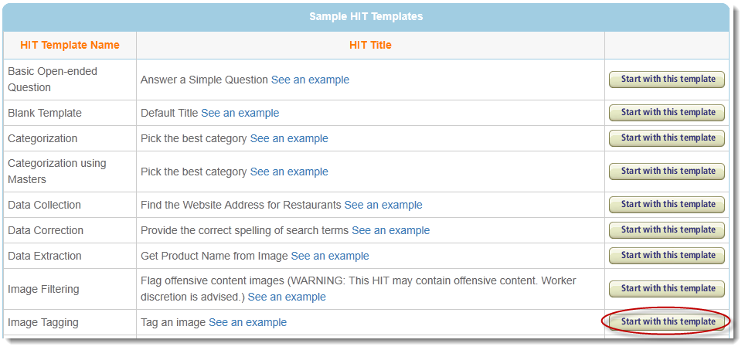
HIT Template
Define properties
Design layout
Preview

Slide 7
HIT Template
Properties
Template Name
Title
Description
Keywords
Time Allowed
Expiration Date
Qualifications
Reward
Number of assignments
Custom options

Slide 8
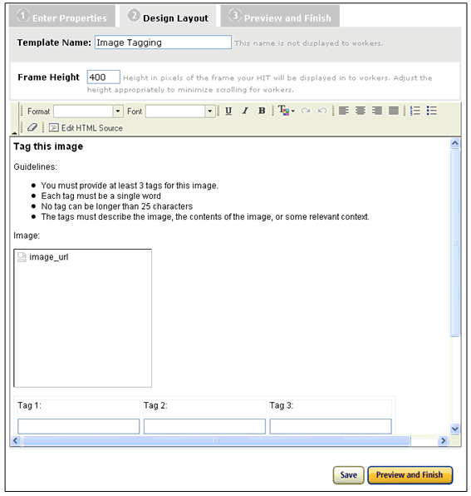
HIT Template
Design
HTML

Slide 9
HIT Template
Design
Template Variables
Variables are replaced by data from a HIT data file
<img width="200" height="200" alt="imagevariableName" style="margin-right: 10px;" src="${image_url}" />

Slide 10
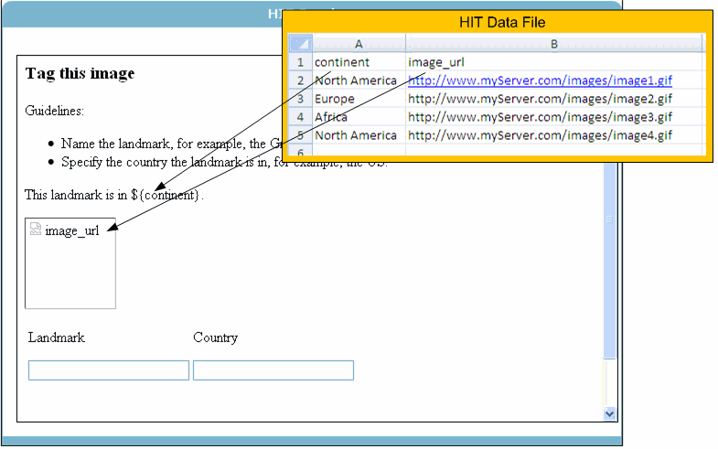
HIT Template
Design
Data File
.CSV file (Comma Separated Value)
Row 1: Variable Names
Rows 2-5: Variable for each HIT

Slide 11
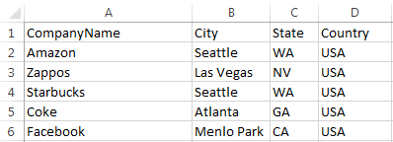
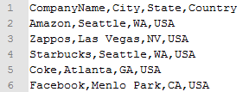
HIT Template
Result
Also .CSV
Table rows separated by line breaks.
Columns separated by commas.
First row is a header with labels for each column.

Slide 12
HIT Template
Accessing assignment details in JavaScript
var assignmentId = turkGetParam('assignmentId', '');
if (assignmentId != '' && assignmentId != 'ASSIGNMENT_ID_NOT_AVAILABLE') {
var workerId = turkGetParam('workerId', '');
function turkGetParam( name, defaultValue ) {
var regexS = "[\?&]"+name+"=([^&#]*)";
var regex = new RegExp( regexS );
var tmpURL = window.location.href;
var results = regex.exec( tmpURL );
if( results == null ) {
return defaultValue;
} else { return results[1]; }
}
Function automatically included
by Amazon
Also commonly see a gup function
used for the same purpose

Slide 13
Publishing HITs
Select created template

Slide 14
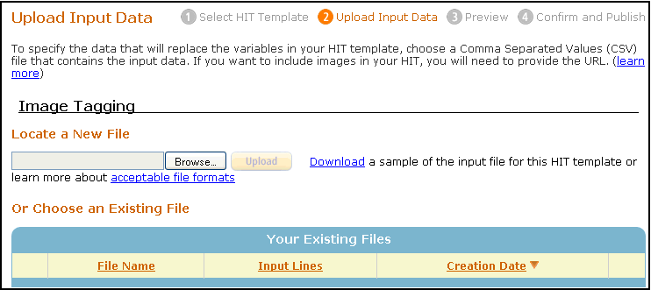
Publishing HITs
Upload Data File

Slide 15
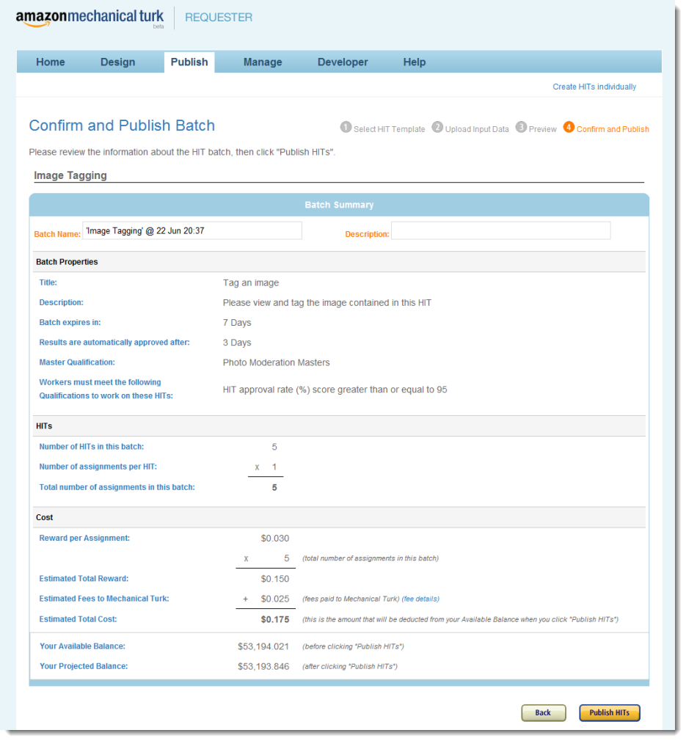
Publishing HITs
Preview and Publish

Slide 16
Qualification
Qualification
Make sure that a worker meets some criteria for the HIT
95% Approval rating, etc.
Requester User Interface (RUI) doesn’t support Qualification Tests for a worker to gain a qualification
Must use Mechanical Turk APIs or command line tools

Slide 17
Masters
Workers who have consistently completed HITs of a certain type with a high degree of accuracy for a variety of requestors
Exclusive access to certain work
access to private forum
Performance based distinction
Masters, Categorization Masters, Photo Moderation Masters – superior performance for thousands of HITs

Slide 18
Command Line Interface
Abstract from the “muck” of using web services
Create solutions without writing code
Allows you to focus more on solving the business problem and less on managing technical details
mturk.properties file for keys and URLs
Input: *.input, *.properties, and *.question files
Output: *.success, and *.results

Slide 19
*.input
Tab delimited file
Contains variable names and locations
Image1 | Image2 | Image3
Image1.jpg | Image2.jpg | Image3.jpg
Image1 Image2 Image3
Image1.jpg Image2.jpg Image3.jpg

Slide 20
*.properties
Title
Description
Keywords
Reward
Assignments
Annotation
Assignment duration
Hit lifetime
Auto approval delay
Qualification

Slide 21
*.question
XML format
Define the HIT layout
Consists of:
<Overview>: Instructions and information
<Question>
Can be a QuestionForm, ExternalQuestion, or a HTMLQuestion

Slide 22
<Question>
*QuestionIdentifier
DisplayName
IsRequired
*QuestionContent
*AnswerSpecification
FreeTextAnswer, SelectionAnswer, FileUploadAnswer

Slide 23
<Question>
<Question>
<QuestionIdentifier>my_question_id</QuestionIdentifier>
<DisplayName>My Question</DisplayName>
<IsRequired>true</IsRequired>
<QuestionContent> [...] </QuestionContent>
<AnswerSpecification> [...] </AnswerSpecification>
</Question>
<QuestionContent> (and <Overview>) can contain:
<Application>: JavaApplet or Flash element
<EmbeddedBinary>: image, audio, video
<FormattedContent> (later)

Slide 24
*.success and *.results
*.success: tab delimited text file containing HIT IDs and HIT Type IDs
Auto-generated when HIT is loaded
Used to generate *.results
Submitted results in the last columns
generate *.results with getResults command
tab-delimited file, last columns contain worker responses

Slide 25
Command Line Operations
ApproveWork
getBalance
getResults
loadHITs
reviewResults
grantBonus
updateHITs
etc

Slide 26
Loading a HIT
loadHITs -input *.input -question *.question -properties *.properties -sandbox
-sandbox flag to create HIT in sandbox to preview
-preview flag also available
requires XML to be written in a certain way

Slide 27
FormattedContent
Use FormattedContent inside a QuestionForm to use XHTML tags directly
No JavaScript
No XML comments
No element IDs
No class and style attributes
No <div> and <span> elements
URLs limited to http:// https:// ftp:// news:// nntp:// mailto:// gopher:// telnet://
Etc.

Slide 28
FormattedContent
Specified in XML CDATA block inside a FormattedContent element
<QuestionContent>
<FormattedContent><![CDATA[
<font size="4" color="darkblue" >Select the image below that best represents: Houses of Parliament, London, England</font>
]]></FormattedContent>
</QuestionContent>

Slide 29
Qualification Requirements
qualification.1: qualification type ID
qualification.comparator.1: type of comparison (greaterthan, etc.)
qualification.value.1: integer value to be compared to
qualification.locale.1: locale value
qualification.private.1: public or private HIT
Increment the *.1 to specify additional qualifications

Slide 30
*.properties
*.properties example
Worker must have 25% approval rate and HIT can be previewed by those that don’t meet the qualification
Qualification TypeId for percent assignments approved
qualification.1:000000000000000000L0 qualification.comparator.1:greaterthan qualification.value.1:25 qualification.private.1:false

Slide 31
External HIT
Use an ExternalQuestion
${helper.urlencode($urls)} to encode urls from *.input to show in externalpage.htm
<ExternalQuestion xmlns="http://mechanicalturk.amazonaws.com/AWSMechanicalTurkDataSchemas/2006-07-14/ExternalQuestion.xsd"> <ExternalURL>http://s3.amazonaws.com/mturk/samples/sitecategory/externalpage.htm?url=${helper.urlencode($urls)}</ExternalURL> <FrameHeight>400</FrameHeight> </ExternalQuestion>

Slide 32
External HIT
In the external .htm:
<form id="mturk_form" method="POST" action="http://www.mturk.com/mturk/externalSubmit">
(…question…)
And then submit the assignment to Mturk
if (gup('assignmentId') == "ASSIGNMENT_ID_NOT_AVAILABLE") {
…
} else {
var form = document.getElementById('mturk_form');
if (document.referrer && ( document.referrer.indexOf('workersandbox') != -1) ) {
form.action = "http://workersandbox.mturk.com/mturk/externalSubmit";
}
}

Slide 33
Other Useful Options
*.question
Create five questions, where the first 3 are required
#set( $minimumNumberOfTags = 3 ) #foreach( $tagNum in [1..5] ) <Question> <QuestionIdentifier>tag${tagNum}</QuestionIdentifier> #if( $tagNum <= $minimumNumberOfTags) <IsRequired>true</IsRequired> #else <IsRequired>false</IsRequired> #end

Slide 34
Qualification Test
Given a request for a qualification from a worker, you can:
Manually approve qualification request
Provide answer key and Mturk will evaluate request
Auto-grant qualification
Qualifications can also be assigned to a worker without a request

Slide 35
Qualification Test
*.question, *.properties, *.answer
Define the test questions in *.question and answers in *.answer
createQualificationType -properties qualification.properties
-question qualification.question
-answer qualification.answer
-sandbox

Slide 36
Qualification Test (Question)
<QuestionForm xmlns="http://mechanicalturk.amazonaws.com/AWSMechanicalTurkDataSchemas/2005-10-01/QuestionForm.xsd">
<Overview>
<Title>Trivia Test Qualification</Title>
</Overview>
<Question>
<QuestionIdentifier>question1</QuestionIdentifier>
<QuestionContent>
<Text>What is the capital of Washington state?</Text>
</QuestionContent>
<AnswerSpecification>
…

Slide 37
Qualification Test (Answer Key)
<?xml version="1.0" encoding="UTF-8"?>
<AnswerKey xmlns="http://mechanicalturk.amazonaws.com/AWSMechanicalTurkDataSchemas/2005-10-01/AnswerKey.xsd">
<Question>
<QuestionIdentifier>question1</QuestionIdentifier>
<AnswerOption>
<SelectionIdentifier>1b</SelectionIdentifier>
<AnswerScore>10</AnswerScore>
</AnswerOption>
</Question>
</AnswerKey>
Auto-assign qualification and score with answer key

Slide 38
Qualification Test Properties
name
description
keywords
retrydelayinseconds
testdurationinseconds
autogranted

Slide 39
Matlab Turk Tool
aws_access_key = ;
aws_secret_key = ;
sandbox = true;
turk = InitializeTurk(aws_access_key, aws_secret_key, sandbox);
result = RequestTurk(turk, 'GetAccountBalance', {'ResponseGroup.0','Minimal','ResponseGroup.1','Request'});
result.GetAccountBalanceResponse.GetAccountBalanceResult.AvailableBalance.Amount.Text
Initialize with keys and sandbox option
Command line operation
Parameters
Operations

Slide 40
Matlab Turk Tool
<GetAccountBalanceResult>
<Request>
<IsValid>True</IsValid>
</Request>
<AvailableBalance>
<Amount>10000.000</Amount>
<CurrencyCode>USD</CurrencyCode>
<FormattedPrice>$10,000.00</FormattedPrice>
</AvailableBalance>
</GetAccountBalanceResult>
result.GetAccountBalanceResponse.GetAccountBalanceResult.AvailableBalance.Amount.Text

Slide 41
Paid By Bonus
Approve individually or by batch
Reject individually or by batch
Give bonuses to good workers
Can download batch into a .CSV, mark accept/reject, then upload updated .CSV to the Mechanical Turk

Slide 42
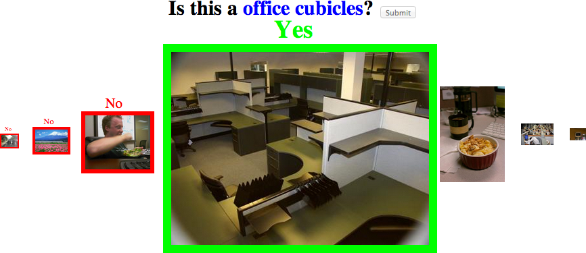
TurkCleaner
Have the user select a subset of images that satisfy certain rules.
Copy .html into template, parse .CSV into Matlab readable format

Slide 43
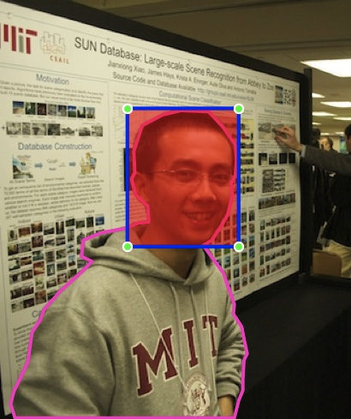
DrawMe
Line drawing on an image.
Copy .html into Mturk template
.CSV file can be parsed into Matlab cell arrays for processing

Slide 44
Demographics

Slide 45
Demographics

Slide 46
Best Practice
Motivation
Incentives: entertainment, altruism, financial reward
Task Design
Easy to understand visuals, design interface such that accurate task completion requires as much effort as adversarial task completion, financial gain for amount of work tradeoff for worker
Creation task vs. Decision task
High Quality Results
Heuristics such as gold standard and majority vote
Cost Effectiveness

Slide 47
Creation Task vs Decision Task
Creation:
Write a description of an image
Decision:
Given two descriptions for the same image, decide which description is best

Slide 48
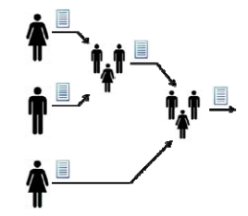
Iterative and Parallel
Iterative: sequence of tasks, where each task’s result feeds into the next task (better average response)
Parallel: workers are not shown previous work (better best response)

Slide 49
Task Design

Slide 50
Gold Standard
Present workers with control questions where the answer is known to judge the ability of the worker.
Requires keeping track of workers over time or presenting multiple questions per task.

Slide 51
Majority Vote
Check the responses from multiple turkers against each other.
Averaging multiple labels, etc.

Slide 52
Cost Effectiveness
[Welinder, et. al.] Estimation of annotator reliabilities
Use the reliability of the annotator to determine how many additional labels are needed to correctly label the image.

Slide 53
Augmenting Computer Vision
Using humans to improve performance

Slide 54
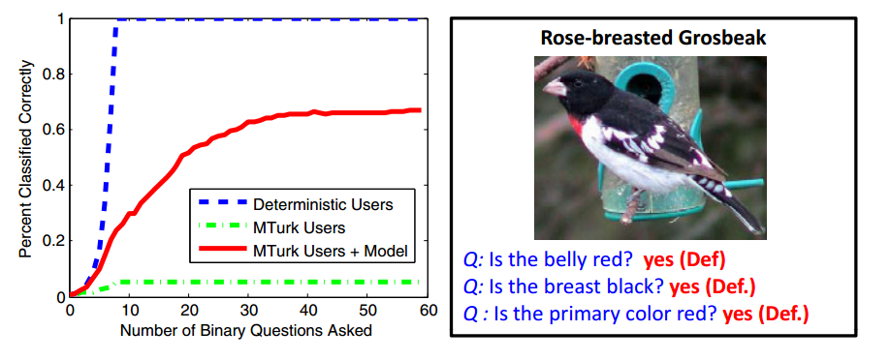
Augmenting Computer Vision
Deterministic Users: assumed perfect users
Turkers: subjective answers degrade performance (brown vs buff)

Slide 55
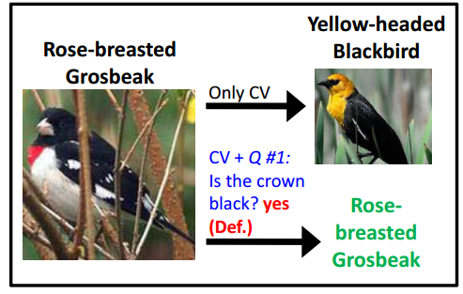
Augmenting Computer Vision
Human answer corrects computer vision’s initial prediction

Slide 56
TurKit
Toolkit for prototyping and exploring algorithmic human computation

Slide 57
TurKit Script
extension of JavaScript
wrapper for MTurk API
ideas = []
for (var i = 0; i < 5; i++) {
idea = mturk.prompt(
"What’s fun to see in New York City?
Ideas so far: " + ideas.join(", "))
ideas.push(idea)
}
ideas.sort(function (a, b) {
v = mturk.vote("Which is better?", [a, b])
return v == a ? ‐1 : 1
})
Generates ideas for things to see from 5 different workers and getting workers to sort the list

Slide 58
Crash-and-rerun programming
Script is executed until it crashes
Every line that is successfully run is stored in a database
If script needs to be rerun, cost of rerunning human computation task is avoided by looking up the previous result (use keyword once)
waitForHIT function that crashes unless results are ready

Slide 59
TurKit: Quicksort
quicksort(A)
if A.length > 0
pivot ← A.remove(once A.randomIndex())
left ← new array
right ← new array
for x in A
if compare(x, pivot) A
left.add(x)
else
right.add(x)
quicksort(left)
quicksort(right)
A.set(left + pivot + right)
A
compare(a, b) A
hitId ← once createHIT(...a...b...)
result ← once getHITResult(hitId)
return (result says a < b) A
Use once if function is:
deterministic
once Math.random() would result in the same value every run
high cost
has side-effects
ex: approving results from a HIT multiple times causes errors

Slide 60
TurKit: Parallelism
If HIT A doesn’t finish, crash that fork and the next fork creates HIT C
Subsequent runs will check each HIT to see if it’s done
join() to ensure previous forks were successful
if previous forks unsuccessful, join crashes current path
fork(function () {
a = createHITAndWait() // HIT A
b = createHITAndWait(...a...) // HIT B
})
fork(function () {
c = createHITAndWait() // HIT C
})

Slide 61
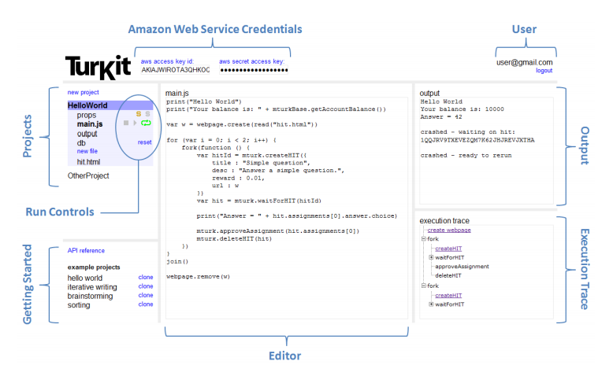
TurKit IDE

Slide 62
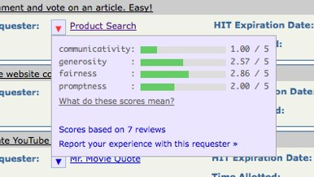
Turker Forum and Browser Plugin
Turkopticon: (Union 2.0) shows reviews of requestors on Amazon MTurk
TurkerNation
Helpful Blogs for Requestors:
[Tips for Requestors]
[The Mechanical Turk Blog]

