Slide 1
Object Detection
Shuran Song

Slide 2
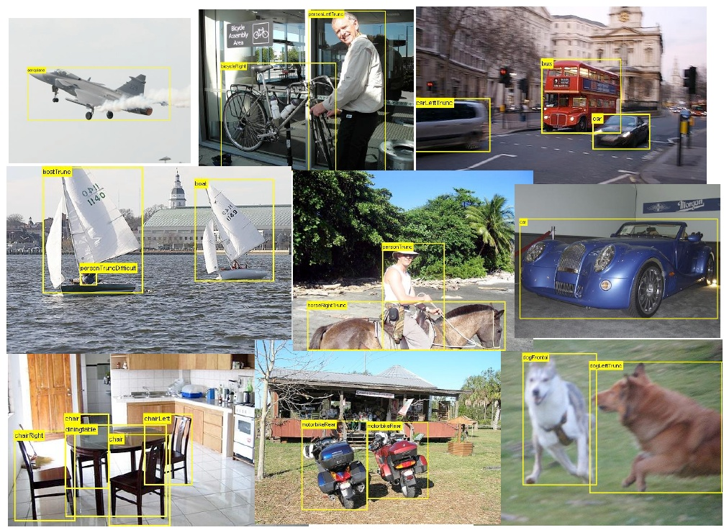
Task: Generic object detection

Slide 3
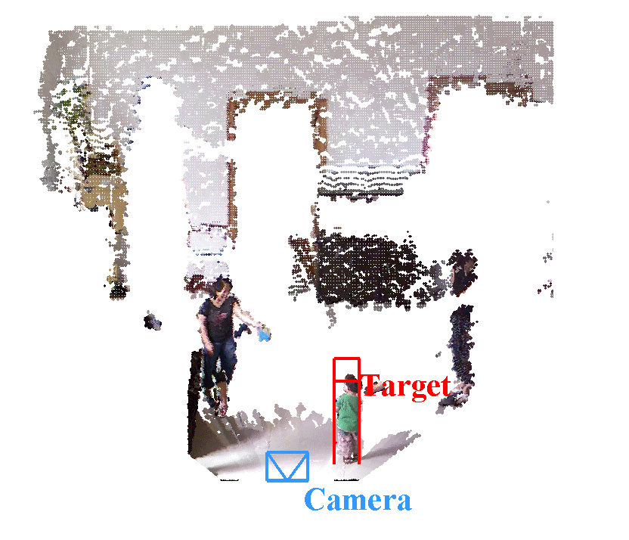
Task: Generic object detection
In this lecture we focus on 2D image object detection but object detection can also in 3D

Slide 4
Outline
Basic object detection algorithms
  Rigid Template
  Part Based detector
Features
Data set
New techniques for object detection

Slide 5
Object detection algorithms

Slide 6
Outline
Rigid Template
  HOG for human detection [Dalal Triggs]
  Exemplar SVM detector
Part Based detector
  Deformable Part Model
  Poselets
  3D Cuboid detector

Slide 7
Histograms of oriented gradients for human detection
[DalalTriggs]

Slide 8
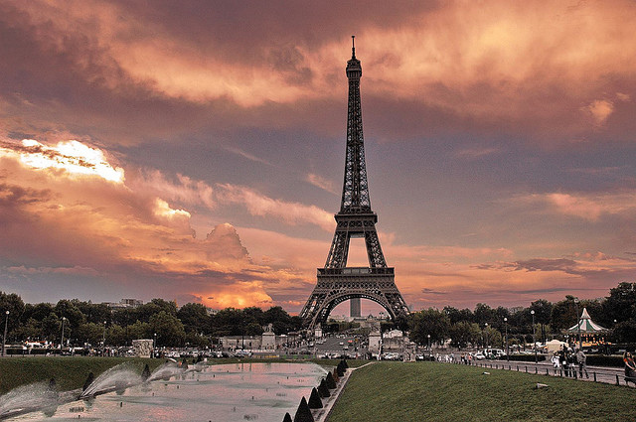
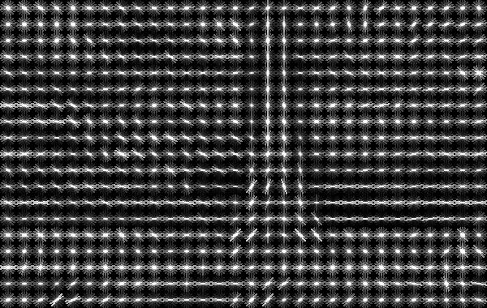
Human detection with HOG: Basic Steps
1. Map image to feature Space (HOG)

Slide 9
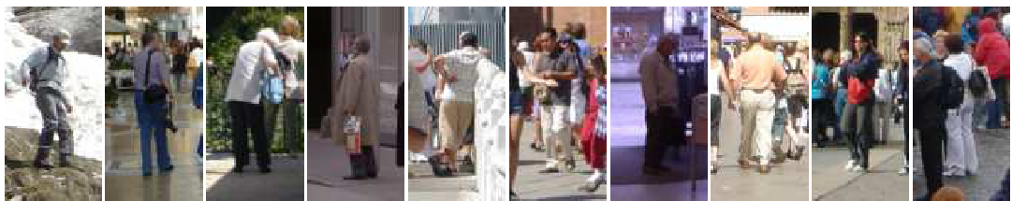
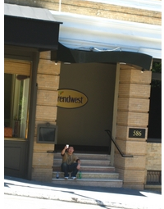
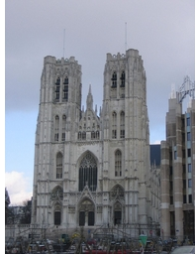
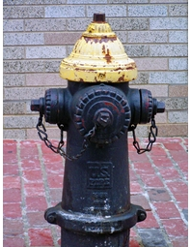
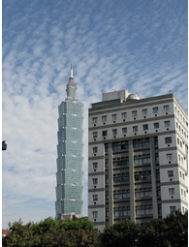
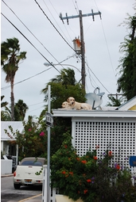
Human detection with HOG: Basic Steps
1. Map image to feature Space (HOG)
2. Training with positive and negative (linear SVM)
positive training examples
negative training examples

Slide 10
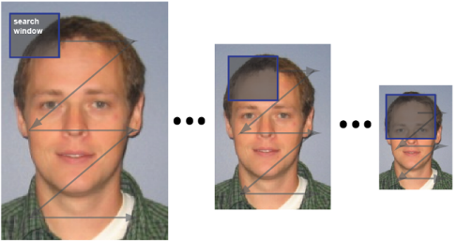
Human detection with HOG: Basic Steps
1. Map image to feature Space (HOG)
2. Training with positive and negative (linear SVM)
3. Testing : scan image in all scale and all location
Binary classification on each location

Slide 11

Image pyramid
Problem :
Bounding box size is different for the same
object (different depth)
Solution 1:
Resize the box and do multiple convolution?
Not ideal :
It will change the feature dimension, need to retrain the SVM for each scale.

Slide 12
Image pyramid
Solution 2:
Resize the image and do multiple convolution?-> image pyramid
Image is smaller ~ box is bigger
Image is larger ~ box is smaller

Slide 13
Human detection with HOG: Basic Steps
1. Map image to feature Space (HOG)
2. Training with positive and negative (linear SVM)
3. Testing : scan image in all scale and all location
Binary classification on each location

Slide 14
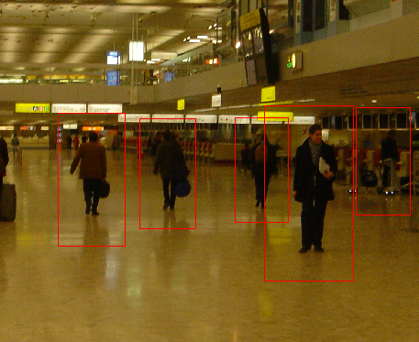
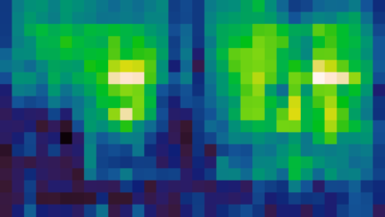
Human detection with HOG: Basic Steps
1. Map image to feature Space (HOG)
2. Training with positive and negative (linear SVM)
3. Testing : scan image in all scale and all location
4. Report box： non-maximum suppression
Final Boxes
Detector response map
After thresholding
After non-maximum suppression

Slide 15
Summary of Basic object detection Steps
Training:
Train a classifier describe the detection target
Testing :
Detection by binary classification on all location

Slide 16
HOG descriptor
Notes:
Pedro Felipe Felzenszwalb’ s implementation

Slide 17







HOG: Gradients
Compress image to 64x128 pixels
Convolution with [-1 0 1] [-1;0; 1] filters
Compute gradient magnitude + direction
For each pixel: take the color channel with greatest magnitude as final gradient

Slide 18
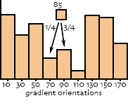
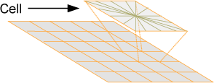
HOG: Cell histograms
Divide the image to cells, each cell 8x8 pixels
Snap each pixel’s direction to one of 18 gradient orientations
Build histogram pre-cell using magnitudes

Slide 19
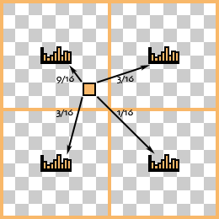
Histogram interpolation example
Interpolated trilinearly:
  Bilinearly into spatial cells
  Linearly into orientation bins

Slide 20
Normalization
Cell
Current cell : 1x18 histogram
Cell
Block: 2x2 cell
overlapping with current cell
contrast sensitive features: 18 orientation -> 18 dim
contrast insensitive features: 9 orientation -> 9 dim
Normalize 4 times by its neighbor blocks, and average them
3. texture features: sum of the magnitude over all orientation and normalize 4 time,not average -> 4 dim
In total each cell : 18+9+4 dimension of feature
Notes:
Shortly explain l2hys

Slide 21
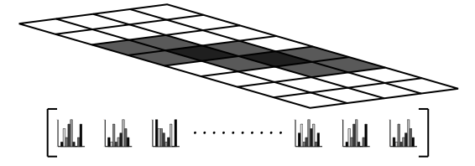





Final Descriptor
Concatenation the normalized histogram
Visualization:

Slide 22
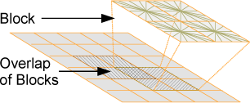
HOG Descriptor:
Compute gradients on an image
region of 64x128 pixels
Compute histograms on ‘cells’ of
typically 8x8 pixels (i.e. 8x16 cells)
Normalize histograms within
overlapping blocks of cells
Concatenate histograms
It is a typical procedure of feature extraction !

Slide 23
Feature Engineering
Developing a feature descriptor requires a lot of engineering
  Testing of parameters (e.g. size of cells, blocks, number of cells in a block, size of overlap)
  Normalization schemes
An extensive evaluation was performed to make these design desiccations
It’s not only the idea, but also the engineering effort

Slide 24
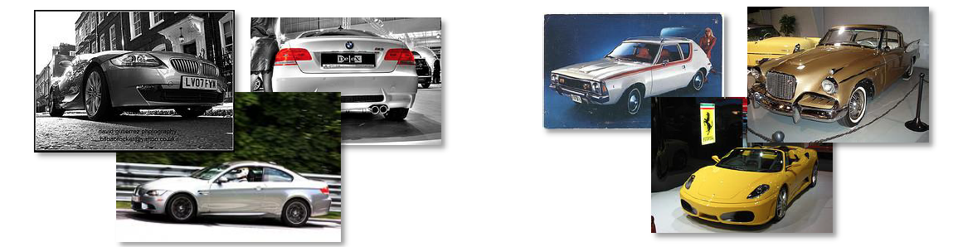
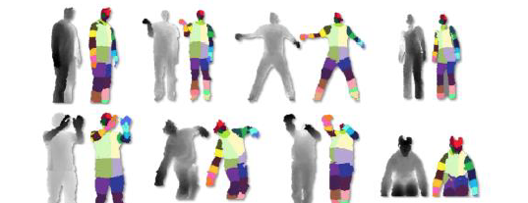
Problem ?
Single, rigid template usually not enough to represent a category.
Many object categories look very different from different viewpoints, or style
Many objects (e.g. humans) are articulated, or have parts that can vary in configuration

Slide 25
Solution :
Exemplar SVM: Ensemble of Exemplar-SVMs for Object Detection and Beyond
Part Based Model

Slide 26
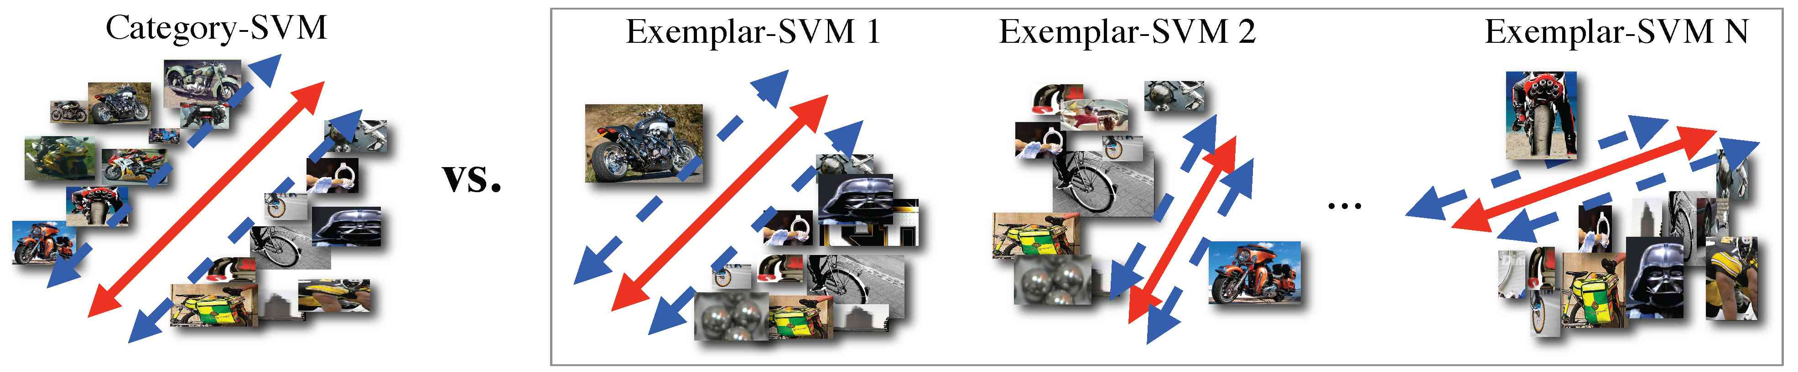
Exemplar-SVM
Still a rigid template,but train a separate SVM for each positive instance
For each category it can has exemplar with different size aspect ratio

Slide 27
Benefit from Exemplar-SVM ?
Handel the intra-category variance naturally, without using complicated model.
Compare to nearest neighbor approach: make use of negative data and train a discriminative object detector
Explicit correspondence from detection result to training exemplar

Slide 28
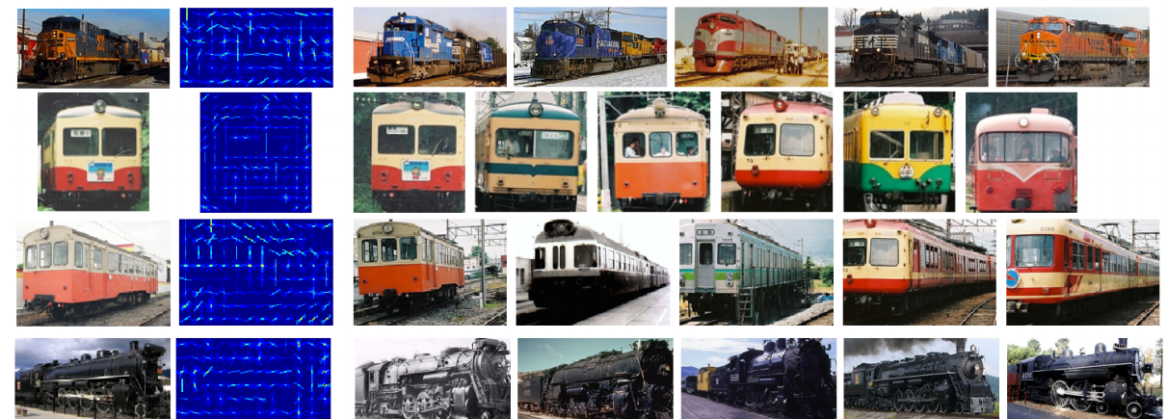
Benefit from Exemplar-SVM ?
Explicit correspondence from detection result to training exemplar
We not only know it is train,but also its orientation and type!

Slide 29
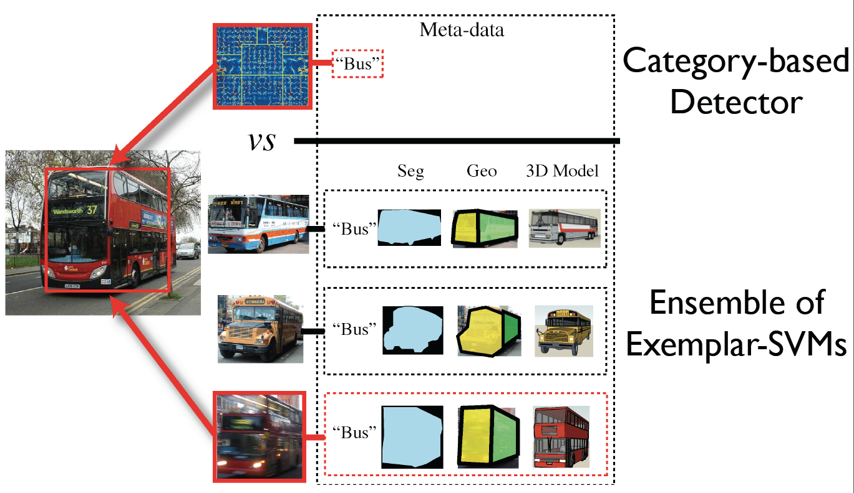
Benefit from Exemplar-SVM ?
We can do even more

Slide 30

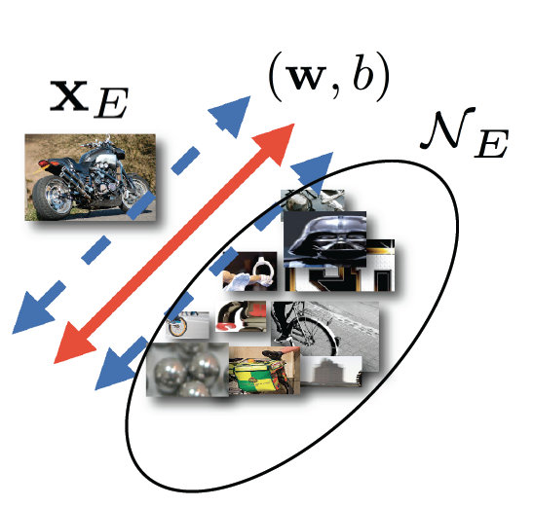
Training Exemplar-SVM
Objective Function:
h(x) = max(1-x,0)
distance to the margin for
the support vectors
1
h(x) =0
h(x) =1-x
-1

Slide 31

Training Exemplar-SVM
Objective Function:
Exemplar represented by ~100 HOG Cells

Slide 32

Training Exemplar-SVM
Objective Function:
Exemplar represented by ~100 HOG Cells
Windows from images not containing any in-class instances

Slide 33
Training Exemplar-SVM
Objective Function:
-1
h(x) =0
-1
Learn the w that minimize the objective function, equivalent to maximize the margin

Slide 34
Hard Negative Mining
Windows from images not containing any in-class instances: but there is too many!
2,000 images x 10,000 windows per image = 20M negatives
Find ones that you get wrong by a search, and train on these hard ones

Slide 35
Hard Negative Mining
Input : Positive : exemplar E
Negative : images and bounding boxes for this category
    N={(J₁,B₁), (J₂,B₂),…(J_{m},B_{m})}
Initialize: random pick m patches N_{random} from N that not overlap with
[SV,b,w]=trainSVM(E, N_{random})
Hard negative mining
While : i != m or N_{hard} not empty
for i= 1to n do
D = detect(b,w,J_{i})
N_{i}= D.conf > threshold & D not overlap with B_{i}
Add Ni to N_{hard}
if |N_{hard}| > memory-limit, then break;
end
[SV^{new},b^{new},w^{new}]=trainSVM(E, [N_{random,}SV])
SV = [SV; SV^{new}]
end

Slide 36
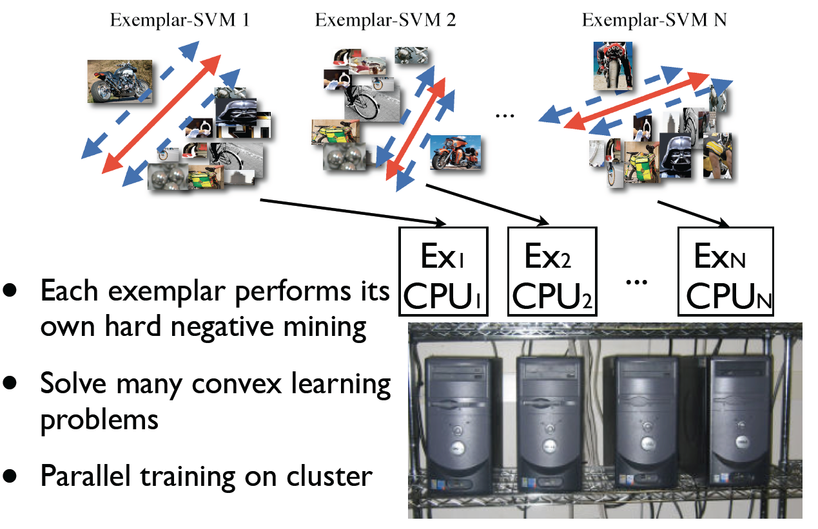
Embarrassingly Parallel

Slide 37
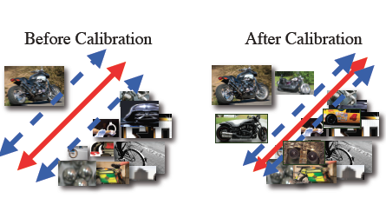
Calibration
Idea : make different exemplar detector's score compatible.
Good exemplar vs Bad exemplar

Slide 38
Calibration
Idea : make different exemplar detector's score compatible.
1. On Validation set :
Sort detection by score,
classify true/false detection
2. sigmoid function
Target Score
Good positive :
Similar with exemplar
1
negative:
-1
Detection Score
Detection Score
All detector’s scores are from 0 to 1.
The calibrated score reflects each detector’s presicion

Slide 39
Calibration
Idea : make different exemplar detector's score compatible.
Exemplar 1
Exemplar 2
Target Score
Target Score
1
1
-1
-1
Detection Score
Detection Score
Which one is “better” Exemplar?

Slide 40
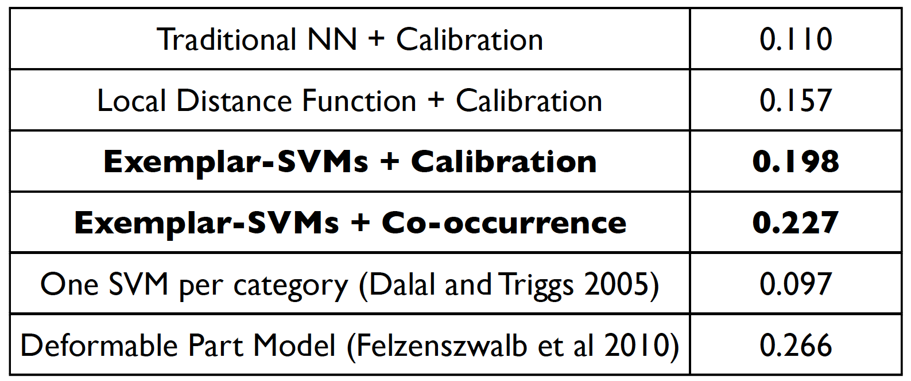
Performance

Slide 41
Performance
We can do better

Slide 42
Part Based detector
Pictorial Structures
Without part label
  Deformable part model
With part labeled
  Poselets
  3D Cuboid detector

Slide 43

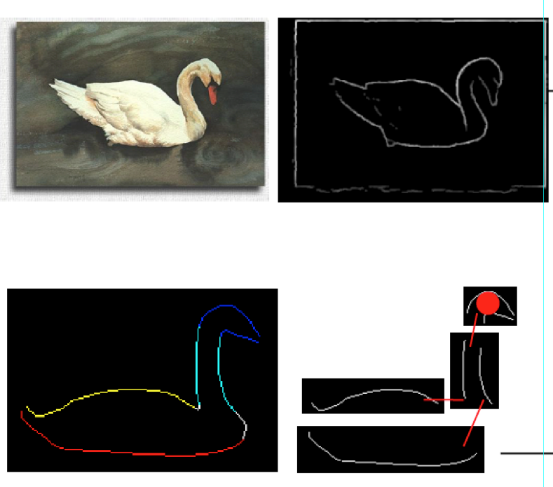
Part Based detector
Objects are represented by features of parts and spatial relations between parts

Slide 44
Part Based detector
How to defined the parts for one object category
How to represent their spatial relation shape
How to combine parts detection and spatial relations to obtained the final detection

Slide 45
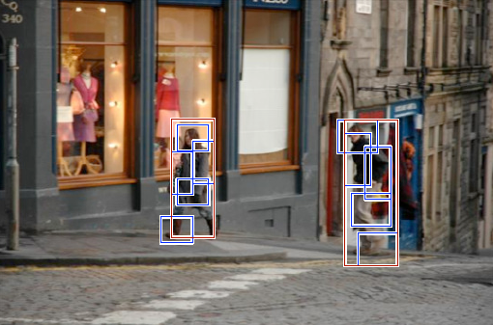
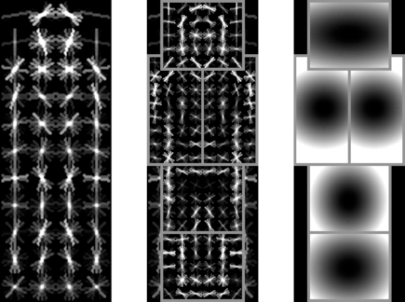
DPM : Object Detection with
Discriminatively Trained Part Based Models
P. Felzenszwalb, R. Girshick, D. McAllester, D. Ramanan, Object Detection with Discriminatively Trained Part Based Models, PAMI 32(9), 2010

Slide 46
DPM: overview
• Each category detector has mixture of deformable part models (components)
• Each component has global template + deformable parts
• Fully trained from bounding boxes alone
(Latent SVM)

Slide 47
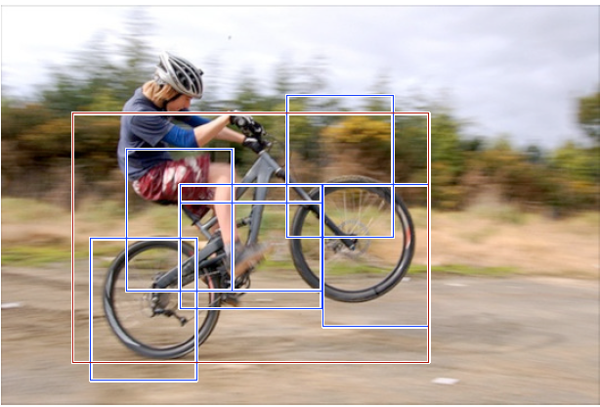
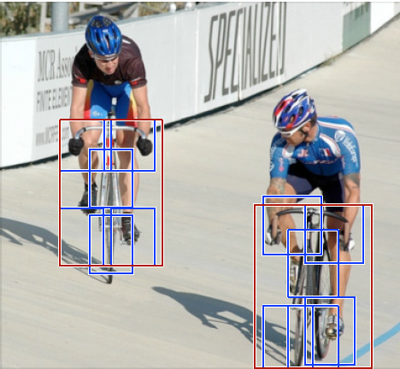
DPM: component
Each category detector has mixture of component for different aspect ratio (handle intra-class variance)
Each component has a it’s own DPM model

Slide 48
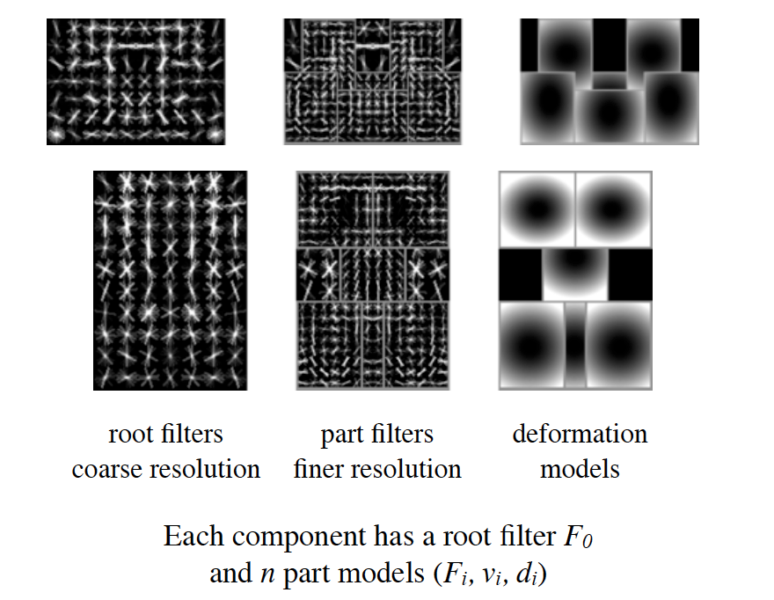
DPM: component

Slide 49
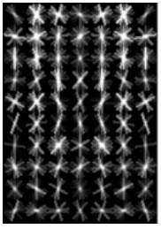
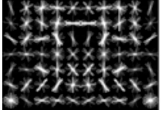
DPM: Initialization
Root filter for each component
For each component warp all positives to have same size
Random pick negatives with same size
Standard SVM no latent information

Slide 50
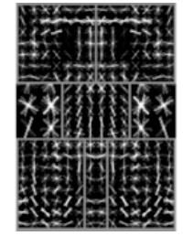
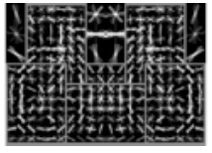
DPM: Initialization
Initializing Part Filter
Fixed number : 6 parts per component
Choose the high-energy regions of the root filter
(Energy : norm of positive weight in subwindow)
Greedy approach: once part placed set to zero and find next high-energy part

Slide 51
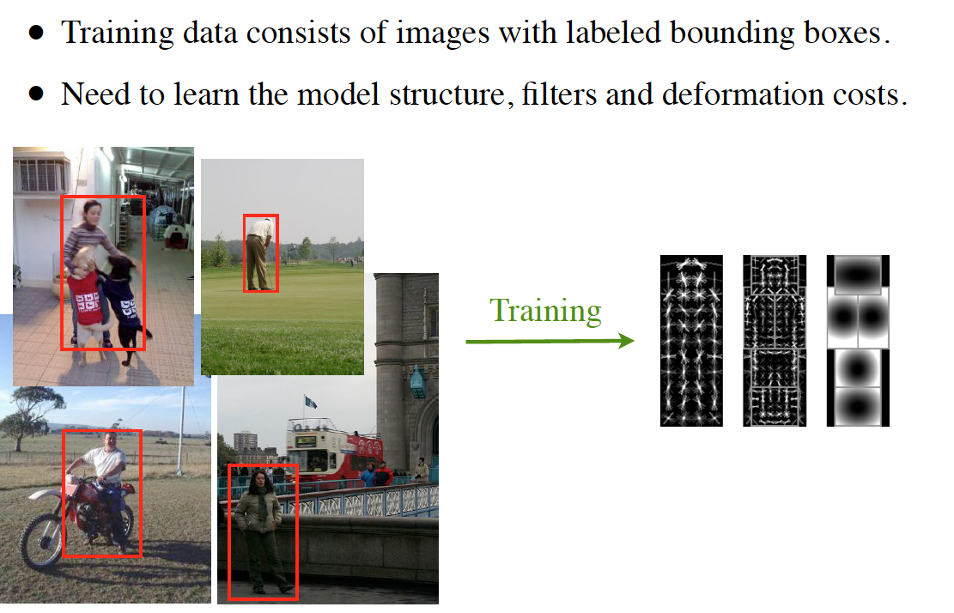
DPM: Training
Training data consists of images with labeled bounding boxes.
Need to learn the model structure, filters and deformation costs.

Slide 52
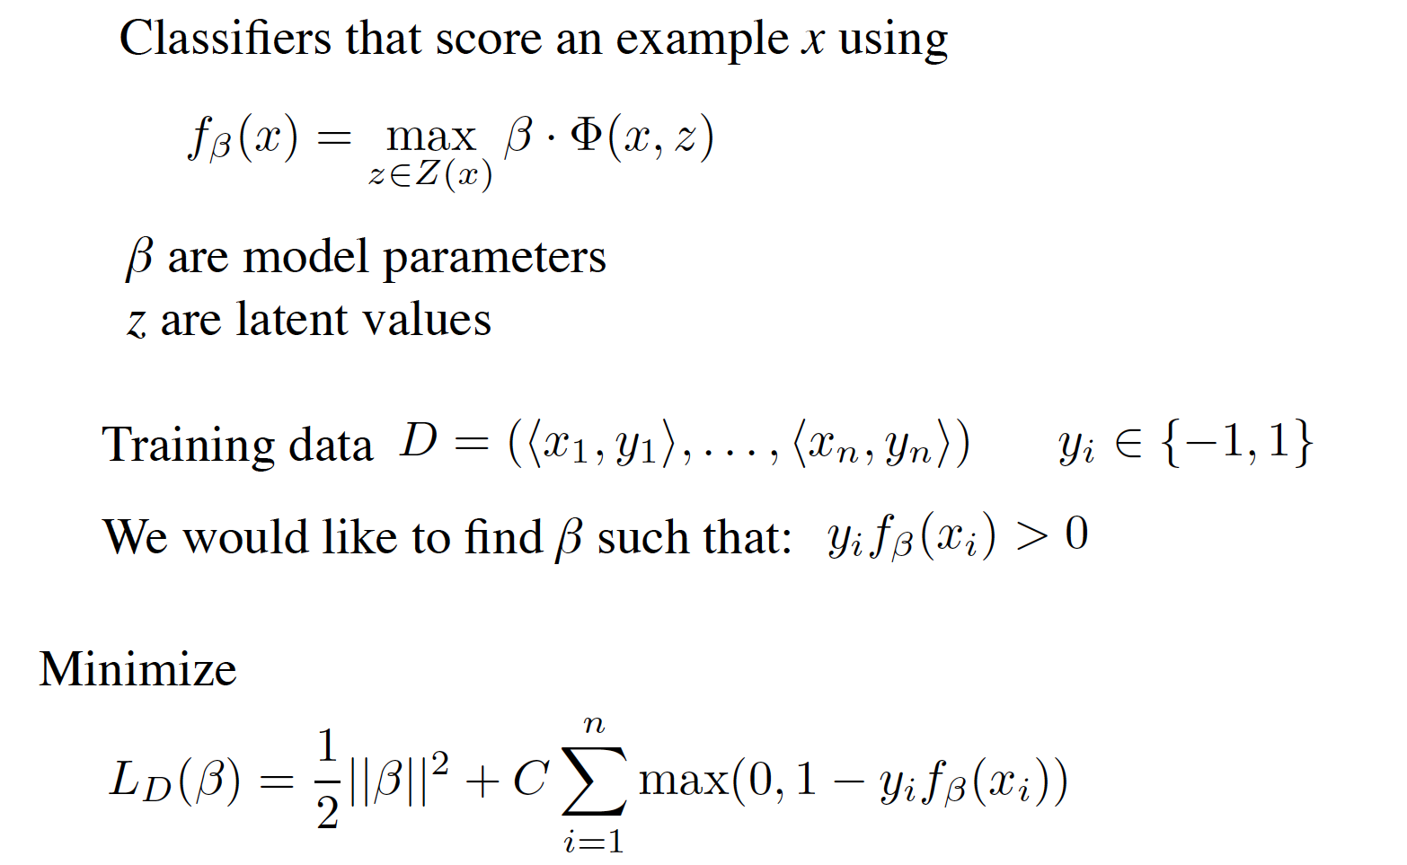
DPM: Latent SVM training

Slide 53
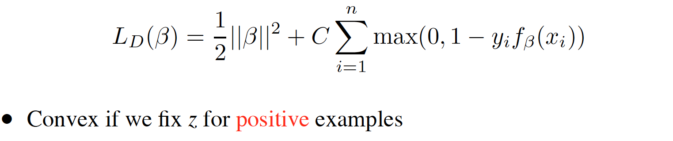

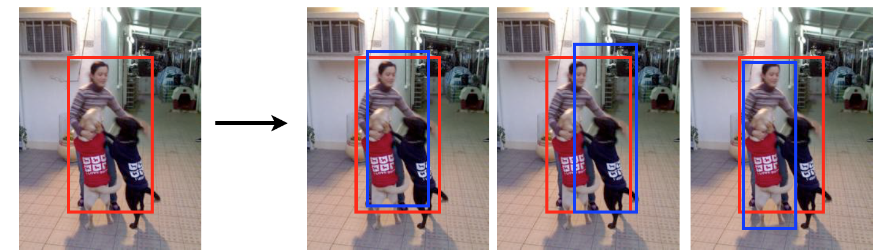
DPM: Latent SVM training
  Initialize and iterate:
    Fix and find the best z for each training example (detection)
    Fix z and solve for (standard SVM training)
Latent positive
for root

Slide 54
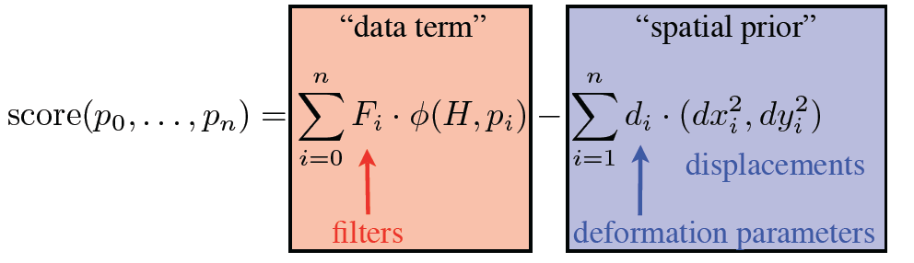
DPM: Detection
Score for one part at certain location :
filter response score – deform cost relative to root

Slide 55

DPM: Detection
Define an overall score for each root location
  Based on best placement of parts
High scoring root locations define detections
Efficient computation: dynamic programming + generalized distance transforms

Slide 56
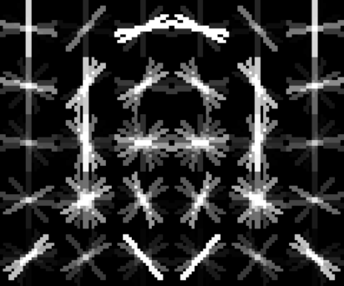
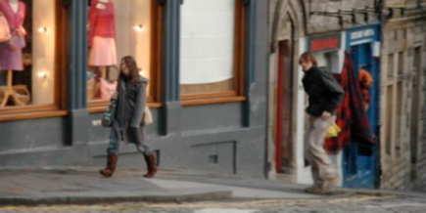

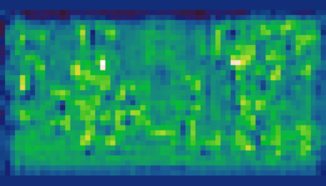
DPM: Detection
head filter
Response of filter in l-th pyramid level
input image
cross-correlation

Slide 57
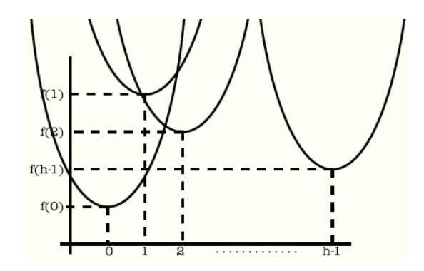
DPM: Detection
Transformed response : max-convolution
cost - response
Root location
Response of filter in l-th pyramid level

Slide 58
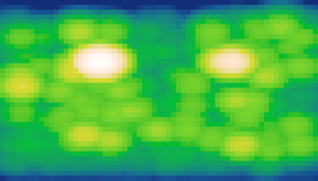
DPM: Detection
Transformed response : max-convolution
cost - response
Root location
For each root location its’ best placement of this part can be read from the transformed response directly

Slide 59
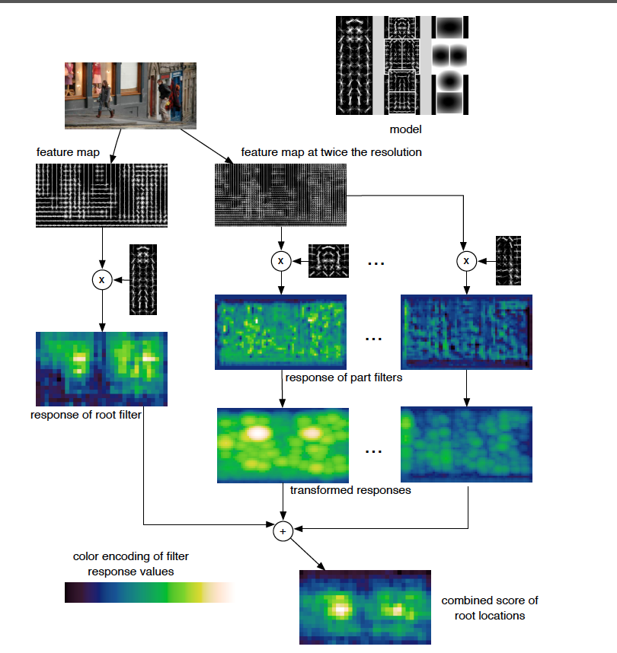

Combine Many Parts

Slide 60
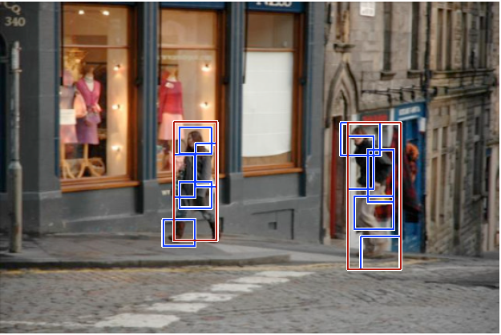

DPM: Detection
(after non-maximum suppression)
~1 second to search all scales

Slide 61


Car model
Component 1
Component 2

Slide 62
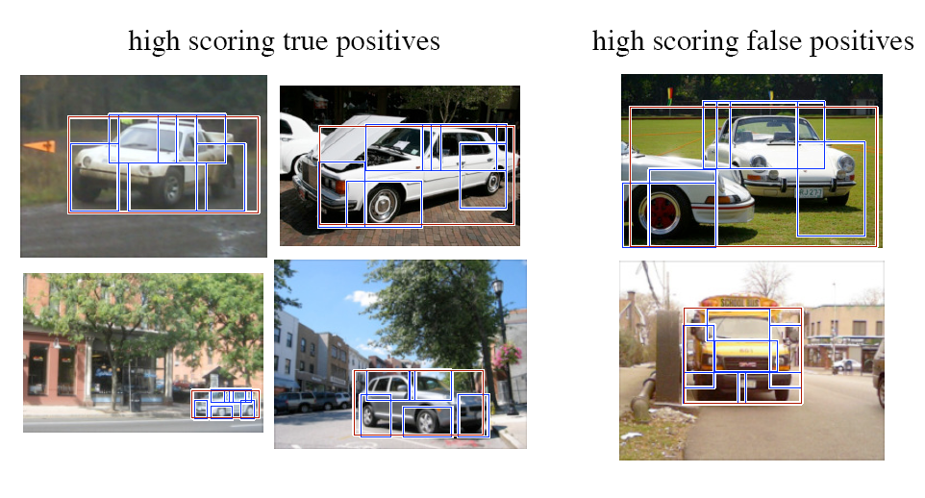
Car detections

Slide 63

More detections

Slide 64
DPM: Learning from weakly-labeled data
Only bounding box no part label need
Can we do better with part labeled ?
  Articulated Human Detection with Flexible Mixtures-of-Parts
  Cuboid detection
  Poselet

Slide 65


  Articulated Human Detection with Flexible Mixtures-of-Parts
Manually labeled part, and defined tree structure

Slide 66

Find part type (component) for each part
Clustering by part label’s location wrt it’s parent
(Not by their aspect ratio)

Slide 67

Learning- Structural SVM
Feature (HOG)
Positive : I image with human , z pose – from label
Negative : I image without human, z pose - any pose
Detection and pose estimation at same time
Notes:
Structural SVM

Slide 68

Detection
Tree structure example : 4 parts head as root, neck is body’s parent

Slide 69

Max(all part type of this type)

Slide 70

Results

Slide 71



3D Cuboid Detector
Input image
Output detections
detect
Synthesized New Views

Slide 72
Poselet

Slide 73

What is a Poselet ?
Poselets capture part of the pose from a given viewpoint
[Bourdev & Malik, ICCV09]
Notes:
So the idea is to have a large number of these parts, which we call poselets. So even difficult examples can be found because a few of these poselets can be triggered.
But there is one problem: In the case face detector, someone had to manually crop out thousands of faces to be able to train a classifier. In our case we have unlimited number of poselets, so we cannot have such a manual step.
73

Slide 74
Poselets
Examples may differ visually but have common semantics
[Bourdev & Malik, ICCV09]
Notes:
So the idea is to have a large number of these parts, which we call poselets. So even difficult examples can be found because a few of these poselets can be triggered.
But there is one problem: In the case face detector, someone had to manually crop out thousands of faces to be able to train a classifier. In our case we have unlimited number of poselets, so we cannot have such a manual step.
74

Slide 75
Poselets
One poselet one classifier not a model for whole human body
Notes:
So the idea is to have a large number of these parts, which we call poselets. So even difficult examples can be found because a few of these poselets can be triggered.
But there is one problem: In the case face detector, someone had to manually crop out thousands of faces to be able to train a classifier. In our case we have unlimited number of poselets, so we cannot have such a manual step.
75

Slide 76

How do we train a poselet?

Slide 77

Finding correspondences at training time
Given part of a human pose
How do we find a similar pose configuration in the training set?

Slide 78
Finding correspondences at training time
Left Shoulder
Left Hip
We use key points to annotate the joints, eyes, nose, etc. of people

Slide 79
Finding correspondences at training time
Residual Error

Slide 80





Training poselet classifiers
Residual Error:
0.15
0.20
0.10
0.85
0.15
0.35
Given a seed patch
Find the closest patch for every other person
Sort them by residual error
Threshold them

Slide 81
Training poselet classifiers
Given a seed patch
Find the closest patch for every other person
Sort them by residual error
Threshold them
Use them as positive training examples to train a linear SVM with HOG features
One poselet one classifier not a model for whole human body

Slide 82
Test time

Slide 83
Goal: Extract attributes of this person
Input:
Target person bounds
Bounds of other nearby people

Slide 84
Step 1: Detect poselet activations
[Bourdev et al, ECCV10]

Slide 85
Step 2: Cluster the activations
Because we know the joint for each poselet

Slide 86
Step 3: Predict person bounds
[Bourdev et al, ECCV10]

Slide 87
Step 4: Identify the correct cluster
Max-flow in bipartite graph

Slide 88

Start with its poselet activations
Poselet
Activations

Slide 89
Beyond detection： Attribute Classification
Context-level
Attribute
Classifiers
Person-level
Attribute
Classifiers
Poselet-level
Attribute
Classifiers
Features
Poselet
Activations

Slide 90
Features

Slide 91



Local & Global Features
A set of local features describes image properties at one particular
location in the image:
Jet of local orientations and scales
A set of global features provides information about the global
image structure without encoding specific objects
+
>
This feature likes images with vertical structures at the top part and
horizontal texture at the bottom part (this is a typical composition of an empty street)
Notes:
HOG is local or global ?

Slide 92
Image Descriptors
HOG
Gist scene descriptor
LBP (Local Binary Pattern)
SIFT (Scale-Invariant Feature Transform)
Notes:
We evaluate a list of global features to see how they works in our SUN dataset.
In this list, there are some baseline features, such as tiny image and color histograms.
There are also some strong features that perform very well empirically.
Due to time constraint, I am going to go through them very quickly. Please stop me if you have any question.
So we’re going to perform scene categorization using various computational features which have no explicit object awareness.
These features encode, for each image, statistics of color, self similarity, geometric layout, and texture
most of these features aren't new, although a few are improvements of recent approaches.
We make no claim that these are biologically plausible.
Highlight - texture features:

Slide 93



GIST:
Slide credit: James Hays
A. Oliva, A. Torralba. Modeling the shape of the scene: a holistic representation of the spatial envelope. IJCV 2001.
Notes:
Bank of gaba filter of different scale and orientation
Get the filter response
Divide the respones map to 4x4 grid
For each grid use mean/ max response value represent the

Slide 94
Example visual gists
Oliva & Torralba (2001)

Slide 95



LBP: Local Binary Pattern
Uniformity <= 2
yes
each has its own bin
no
all goes to one bin
Certain local binary patterns are fundamental properties of texture, providing the vast majority, sometimes over 90%.
They have one thing in common: contains very few spatial transitions.
Uniformity: number of spatial transitions (bitwise 0/1 changes).
Ojala, Pietikäinen, Mäenpää. Multiresolution gray-scale and rotation invariant texture classification with local binary patterns. PAMI’02.
Notes:
Divide the examined window to spatial pyramid cells
For each pixel in a cell, compare the pixel to each of its 8 neighbors (on its left-top, left-middle, left-bottom, right-top, etc.). Follow the pixels along a circle, i.e. clockwise or counter-clockwise.
Where the center pixel's value is greater than the neighbor, write "1". Otherwise, write "0". This gives an 8-digit binary number (which is usually converted to decimal for convenience).
Compute the histogram, over the cell, of the frequency of each "number" occurring (i.e., each combination of which pixels are smaller and which are greater than the center).
http://citeseerx.ist.psu.edu/viewdoc/download?doi=10.1.1.95.7277&rep=rep1&type=pdf
http://www.cs.ucf.edu/courses/cap6412/fall2009/papers/Wang_Han_Yan_iccv09.pdf

Slide 96

SIFT: Scale-Invariant Feature Transform

Slide 97

Key Point Localization
Detect maxima and minima of difference-of Gaussian in scale space
For each maxima and minima we know their
2D location and scale

Slide 98

Select Canonical Orientation

Slide 99


SIFT: Scale-Invariant Feature Transform
normalize(min(0.2,normalize(v)))
Compute image gradients in the chosen region
Weight the gradient magnitude by a Gaussian
Create array of orientation histograms
8 orientations x 4x4 histogram array = 128 dimensions
Implementation Details : http://www.vlfeat.org/api/sift.html#sift-intro-detector
David G. Lowe, "Distinctive image features from scale-invariant keypoints," IJCV, 60, 2 (2004), pp. 91-110.
Notes:
For each key point go to it’s scale find a 16x16
For each 2x 2 region Create array of orientation histograms
A set of orientation histograms are created on 4x4 pixel neighborhoods with 8 bins each.
These histograms are computed from magnitude and orientation values of samples in a 16 x 16 region around the keypoint such that each histogram contains samples from a 4 x 4 subregion of the original neighborhood region.
The magnitudes are further weighted by a Gaussian function with σ equal to one half the width of the descriptor window.
The descriptor then becomes a vector of all the values of these histograms.
Since there are 4 x 4 = 16 histograms each with 8 bins the vector has 128 elements.
This vector is then normalized to unit length in order to enhance invariance to affine changes in illumination.
To reduce the effects of non-linear illumination a threshold of 0.2 is applied and the vector is again normalized.

Slide 100

Color-SIFT

Slide 101

HOG: Histogram of oriented gradients
Compute gradient using ﬁlter: [1; 0; +1]
Discretize gradient orientation: contrast insensitive (9bin) & sensitive (18bin)
Aggregate into cells with “soft binning”
Normalize & Truncate: min(v,0.2)
Dimension reduction
PCA of HOG features
Navneet Dalal and Bill Triggs. Histograms of oriented gradients for human detection. CVPR 2005.
P. Felzenszwalb, R. Girshick, D. McAllester, D. Ramanan. Object Detection with Discriminatively Trained Part Based Models. PAMI2010.
J. Xiao, J. Hays, K. Ehinger, A. Oliva, and A. Torralba. SUN Database: Large-scale Scene Recognition from Abbey to Zoo. CVPR2010.
Notes:
for color images we use the color channel with the largest gradient magnitude to deﬁne gradient magnitude and orientation at each pixel.

Slide 102

HOG: Histogram of oriented gradients
Compute gradient using ﬁlter: [1; 0; +1]
Discretize gradient orientation: contrast insensitive (9bin) & sensitive (18bin)
Aggregate into cells with “soft binning”
Normalize & Truncate: min(v,0.2)
Dimension reduction
31dimension feature vector = 9 (insensitive) +18 (sensitive) + 4 ( )
124dimension feature vector = concatenation of 2x2 neighboring feature vectors together
Navneet Dalal and Bill Triggs. Histograms of oriented gradients for human detection. CVPR 2005.
P. Felzenszwalb, R. Girshick, D. McAllester, D. Ramanan. Object Detection with Discriminatively Trained Part Based Models. PAMI2010.
J. Xiao, J. Hays, K. Ehinger, A. Oliva, and A. Torralba. SUN Database: Large-scale Scene Recognition from Abbey to Zoo. CVPR2010.
Notes:
for color images we use the color channel with the largest gradient magnitude to deﬁne gradient magnitude and orientation at each pixel.

Slide 103
New techniques for object detection
Finding things
Selective search
RCNN

Slide 104

Finding Things: Image Parsing with Regions and Per-Exemplar Detectors

Slide 105

Finding Things: Image Parsing with Regions and Per-Exemplar Detectors
Generation of our detector based data term.

Slide 106

Selective Search for Object Recognition
Like segmentation, we use the image structure to guide our sampling process.
Like exhaustive search, we aim to capture all possible object locations.

Slide 107

Deep learning in object detection

Slide 108



Training RCNN

Slide 109

Result
pre-trained
fine-tuned

Slide 110
Next generation of object detection
Observation:
sliding windows -> segmentation
designed features -> deep learned features
parts based models -> linear SVMs
-------PIOTR’s Blog

Slide 111
Data Set
Data set is critical for the advance of computer vision.
Many algorithm’s success are based on good data set.
Both quantity and quality are important for a dataset

Slide 112


Data Set
The Ultimate Dataset
All scene categories
Large collections of realistic photos
Label all objects
✗
✓
Frame-object Snapshot
Multi-object Scene
Notes:
Therefore, we want to build the ultimate dataset for scene understanding,
[click] Which spans all scene categories,
[click] And with a large collection of realistic photos.
[click] Which means, we don’t want frame-object snapshot like this one with very clean background.
[click] Instead, we want multi-object scenes like this one that you can typically obtain from real environment.
[click] And we also want to label all objects in each image.
We call our database the Scene Understanding Database.
In short, S U N, SUN database.

Slide 113

Data Set: PASCAL
2005-2012
Bounding box annotation
Object in scene : realistic photos
20 class
If there is not PASCAL,there may not be DPM and all the later object detection algorithm

Slide 114

Data Set
Not large enough?

Slide 115

imageNet
20,000+ categories
14,000,000+ images

Slide 116
Scene UNderstanding Database
131,072 images
3,819 object categories
249,522 segmented objects
Notes:
So, in the end, we have a lot of objects labeled. And each image is both labeled with scene category and object polygons.
Similar scale, but what’s the difference ?

Slide 117
Chairs
Location Bias
Size Bias
Number Bias
Context Bias
Occlusion Bias
Background Bias
Lighting Bias
Viewpoint Bias

Slide 118




Object-centric vs. Scene-centric
Image-Net
SUN

Slide 119

Object without Scene
Object without scene
really sucks!
toilet +0.21
Toilet without Restroom
Notes:
Object Recognition without Scene
= Toilet without Restroom
Scene:
a place in which a human can act within.
a place to which a human being could navigate.
a lot more than just a combination of objects.
associated with specific functions and behaviors.
human centric.

Slide 120
Summary
Good object detection algorithm need to consider
What feature ?
  HOG, SIFT …
What model?
  Rigid,DPM…
What data ?
  PASCAL, imageNet, SUN…

