Slide 1
Cloud Computing
John McSpedon

Slide 2
Why Parallel Computation?
Traditional Moore’s Law
Signal Propagation
Memory Access Latency
Huge Datasets

Slide 3
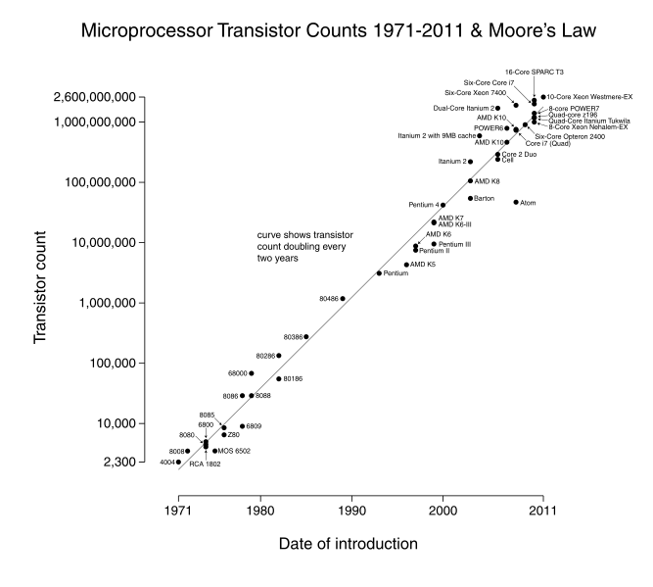
Moore’s Law

Slide 4
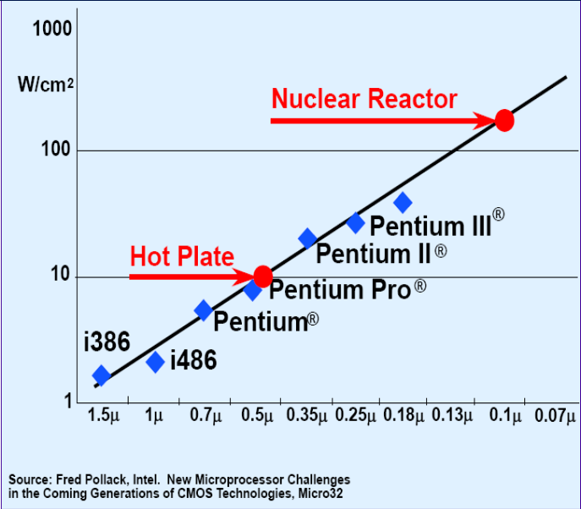
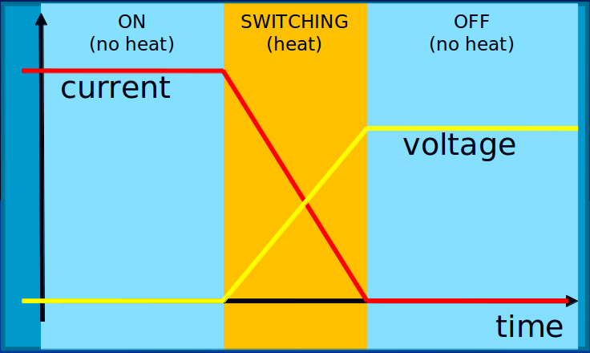
Power Density

Slide 5
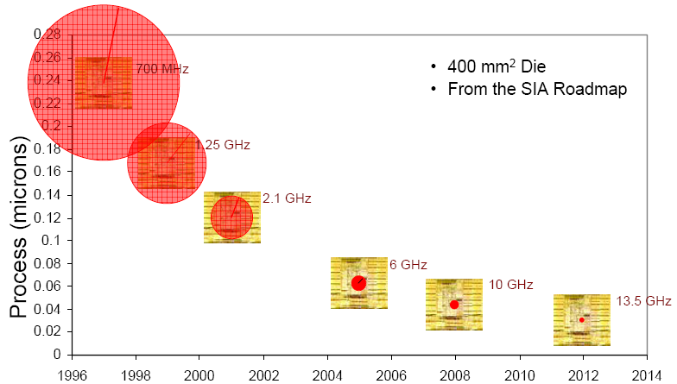
Signal Propagation
Internal signals propagate at ≈⅔ c
Signal radius of one clock cycle?

Slide 6
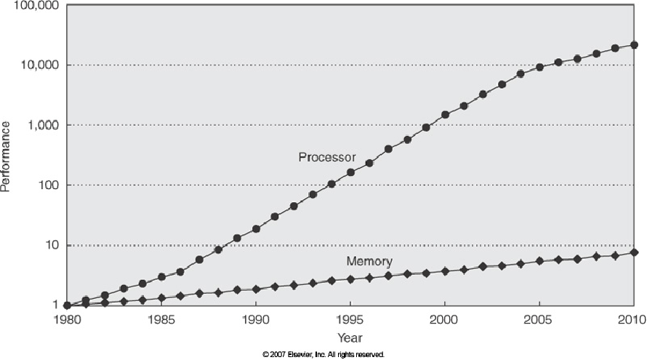
Memory Access Latency
1 machine x 1TB
or
1000 machines x 1GB

Slide 7
Huge Datasets
VOC 2009: 900MB
TME Motorway: 32GB
SUN database: 37GB
>900 million Websites to index
200-300 PB of images on Facebook

Slide 8
Parallel Computation at Princeton
MATLAB parfor
CS ionic cluster (PBS)
MapReduce/Hadoop
Amazon EC2

Slide 9
MATLAB parfor
ridiculously simple
s = 0; parfor i = 1:n if p(i) % p is fxn
s = s + 1; endend
parfor i = 1:length(A) B(i) = f(A(i));end
requires consecutive range of integers

Slide 10
parfor Demo

Slide 11
CS ionic cluster
≈100 node cluster for use by CS department
controlled by a PBS/Torque queue
users communicate via beowulf listserv
jobs submitted via scripts/command line from head node of ionic.cs.princeton.edu

Slide 12
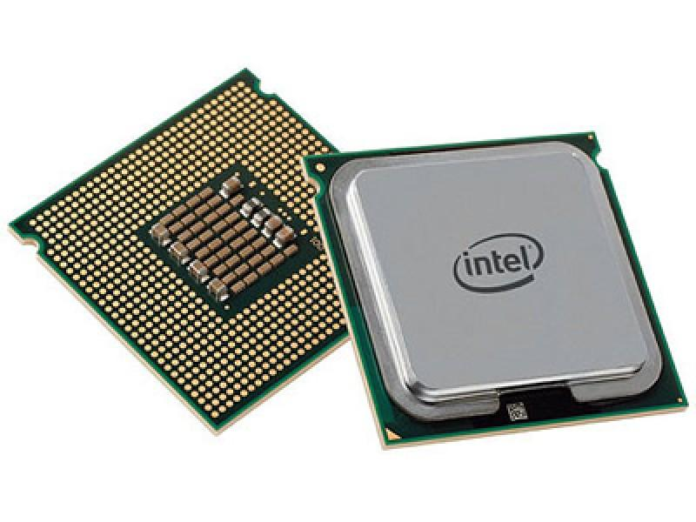
ionic cluster nodes
27x (2 cores @ 2.2GHZ, 8+ GB RAM, 2x73GB disk)
9x (4 cores @ 2.3GHZ, 16 GB RAM, 4x146 GB disk)
48x (2 cores @ ~2 GHZ, 8 GB RAM, 1x750 GB disk)
3x (6 cores @ 3.1GHZ, 48 GB RAM, 2x146 GB disk)

Slide 13
ionic resources
CS Guide intro: https://csguide.cs.princeton.edu/resources/clusters
Job Submission Guide (see chapter 2): http://docs.adaptivecomputing.com/torque/4-2-6/torqueAdminGuide-4.2.6.pdf
Current Node Status: http://ionic.cs.princeton.edu/ganglia/
Queue Policy Guide: http://docs.adaptivecomputing.com/maui/pdf/mauiadmin.pdf

Slide 14
ionic: .sh for single processor job
Hello World files
mcspedon-hp-dv7:~$ ssh mcspedon@ionic.cs.princeton.edu
Last login: Wed Mar 26 17:16:43 2014 from nat-oitwireless-outside-vapornet3-b-227.princeton.edu
[mcspedon@head ~]$ cd COS598C/hello_world/
[mcspedon@head hello_world]$ gcc -o hello hello_world.c
[mcspedon@head hello_world]$ ls
hello hello.sh hello_world.c
[mcspedon@head hello_world]$ qsub ./hello.sh
3648004.head.ionic.cs.princeton.edu
[mcspedon@head hello_world]$ ls
hello hello.err hello.out hello.sh hello.txt hello_world.c
[mcspedon@head hello_world]$ cat hello.out
Starting 3648004.head.ionic.cs.princeton.edu at Wed Mar 26 17:19:55 EDT 2014 on node096.ionic.cs.princeton.edu
Hello World
Done at Wed Mar 26 17:19:55 EDT 2014
[mcspedon@head hello_world]$ cat hello.txt
Hello Filesystem
Notes:
must specify nodes
queue penalizes inaccurate walltime estimates
can add details about memory usage to guarantee sufficient nodes

Slide 15
ionic: single node MATLAB job
bash script to call find_k_closest_imgs.m
mcspedon-hp-dv7:~$ ssh mcspedon@ionic.cs.princeton.edu
Last login: Wed Mar 26 17:18:56 2014 from nat-oitwireless-outside-vapornet3-b-227.princeton.edu
[mcspedon@head ~]$ cd COS598C/ImageSearch/Codebase/
[mcspedon@head Codebase]$ ls
boxes_query04_20140324T161840.mat k_closest.jpg test_whiten.m
find_k_closest_imgs.m learn_image.m voc-release5
generative_RELEASE matlab_singlenode.sh weighted_filter.jpg
getAllJPGs.m query_dir_by_img.m
initmodel_var.m templateMatching
[mcspedon@head Codebase]$ qsub matlab_singlenode.sh
3648005.head.ionic.cs.princeton.edu
[mcspedon@head Codebase]$ ls
boxes_query04_20140324T161840.mat initmodel_var.m query_dir_by_img.m
boxes_query04_20140326T172958.mat k_closest.jpg templateMatching
find_k_closest_imgs.m learn_image.m test_whiten.m
generative_RELEASE matlab_singlenode.sh voc-release5
getAllJPGs.m matlab_singlenode.sh.o3648005 weighted_filter.jpg
Notes:
must specify nodes
queue penalizes inaccurate walltime estimates
can add details about memory usage to guarantee sufficient nodes

Slide 16
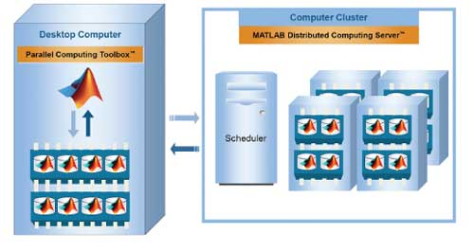
MATLAB Distributed Computing Server
Scales Parallel Computing Toolbox
Duplicates user’s MATLAB licenses
(up to 32 instances on ionic cluster)

Slide 17
ionic: multiple node MATLAB job
Usually called as MATLAB fxn, but MATLAB has been removed from ionic head node.
In communication with CS IT department.
Supposedly users can request a single node with 16 processors in the meantime.

Slide 18
MapReduce/Hadoop
Google FS (2003)
Google MapReduce (2004)
Google Bigtable (2006)

Slide 19
Google FS
Assumptions
commodity hardware with nonzero failure rate
multi-GB files designed for single-write-many-reads
append more important than random write
high bandwidth more important than low latency
Simplest unit is 64MB chunk
1 master, several chunkservers

Slide 20
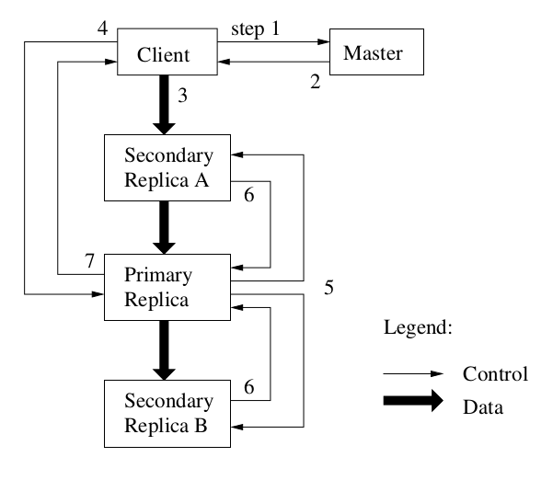
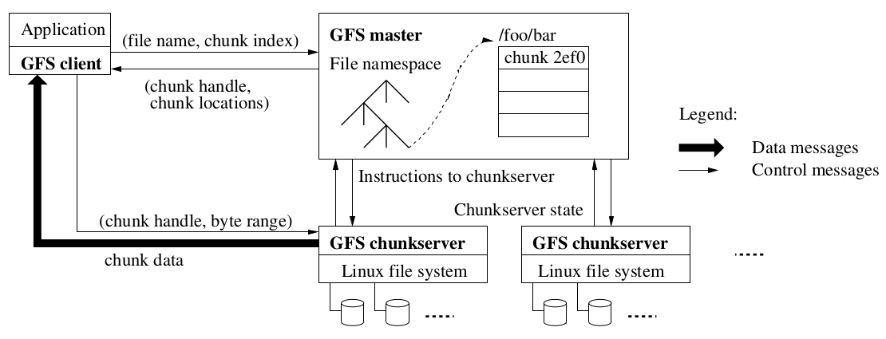
Google FS
Master stores:
file/chunk namespaces,
file -> chunk(s) mapping,
chunk replica locations

Slide 21
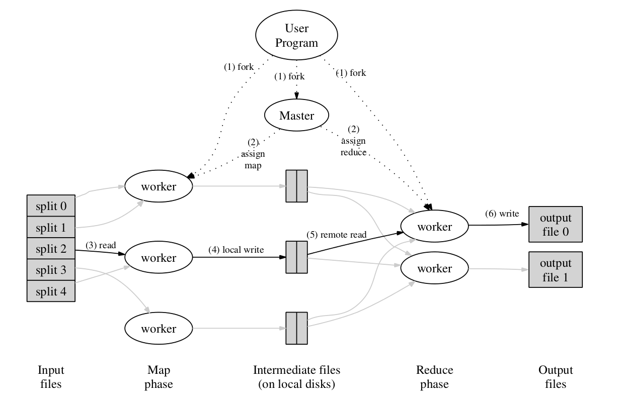
Google MapReduce
map: (k1, v1) -> list(k2, v2)
reduce: (k2, list(v2)) -> list(v2)
choose, e.g.
M = 200,000
R = 5,000
(2,000 workers)
WordCount
Distributed Grep
URL Access Frequency
Reverse Web-Link Graph
Distributed Sort

Slide 22
MapReduce: Word Count
map:
for each word in input
output (word, 1)
reduce:
for each key
sum(values)

Slide 23
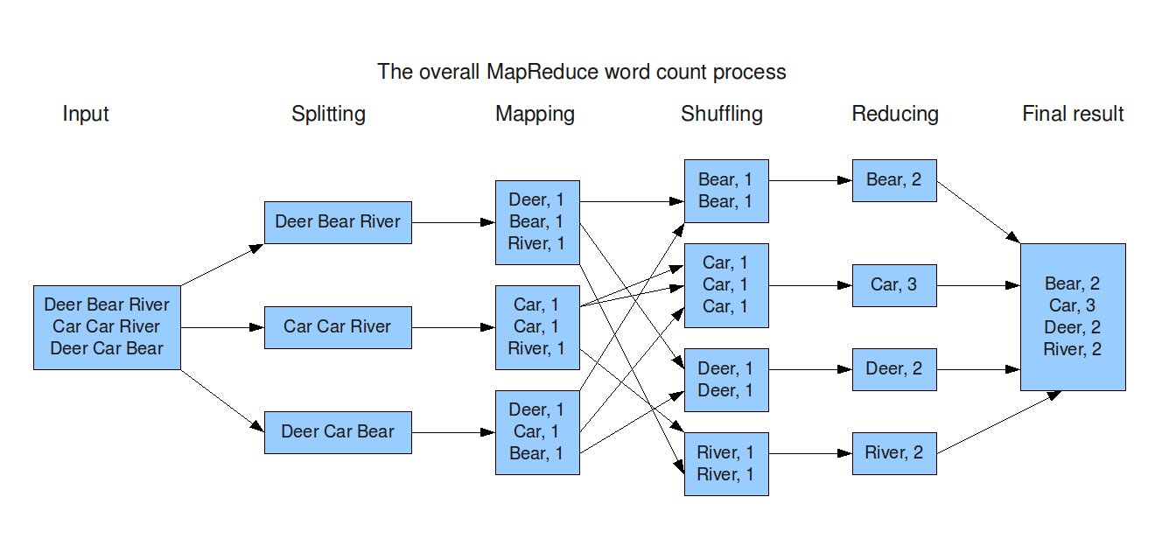

Slide 24
MapReduce: Distributed Grep (1 of 2)
map1:
for each line in input
output (matching line, 1) if match
reduce1:
for each key
sum(values)

Slide 25
MapReduce: Distributed Grep (2 of 2)
map2:
for each (matching line, freq)
output (freq, matching line)
reduce2:
identity fxn
(This sorts matching lines by their frequency)

Slide 26
Google Bigtable
Built on top of Google FS, SSTable, Chubby Lock Service
Choice of row name is important for compression

Slide 27
Apache Hadoop
Open source implementations of Google whitepapers
Hadoop Distributed File System
Hadoop MapReduce
Apache Hbase
Yahoo! web search: 42,000 node cluster
Facebook backend: 200+PB data on HDFS/Hbase

Slide 28
Hadoop 2.2 Pseudo-Cluster
Each CPU core is a worker in MapReduce job
Communicate via network interface (ip 127.0.0.1)
Allows user to test code without charge
Similar steps for installing Hadoop on small clusters

Slide 29
Installation References
official instructions: https://hadoop.apache.org/docs/r2.2.0/hadoop-project-dist/hadoop-common/SingleNodeSetup.html#Single_Node_Setup
64-bit build with fixes for common bugs: http://www.csrdu.org/nauman/2014/01/23/geting-started-with-hadoop-2-2-0-building/
64-bit install:
http://www.csrdu.org/nauman/2014/01/25/hadoop-2-2-0-single-node-cluster/
disabling ipv6: http://askubuntu.com/questions/346126/how-to-disable-ipv6-on-ubuntu
suggested changes to .bashrc:
http://codesfusion.blogspot.com/2013/10/setup-hadoop-2x-220-on-ubuntu.html?m=1

Slide 30
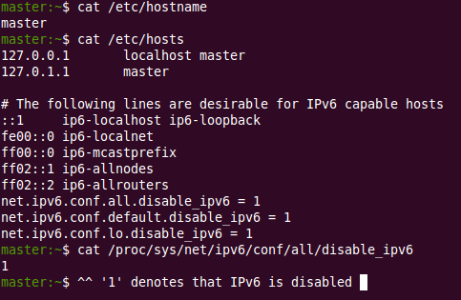
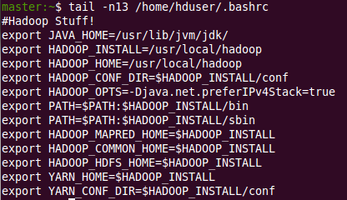
Installation References (continued)

Slide 31
Hadoop Word Count: Map
public static class Map extends MapReduceBase implements Mapper<LongWritable, Text, Text, IntWritable> { private final static IntWritable one = new IntWritable(1); private Text word = new Text(); public void map(LongWritable key, Text value, OutputCollector<Text, IntWritable> output, Reporter reporter) throws IOException { String line = value.toString(); StringTokenizer tokenizer = new StringTokenizer(line); while (tokenizer.hasMoreTokens()) { word.set(tokenizer.nextToken()); output.collect(word, one); } } }

Slide 32
Hadoop Word Count: Reduce
public static class Reduce extends MapReduceBase implements Reducer<Text, IntWritable, Text, IntWritable> { public void reduce(Text key, Iterator<IntWritable> values, OutputCollector<Text, IntWritable> output, Reporter reporter) throws IOException { int sum = 0; while (values.hasNext()) { sum += values.next().get(); } output.collect(key, new IntWritable(sum)); } }

Slide 33
Hadoop Word Count demo
bash scripts
1. Check that current ip address of computer matches second line of /etc/hosts
2. Call startup.sh
3. If ‘jps’ returns the following processes…
4. Call wordcount.sh

Slide 34
Amazon Elastic Compute Cloud (EC2)
Low overhead costs
Outsource cluster management
Access large-storage/ GPU devices
(Don’t manually configure Hadoop)

Slide 35
EC2 Introductory Material
Overview: http://docs.aws.amazon.com/AWSEC2/latest/UserGuide/EC2_GetStarted.html
Pricing:
http://aws.amazon.com/ec2/pricing/
Map Reduce:
http://docs.aws.amazon.com/ElasticMapReduce/latest/DeveloperGuide/emr-get-started-count-words.html
Simple Queue Service:
http://docs.aws.amazon.com/AWSSimpleQueueService/latest/SQSGettingStartedGuide/Welcome.html

Slide 36
Free EC2 Resources (first year)
750 hrs of Linux Micro instance
750 hrs of Microsoft Server Micro instance
750 hrs+15GB Elastic Load Balancing
30 GB storage, 15GB outbound traffic
2 million IOs
Data Transfer in to EC2

Slide 37
Billable EC2 Resources
CPU hours (rounded up to nearest hour)
Data Transfer out of EC2 (0-2 cents/GB)
0.4 cents per 10K IO requests

Slide 38
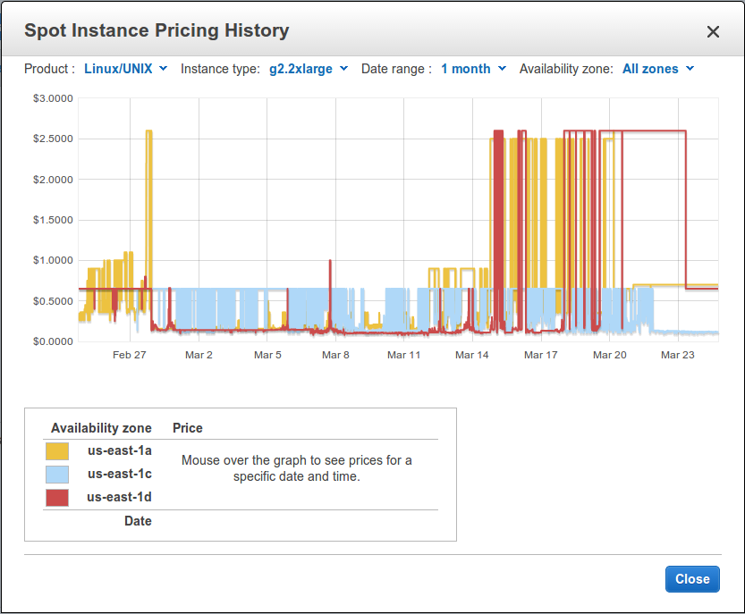
Reserved/
Spot
Instances

Slide 39
Demo: Reserving EC2 Instance
Install Amazon Command Line Tools
Make ‘Administrators’ Security Group
(specify valid incoming addresses for SSH sessions)
IP masks for Princeton
Make Key Pair
https://console.aws.amazon.com/ec2/v2/home?region=us-east-1

Slide 40
Elastic Map Reduce Word Count
import sys import re def main(argv): line = sys.stdin.readline() pattern = re.compile("[a-zA-Z][a-zA-Z0-9]*") try: while line: for word in pattern.findall(line): print "LongValueSum:" + word.lower() + "\t" + "1" line = sys.stdin.readline() except "end of file": return None

Slide 41
Demo: Elastic MapReduce
create storage location:
https://console.aws.amazon.com/s3/
run EMR:
https://console.aws.amazon.com/elasticmapreduce/vnext/home?region=us-east-1#

Slide 42
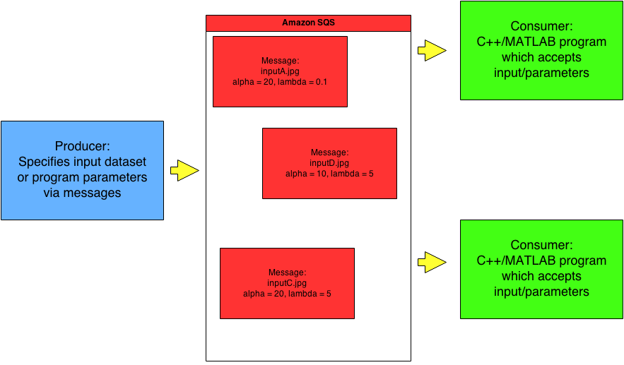
Amazon Simple Queue Service

Slide 43
Amazon SQS
main SQS console:
https://console.aws.amazon.com/sqs/home?region=us-east-1#
e.g. Python SDK for accessing queue:
http://boto.readthedocs.org/en/latest/ref/sqs.html

Slide 44
Additional Resources
Non-CS clusters at Princeton:
http://www.princeton.edu/researchcomputing/computational-hardware/
Hadoop Image Processing Interface:
http://hipi.cs.virginia.edu/
Matlab licensing on EC2:
http://www.mathworks.com/discovery/matlab-ec2.html

