Slide 1

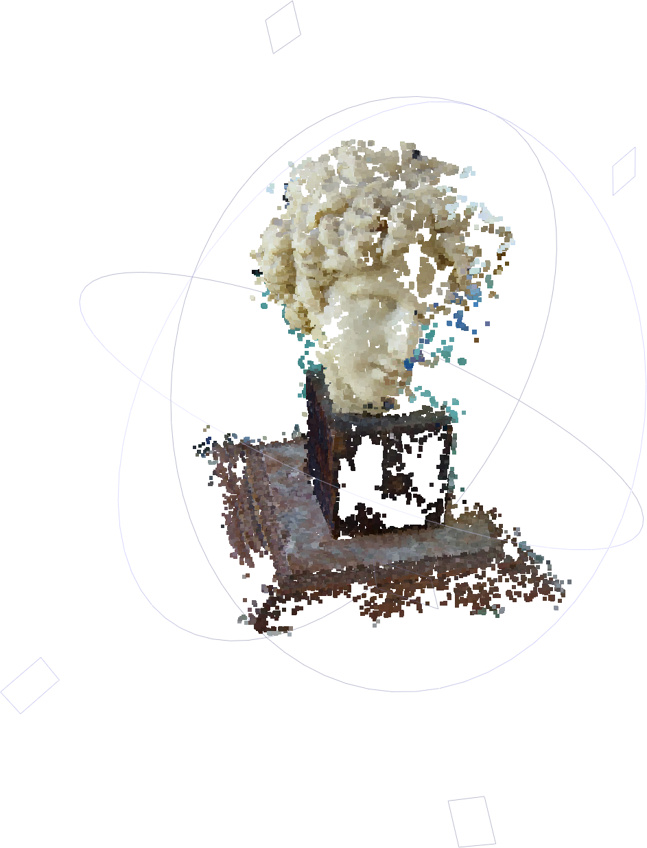
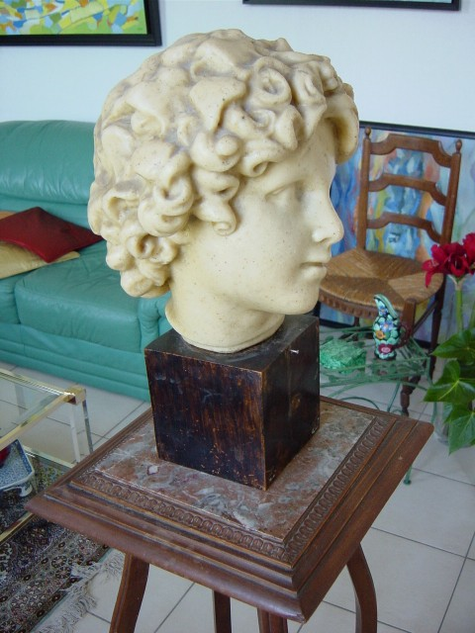
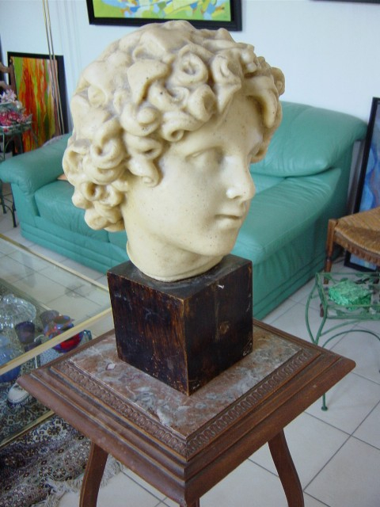
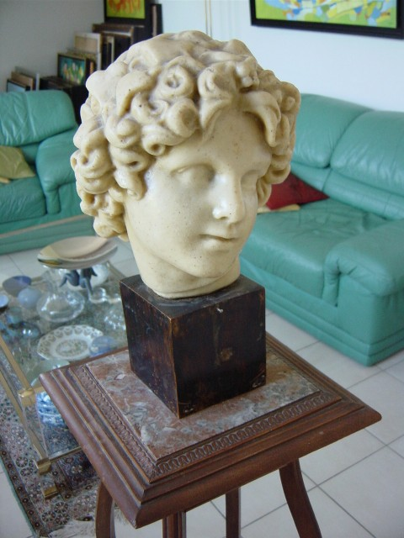
COS429 Computer Vision
Assignment 4 Cloning Yourself
+
+
=

Slide 2
Steps for 3D Reconstruction
Images → Points: Structure from Motion
Points → More points: Multiple View Stereo
Points → Meshes: Model Fitting
Meshes → Models: Texture Mapping
Images → Models: Image-based Modeling
+
=

Slide 3
Steps for 3D Reconstruction
Images → Points: Structure from Motion
Points → More points: Multiple View Stereo
Points → Meshes: Model Fitting
Meshes → Models: Texture Mapping
Images → Models: Image-based Modeling
+
=
+
+
=

Slide 4
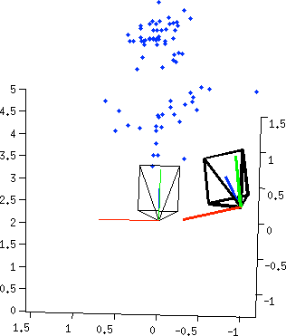
Two-view Reconstruction
keypoints
match
fundamental
matrix
essential
matrix
triangulation
[R|t]
keypoints

Slide 5

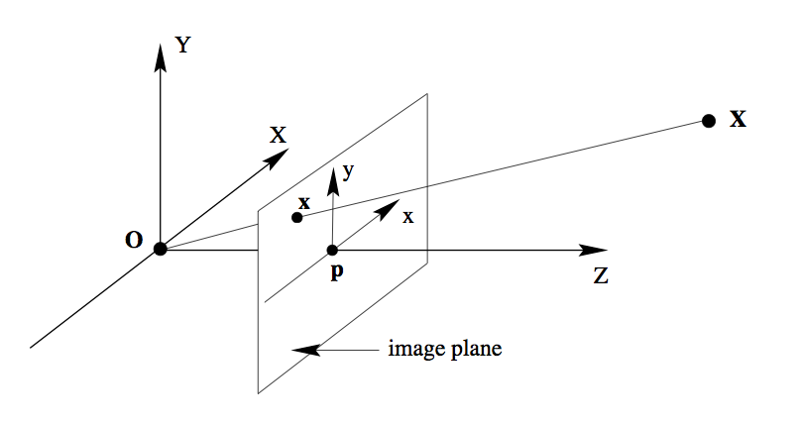
But, why…
There is so many step?
There is so many maths and equations?
Problem
Conceptual Solution
Math Solution
How to write a Rot/Tsl transformation into a linear function?
Homogenous Coordinates
X → [X;1]
X’ = R*X + T*1
How to get the pixel location on an image of a 3D point?

Slide 6
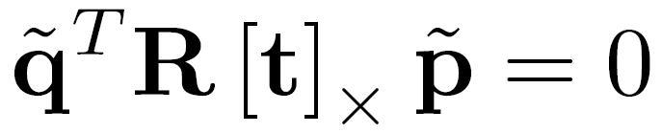




Now think about SFM…
In order to get 3D points,
  Corresponding points
  R,T between two images
→ SIFT Keypoint Matching
→
3d point lies somewhere along r
0
Image 1
Image 2

Slide 7
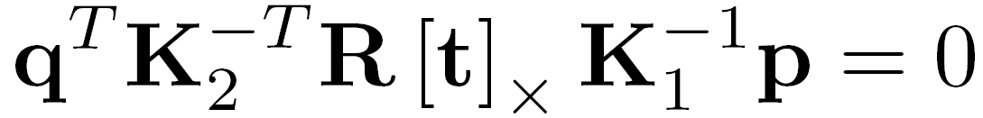
R, T between two images…
Essential Matrix
Fundamental Matrix
Conceptual Solution:
Given (p,q) pairs, we can get K^{-T}R[t]_{x}K⁻¹.
Given K, we can get R[t]_{x} , then decompose them to R, T.
0
Image 1
Image 2

Slide 8
Two-view Reconstruction
keypoints
match
fundamental
matrix
essential
matrix
triangulation
[R|t]
keypoints

Slide 9
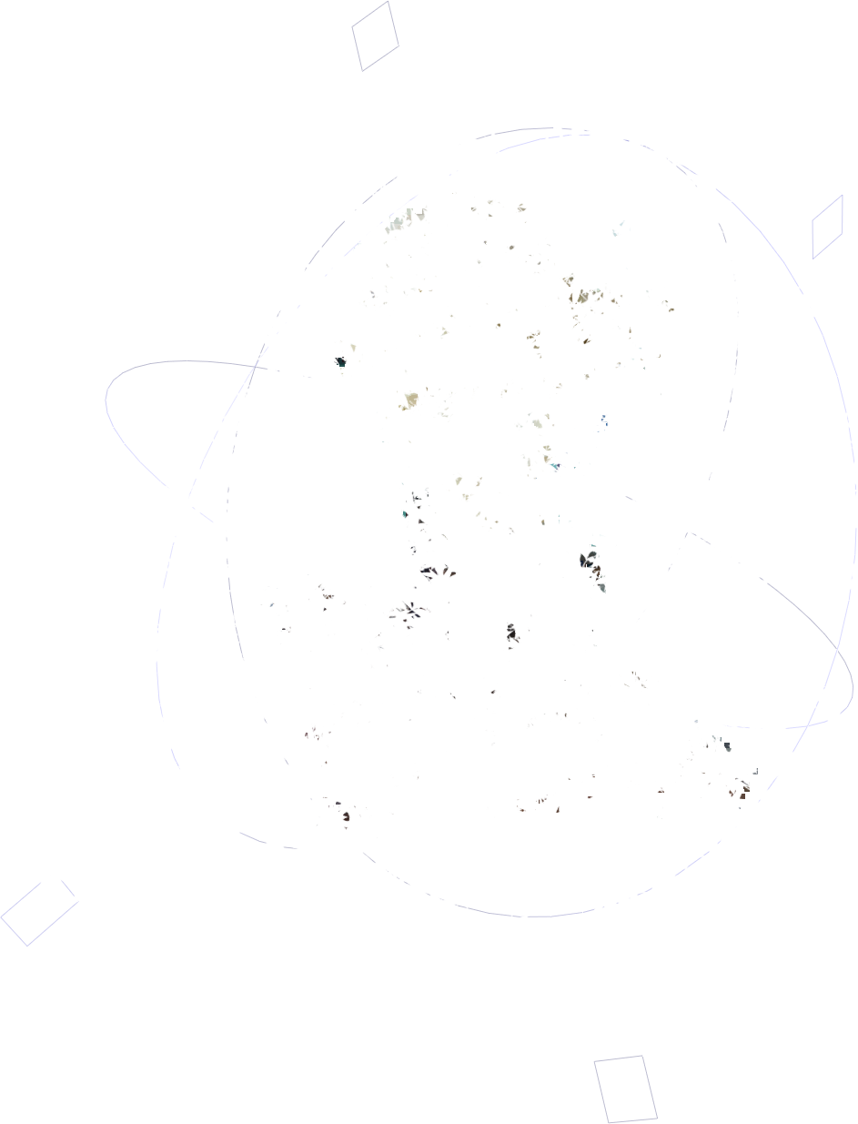

Steps
Images → Points: Structure from Motion
Points → More points: Multiple View Stereo
Points → Meshes: Model Fitting
Meshes → Models: Texture Mapping
Images → Models: Image-based Modeling
+
=
+
+
=

Slide 10
Structure From Motion
Structure = 3D Point Cloud of the Scene
Motion = Camera Location and Orientation
SFM = Get the Point Cloud from Moving Cameras
Structure and Motion: Joint Problems to Solve
+
+
=
Notes:
Degree of free :6

Slide 11
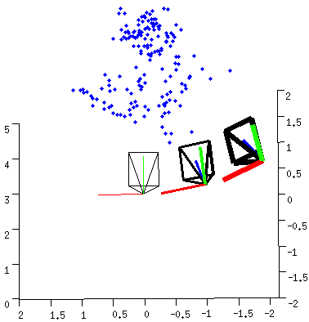
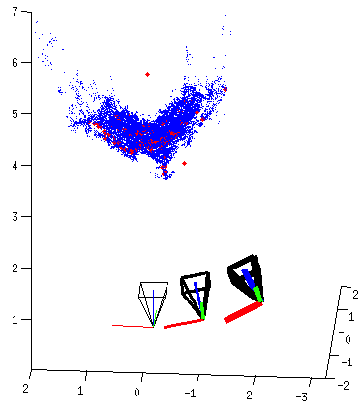
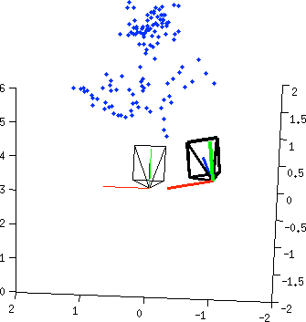
Pipeline
Structure from Motion (SFM)
Multi-view Stereo (MVS)

Slide 12
Pipeline
Structure from Motion (SFM)
Multi-view Stereo (MVS)

Slide 13
Two-view Reconstruction

Slide 14
Two-view Reconstruction

Slide 15

Keypoints Detection
keypoints
match
fundamental
matrix
essential
matrix
triangulation
[R|t]
keypoints

Slide 16
Descriptor for each point
SIFT
descriptor
SIFT
descriptor
keypoints
match
fundamental
matrix
essential
matrix
triangulation
[R|t]
keypoints

Slide 17

Same for the other images
SIFT
descriptor
SIFT
descriptor
SIFT
descriptor
SIFT
descriptor
keypoints
match
fundamental
matrix
essential
matrix
triangulation
[R|t]
keypoints

Slide 18
Point Match for correspondences
SIFT
descriptor
SIFT
descriptor
SIFT
descriptor
SIFT
descriptor
keypoints
match
fundamental
matrix
essential
matrix
triangulation
[R|t]
keypoints

Slide 19
Point Match for correspondences
SIFT
descriptor
SIFT
descriptor
SIFT
descriptor
SIFT
descriptor
keypoints
match
fundamental
matrix
essential
matrix
triangulation
[R|t]
keypoints

Slide 20
3. Fundamental Matrix
Image 1
R₁,t₁
Image 2
R₂,t₂

Slide 21
3. RANSAC to Estimate Fundamental Matrix
For many times
  Pick 8 points
  Compute a solution for using these 8 points
  Count number of inliers that with close to 0
Pick the one with the largest number of inliers

Slide 22
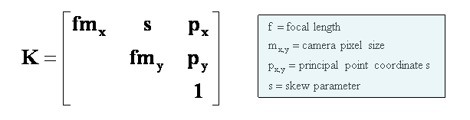
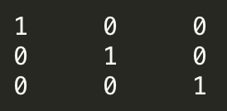
4.Fundamental Matrix → Essential Matrix
When violated?

Slide 23
5.Essential Matrix →
Image 1
R₁,t₁
Image 2
R₂,t₂

Slide 24
5. Essential Matrix →
Result 9.19. For a given essential matrix
and the first camera matrix , there are four possible choices for the second camera matrix :
Page 259 of the bible (Multiple View Geometry, 2nd Ed)

Slide 25
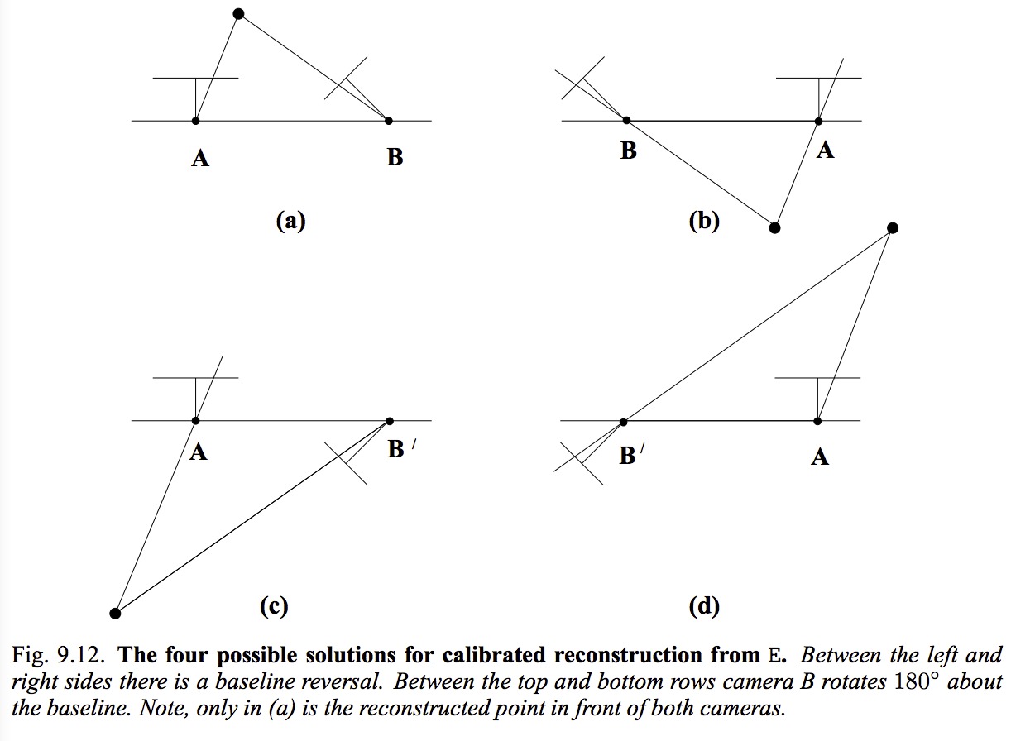
5. Four Possible Solutions
Page 260 of the bible (Multiple View Geometry, 2nd Ed)

Slide 26
Triangulation
Image 1
R₁,t₁
Image 2
R₂,t₂

Slide 27
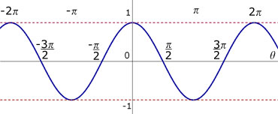
In front of the camera?
A point
Direction from camera center to point
Angle Between Two Vectors
Angle Between and View Direction
Just need to test

Slide 28
Pick the Solution
With maximal number of points in front of both cameras.
Page 260 of the bible (Multiple View Geometry, 2nd Ed)

Slide 29
Two-view Reconstruction
keypoints
match
fundamental
matrix
essential
matrix
triangulation
[R|t]
keypoints

Slide 30
Pipeline
Structure from Motion (SFM)
Multi-view Stereo (MVS)

Slide 31
Confliction
?

Slide 32
Pipeline
Taught
Next

Slide 33
Merge Two Point Cloud

Slide 34
Merge Two Point Cloud
There can be only one

Slide 35
Merge Two Point Cloud
From the 1st and 2nd images, we have
and
From the 2nd and 3rd images, we have
and
Exercise: How to transform the coordinate system of the second point cloud to align with the first point cloud so that there is only one
?

Slide 36
Merge Two Point Cloud

Slide 37
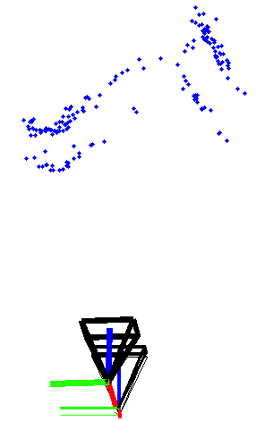
Oops
See From a Different Angle

Slide 38
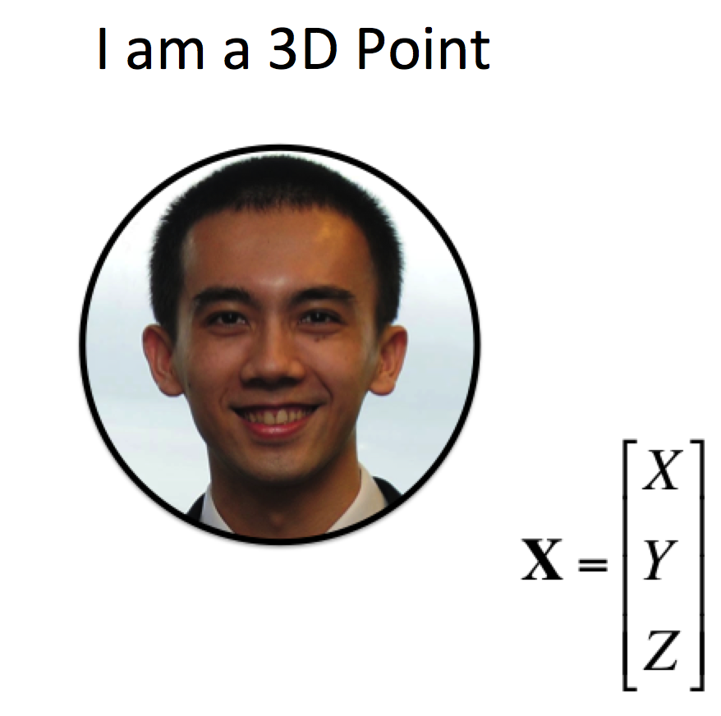
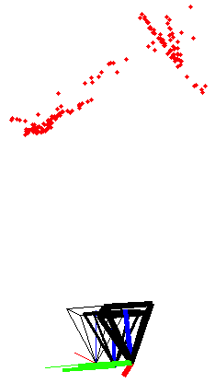
Bundle Adjustment
is not small enough to trigger quantum effect…
Assume RTs are correct, error are all shown in point cloud.
Jointly optimize RTs and points

Slide 39
“America's Next Top Model”
Image 1
Image 3
R₁,t₁
R₃,t₃
Image 2
R₂,t₂

Slide 40
“America's Next Top Model”
Point 1
Point 2
Point 3
Image 1
Image 2
Image 3

Slide 41
Rethinking the SFM problem
Input: Observed 2D image position
Output:
Unknown Camera Parameters (with some guess)
Unknown Point 3D coordinate (with some guess)

Slide 42
Bundle Adjustment
A valid solution and
must let
Re-projection
=
Observation

Slide 43
Bundle Adjustment
A valid solution and
must let the Re-projection close to the Observation, i.e. to minimize the reprojection error
x = lsqnonlin(fun(x),x0)
[vec,resnorm,residuals,exitflag] =
Lsqnonlin(@(x)reprojectionResidual(graph.ObsIdx,graph.ObsVal,px,py,f,x), [Mot(:);Str(:)],[],[],options);

Slide 44
Bundle Adjustment
Why do we need to estimate essential matrix?
  Initialization of non-linear optimization
Can we optimize only RTs or only points?
  Can, but since error exists in both side, better optimize together
Time efficiency?
  Use sparsity to speed up
[vec,resnorm,residuals,exitflag] =
Lsqnonlin(@(x)reprojectionResidual(graph.ObsIdx,graph.ObsVal,px,py,f,x), [Mot(:);Str(:)],[],[],options);
Point 1
Point 2
Point 3
Image 1
Image 2
Image 3

Slide 45
Problem Solved?
Initial guess + global optimization
What should we take care when capturing data for reconstruction?
  Texture
  good lighting
  Subject don’t move
  no motion blur
  common overlapping

Slide 46
Assignment Problems

Slide 47
Problem 1: Run the SFMedu system
Run SFMedu2.m
  May need to compile the priority_queue_1.0 package
Install MeshLab to view the point could
Take a snapshot

Slide 48
Problem 2: List the Major Steps
Read the code SFMedu2.m.
Summarize the major steps for
  SfM
  dense stereo matching
  Hint: Compare the lecture notes and code side by side. Pick the part of lecture notes that match the code.

Slide 49
Problem 3: Principal Point
Read the code carefully to see what is the assumption for the principal points in this system
When this assumption is violated ?

Slide 50
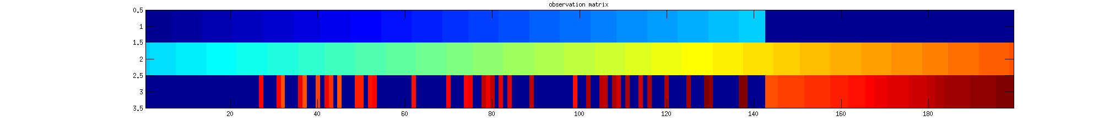
Problem 4: Data Structure
See what are the fields of Graph
  What is the data in each field?
  Why each one is necessary for SfM system
  function graph=pair2graph(pair,frames)
  graph.f …
  graph.Mot …
  graph.Str …
  graph.ObsVal …
  graph.ObsIdx …
Point 1
Point 2
Point 3
Image 1
Image 2
Image 3
Camera
Points
Notes:
Because Matlab doesn’t support sparse 3D array, we have to break it down to a 2D sparse array ObsIdx to point to ObsVal where the actual pixel location (x and y) is stored.

Slide 51
Problem 5: Reconstruct Yourself
Tips:
good lighting
Subject don’t move
Enough texture
no motion blur
common overlapping

Slide 52
Problem 6: Compute the Reprojection Error
residuals = reprojectionResidual(ObsIdx,ObsVal,px,py,f,Mot,Str)
ObsIdx: index of KxN for N points observed by K cameras, sparse matrix
ObsVal: 2xM for M observations
px,py: principle points in pixels
f: focal length in pixels
Mot: 3x2xK for K cameras
-> need to use “RotationMatrix2AngleAxis” to covert the 3x3 matrix to 3 number vector AngleAxis representation
Str: 3xN for N points

Slide 53
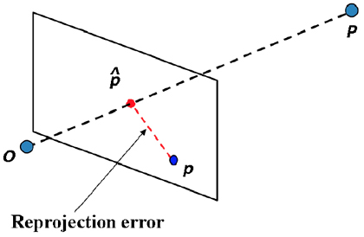
Problem 6: Compute the Reprojection Error
residuals = reprojectionResidual(ObsIdx,ObsVal,px,py,f,Mot,Str)
Average Reprojetion error = sqrt(sum(residuals.^2)/n)
n= number of points

Slide 54
Problem 7: Visualize the Reprojection Points
For each camera:
Transform points (Str) from word coordinate to camera coordinate (transformPtsByRt )
Project to 2D
Transform coordinate
  xy(1,:) = -xy(1,:) + frames.imsize(2)/2;
Plot
Notes:
xy(1,:) = -xy(1,:) + frames.imsize(2)/2; xy(2,:) = -xy(2,:) + frames.imsize(1)/2;

Slide 55
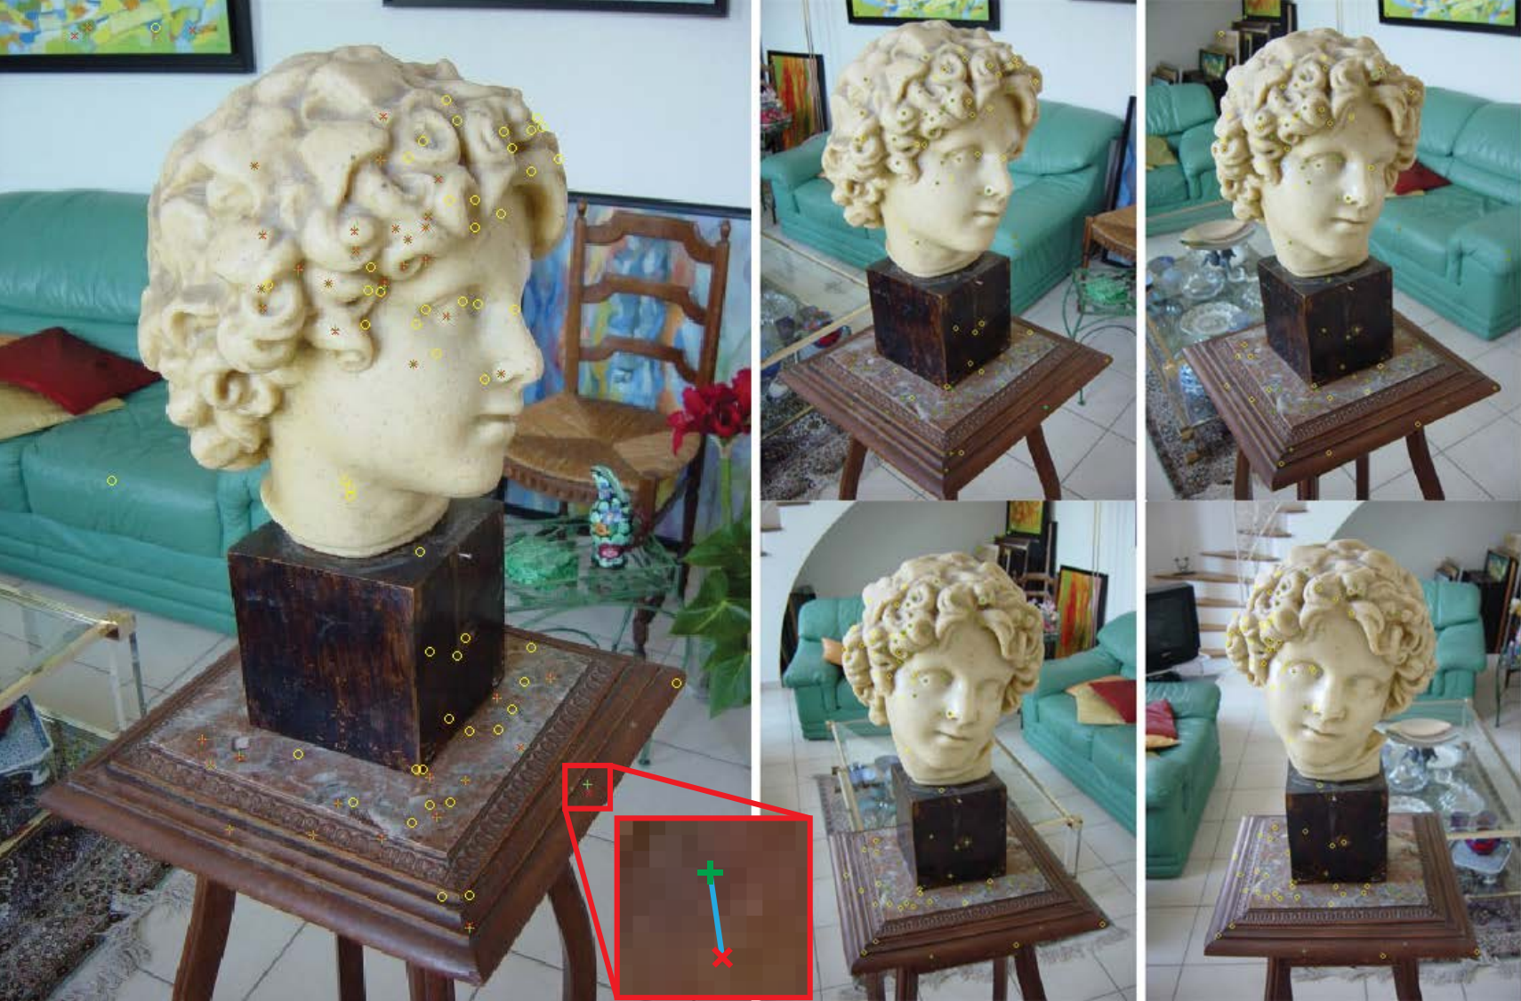
Problem 7: Visualize the Reprojection Points
red x: each observed keypoint
green +: reprojection of its 3D estimated location
blue line −: these two points are connected by a blue line
yellow o: porjection of points reconstruction from other views

Slide 56
Problem 8: Levenberg-Marquardt
[vec,resnorm,residuals,exitflag] =
^{lsqnonlin(}
@(x)reprojectionResidual(graph.ObsIdx,graph.ObsVal,px,py,f,x), [Mot(:);Str(:)]
^{,[],[],options);}
Try to minimize the sum of squares of function : reprojectionResidual
With function input : x
[Mot(:), Str(:)]: Initialization

Slide 57
Bundle Adjustment
A valid solution and
must let the Re-projection close to the Observation, i.e. to minimize the reprojection error

Slide 58
Problem 9: Motion Adjustment Only
Problem 10: Structure Adjustment Only
Hint:
reprojectionResidual can also be called by
reprojectionResidual(ObsIdx,ObsVal,px,py,f,Mot,Str)
If we want to adjust motion which variable should be input ?

Slide 59
Problem 9: Motion Adjustment Only
Problem 10: Structure Adjustment Only
x = lsqnonlin(fun,x0)
x = lsqnonlin(fun,x0) starts at the point x0 and finds a minimum of the sum of squares of the functions described in fun. fun should return a vector of values and not the sum of squares of the values. (The algorithm implicitly computes the sum of squares of the components of fun(x).)
http://www.mathworks.com/help/optim/ug/lsqnonlin.html

Slide 60
Problem 11: Why to Estimate the Essential Matrix?
Why not just do the bundle adjustment directly?
Is there other way to bypass the estimation of essential matrix?
Provide your answer in the report.

Slide 61
Q & A
+
+
=

