Slide 1
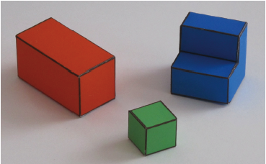
Problem Set 2 Reconstructing a Simpler World
COS429 Computer Vision
Due October (one week from today)13th
Notes:
Has more questions than ps1
Still very few lines of code to write (2, to be specific)
Takes time to understand what’s going on in the provided code
Start early to download and read the code

Slide 2
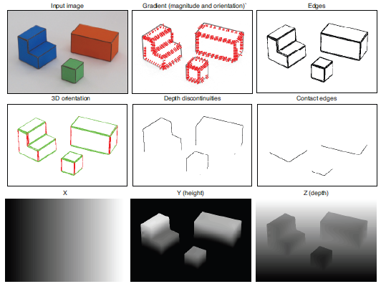
Goal: Recover the 3D structure of the world
Notes:
Computer vision is the descipline that study how to use machine captured images to understand the real world
Start to learn about key concepts in computer vision and implement key functions
HOWEVER, our world is complicated, so computer vision is hard
BUT computer vision is only as difficult as the world it operates on.
If the world is simple enough, then vision is simple

Slide 3
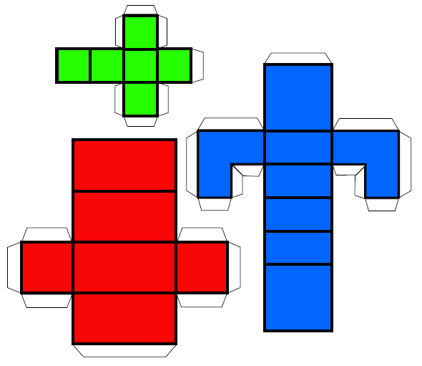
Problem 1: Making the World Simpler
Simple World Assumptions:
Flat surfaces that are either horizontal or vertical
Objects rest on a white horizontal ground plane
Task:
Print Figure 1 and create objects for the world
Take a picture of the world you created and add it to the report
Notes:
Key elements of world: Shape, color,
Red, blue, green, easy enough to tell apart using simple color threshold

Slide 4
Problem 2: Taking Orthographic Pictures
Goal:
Want pictures that preserve parallel lines from 3D to 2D
Willing to accept weak perspective effects
Notes:
Now we have our world, we want to take pictures of the world, and use them as input for our vision system
We need to be careful when taking such pictures
Because the pictures we take may distort the reality

Slide 5
Problem 2: Taking Orthographic Pictures
Close up without zoom; closer edges are larger;
Parallel lines in 3D are not parallel.
Far away with zoom; edges are approximately
equal in size and Parallel
Notes:
Projective effects

Slide 6
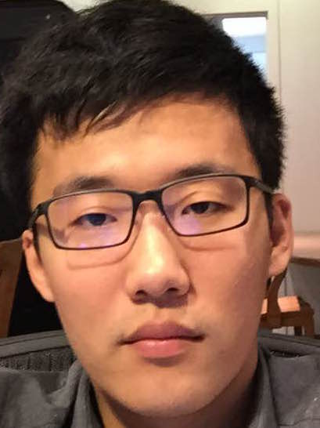
Real life: Orthographic
Selfie: Perspective
Notes:
How far TA’s in this class are willing to go to help you
There are research going on in this building to make selfies look for reallife
Although I think the easier solution is to use a selfie stick

Slide 7
f
f
Notes:
If both objects are far away, their distances from the lens are approximately the same, and their images will be approximately parallel and equal

Slide 8
Problem 2: Taking Orthographic Pictures
Perspective:
Take close-up pictures
Orthographic:
Take pictures from far away
Use the zoom of the camera
Crop the the central part of the image
Requirement:
Make the two images look as similar as possible. Submit the two pictures with the report

Slide 9
Problem 3: Orthographic Projection
Goal:
Projecting a 3D point to 2D
(X, Y, Z) (x, y)
Easy to do because we are reducing dimensions
Notes:
We want to understand where a point in the real world end up in our image
This is easy to do because we have plenty of information

Slide 10
Y
X
Z
Notes:
Coordinate system for the real world
Notice Y is the vertical axis, and Z,X are the horizontal ones
WE gonna go through all the correspondence in the instruction and make sure we understand it

Slide 11
Y
X
$$𝒫:X=0$$
Z
Notes:
The camera center is inside the plane X = 0

Slide 12
Y
X
y
x
Z
Notes:
The camera center is inside the plane X = 0

Slide 13
Y
X
$$𝒫:Y=0$$
Z
Notes:
and the horizontal axis of the camera (x) is parallel to the ground plane (Y = 0)

Slide 14
Y
X
y
x
$$𝒫:Y=0$$
Z
Notes:
and the horizontal axis of the camera (x) is parallel to the ground plane (Y = 0)

Slide 15
Y
X
y
x
o(x = 0, y = 0)
O(X = 0, Y = 0, Z = 0)
Z
Notes:
The camera is tilted so that the line connecting the origin of the world coordinates system and the image center is perpendicular to the image plane.

Slide 16
Y
X
y
x
o(x = 0, y = 0)
$$θ$$
O(X = 0, Y = 0, Z = 0)
Z
Notes:
The angle θ is the angle between this line and the Z axis.

Slide 17
y
Image Surface
x
Notes:
The resolution of the image (the number of pixels) will also affect the transformation from world coordinates to image coordinates via a constant factor α (we assume that pixels are square and α = 1).

Slide 18
y
$$α$$
$$α$$
P(x1, y1)
x
Notes:
The resolution of the image (the number of pixels) will also affect the transformation from world coordinates to image coordinates via a constant factor α (we assume that pixels are square and α = 1).

Slide 19
y
$$α$$
$$α$$
P(x1, y1)
(x1/$α$, y1/$α$)
x
Notes:
The resolution of the image (the number of pixels) will also affect the transformation from world coordinates to image coordinates via a constant factor α (we assume that pixels are square and α = 1).
Granularity
As fine as alpha

Slide 20
y
$$α$$
$$α$$
P(x1, y1)
(x1/$α$, y1/$α$)
x
Notes:
The resolution of the image (the number of pixels) will also affect the transformation from world coordinates to image coordinates via a constant factor α (we assume that pixels are square and α = 1).

Slide 21
Problem 3: Orthographic Projection
Projecting a 3D point to 2D
(X, Y, Z) (x, y)
Task:
Prove the two projection equations below that relate the 3D world position (X, Y, Z) to the 2D projected camera position (x, y)
Notes:
The image is parametrized by coordinates (x,y). The center of the image is at coordinates (x0,y0).

Slide 22
Problem 3: Orthographic Projection
Projecting a 3D point to 2D
(X, Y, Z) (x, y)
Task:
Prove the two projection equations below that relate the 3D world position (X, Y, Z) to the 2D projected camera position (x, y)
World coordinates
x =
X + x₀
y =
cos(θ) Y – sin(θ) Z + y₀
image coordinates
Notes:
The image is parametrized by coordinates (x,y). The center of the image is at coordinates (x0,y0).

Slide 23
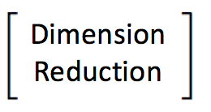
Problem 3: Orthographic Projection
Projecting a 3D point to 2D
(X, Y, Z) (x, y)
Task:
Prove the two projection equations below that relate the 3D world position (X, Y, Z) to the 2D projected camera position (x, y)
Rotation
Dimension
Reduction
2D Translation
Notes:
The image is parametrized by coordinates (x,y). The center of the image is at coordinates (x0,y0).

Slide 24
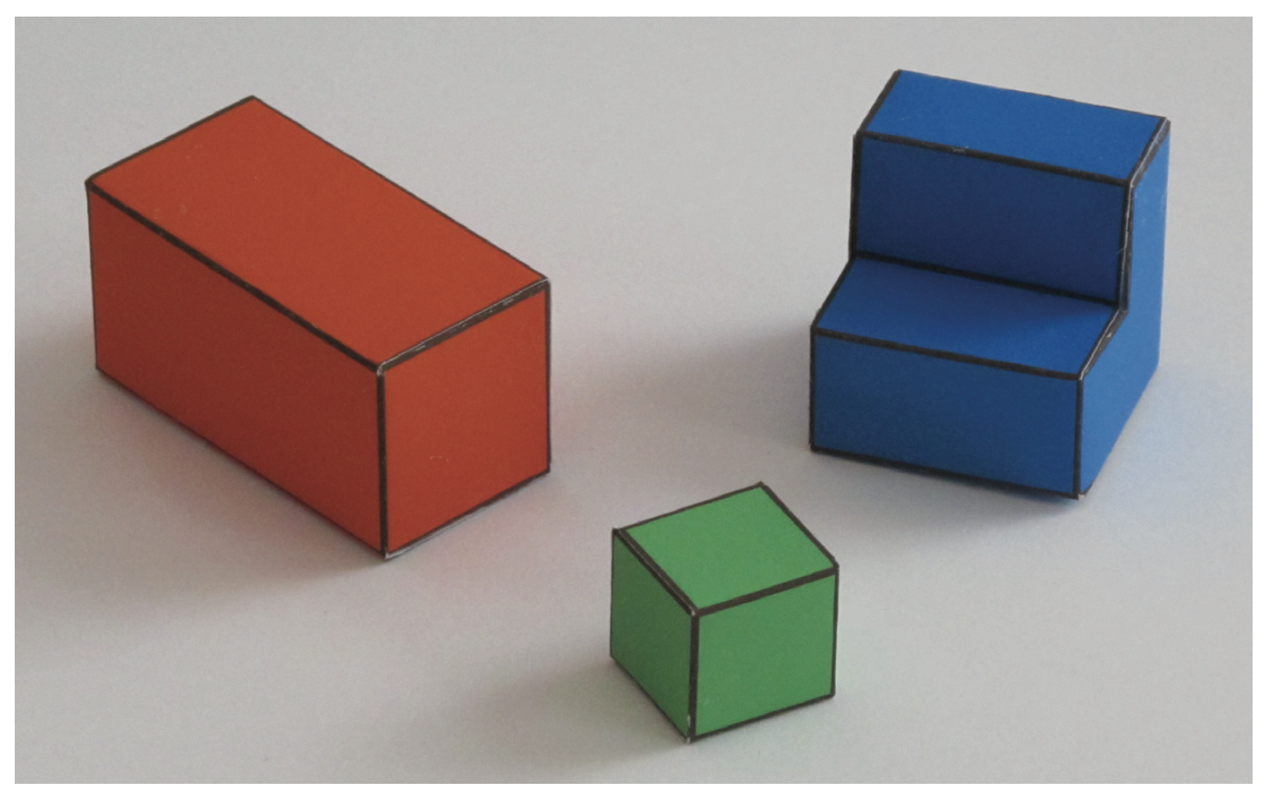
Problem 4, 5, 6: Recover 3D points from 2D
Notes:
The meat of the assignment
Given a picture in 2D, we want to understand what it implies about the real 3D world

Slide 25
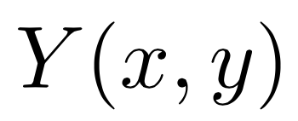
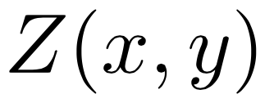
Problem 4, 5, 6: Recover 3D points from 2D
Notes:
End goal is to find X(x, y), Y(x, y), Z(x, y)
Given our coordinate system: X(x, y) = x
Harder to find Y and Z since one dimension was lost due to projection
Create linear system of equations of constraints

Slide 26
Problem 4, 5, 6: Recover 3D points from 2D
Notes:
End goal is to find X(x, y), Y(x, y), Z(x, y)
Given our coordinate system: X(x, y) = x
Harder to find Y and Z since one dimension was lost due to projection
Create linear system of equations of constraints

Slide 27
Problem 4, 5, 6: Recover 3D points from 2D
???
Notes:
End goal is to find X(x, y), Y(x, y), Z(x, y)
Given our coordinate system: X(x, y) = x
Harder to find Y and Z since one dimension was lost due to projection
Create linear system of equations of constraints

Slide 28
Problem 4: Edge Constraints
Crack the problem by first looking at special points with special features

Slide 29
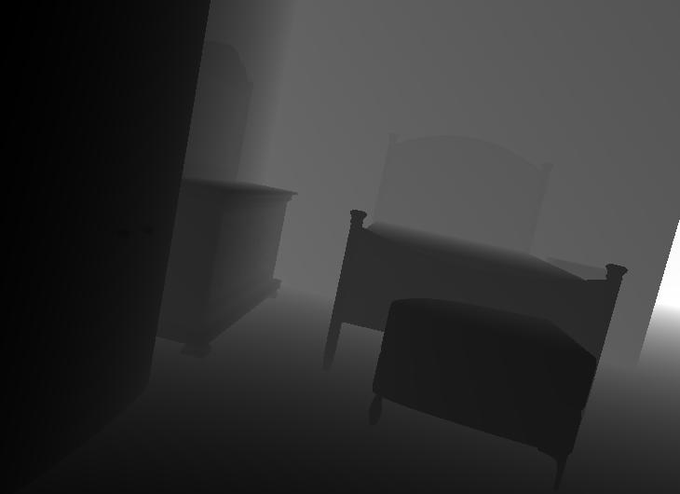
Problem 4: Edge Constraints
Extract edges from the image:
I(x, y) =
Notes:
If we are able to tell a point is on an edge, we can use special assumptions we made about edges in our world to put further constraints on the point
REMEMBER our assumptions: surfaces are either horizontal or vertical

Slide 30
Problem 4: Edge Constraints
How to identify an edge?
Edge in 2D
Notes:
If we are able to tell a point is on an edge, we can use special assumptions we made about edges in our world to put further constraints on the point
REMEMBER our assumptions: surfaces are either horizontal or vertical

Slide 31
Problem 4: Edge Constraints
How to identify an edge?
“Edge” in 1D
Notes:
How do we find such “edges in 1D”?
Derivatives!

Slide 32
The Gradient
Notes:
The gradient is a fancy word for derivative, or the rate of change of a function. It's a vector (a direction to move) that points in the direction of greatest increase of a function (intuition on why)
Encodes information of rate of change in every direction

Slide 33
The Gradient

Slide 34
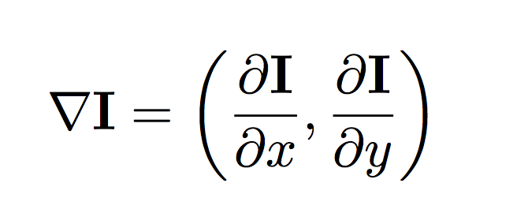
The Gradient
Notes:
In 2 dimension

Slide 35
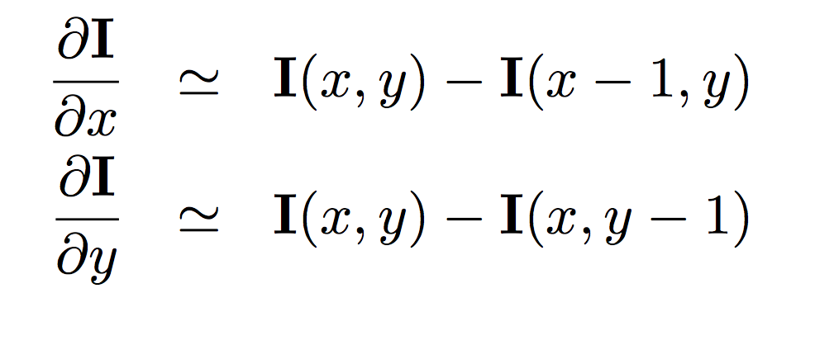
The Gradient
Notes:
Cant simply apply derivatives to non-continuous functions
Our images are discrete meshes or grids
Very naïve approximation

Slide 36
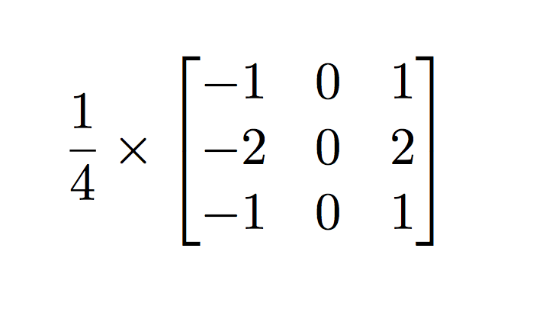
The Gradient
The Sobel operator
Notes:
The Sobel operator, sometimes called the Sobel-Feldman operator or Sobel filter, is used in image processing andcomputer vision, particularly within edge detection algorithms where it creates an image emphasising edges.

Slide 37
Using the The Sobel operator to compute derivatives (and detect edges)
Notes:
If we define Aas the source image, and G_{x} and G_{y} are two images which at each point contain the horizontal and vertical derivative approximations, the computations are as follows:^{[2]}

Slide 38
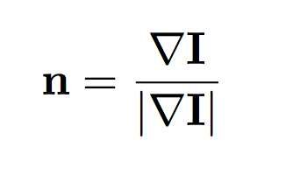
Problem 4: Edge Constraints
Edge strength:
Edge Orientation:
Notes:
Edge strength:
Edge orientation:
and the normal vector to the direction of the edge

Slide 39
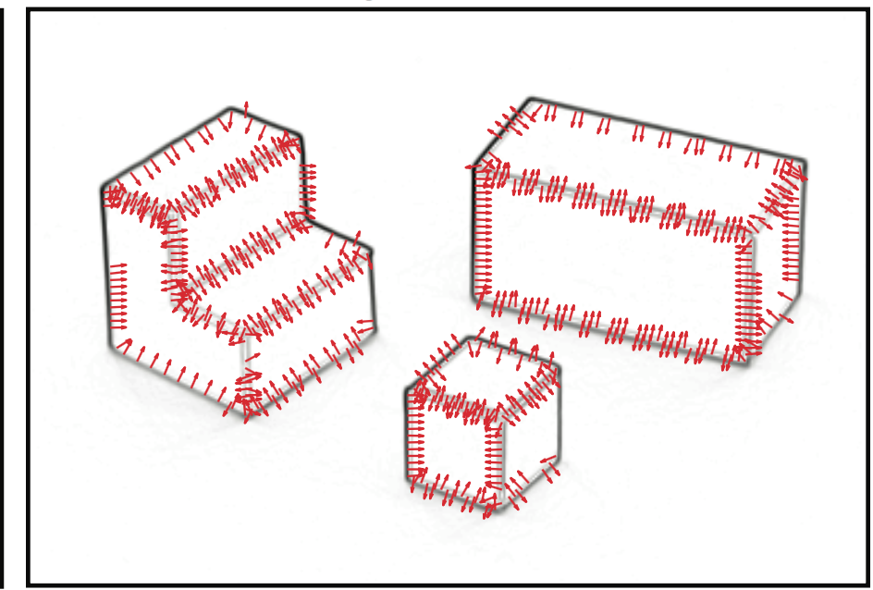
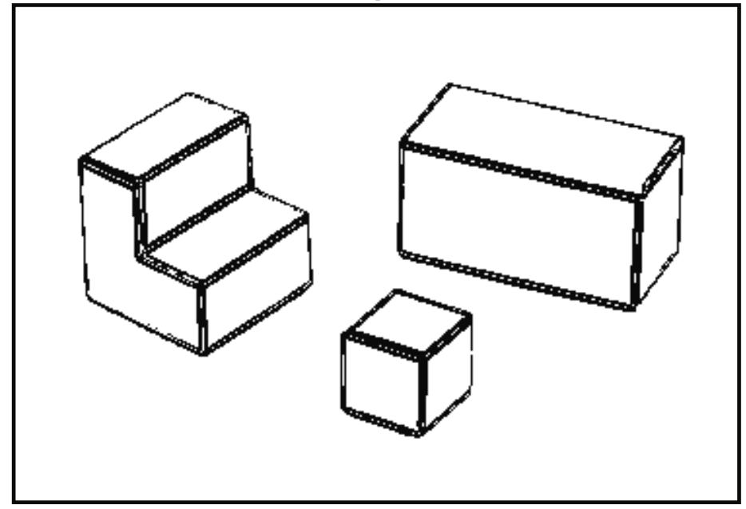
Problem 4: Edge Constraints
Notes:
NOW we have a tool to do something with the pictures we have taken
The first decision that we will perform is to decide which pixels correspond to edges (regions of the image with sharp intensity variations). We will do this by simply thresholding the edge strength E(x,y). In the pixels with edges, we can also measure the edge orientation ✓(x,y).

Slide 40
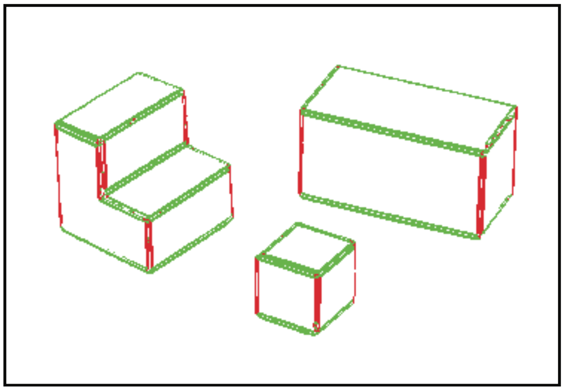
Problem 4: Edge Constraints
Vertical Edges in 3D?
Notes:
QUESTIONS: are vertical edges in 3D guaranteed to be verticle in 2D?
How about vice versa: are verticle edges in 2D guaranteed to be vertical in 3D?
the camera having its horizontal axis parallel to the ground, we know that vertical 3D lines will project into vertical 2D lines in the image.

Slide 42
Problem 4: Edge Constraints
Horizontal Edges in 3D?
Notes:
Anything that deviates from verticality in 15 degrees is labeled as horizontal.

Slide 43
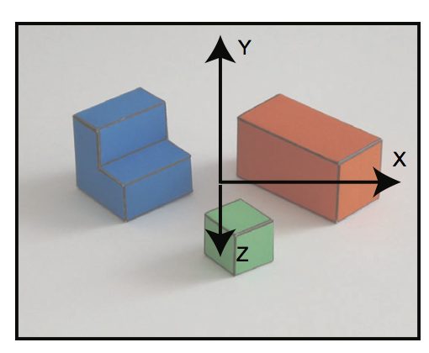
Problem 4: Edge Constraints
Notes:
If we know that a point is on an edge, we can tell something about their 3D position
Vertical: x, z stay constant
Horixontal: Y constant along edge: the derivative along the edge should be zero:

Slide 44
Problem 4: Edge Constraints
Notes:
Vertical: x, z stay constant
Horixontal: Y constant along edge: the derivative along the edge should be zero:

Slide 45
Problem 4: Edge Constraints
For 2D points on vertical edges:
Notes:
Vertical: x, z stay constant
Horixontal: Y constant along edge: the derivative along the edge should be zero:

Slide 46
Problem 4: Edge Constraints
For 2D points on vertical edges:
For 2D points on horizontal edges:
Notes:
Horixontal: Y constant along edge: the derivative along the edge should be zero:
T is the tangential vector

Slide 47
Problem 4: Edge Constraints
For 2D points on vertical edges:
For 2D points on horizontal edges:
Notes:
Hence, the directional derivative is the dot product of the gradient and the vector u.

Slide 48
Problem 4: Edge Constraints
Constraints for points on edges?
Task: Write the derivative constraints for Z(x, y) in the report
$$\frac{∂Z}{∂y}, \frac{∂Z}{∂t}, \frac{∂^{2}Z}{∂x^{2}}, \frac{∂^{2}Z}{∂y^{2}}, \frac{∂^{2}Z}{∂y∂x}$$
Notes:
Vertical: x, z stay constant
Horixontal: Y constant along edge: the derivative along the edge should be zero:

Slide 49
Problem 4: Edge Constraints
Constraints for points on edges?
Task: Write the derivative constraints for Z(x, y) in the report
$$\frac{∂Z}{∂y}, \frac{∂Z}{∂t}, \frac{∂^{2}Z}{∂x^{2}}, \frac{∂^{2}Z}{∂y^{2}}, \frac{∂^{2}Z}{∂y∂x}$$
Z(x,y) for points on the vertical edges?
Z(x,y) for points on the horizontal edges?
Notes:
Vertical: x, z stay constant
Horixontal: Y constant along edge: the derivative along the edge should be zero:

Slide 50
Problem 4: Ground Constraints
Color threshold determines ground from objects
On the ground Y(x, y) = 0
Notes:
Vertical: x, z stay constant
Horixontal: Y constant along edge: the derivative along the edge should be zero:

Slide 51
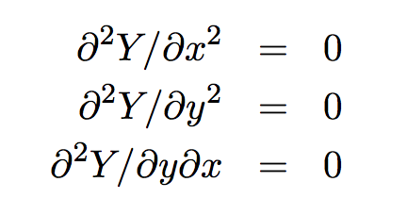
Problem 5: Surface Constraints
Constraints for points on flat surfaces:
Approximating second derivatives:

Slide 52
Problem 5: Fill Missing Code for Constraints
Want to use constraints from Problem 4 and 5 to determine Y(x, y) and Z(x, y)
Two constraints missing from existing code
Task:
Write two lines of code (lines 171 and 187)
Copy these two lines and add them to the report

Slide 53
Problem 6: A Simple Inference Scheme
Write the constraints as a system of linear equations
Task:
Run simpleworldY.m to generate images for the report
Include some screen shots of the generated figures and include in report

Slide 54
Extra Credit 1: Violating Simple World Assumptions
What if we violate our assumptions?
Show examples where the reconstruction fails
Why does it fail?

Slide 55
Notes:
What’s wrong with this image? What assumption about simple world is it violating?
Vertical edge, horizontal edges
Edge connecting them, can they be parallel to the ground?

Slide 56
Extra Credit 2: The Real World
Take pictures of the real world
How can we modify this assignment to getter better 3D reconstruction in the real world?
Try to handle a few more situations
Possible final project?
Notes:
Does mean that we want you to solve it
But make it able to handle more situations, make more or less assumptions of the world.

Slide 57
What to Submit:
One PDF file report
One ZIP file containing all the source code, and a “simpleworldY.m” file that takes no parameters as input and runs directly in Matlab to generate the results reported in your PDF file.

Slide 58
PDF Report
(1) Take a picture of the world you created
(2) Submit two pictures – one showing orthographic projection and the other perspective projection
(3) Prove the two projection equations
(4) Write the constraints for Z(x, y)
(5) Fill in missing kernels (lines 171 and 187) and copy code into report
(6) Show results and figures output by simpleworldY.m
[Optional] Extra credit

