Slide 1

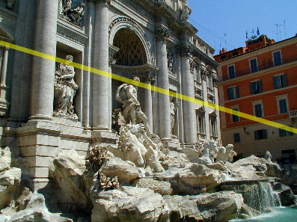
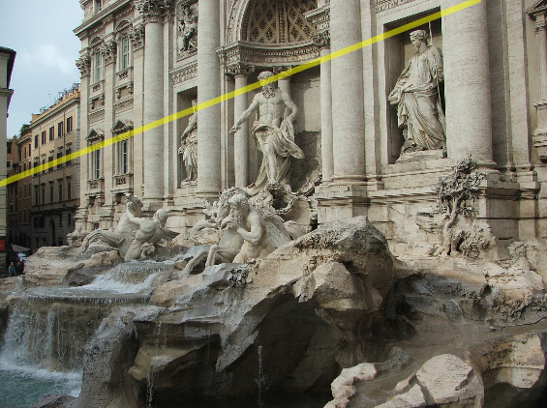
The Fundamental Matrix Song
COS429 Computer Vision

Slide 2




Two-view geometry
3d point lies somewhere along r
epipolar line
epipolar line
(projection of r)
epipolar plane
0
Image 1
Image 2

Slide 3


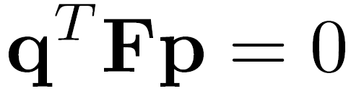
Fundamental matrix
epipolar line
epipolar line
(projection of ray)
epipolar plane
0
Image 1
Image 2
This epipolar geometry of two views is described by a Very Special 3x3 matrix , called the fundamental matrix
maps (homogeneous) points in image 1 to lines in image 2!
The epipolar line (in image 2) of point p is:
Epipolar constraint on corresponding points:

Slide 4


Fundamental matrix
epipolar line
epipolar line
(projection of ray)
epipolar plane
0
Two Special points: e₁ and e₂ (the epipoles): projection of one camera into the other

Slide 5
Fundamental matrix
0
Two special points: e₁ and e₂ (the epipoles): projection of one camera into the other
All of the epipolar lines in an image pass through the epipole

Slide 6
Rectified case
Images have the same orientation, t parallel to image planes
Where are the epipoles?

Slide 7


Epipolar geometry demo

Slide 8



Relationship with homography?
Images taken from the same center of projection? Use a homography!

Slide 9



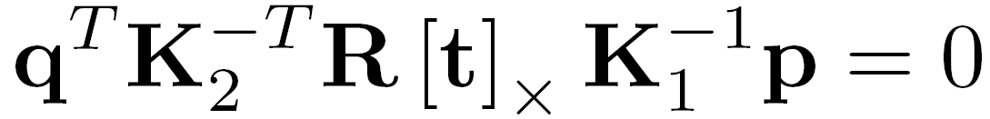

Fundamental matrix – uncalibrated case
0
: intrinsics of camera 1
: intrinsics of camera 2
: rotation of image 2 w.r.t. camera 1
the Fundamental matrix

Slide 10
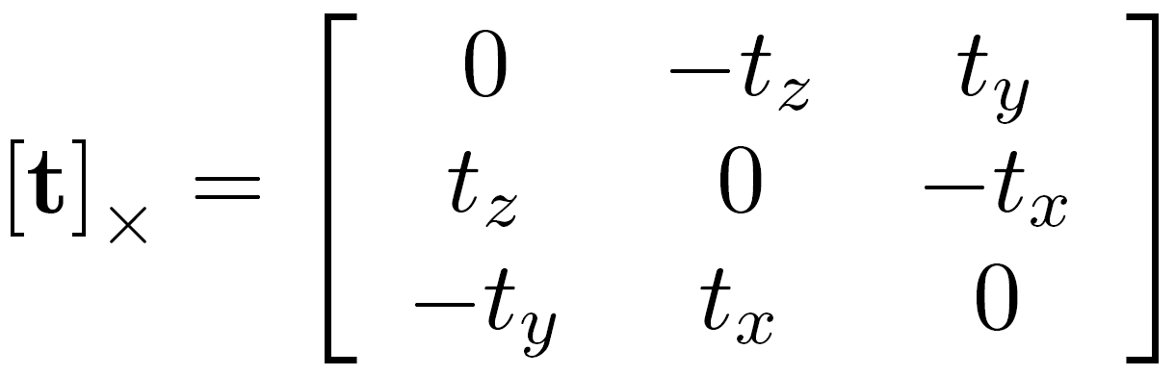
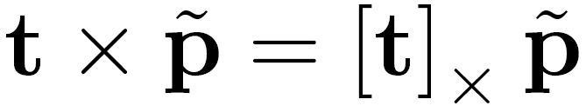
Cross-product as linear operator
  Useful fact: Cross product with a vector t can be represented as multiplication with a (skew-symmetric) 3x3 matrix

Slide 11


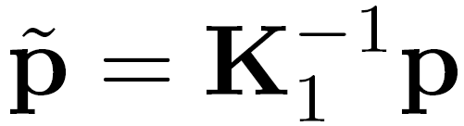
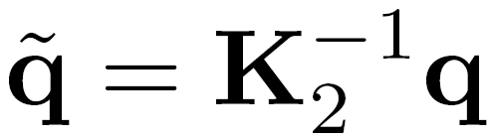
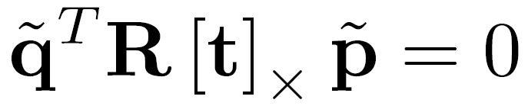
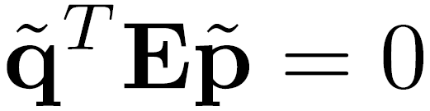

Fundamental matrix – calibrated case
0
: ray through p in camera 1’s (and world) coordinate system
: ray through q in camera 2’s coordinate system
{
the Essential matrix

Slide 12

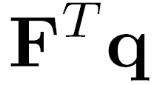

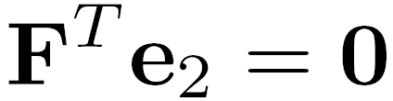
Properties of the Fundamental Matrix
is the epipolar line associated with
is the epipolar line associated with
and
is rank 2
How many parameters does F have?
T

Slide 13
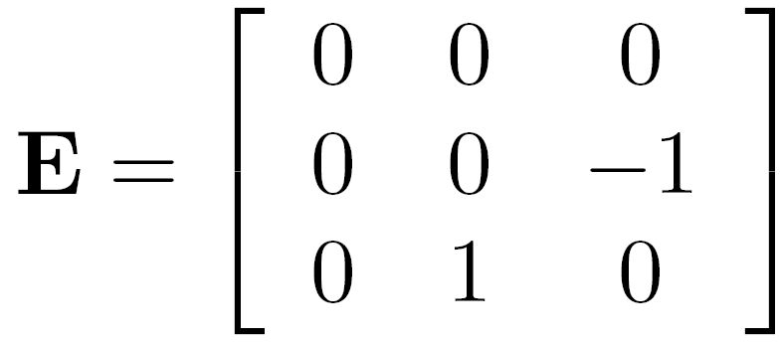

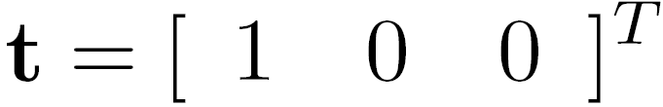
Rectified case

Slide 14
Stereo image rectification
reproject image planes onto a common
plane parallel to the line between optical centers
pixel motion is horizontal after this transformation
two homographies (3x3 transform), one for each input image reprojection
C. Loop and Z. Zhang. Computing Rectifying Homographies for Stereo Vision. IEEE Conf. Computer Vision and Pattern Recognition, 1999.

Slide 15
Questions?

Slide 16


Estimating F
If we don’t know K₁, K₂, R, or t, can we estimate F for two images?
Yes, given enough correspondences

Slide 17
Estimating F – 8-point algorithm
The fundamental matrix F is defined by
for any pair of matches x and x’ in two images.
Let x=(u,v,1)^{T} and x’=(u’,v’,1)^{T},
each match gives a linear equation

Slide 18
8-point algorithm
In reality, instead of solving , we seek f to minimize , least eigenvector of .

Slide 19
8-point algorithm – Problem?
F should have rank 2
To enforce that F is of rank 2, F is replaced by F’ that minimizes subject to the rank constraint.
This is achieved by SVD. Let , where
, let
then is the solution.

Slide 20
8-point algorithm
% Build the constraint matrix
A = [x2(1,:)‘.*x1(1,:)' x2(1,:)'.*x1(2,:)' x2(1,:)' ...
x2(2,:)'.*x1(1,:)' x2(2,:)'.*x1(2,:)' x2(2,:)' ...
x1(1,:)' x1(2,:)' ones(npts,1) ];
[U,D,V] = svd(A);
% Extract fundamental matrix from the column of V
% corresponding to the smallest singular value.
F = reshape(V(:,9),3,3)';
% Enforce rank2 constraint
[U,D,V] = svd(F);
F = U*diag([D(1,1) D(2,2) 0])*V';

Slide 21
8-point algorithm
Pros: it is linear, easy to implement and fast
Cons: susceptible to noise

Slide 22
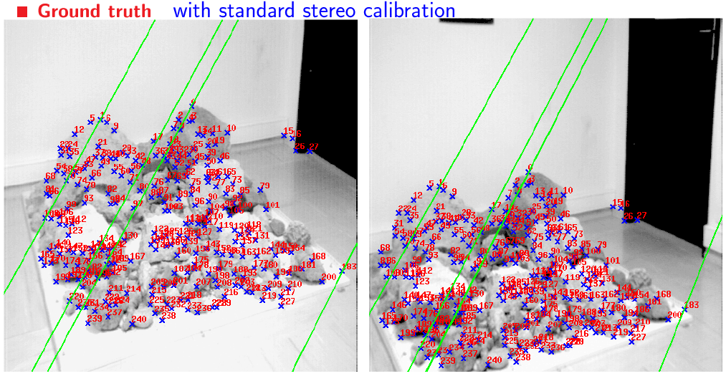
Results (ground truth)

Slide 23
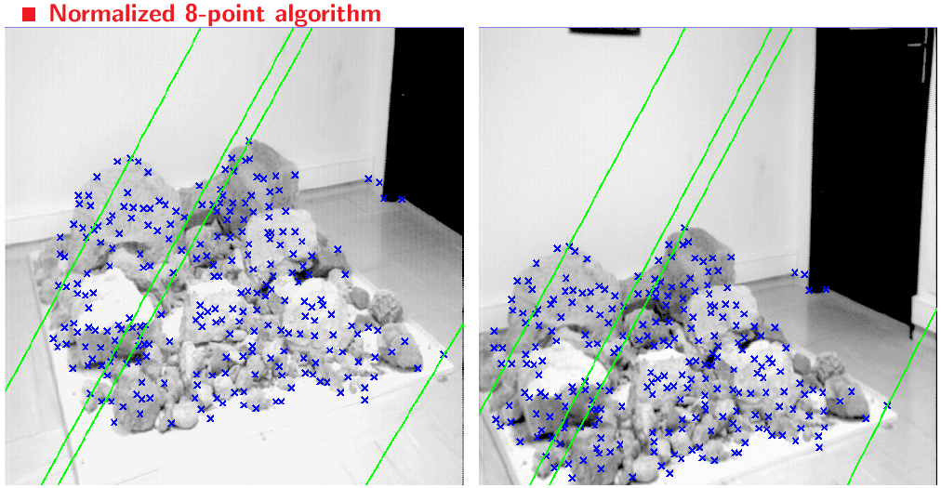
Results (normalized 8-point algorithm)

Slide 24
So Far

Slide 25

I am a 3D Point

Slide 26
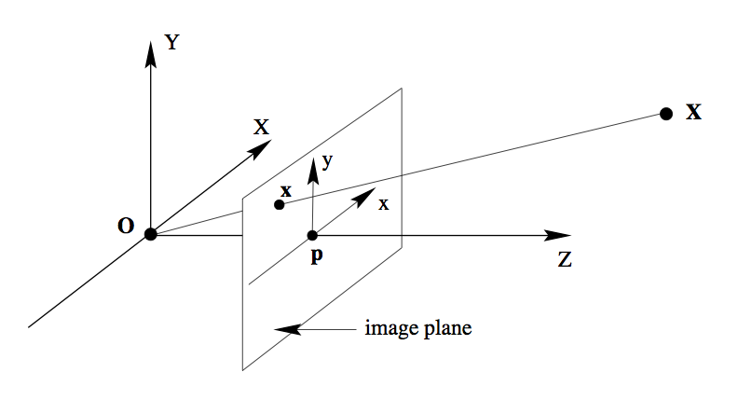
Similar Triangle

Slide 27
Similar Triangle

Slide 28
When they take a picture:
Up to a scale

Slide 29
World Coor. → Camera Coor.
Camera Parameter
Camera Projection Matrix
Intrinsic
Extrinsic

Slide 30
Computing vanishing points
V
P₀
D
Properties
  P∞ is a point at infinity, v is its projection
  Depends only on line direction
  Parallel lines P₀ + tD, P₁ + tD intersect at P∞

Slide 31
Computing vanishing lines
v₁
l
v₂
C
l
ground plane
Properties
  l is intersection of horizontal plane through C with image plane
  Compute l from two sets of parallel lines on ground plane
  All points at same height as C project to l
    points higher than C project above l
  Provides way of comparing height of objects in the scene

Slide 32
Measuring height
5.4
5
How high is the camera?
Camera height
4
3.3
3
2.8
2
1

Slide 33
The cross ratio
A Projective Invariant
  Something that does not change under projective transformations (including perspective projection)
The cross-ratio of 4 collinear points
P₄
P₃
P₂
P₁
Can permute the point ordering
  4! = 24 different orders (but only 6 distinct values)
This is the fundamental invariant of projective geometry

Slide 34


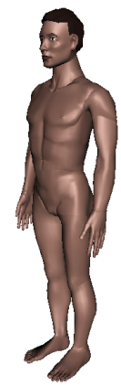
Measuring height
v_{z}
r
vanishing line (horizon)
t₀
t
v_{x}
v
v_{y}
H
R
H
b₀
b
image cross ratio

Slide 35
Two-view geometry
3d point lies somewhere along r
epipolar line
epipolar line
(projection of r)
epipolar plane
0
Image 1
Image 2

Slide 36
Fundamental matrix – uncalibrated case
0
: intrinsics of camera 1
: intrinsics of camera 2
: rotation of image 2 w.r.t. camera 1
the Fundamental matrix

Slide 37
Fundamental matrix – calibrated case
0
: ray through p in camera 1’s (and world) coordinate system
: ray through q in camera 2’s coordinate system
{
the Essential matrix

Slide 38
Stereo image rectification
reproject image planes onto a common
plane parallel to the line between optical centers
pixel motion is horizontal after this transformation
two homographies (3x3 transform), one for each input image reprojection
C. Loop and Z. Zhang. Computing Rectifying Homographies for Stereo Vision. IEEE Conf. Computer Vision and Pattern Recognition, 1999.

Slide 39
Estimating F – 8-point algorithm
The fundamental matrix F is defined by
for any pair of matches x and x’ in two images.
Let x=(u,v,1)^{T} and x’=(u’,v’,1)^{T},
each match gives a linear equation

Slide 40
8-point algorithm
In reality, instead of solving , we seek f to minimize , least eigenvector of .

Slide 41


Slide 42
What about more than two views?
The geometry of three views is described by a 3 x 3 x 3 tensor called the trifocal tensor
The geometry of four views is described by a 3 x 3 x 3 x 3 tensor called the quadrifocal tensor
After this it starts to get complicated…

Slide 43
Point-to-point
Correspondences

Slide 44
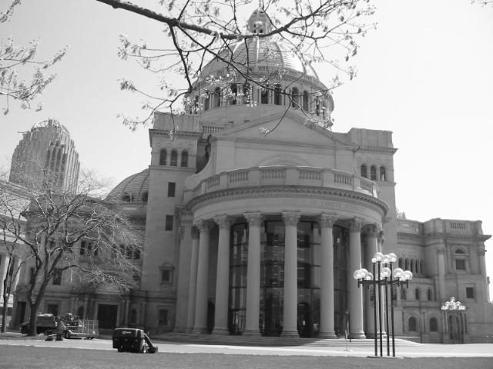
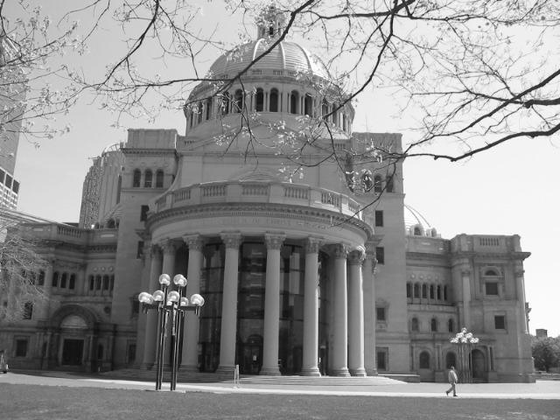
Image Correspondence
Goal: Find map between two images

Slide 45
Image Correspondence
Goal: Find map between two images
  Sparse correspondences: map a small number of points
  Dense correspondences: map all points

Slide 46
This class: interest points
Note: “interest points” = “keypoints”, also sometimes called “features”
Many applications
  tracking: which points are good to track?
  recognition: find patches likely to tell us something about object category
  3D reconstruction: find correspondences across different views

Slide 47

This class: interest points
original
Suppose you have to click on some point, go away and come back after I deform the image, and click on the same points again.
  Which points would you choose?
deformed

Slide 48




Overview of Keypoint Matching
1. Find a set of
distinctive key-
points
A₁
B₃
2. Define a region
around each
keypoint
A₂
A₃
B₁
B₂
3. Extract and
normalize the
region content
4. Compute a local
descriptor from the
normalized region
5. Match local
descriptors

Slide 49
Goals for Keypoints
Detect points that are repeatable and distinctive

Slide 50
Key trade-offs
A₁
B₃
A₂
A₃
B₂
B₁
Detection of interest points
More Repeatable
More Points
Robust detection
Precise localization
Robust to occlusion
Works with less texture
Description of patches
More Distinctive
More Flexible
Minimize wrong matches
Robust to expected variations
Maximize correct matches

Slide 51

Invariant Local Features
Image content is transformed into local feature coordinates that are invariant to translation, rotation, scale, and other imaging parameters
Features Descriptors

Slide 52
Choosing distinctive interest points
If you wanted to meet a friend would you say
  “Let’s meet on campus.”
  “Let’s meet on Green street.”
  “Let’s meet at Green and Wright.”
  Corner detection
Or if you were in a secluded area:
  “Let’s meet in the Plains of Akbar.”
  “Let’s meet on the side of Mt. Doom.”
  “Let’s meet on top of Mt. Doom.”
  Blob (valley/peak) detection

Slide 53

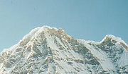

Matching Image Features
Feature Detection:
Identify image features
Feature Description:
Extract feature descriptor
for each feature
Feature Matching:
Find candidate matches
between features
Feature Correspondence:
Find consistent set of
(inlier) correspondences
between features
Kristen Grauman

Slide 54
Matching Image Features
Feature Detection:
Identify image features
Feature Description:
Extract feature descriptor
for each feature
Feature Matching:
Find candidate matches
between features
Feature Correspondence:
Find consistent set of
(inlier) correspondences
between features
Kristen Grauman

Slide 55
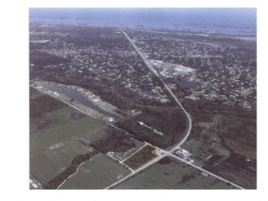
Choosing interest points
Where would you tell your friend to meet you?
Notes:
Corners!

Slide 56
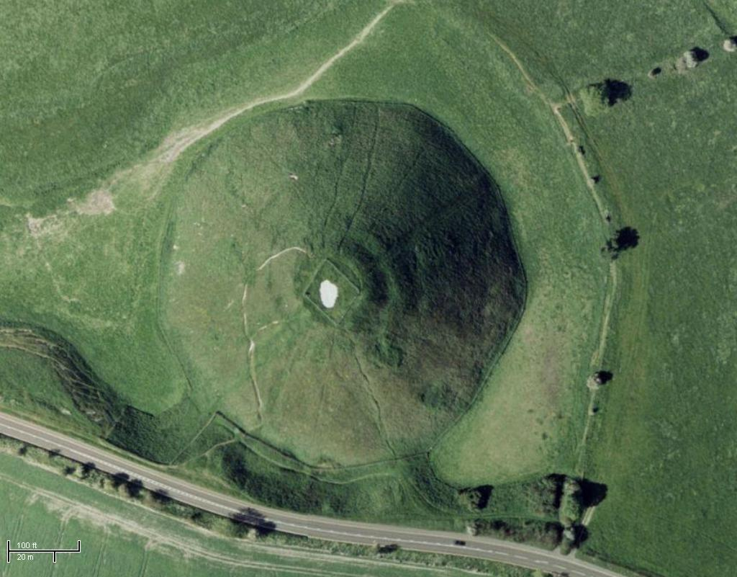
Choosing interest points
Where would you tell your friend to meet you?
Notes:
Blobs!

Slide 57
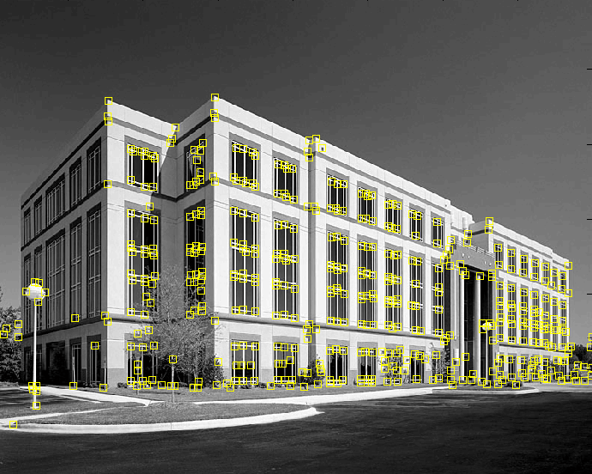
Feature extraction: Corners
9300 Harris Corners Pkwy, Charlotte, NC
Slides from Rick Szeliski, Svetlana Lazebnik, and Kristin Grauman
Notes:
http://g.co/maps/qcrr3 google street view

Slide 58


Why extract features?
Motivation: panorama stitching
  We have two images – how do we combine them?

Slide 59
Local features: main components
Detection: Identify the interest points
Description: Extract vector feature descriptor surrounding each interest point.
Matching: Determine correspondence between descriptors in two views
Kristen Grauman

Slide 60

Characteristics of good features
Repeatability
  The same feature can be found in several images despite geometric and photometric transformations
Saliency
  Each feature is distinctive
Compactness and efficiency
  Many fewer features than image pixels
Locality
  A feature occupies a relatively small area of the image; robust to clutter and occlusion

Slide 61
Goal: interest operator repeatability
We want to detect (at least some of) the same points in both images.
Yet we have to be able to run the detection procedure independently per image.
No chance to find true matches!
Kristen Grauman
Notes:
61

Slide 62
Goal: descriptor distinctiveness
We want to be able to reliably determine which point goes with which.
Must provide some invariance to geometric and photometric differences between the two views.
?
Kristen Grauman

Slide 63
Local features: main components
Detection: Identify the interest points
Description:Extract vector feature descriptor surrounding each interest point.
Matching: Determine correspondence between descriptors in two views

Slide 64
Many Existing Detectors Available
Hessian & Harris [Beaudet ‘78], [Harris ‘88]
Laplacian, DoG [Lindeberg ‘98], [Lowe 1999]
Harris-/Hessian-Laplace [Mikolajczyk & Schmid ‘01]
Harris-/Hessian-Affine [Mikolajczyk & Schmid ‘04]
EBR and IBR [Tuytelaars & Van Gool ‘04]
MSER [Matas ‘02]
Salient Regions [Kadir & Brady ‘01]
Others…

Slide 65
Feature Detection
Goals:
Repeatability
  The same feature can be found in several images despite geometric and photometric transformations
Distinctiveness
  Each feature has a distinguishing description
Compactness and efficiency
  Many fewer features than image pixels
Locality
  A feature occupies a relatively small area of the image; robust to clutter and occlusion

Slide 66
Feature Detection: Repeatability
We want to detect (at least some of) the same features in both images.
Yet we have to be able to run the detection procedure independently per image.
Notes:
66

Slide 67
Feature Detection: Repeatability
We want to detect (at least some of)
the same features in both images.
Features should appear at “stable” locations
that are invariant to typical image variations
No chance to find true matches!
Notes:
67

Slide 68
Feature Detection: Distinctiveness
We want to be able to reliably determine which feature goes with which
Features should appear at locations
with distinctive appearances
Notes:
68

Slide 69
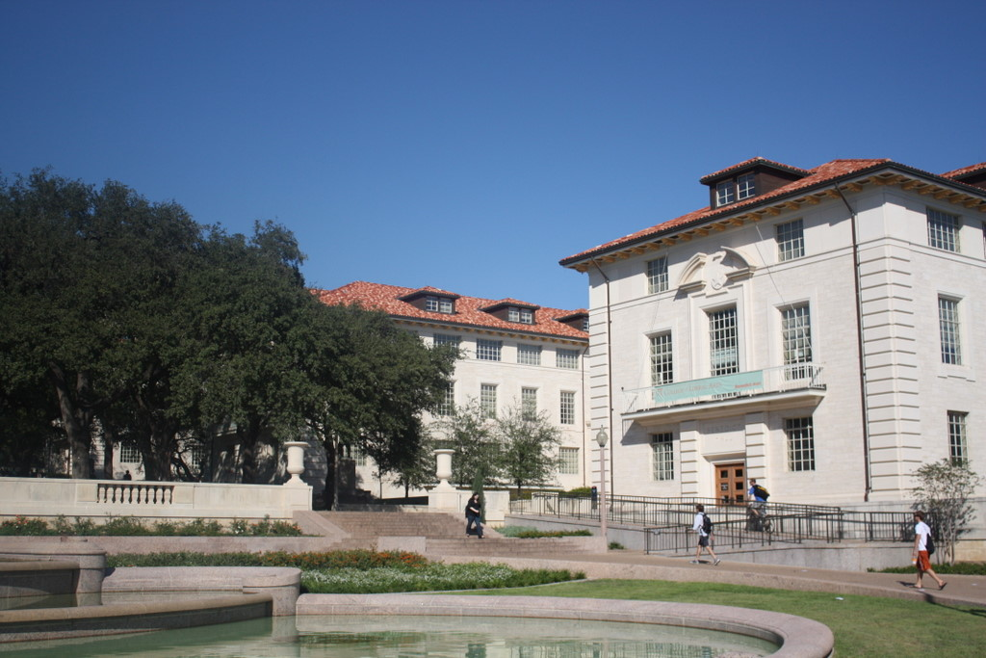
What points would you choose?
Kristen Grauman

Slide 70
Feature Detection
Some feature point detection methods:
Corners
  Harris
Scale-space blobs
  SIFT

Slide 71
Feature Detection
Some feature point detection methods:
Corners
  Harris
Scale-space blobs
  SIFT

Slide 72

Corner Detection: Basic Idea
We should easily recognize the point by looking through a small window
Shifting a window in any direction should give a large change in intensity
“flat” region:
no change in all directions
“edge”:
no change along the edge direction
“corner”:
significant change in all directions
Source: A. Efros

Slide 73
Finding Corners
Key property: in the region around a corner, image gradient has two or more dominant directions
Corners are repeatable and distinctive
C.Harris and M.Stephens. "A Combined Corner and Edge Detector.“ Proceedings of the 4th Alvey Vision Conference: pages 147--151.

Slide 74
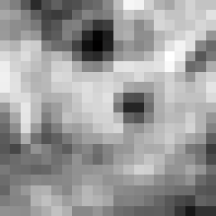

Corner Detection: Mathematics
Change in appearance of window w(x,y)
for the shift [u,v]:
I(x, y)
E(u, v)
E(3,2)
w(x, y)

Slide 75
Corner Detection: Mathematics
Change in appearance of window w(x,y)
for the shift [u,v]:
I(x, y)
E(u, v)
E(0,0)
w(x, y)

Slide 76
Corner Detection: Mathematics
Change in appearance of window w(x,y)
for the shift [u,v]:
Window function
Shifted intensity
Intensity
Window function w(x,y) =
or
1 in window, 0 outside
Gaussian
Source: R. Szeliski

Slide 77
Corner Detection: Mathematics
Change in appearance of window w(x,y)
for the shift [u,v]:
We want to find out how this function behaves for small shifts
E(u, v)

Slide 78
Corner Detection: Mathematics
Change in appearance of window w(x,y)
for the shift [u,v]:
We want to find out how this function behaves for small shifts
Local quadratic approximation of E(u,v) in the neighborhood of (0,0) is given by the second-order Taylor expansion:

Slide 79
Corner Detection: Mathematics
Second-order Taylor expansion of E(u,v) about (0,0):

Slide 80
Corner Detection: Mathematics
Second-order Taylor expansion of E(u,v) about (0,0):

Slide 81
Corner Detection: Mathematics
Second-order Taylor expansion of E(u,v) about (0,0):

Slide 82
Corner Detection: Mathematics
The quadratic approximation simplifies to
where M is a second moment matrix computed from image derivatives:
M

Slide 83


Corners as distinctive interest points
2 x 2 matrix of image derivatives (averaged in neighborhood of a point).
Notation:

Slide 84
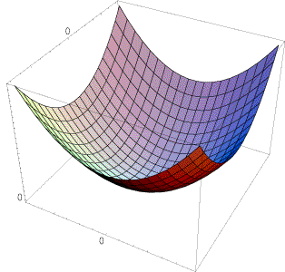
Interpreting the second moment matrix
The surface E(u,v) is locally approximated by a quadratic form. Let’s try to understand its shape.

Slide 85
Interpreting the second moment matrix
First, consider the axis-aligned case (gradients are either horizontal or vertical)
If either λ is close to 0, then this is not a corner, so look for locations where both are large.

Slide 86
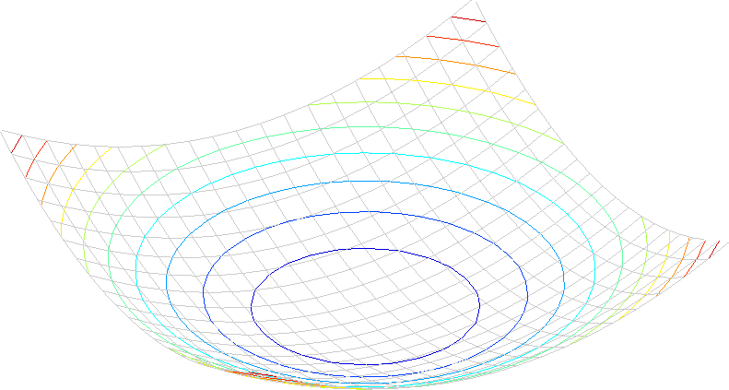
Interpreting the second moment matrix
Consider a horizontal “slice” of E(u, v):
This is the equation of an ellipse.

Slide 87
Interpreting the second moment matrix
Consider a horizontal “slice” of E(u, v):
This is the equation of an ellipse.
Diagonalization of M:
The axis lengths of the ellipse are determined by the eigenvalues and the orientation is determined by R
direction of the fastest change
direction of the slowest change
(λ_{max})^{-1/2}
(λ_{min})^{-1/2}

Slide 88
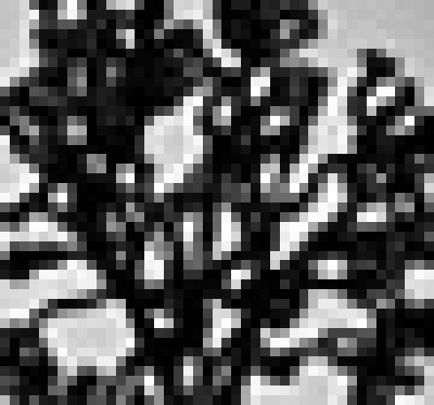
Visualization of second moment matrices

Slide 89
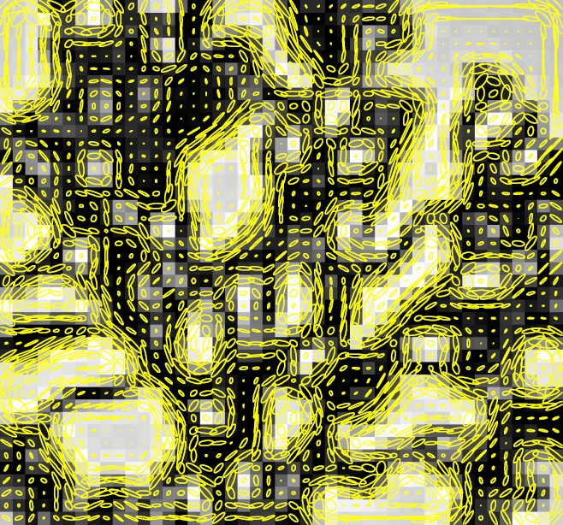
Visualization of second moment matrices

Slide 90
Interpreting the eigenvalues
Classification of image points using eigenvalues of M:
λ₂
“Edge”
λ₂ >> λ₁
“Corner”
λ₁ and λ₂ are large,
λ₁ ~ λ₂;
E increases in all directions
λ₁ and λ₂ are small;
E is almost constant in all directions
“Flat” region
“Edge”
λ₁ >> λ₂
λ₁

Slide 91
Corner response function
α: constant (0.04 to 0.06)
“Edge”
R < 0
“Corner”
R > 0
|R| small
“Flat” region
“Edge”
R < 0

Slide 92
Harris corner detector
Compute M matrix for each image window to get their cornerness scores.
Find points whose surrounding window gave large corner response (f> threshold)
Take the points of local maxima, i.e., perform non-maximum suppression
C.Harris and M.Stephens. “A Combined Corner and Edge Detector.” Proceedings of the 4th Alvey Vision Conference: pages 147—151, 1988.
Notes:
92

Slide 93

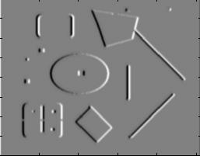
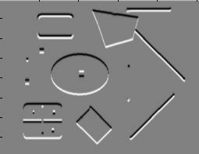
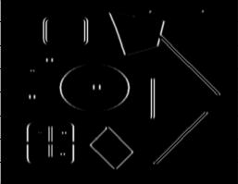
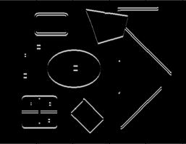
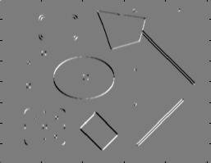
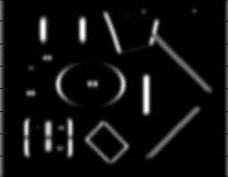
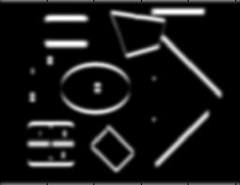
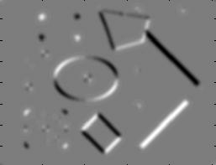
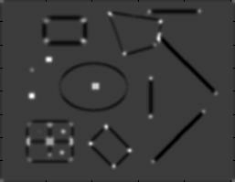
Harris Detector [Harris88]
Second moment matrix
1. Image derivatives
I_{x}
I_{y}
(optionally, blur first)
I_{x}²
I_{y}²
I_{x}I_{y}
2. Square of derivatives
3. Gaussian
filter g(σ_{I})
g(I_{x}²)
g(I_{y}²)
g(I_{x}I_{y})
4. Cornerness function – both eigenvalues are strong
5. Non-maxima suppression
har

Slide 94

Harris Detector: Steps

Slide 95

Harris Detector: Steps
Compute corner response R

Slide 96

Harris Detector: Steps
Find points with large corner response: R>threshold

Slide 97
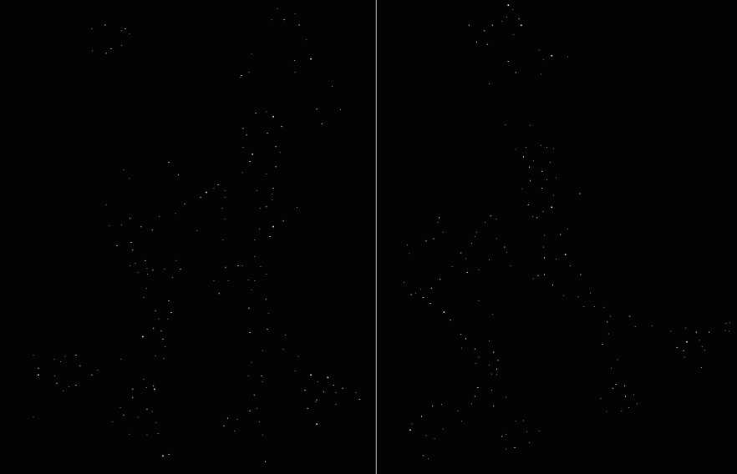
Harris Detector: Steps
Take only the points of local maxima of R

Slide 98

Harris Detector: Steps

Slide 99
Invariance and covariance
We want corner locations to be invariant to photometric transformations and covariant to geometric transformations
  Invariance: image is transformed and corner locations do not change
  Covariance: if we have two transformed versions of the same image, features should be detected in corresponding locations

Slide 100
Affine intensity change
I → a I + b
Only derivatives are used => invariance to intensity shift I → I + b
Intensity scaling: I → a I
R
R
threshold
x (image coordinate)
x (image coordinate)
Partially invariant to affine intensity change

Slide 101
Image translation
Derivatives and window function are shift-invariant
Corner location is invariant w.r.t. translation

Slide 102
Image rotation
Second moment ellipse rotates but its shape (i.e. eigenvalues) remains the same
Corner location is invariant w.r.t. rotation

Slide 103
Scaling
Corner
All points will be classified as edges
Corner location is not invariant to scaling!

Slide 104
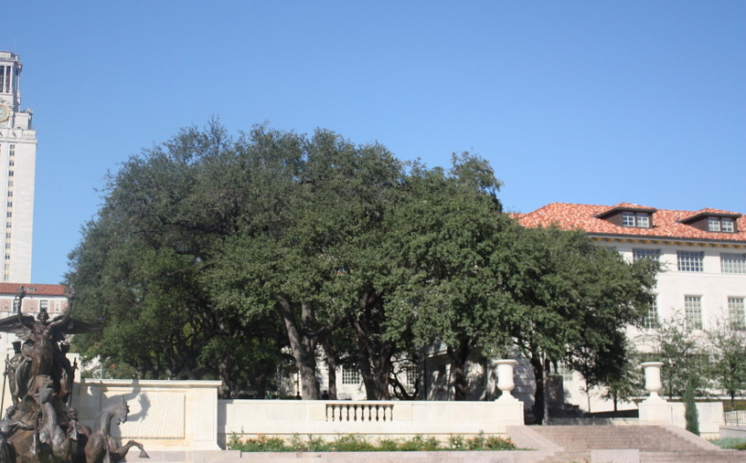
Scale invariant interest points
How can we independently select interest points in each image, such that the detections are repeatable across different scales?

Slide 105
Feature Detection
Some feature point detection methods:
Corners
  Harris corner detector
Scale-space blobs
  SIFT

Slide 106
Blob detection
Intuition: centers of “blobs” provide stable feature points

Slide 107
Scale invariant interest points
Intuition: size of blobs provide feature scale
f
f
Image 1
Image 2
s₁
region size
s₂
region size

Slide 108


Blob detection
Laplacian of Gaussian: good operator for blob detection

Slide 109


Blob detection: scale selection
Laplacian-of-Gaussian = “blob” detector
filter scales
img2
Bastian Leibe
img1
img3

Slide 110
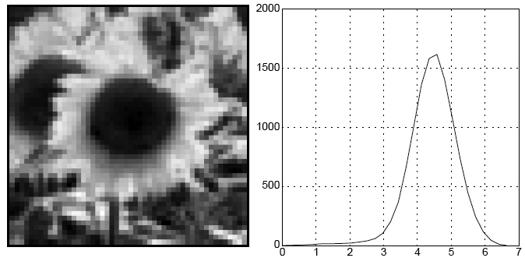
Blob detection
We define the characteristic scale as the scale that produces peak of Laplacian response
characteristic scale
Slide credit: Lana Lazebnik

Slide 111

Example
Original image at ¾ the size
Kristen Grauman

Slide 112
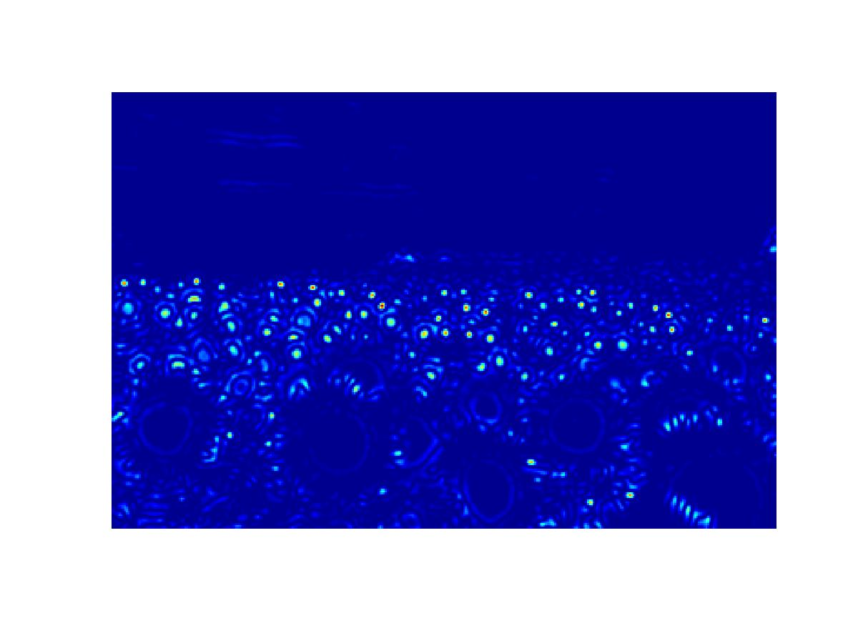
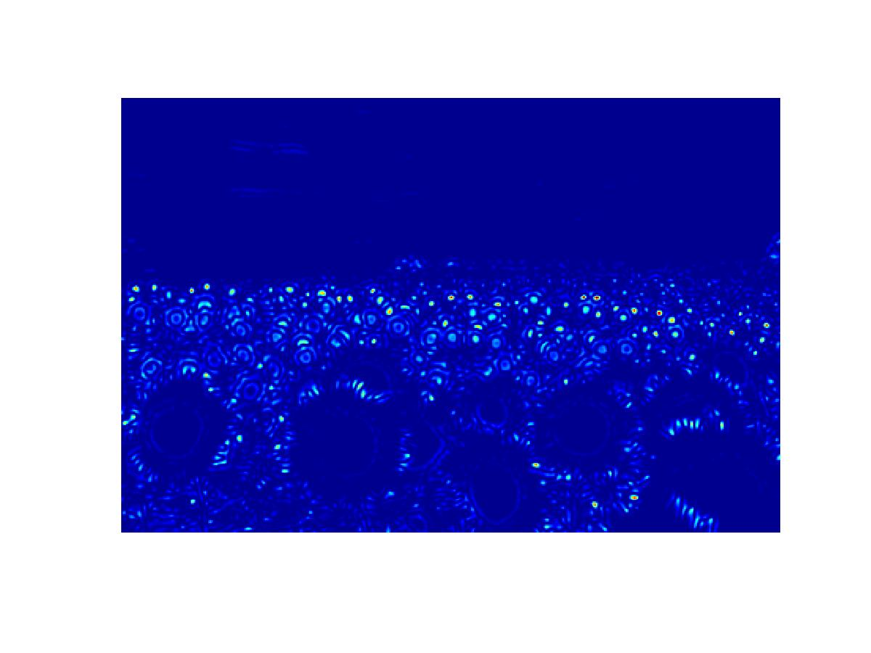
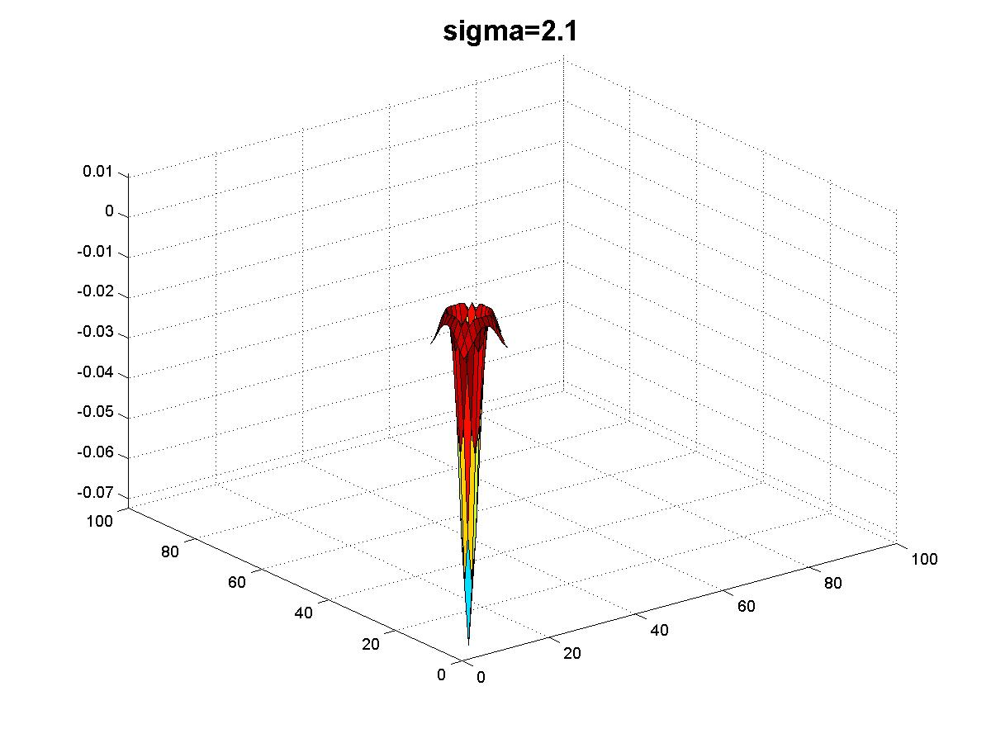
Original image at ¾ the size
Kristen Grauman

Slide 113
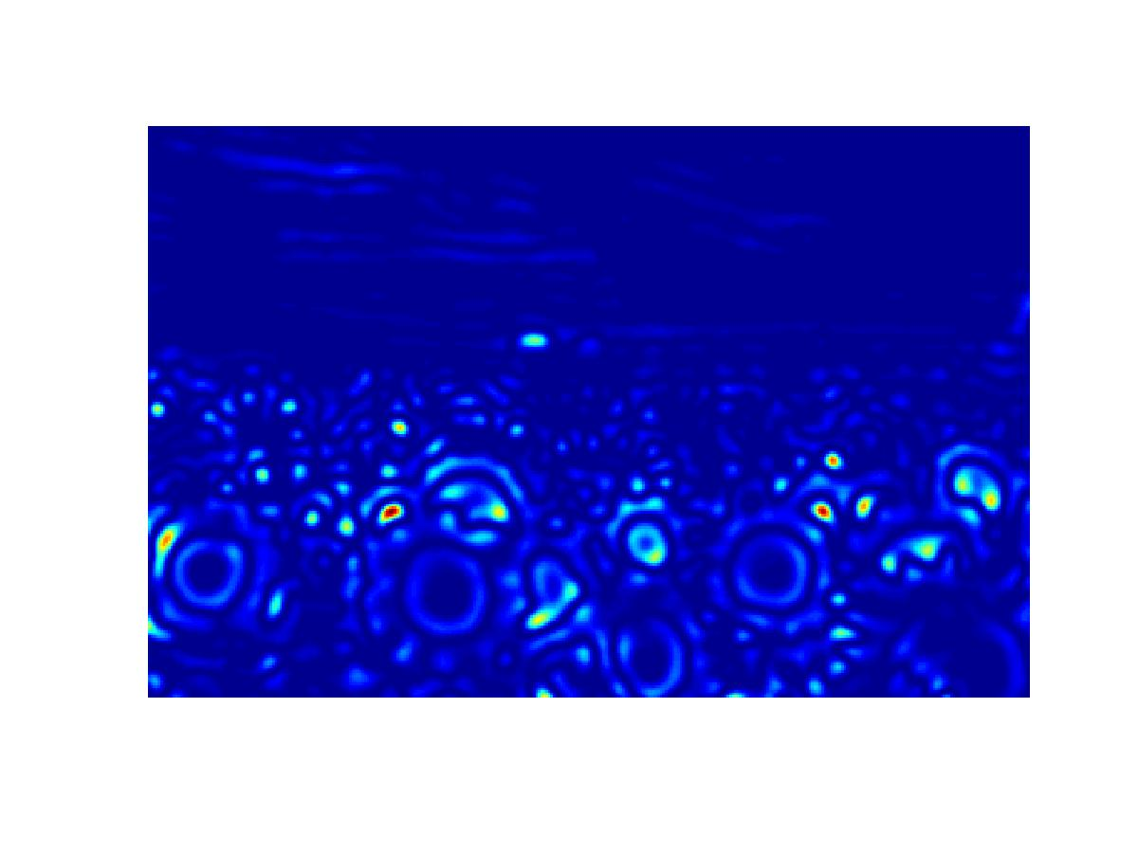
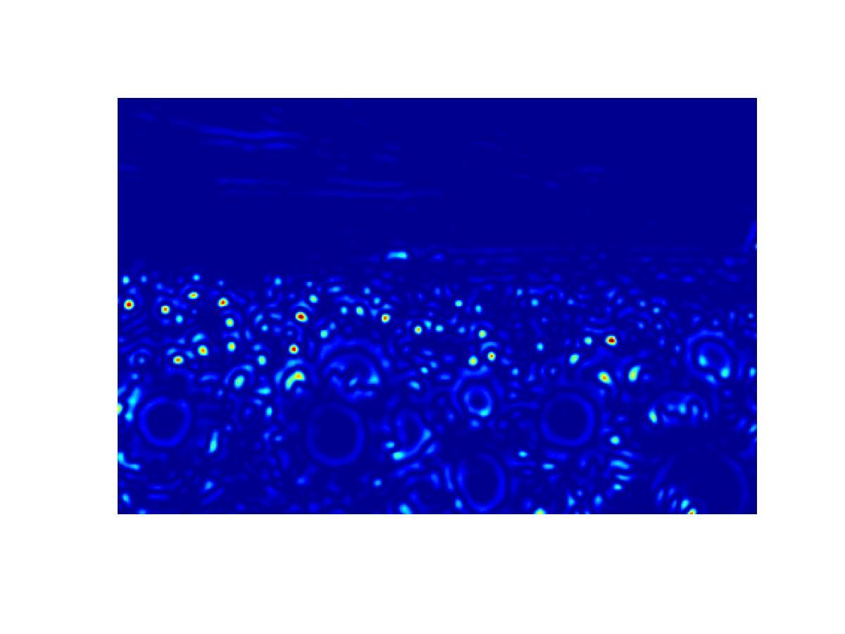
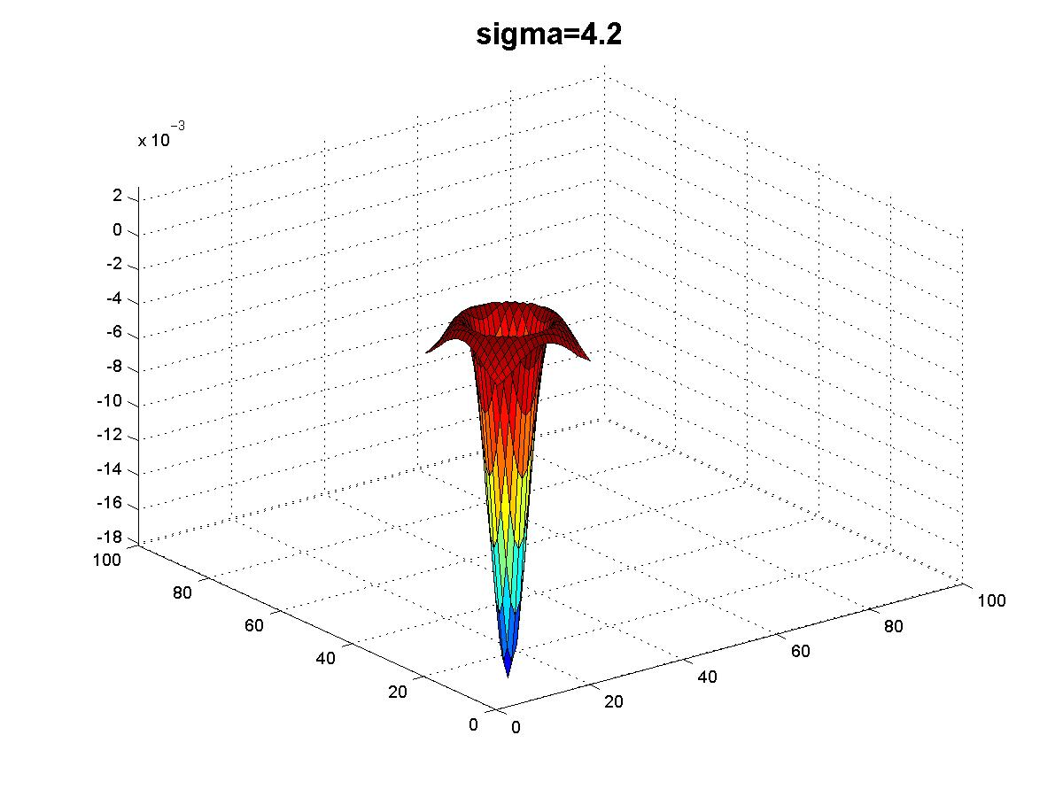
Kristen Grauman

Slide 114
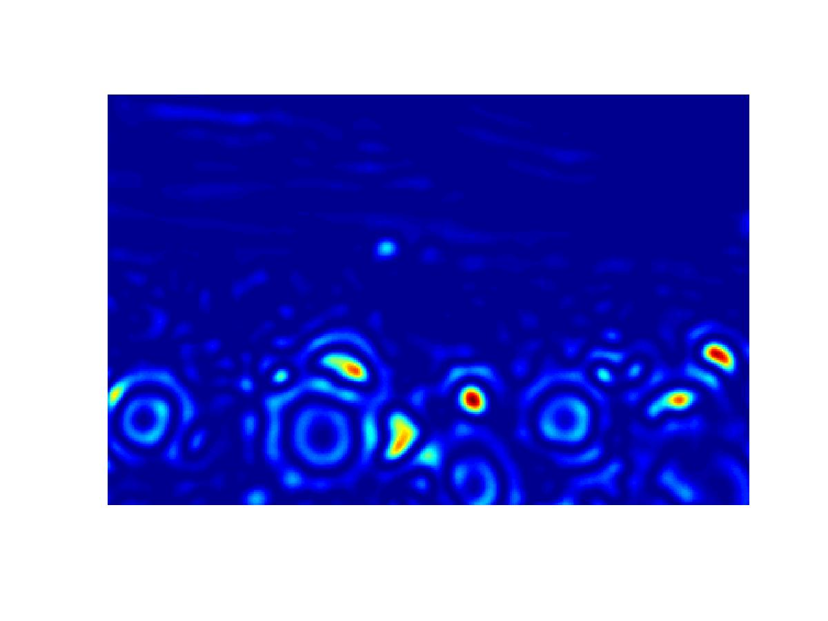
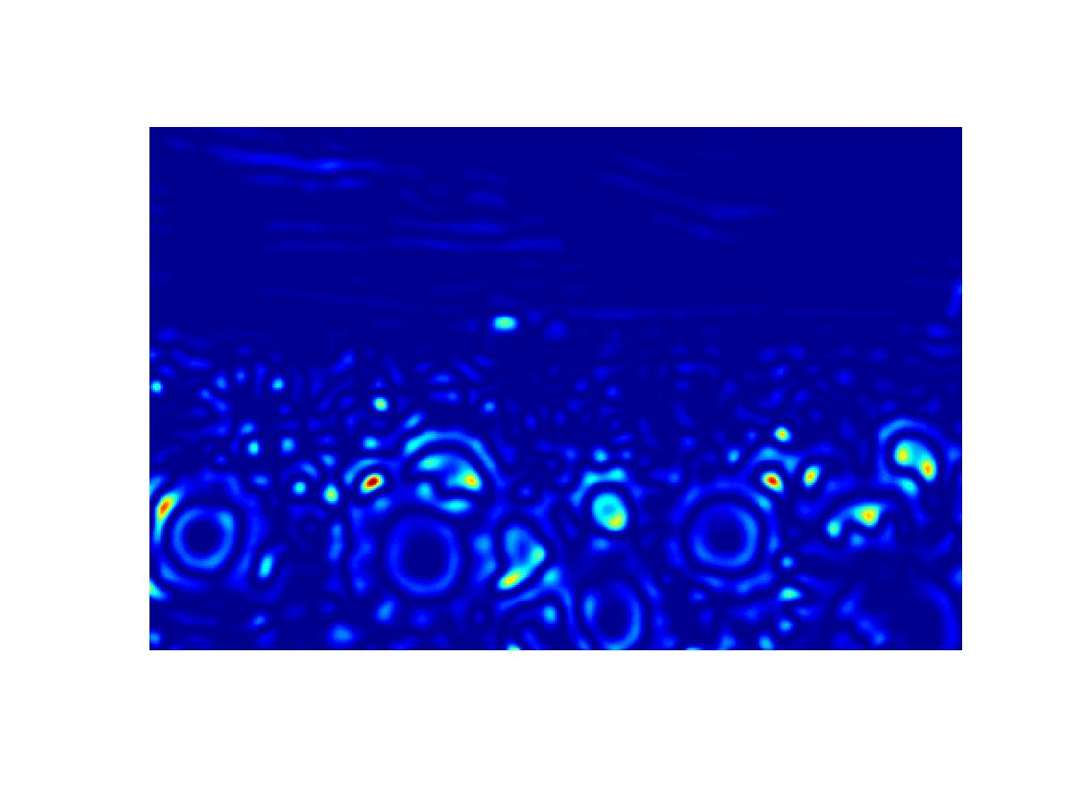

Kristen Grauman

Slide 115



Kristen Grauman

Slide 116



Kristen Grauman

Slide 117



Kristen Grauman

Slide 118






Scale invariant interest points
Interest points are local maxima in both position and scale.
σ5
σ4
scale
σ3
σ2
⇒ List of
(x, y, σ)
σ1
Squared filter response maps

Slide 119


Scale-space blob detector: Example
Image credit: Lana Lazebnik

Slide 120
SIFT Feature Detector
Scale-space blob detection, but …
  Approximate the Laplacian with a
  difference of Gaussians (DoG)
    More efficient to implement
  Reject points with bad contrast:
    DoG smaller than 0.03 (image values in [0,1])
  Reject edges
    Similar to the Harris detector; look at the
    autocorrelation matrix

Slide 121


SIFT Feature Detector
Approximate the Laplacian with a difference of Gaussians; more efficient to implement.
(Laplacian)
(Difference of Gaussians)

Slide 122

SIFT Feature Detector
Maxima of DoG

Slide 123

SIFT Feature Detector
After removing low contrast and edges

Slide 124

SIFT Orientation assignment
By assigning a consistent orientation, the keypoint descriptor can be orientation invariant.
Let, for a keypoint, L is the image with the closest scale.
  Compute gradient magnitude and orientation using finite differences:

Slide 125

SIFT Orientation assignment

Slide 126

SIFT Orientation assignment

Slide 127

SIFT Orientation assignment

Slide 128

SIFT Orientation assignment

Slide 129
SIFT Orientation Assignment
Any peak within 80% of the highest peak is used to create a keypoint with that orientation
~15% assigned multiplied orientations, but contribute significantly to the stability

Slide 130

SIFT Feature Points

Slide 131
Matching Image Features
Feature Detection:
Identify image features
Feature Description:
Extract feature descriptor
for each feature
Feature Matching:
Find candidate matches
between features
Feature Correspondence:
Find consistent set of
(inlier) correspondences
between features
Kristen Grauman

Slide 132
Feature Descriptors
How should we represent the local area
around each feature point (for matching)?

Slide 133

Raw Pixel Values?
The simplest way to describe the neighborhood around an interest point is to write down the list of luminances in a k x k window around the point to form a feature vector.

Slide 134
Raw Pixel Values?
The simplest way to describe the neighborhood around an interest point is to write down the list of luminances in a k x k window around the point to form a feature vector.
0.2
0.2
0.2
0.2
0.1
0.3
0.2
0.3
0.3
0.2
0.7
0.4
0.6
0.8
0.6
…

Slide 135
Raw Pixel Values?
Problems?

Slide 136


Window Feature Descriptor
Rotate image region
around point based on
the feature orientation
Scale image region
around the point based on
the feature scale
Concatenate luminance
of all pixels in the
k x k window around
the point in the
rotated/scaled window
into a feature vector
CSE 576: Computer Vision
Image from Matthew Brown

Slide 137




Window Feature Descriptor
e.g. scale, translation, rotation

Slide 138
Window Feature Descriptor
Problems?

Slide 139

Window Feature Descriptor
Sensitive to small shifts or rotations

Slide 140

Window Feature Descriptor
Sensitive to photometric differences
Figure from T. Tuytelaars ECCV 2006 tutorial

Slide 141


SIFT Feature Descriptor [Lowe 2004]
Use histograms to bin pixels within sub-patches according to their orientation.
0
2
π

Slide 142

SIFT Feature Descriptor
Gradient magnitude and
orientation at each point
weighted by a Gaussian
Orientation histograms:
sum of gradient magnitude
at each direction
In practice, 4x4 arrays of 8 bin histogram is used,
a total of 128 features for one keypoint
Image from Lowe

Slide 143


SIFT Feature Descriptor
Extraordinarily robust matching technique
  Can handle changes in viewpoint
    Up to about 60 degree out of plane rotation
  Can handle significant changes in illumination
    Sometimes even day vs. night (below)
  Fast and efficient—can run in real time
  Lots of code available
    http://people.csail.mit.edu/albert/ladypack/wiki/index.php/Known_implementations_of_SIFT
Steve Seitz

Slide 144


SIFT Feature Descriptor
NASA Mars Rover images

Slide 145


SIFT Feature Descriptor
NASA Mars Rover images
with SIFT feature matches
Figure by Noah Snavely

Slide 146
Matching Image Features
Feature Detection:
Identify image features
Feature Description:
Extract feature descriptor
for each feature
Feature Matching:
Find candidate matches
between features
Feature Correspondence:
Find consistent set of
(inlier) correspondences
between features
Kristen Grauman

Slide 147
Feature Matching
Goal: produce a set of
candidate matches that
contains…
Many “correct” matches
As few “wrong” matches
as possible
We will consider only these
candidate matches when
searching for correspondences

Slide 148
Feature Matching
How?

Slide 149
Feature Matching
Feature Position,
Scale, & Orientation

Slide 150
Feature Matching
Feature Position,
Scale, & Orientation
0.2
0.7
0.4
0.6
0.8
0.6
…
Feature Descriptor

Slide 151
Feature Matching
Descriptor Space

Slide 152
Feature Matching
Descriptor Space

Slide 153
Feature Matching
Descriptor Space

Slide 154
Feature Matching
What is a good way to
choose candidate matches?
Descriptor Space

Slide 155
Feature Matching
Simple method 1: create matches from each feature A_{i} to feature B_{k} in B with minimum d(A_{i},B_{k})
A_{i}
Descriptor Space
d(A_{i},B_{j}) is Euclidean distance
in descriptor space

Slide 156
Feature Matching
Simple method 1: create matches from each feature A_{i} to feature B_{k} in B with minimum d(A_{i},B_{k})
A_{i}
B_{k}
Descriptor Space
d(A_{i},B_{j}) is Euclidean distance
in descriptor space

Slide 157
Feature Matching
Simple method 1: create matches from each feature A_{i} to feature B_{k} in B with minimum d(A_{i},B_{k})
A_{i}
B_{k}
Descriptor Space
d(A_{i},B_{j}) is Euclidean distance
in descriptor space

Slide 158
Feature Matching
Simple method 2: create matches from each feature A_{i} to feature B_{k} in B with minimum d(A_{i},B_{k})
iff d(A_{i},B_{k}) < threshold
A_{i}
B_{k}
Descriptor Space
d(A_{i},B_{j}) is Euclidean distance
in descriptor space

Slide 159
Feature Matching
Simple method 2: create matches from each feature A_{i} to feature B_{k} in B with minimum d(A_{i},B_{k})
iff d(A_{i},B_{k}) < threshold
B_{k}
A_{i}
Descriptor Space
d(A_{i},B_{j}) is Euclidean distance
in descriptor space

Slide 160
Feature Matching
Ratio method: create matches from each feature A_{i} to the closest feature in B with minimum d(A_{i},B_{k})
iff d(A_{i},B_{k}) / d(A_{i},B_{k2}) < threshold
B_{k} is the closest feature
B_{k2} is the second closest feature
B_{k2}
B_{k}
Descriptor Space
d(A_{i},B_{j}) is Euclidean distance
in descriptor space

Slide 161

Feature Matching
Ratio method: threshold ratio of L2 distance to best match divided by L2 distance to 2nd best match
Typically
threshold at
ratio < 0.6
Lowe IJCV 2004

Slide 162
Feature Matching
Mutual closest method: create matches between features A_{i} and B_{k} iff they are mutually closest
among all pairs of features
Descriptor Space

Slide 163
Feature Matching
Mutual closest method: create matches between features A_{i} and B_{k} iff they are mutually closest
A
B

Slide 164
Feature Matching
Mutual closest method: create matches between features A_{i} and B_{k} iff they are mutually closest
A
B
C
(A,B) is a bad match

Slide 165
Feature Matching
Mutual closest method: create matches between features A_{i} and B_{k} iff they are mutually closest
B
A
(A,B) is a good match

Slide 166


Last lecture before fall recess!
Image Correspondence
Yes! I can!
So Far!

Slide 167
Image Correspondence
Goal: Find map between two images

Slide 168

Top three most important things in CV:
Correspondence
Correspondence
Correspondence
Takeo Kanade

Slide 169
Matching Image Features
Feature Detection:
Identify image features
Feature Description:
Extract feature descriptor
for each feature
Feature Matching:
Find candidate matches
between features
Feature Correspondence:
Find consistent set of
(inlier) correspondences
between features
Kristen Grauman

Slide 170
Corner Detection: Basic Idea
We should easily recognize the point by looking through a small window
Shifting a window in any direction should give a large change in intensity
“flat” region:
no change in all directions
“edge”:
no change along the edge direction
“corner”:
significant change in all directions
Source: A. Efros

Slide 171
Interpreting the second moment matrix
Consider a horizontal “slice” of E(u, v):
This is the equation of an ellipse.
Diagonalization of M:
The axis lengths of the ellipse are determined by the eigenvalues and the orientation is determined by R
direction of the fastest change
direction of the slowest change
(λ_{max})^{-1/2}
(λ_{min})^{-1/2}

Slide 172
Visualization of second moment matrices

Slide 173
Visualization of second moment matrices

Slide 174
Corner response function
α: constant (0.04 to 0.06)
“Edge”
R < 0
“Corner”
R > 0
|R| small
“Flat” region
“Edge”
R < 0

Slide 175
Image translation
Derivatives and window function are shift-invariant
Corner location is invariant w.r.t. translation

Slide 176
Image rotation
Second moment ellipse rotates but its shape (i.e. eigenvalues) remains the same
Corner location is invariant w.r.t. rotation

Slide 177
Scaling
Corner
All points will be classified as edges
Corner location is not invariant to scaling!

Slide 178
Scale invariant interest points
Intuition: size of blobs provide feature scale
f
f
Image 1
Image 2
s₁
region size
s₂
region size

Slide 179
Blob detection: scale selection
Laplacian-of-Gaussian = “blob” detector
filter scales
img2
Bastian Leibe
img1
img3

Slide 180
SIFT Orientation assignment

Slide 181
Window Feature Descriptor
Rotate image region
around point based on
the feature orientation
Scale image region
around the point based on
the feature scale
Concatenate luminance
of all pixels in the
k x k window around
the point in the
rotated/scaled window
into a feature vector
CSE 576: Computer Vision
Image from Matthew Brown

Slide 182
Window Feature Descriptor
e.g. scale, translation, rotation

Slide 183
SIFT Feature Descriptor [Lowe 2004]
Use histograms to bin pixels within sub-patches according to their orientation.
0
2
π

Slide 184
Feature Matching
Ratio method: create matches from each feature A_{i} to the closest feature in B with minimum d(A_{i},B_{k})
iff d(A_{i},B_{k}) / d(A_{i},B_{k2}) < threshold
B_{k} is the closest feature
B_{k2} is the second closest feature
B_{k2}
B_{k}
Descriptor Space
d(A_{i},B_{j}) is Euclidean distance
in descriptor space

Slide 185
Feature Matching
Ratio method: threshold ratio of L2 distance to best match divided by L2 distance to 2nd best match
Typically
threshold at
ratio < 0.6
Lowe IJCV 2004

Slide 186
Feature Matching
Mutual closest method: create matches between features A_{i} and B_{k} iff they are mutually closest
among all pairs of features
Descriptor Space

Slide 187
Image Mosaicing
Feature Detection:
Identify image features
Feature Description:
Extract feature descriptor
for each feature
Feature Matching:
Find candidate matches
between features
Feature Correspondence:
Find consistent set of
(inlier) correspondences
between features
Kristen Grauman

Slide 188
Image Mosaicing
Feature Detection:
Identify image features
Feature Description:
Extract feature descriptor
for each feature
Feature Matching:
Find candidate matches
between features
Feature Correspondence:
Find consistent set of
(inlier) correspondences
between features
Kristen Grauman

Slide 189
Feature Correspondence
Candidate matches
Source: L. Lazebnik

Slide 190
Feature Correspondence
Correspondences
Source: L. Lazebnik

Slide 191
Feature Correspondence
How?
Source: L. Lazebnik

Slide 192
Feature Correspondence
Goal: produce a set of
correspondences that …
Contains >=4 matches
to define a homography
Contains only matches
that agree on the same
homography
Aligns as many matching
features as possible

Slide 193
Estimating the Homography
A mosaic has a natural interpretation in 3D
  The images are reprojected onto a common plane
  The mosaic is formed on this plane
  Mosaic is a synthetic wide-angle camera
View plane
Source: Steve Seitz

Slide 194
Estimating the Homography
A homography is the transformation that projects an image onto a new view plane from the same viewpoint (center of projection)
Center of
Projection
View plane
Source: Steve Seitz

Slide 195
Feature Correspondence
Observation 1: any combination of >= 4 matches
defines a homography
Source: L. Lazebnik

Slide 196

Feature Correspondence
Observation 1: any combination of >= 4 matches
defines a homography
Source: L. Lazebnik

Slide 197
Feature Correspondence
Observation 2: every homography H provides a map
P’ = H(p)
Source: L. Lazebnik

Slide 198
Feature Correspondence
Observation 3: can measure how “good” a map is
based on how many matches are aligned by it
  generator matches: features defining the homography
  inlier matches: other features aligned by homography
  outlier matches: others (not shown)
Source: L. Lazebnik

Slide 199
RANSAC for Image Mosaics
RANSAC loop:
1. Select four matches (at random)
2. Compute homography H aligning those matches
3. Find inlier matches where d(p_{i}’, Hp_{i})< ε
4. Re-compute H to align on all of its inliers (least squares)
5. Re-find inlier matches where d(p_{i}’, Hp_{i})< ε
6. H*=H if has H largest set of inliers seen so far
Warp image by H*
Composite images
Slide credit: Steve Seitz

Slide 200
RANSAC for Image Mosaics
RANSAC loop:
1. Select four matches (at random)
2. Compute homography H aligning those matches
3. Find inlier matches where d(p_{i}’, Hp_{i})< ε
4. Re-compute H to align on all of its inliers (least squares)
5. Re-find inlier matches where d(p_{i}’, Hp_{i})< ε
6. H*=H if has H largest set of inliers seen so far
Warp image by H* and composite images
Source: L. Lazebnik

Slide 201
RANSAC for Image Mosaics
RANSAC loop:
1. Select four matches (at random)
2. Compute homography H aligning those matches
3. Find inlier matches where d(p_{i}’, Hp_{i})< ε
4. Re-compute H to align on all of its inliers (least squares)
5. Re-find inlier matches where d(p_{i}’, Hp_{i})< ε
6. H*=H if has H largest set of inliers seen so far
Warp image by H* and composite images
Source: L. Lazebnik

Slide 202
RANSAC for Image Mosaics
RANSAC loop:
1. Select four matches (at random)
2. Compute homography H aligning those matches
3. Find inlier matches where d(p_{i}’, Hp_{i})< ε
4. Re-compute H to align on all of its inliers (least squares)
5. Re-find inlier matches where d(p_{i}’, Hp_{i})< ε
6. H*=H if has H largest set of inliers seen so far
Warp image by H* and composite images
Source: L. Lazebnik

Slide 203
RANSAC for Image Mosaics
RANSAC loop:
1. Select four matches (at random)
2. Compute homography H aligning those matches
3. Find inlier matches where d(p_{i}’, Hp_{i})< ε
4. Re-compute H to align on all of its inliers (least squares)
5. Re-find inlier matches where d(p_{i}’, Hp_{i})< ε
6. H*=H if has H largest set of inliers seen so far
Warp image by H* and composite images
Source: L. Lazebnik

Slide 204
RANSAC for Image Mosaics
RANSAC loop:
1. Select four matches (at random)
2. Compute homography H aligning those matches
3. Find inlier matches where d(p_{i}’, Hp_{i})< ε
4. Re-compute H to align on all of its inliers (least squares)
5. Re-find inlier matches where d(p_{i}’, Hp_{i})< ε
6. H*=H if has H largest set of inliers seen so far
Warp image by H* and composite images
Source: L. Lazebnik

Slide 205
Image Mosaicing (summary, so far)
Feature Detection:
Identify image features
Feature Description:
Extract feature descriptor
for each feature
Feature Matching:
Find candidate matches
between features
Feature Correspondence:
Find consistent set of
(inlier) correspondences
between features
Kristen Grauman

Slide 206
Image Mosaicing (rest of the story)
4) Estimate homography:
Solve linear system of equations
5) Warp one image to the other
Apply homography transformation to every pixel
6) Composite images:
Blend pixels in overlap area
Kristen Grauman

Slide 207
Image Mosaicing (rest of the story)
4) Estimate homography:
Solve linear system of equations
5) Warp one image to the other
Apply homography transformation to every pixel
6) Composite images:
Blend pixels in overlap area
Kristen Grauman

Slide 208
Estimating the Homography
A mosaic has a natural interpretation in 3D
  The images are reprojected onto a common plane
  The mosaic is formed on this plane
  Mosaic is a synthetic wide-angle camera
View plane
Source: Steve Seitz

Slide 209
Estimating the Homography
A homography is the transformation that projects an image onto a new view plane from the same viewpoint (center of projection)
Center of
Projection
View plane
Source: Steve Seitz

Slide 210
What is a Homography?
A projective transform mapping between any two PPs with the same center of projection
  rectangle should map to arbitrary quadrilateral
  lines stay straight
  but don’t stay parallel
PP2
PP1
Source: Alyosha Efros

Slide 211

What is a Homography?
A projective transform of 2D points in homogeneous coordinates can be represented by a 3x3 matrix
Homogeneous
Coordinates

Slide 212
Estimating the Homography
…
…
To compute the homography given pairs of corresponding points in the images, we solve a system of equations
min || Hp – p’ ||²

Slide 213
Image Mosaicing
4) Estimate homography:
Solve linear system of equations
5) Warp one image to the other
Apply homography transformation to every pixel
6) Composite images:
Blend pixels in overlap area
Kristen Grauman

Slide 214


Image Warping
H(x,y)
y
y’
x
x’
f(x,y)
g(x’,y’)
Given a coordinate transform H and a source image f(x,y), compute a transformed image g(H(x,y)) = f(x,y)?
Slide from Alyosha Efros, CMU

Slide 215
Image warping
H⁻¹(x,y)
y
y’
x
x
x’
f(x,y)
g(x’,y’)
Reverse mapping:
Get each pixel g(x’,y’) from its corresponding location (x,y) = H⁻¹(x’,y’) in the source image f(x,y)
Slide from Alyosha Efros, CMU

Slide 216
Image Mosaicing
4) Estimate homography:
Solve linear system of equations
5) Warp one image to the other
Apply homography transformation to every pixel
6) Composite images:
Blend pixels in overlap area
Kristen Grauman

