Slide 1
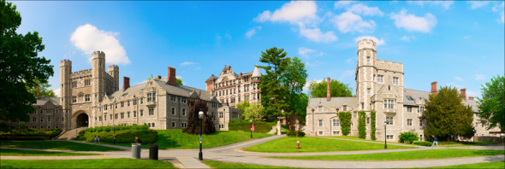
COS 429 PS3: Stitching a Panorama
Due November 4th

Slide 2
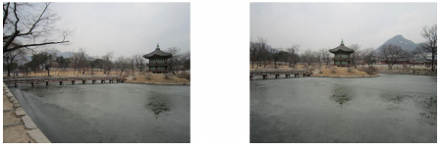
Goal
Find key features in images and correspondences between images
Use RANSAC to find the best correspondences
Map one image plane to another to create a panoramic image

Slide 3
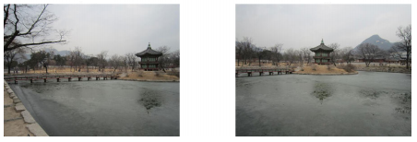
Problem 1: Preprocessing
Most feature descriptors only work with grayscale images
Task:
Convert color images to grayscale
You can use Matlab function rgb2gray
Copy the lines of code you wrote in the report

Slide 4
Problem 2: Detecting Key Points
Want to detect the key points in both images and find corresponding key points between both images
Task:
Find SURF features in both images
You can use Matlab function detectSURFFeatures
Copy the lines of code you wrote in the report

Slide 5
Problem 3: Extracting Descriptors
Extract feature descriptors at each key point detected in Problem 2
Task:
Extract feature for each key point
You can use Matlab function extractFeatures
Visualize the descriptors and include in the report
Copy the lines of code you wrote in the report

Slide 6
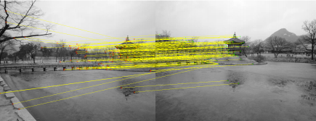
Problem 4: Matching Features
Task:
Find matching features between both images
You can use the Matlab function matchFeatures
Visualize the matching results and include a figure in your report
Copy the lines of code you wrote in the report

Slide 7
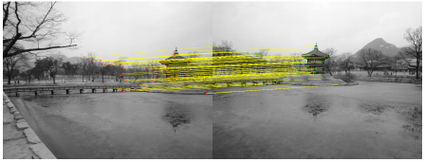
Problem 5: RANSAC to Estimate Homography
We want to exclude outlier matches and compute a homography to map one image plane to the other
Task:
Use RANSAC to estimate a homography
You can use Matlab function estimateGeometricTransform
Visualize the matching results and include in your report
Copy the lines of code you wrote in the report

Slide 8
Problem 6: Stitching Panorama
Need to warp images to make a panorama
Map pixels in the warped image to pixels in the input image to avoid holes in the final image
Code provided to warp the first image
Task:
Write similar code to warp and paste the second image to produce a final panoramic image
You can use MATLAB functions imwarp, vision.AlphaBlender, and step to overlay the second image on the first
Add the resulting panorama to your report
Copy the lines of code you wrote in the report

Slide 9
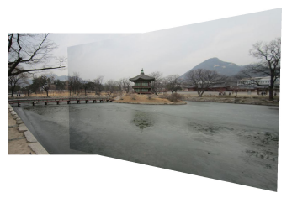
Notes:
Don’t worry about blending (visible seams)
Results will vary since RANSAC is a randomized algorithm

Slide 10
Problem 7: Take Your Own Pictures for Princeton Campus
Task:
Take two pictures of Princeton’s campus, run the code to stitch them together
Include the original two photos and the final panorama in your report

Slide 11
Extra Credit
Many possible ways to get extra credit:
Try alpha blending to merge the overlapping image regions to get rid of boundary
Use Graph Cut to find an optimal seam between the two images
Use Poisson blending to blend the two images
Handle more than 2 images
Combine photographs into a 360° x 180° panorama (equirectangular projection)
Convert the panorama into a stereographic projection
Reconstruct the 3D geometry of the panorama

Slide 12
What to Submit:
One PDF file report
One ZIP file containing all the source code, and a “ps3.m” file that takes no parameters as input and runs directly in Matlab to generate the results in the pdf report

