Slide 1
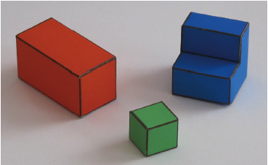
COS 429 PS2: Reconstructing a Simpler World
Due October 16th

Slide 2
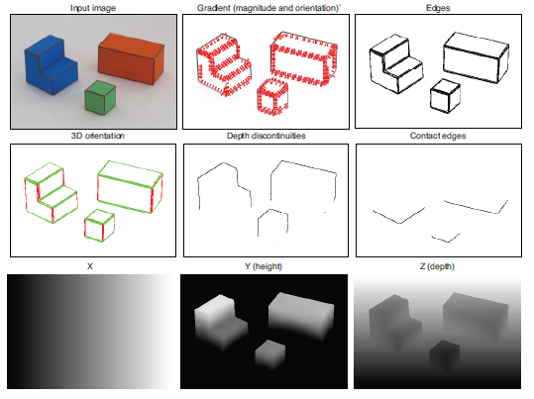
Goal
Recover the 3D structure of the world

Slide 3
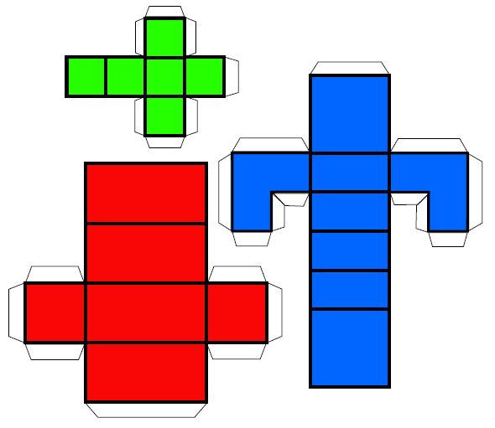
Problem 1: Making the World Simpler
Simple World Assumptions:
Flat surfaces that are either horizontal or vertical
Objects rest on a white horizontal ground plane
Task:
Print Figure 1 and create objects for the world
Take a picture of the world you created and add it to the report

Slide 4
Problem 2: Taking Orthographic Pictures
Goal:
Want pictures that preserve parallel lines from 3D to 2D
Willing to accept weak perspective effects

Slide 5
How:
Use the zoom of the camera or crop the central part of a picture
Task:
Take two pictures of the same scene so one image exhibits perspective projection and the other orthographic project and add it to the report
Want both pictures to look as similar as possible

Slide 6
Problem 3: Orthographic Projection
Two coordinate systems (X, Y, Z) world and (x, y) image
X axis of world coordinate system aligns with x axis of camera plane
Y and Z axes of world coordinate system align with y axis of camera plane

Slide 7
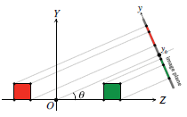
Task:
Prove the two projection equations below that relate the 3D world position (X, Y, Z) to the 2D projected camera position (x, y)
x = αX + x₀
y = α(cos(θ)Y – sin(θ)Z) + y₀

Slide 8
Problem 4: Geometric Constraints
Find edges with corresponding strengths and orientations
End goal is to find X(x, y), Y(x, y), Z(x, y)
Given our coordinate system: X(x, y) = x
Harder to find Y and Z since one dimension was lost due to projection
Create linear system of equations of constraints

Slide 9
Color threshold determines ground from objects
On the ground Y(x, y) = 0
Assume parallel projection
All 2D vertical edges are 3D vertical edges
Fails occasionally

Slide 10
Constraints
Vertical Edges: $\frac{∂Y}{∂y}=\frac{1}{\cos\left(θ\right)}$
Equals $\frac{1}{\cos\left(θ\right)}$ using the projection equations proved earlier
The vector t = (-n_{y}, n_{x}) is the direction tangent to an edge
Horizontal Edges: $\frac{∂Y}{∂t}=∇Y ∙t=−n_{y}\frac{∂Y}{∂x}+n_{x}\frac{∂Y}{∂y}=0$
Equals 0 since the Y coordinate does not change for horizontal edges
Task:
Write the derivative constraints for Z(x, y) in the report
$\frac{∂Z}{∂y}, \frac{∂Z}{∂t}, \frac{∂^{2}Z}{∂x^{2}}, \frac{∂^{2}Z}{∂y^{2}}, \frac{∂^{2}Z}{∂y∂x}$

Slide 11
A simple inference scheme
Y
b
=
Constraint weights
A Y = b
Y = (A^{T}A)⁻¹ A^{T}b
Matlab
Y = A\b;

Slide 12
Problem 5: Approximation of Derivatives
Want to use constraints from Problem 4 to determine Y(x, y) and Z(x, y)
Two constraints missing from existing code
Task:
Write two lines of code (lines 171 and 187)
Copy these two lines and add them to the report

Slide 13
Problem 6: A Simple Inference Scheme
Write the constraints as a system of linear equations
Task:
Run simpleworldY.m to generate images for the report
Include some screen shots of the generated figures and include in report

Slide 14
Extra Credit 1: Violating Simple World Assumptions
What if we violate our assumptions?
Show examples where the reconstruction fails
Why does it fail?

Slide 15
Extra Credit 2: The Real World
Take pictures of the real world
How can we modify this assignment to getter better 3D reconstruction in the real world?
Try to handle a few more situations
Possible final project?

Slide 16
What to Submit:
One PDF file report
One ZIP file containing all the source code, and a “simpleworldY.m” file that takes no parameters as input and runs directly in Matlab to generate the results reported in your PDF file.

Slide 17
PDF Report
(1) Take a picture of the world you created
(2) Submit two pictures – one showing orthographic projection and the other perspective projection
(3) Prove the two projection equations
(4) Write the constraints for Z(x, y)
(5) Fill in missing kernels (lines 171 and 187) and copy code into report
(6) Show results and figures output by simpleworldY.m
[Optional] Extra credit

